Slide 1
Africa for sustainable development Fellowship
Introduction
COHORT 3 Profiles

Slide 2
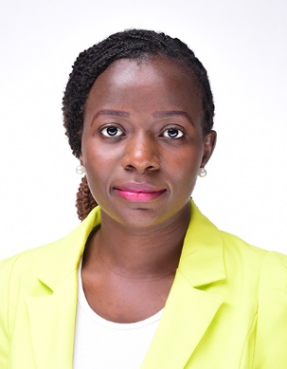
Josephine Adhiambo Ogaja
Sustainable Infrastructure Development
Josephine Ogaja is a Public Health practitioner whose main interests are in Monitoring and Evaluation, Research, Data analysis and population health. She is experienced in designing and leading research projects, understanding donor expectations and trends for Monitoring and Evaluation, Data quality assessment to improve systems, data analysis and capacity building.
Josephine is also passionate about volunteering. She is a life member of Kenya Red Cross Society where she has been involved in Disaster management, peace building and tracing services. She is also a volunteer with the Kenya Youth Army where she is the Research and Development Officer-Nairobi Branch.
She lives by the Kurt Bollacker’s slogan which says, “Data that is loved tends to survive.”
Key Achievements:
BSc Environmental Health
Certificate in Impact Evaluation, ClonesHouse Nigeria
Trained in Youth Leadership, resource mobilization, and how to use malaria scorecards to drive action, accountability and advocacy.
Kenya Malaria Youth Army & Kenya Red Cross Society volunteer

