Slide 1
Africa for sustainable development Fellowship
Introduction
COHORT 3 Profiles

Slide 2
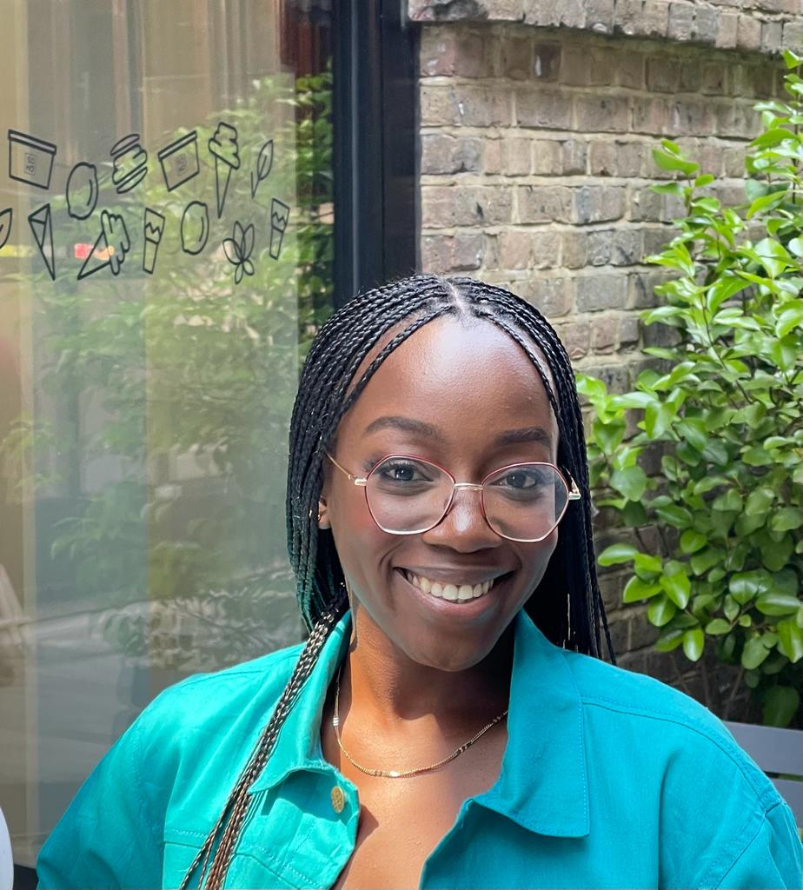
Maame Adwoa Ofori-Kwafo
SDG 8; Decent work and economic growth.
Maame Adwoa Ofori-Kwafo is a Sustainable Development Goals advocate whose focus is on educating the general public, specifically, the youth in Ghana on the SDGs and how they can contribute to it. With a strong academic foundation in Development Finance and hands-on experience, Maame has channeled her expertise and enthusiasm toward effecting positive change. She has actively contributed to various initiatives, from spearheading award-winning social enterprises to leading training and capacity-building sessions on the SDGs. Her extensive engagement extends to community education and grants management. Maame’s goal is to leverage her expertise, passion, and unwavering dedication to create a more sustainable and equitable future for all.
Key Achievements:
Conceptualized an award winning social enterprise pitch.
Trained 6 Purpose Driven Organisations on Social Impact and the SDGs.
Supported small businesses in Ghana to increase revenue through establishing B2B partnerships.
Program Milestones:
Educated 100+ youth in Ghana on the SDGs

