Slide 1
Africa for sustainable development Fellowship
Introduction
COHORT 3 Profiles

Slide 2
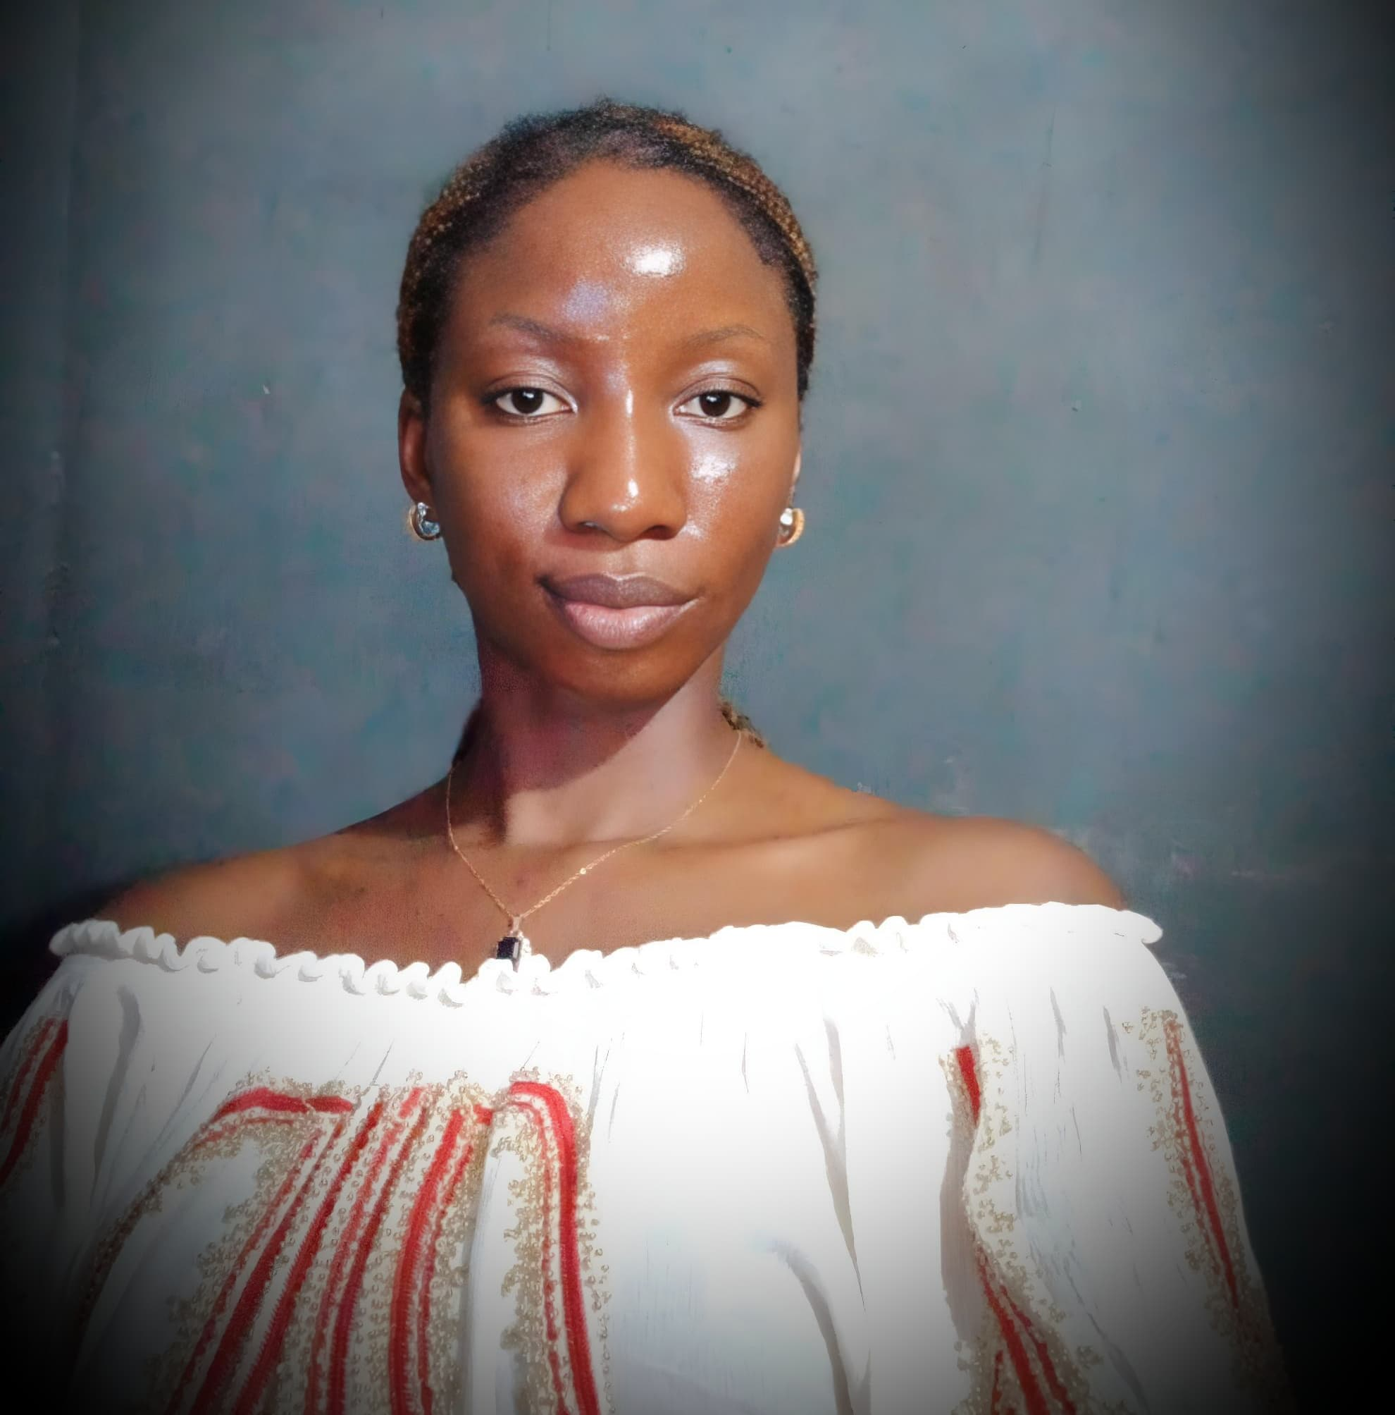
Sarah Sherah Alibaba
Renewable Energy
Sarah Sherah Alibaba is a Sustainable Development Goals champion whose focus has been working with Solar Companies to provide cost-effective Solar Home Systems to off-grid households. Thereby creating community solutions. Sarah is currently working with Pas Solar Limited for over 5 years leading a team of 7 people. Sarah is highly talented and a professional manager, familiar with leading a department and holds over 5 years of experience in planning, administrative duties, operations , sales and marketing.
Program Milestones:
Increase customer base of 400+ to gain more access to Solar Home Systems.
Key Achievements:
Provided Solar Home Systems to over 400 off-grid households
Outreach on the benefits and importance of Solar Home Systems to 10 off-grid communities and also expansion of customer base across the 10 communities with 50%

