Slide 1
Africa for sustainable development Fellowship
Introduction
COHORT 3 Profiles

Slide 2
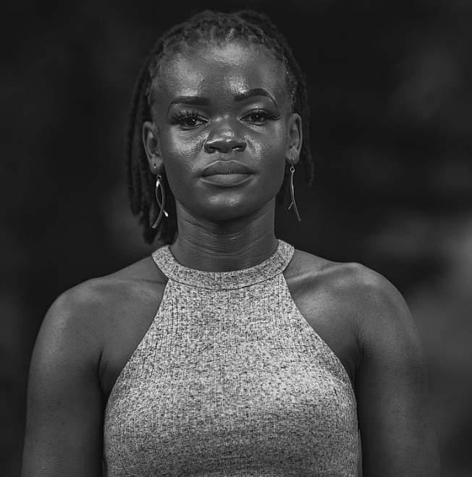
Violet Obwanda
Agro Bamboo/Climate Change and Agro forestry
Andati Morris Shapwala is a Sustainable Development Goals champion whose focus has been working with young people and making sure they get the proper skills in order to sustain themselves and create community solutions. Andati has worked at Africa for SDGs and during his 5-year tenure he oversaw projects as the project coordinator at the community level and was the lead trainer on sustainable development. Andati is also the executive director and founder of Smart Talk Café and AgroBamboo, where he is the program and project coordinator and leads a team of four people. He is also a trained expert in Bamboo development. AgroBamboo is an agroforestry initiative in Rwanda developed in 2021. AgroBamboo focuses on developing quality bamboo products through engagement in the bamboo value chain in Rwanda looking into developing community SMEs in Rwanda as well as develop its focus on environmetal conservation. Visit https://agrobamboo.godaddysites.com/ for more information.

