Slide 1
Africa for sustainable development Fellowship
Introduction
COHORT 3 Profiles

Slide 2
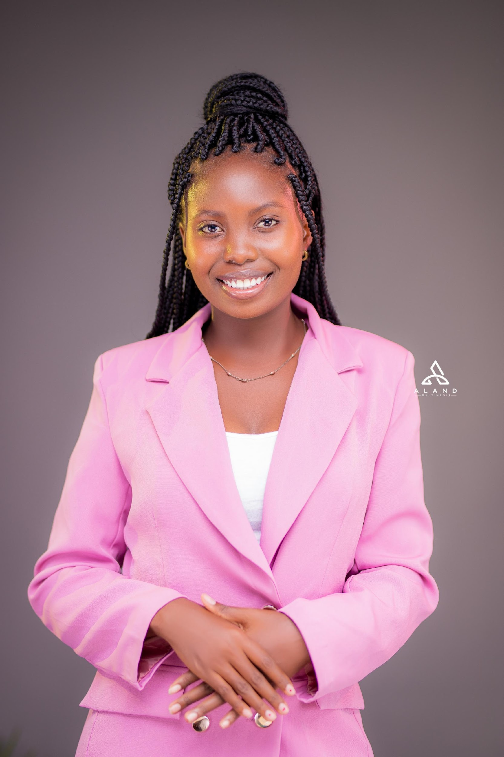
Yewo Grace Gondwe
Human Rights Advocate
Yewo Grace Gondwe is a Malawian young lady, aged 26 who is dedicated to foster youth empowerment and advocate for the protection of human rights. She is a Social scientist with exceptional leadership, and policy advocacy skills. She has devoted over 5 years to NGOs steering community projects in SRHR, governance, gender equality and human rights. Currently working with the Malawi Sexual Reproductive Health and Rights alliance as a Program Advocacy Coordinator, she spearheads SRHR advocacy initiatives at local, national and international levels. Her unwavering commitment radiates through her advocacy, volunteerism and youth empowerment to challenge systemic inequalities for a fairer world. Her service in the WHO Youth Council, is a commitment to contributing towards lasting change on global health. She Holds a Bachelor’s Degree of Social Science with a major in Development Studies and currently pursuing a Master of Arts in International Relations and Diplomacy.
Key Achievements:
BSc in Development Studies
Appointed in the World Health Organisation Youth Council
Serve as a member of the global Youth coalition for Reproductive Rights
National steering committee member for the USAID Momentum Tiyeni youth innovation Challenge
Young women Leadership Programme fellow
National Coordinator for Generation Democracy, Malawi Chapter
Research to Change USAID Youth Excel Mentorship Programme Fellow
Africa for Sustainable Development Fellow

