Slide 1

Remembering…
Take this moment to reflect on those who passed on. Remember them now!
If you did not have a chance to send in a name, say their name during this moment of reflection…

Slide 2
And Still Remembering…
Those who have gone on before…
Our Wall of Remembrance

Slide 3
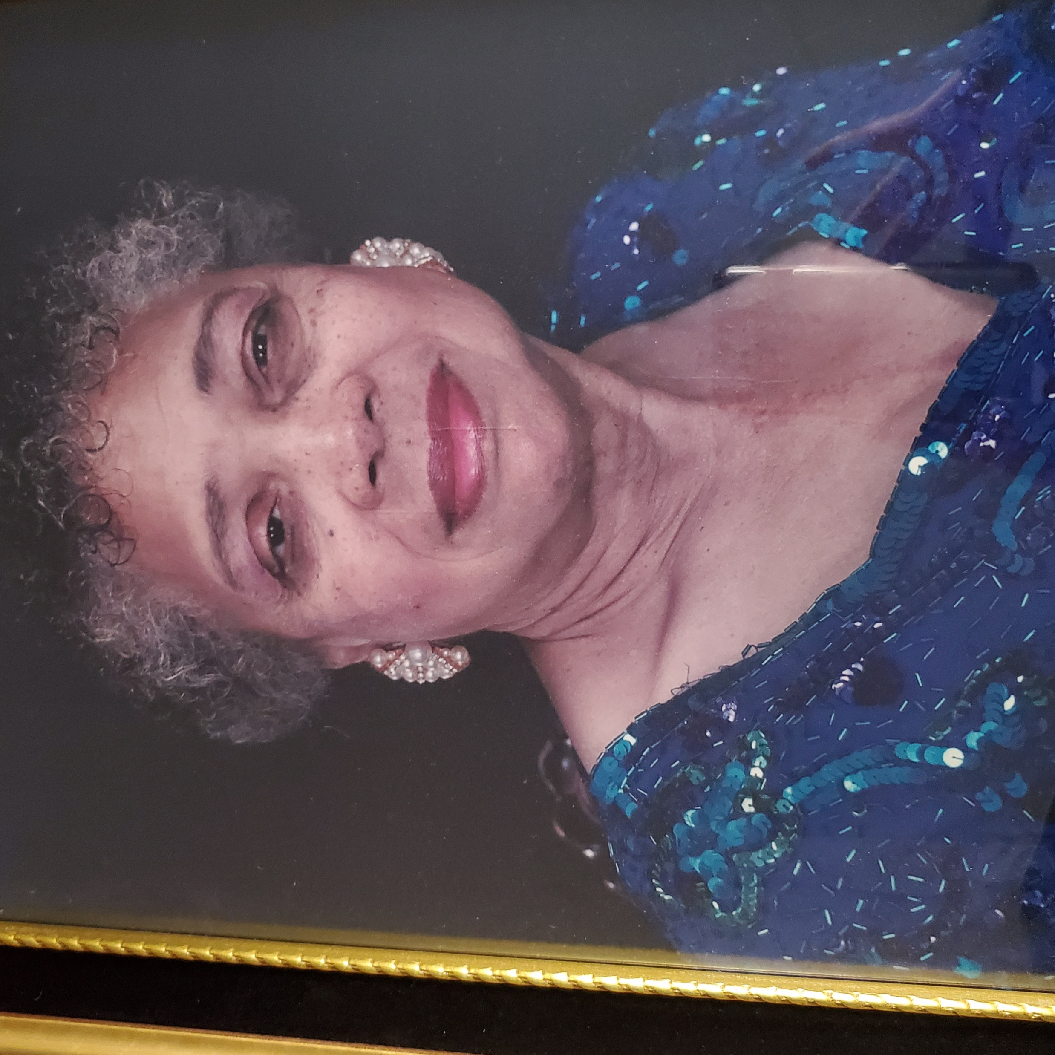
“In Loving memory”, Marthenia V. Jones 1928-2001
With Love,
Your daughters, Sandra, Phyllis, Toni, Marcella, Julia & their families

Slide 4

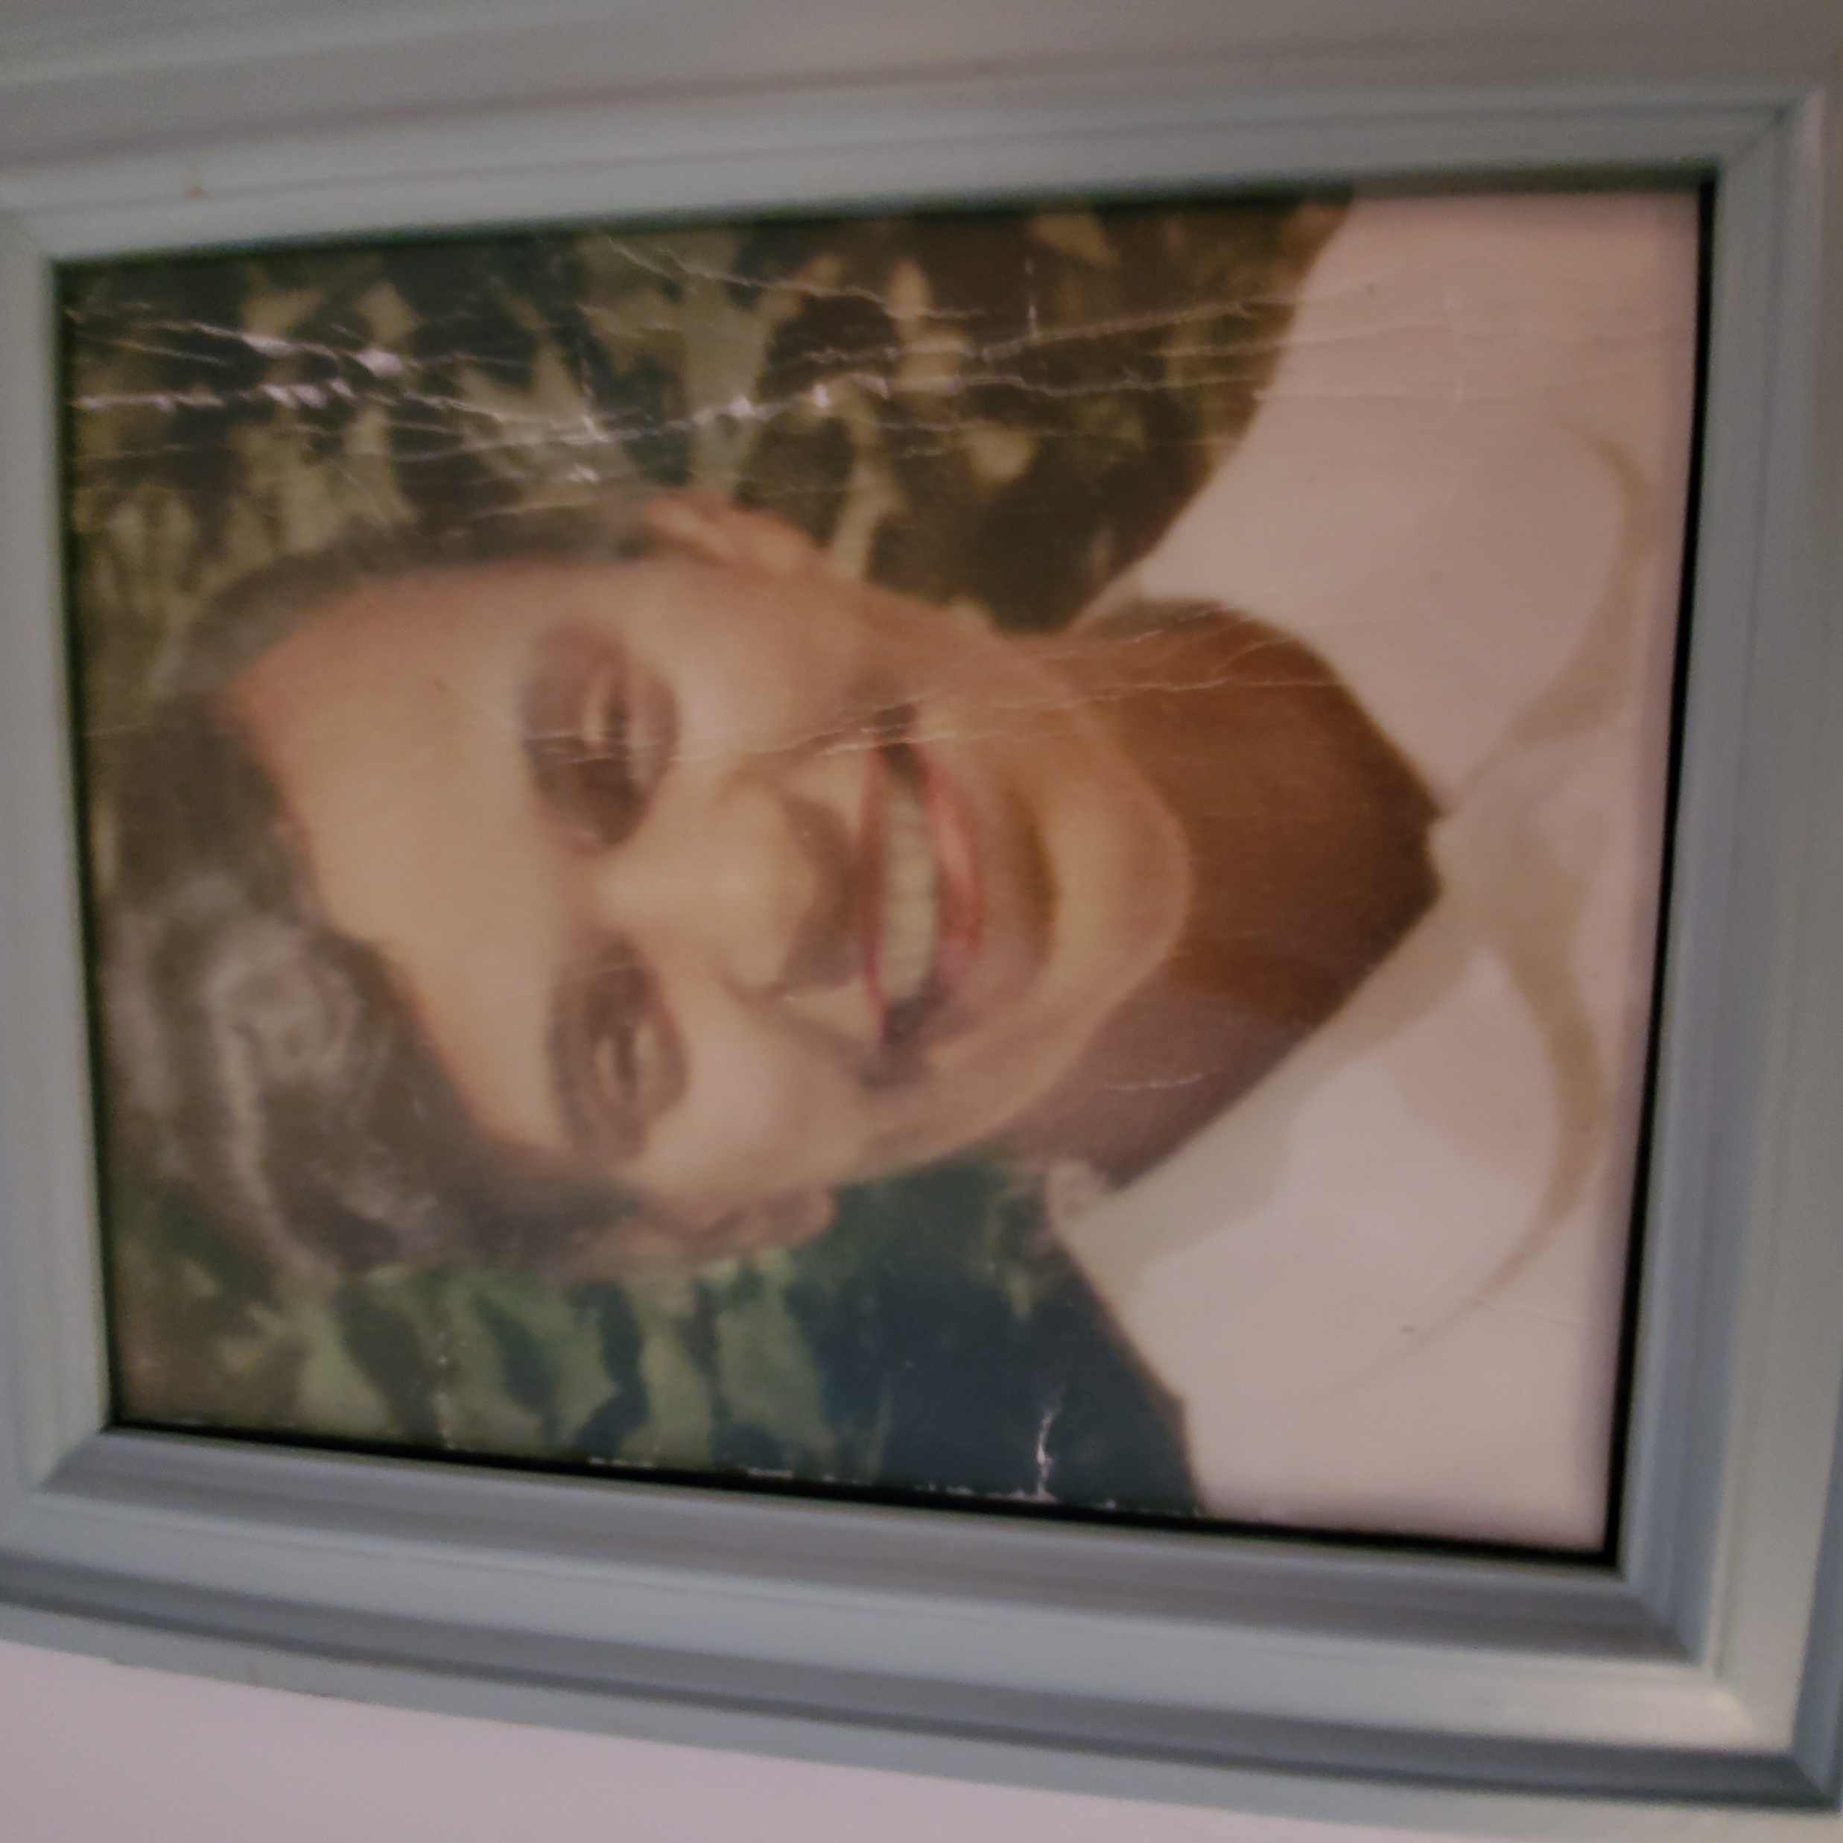
Beloved Mother Grandmother, & great-grandmother
Barbara DeBerry
Love,
Alona Johnson, Alonzo iii, kim deberry and their families

Slide 5
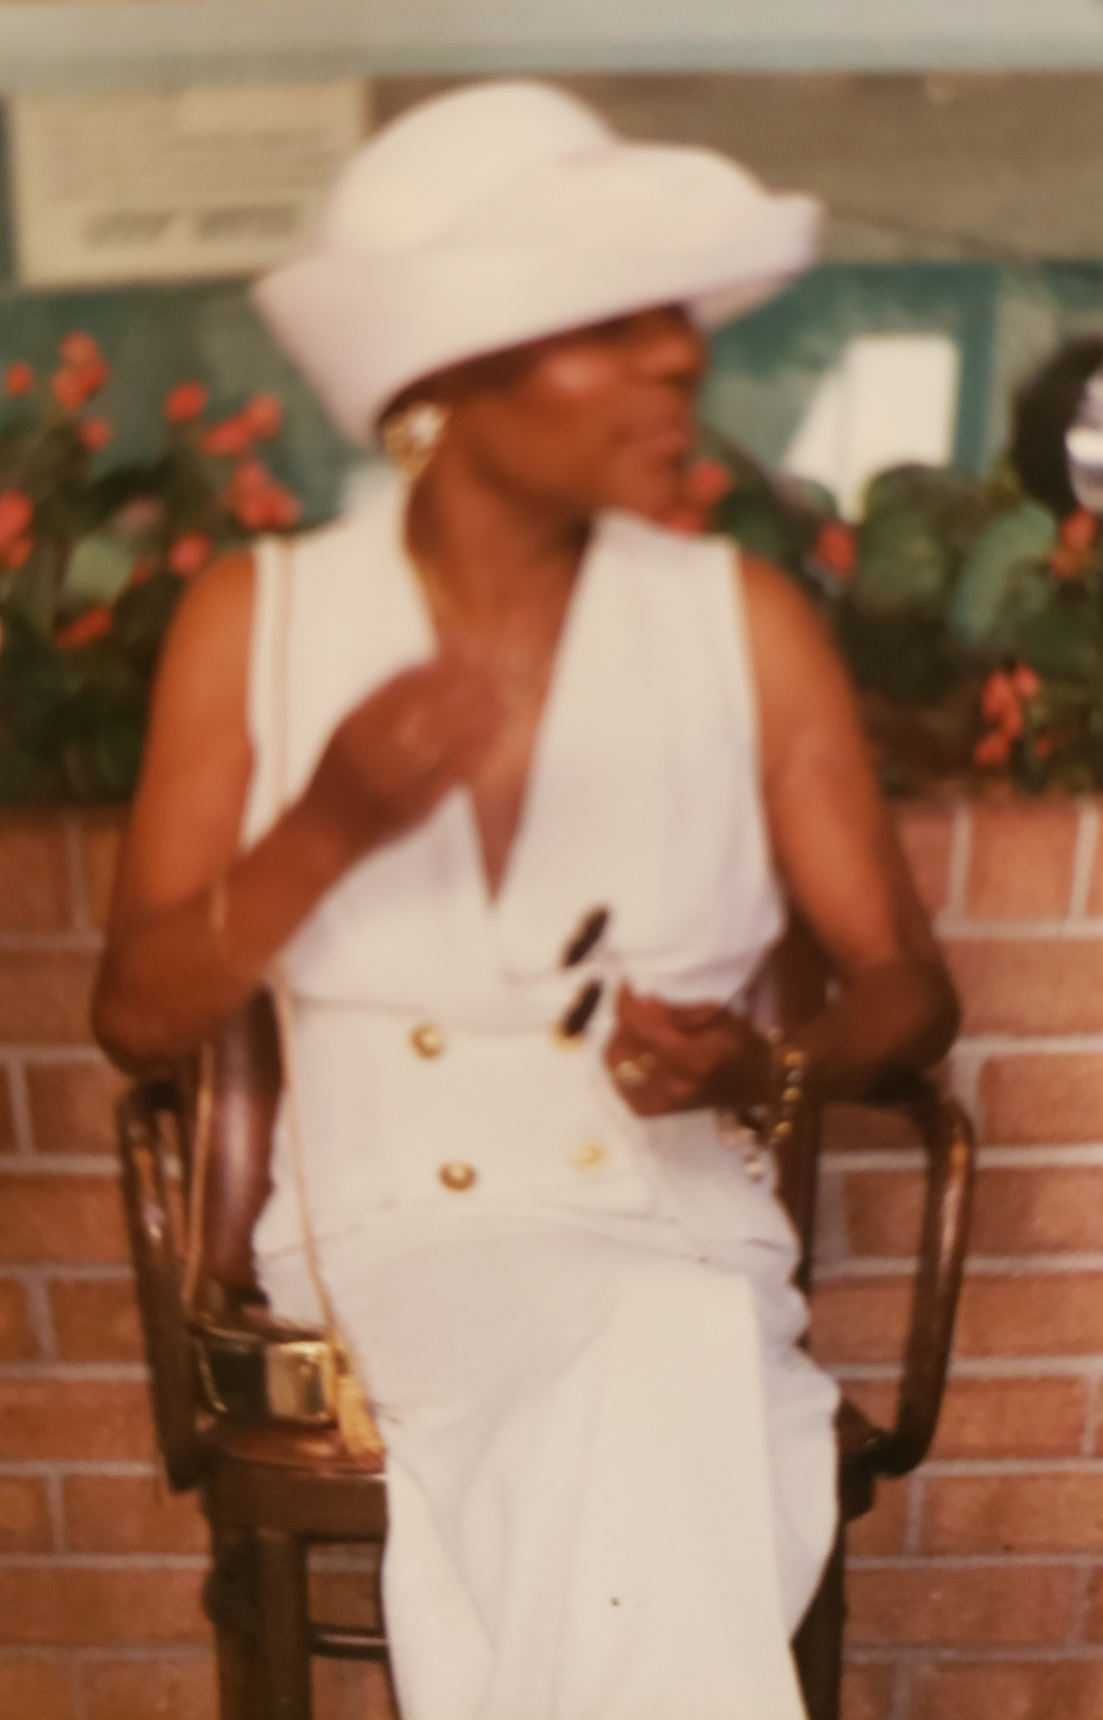
My Beloved Mother,
Barbara Conwell
Love,
Kwanza Gipson

Slide 6
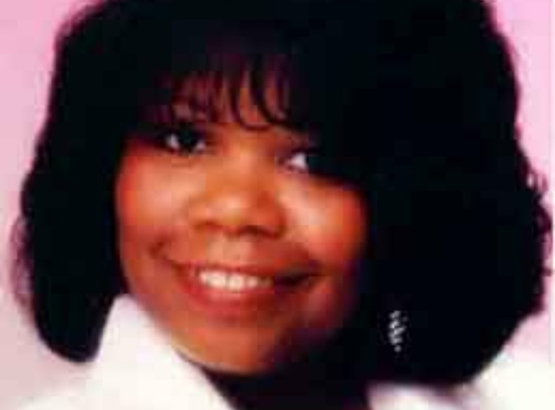
“A very special and beautiful woman of God,”
Sunya Lorena Smith, my Sister!
Lisa Broadway

Slide 7
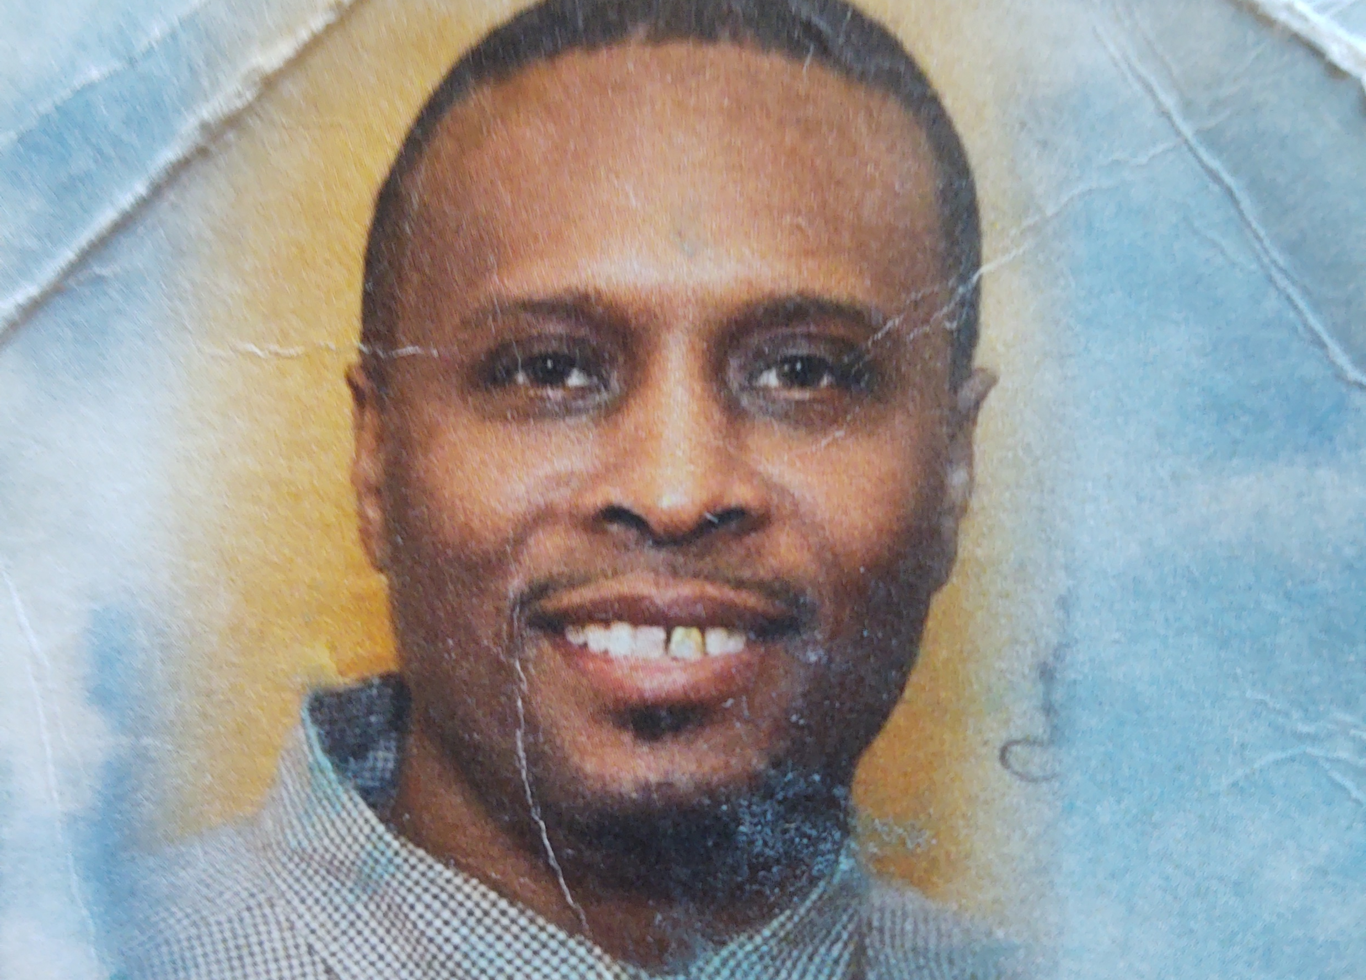
Tyrone Boykin, Jr.-
“A beautiful son will always be in my heart!”
Love, Mom –
Glenda Washington

Slide 8
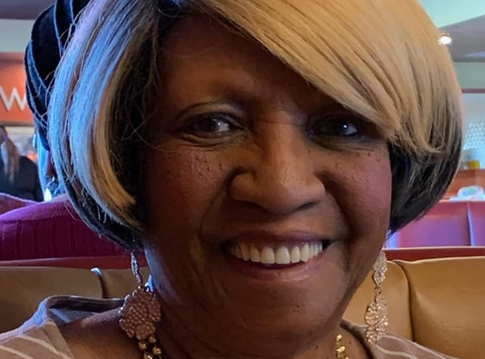
My dear sister, Janice Rivers Blunt, found out in December 2020 that she would not survive an operation because of ALS ravaging her body, came home to die surrounded by her family. She said “ I am content. I know where I am going.” She made it easier for us because of her trust in the Lord. Myra D. McIlwain

Slide 9
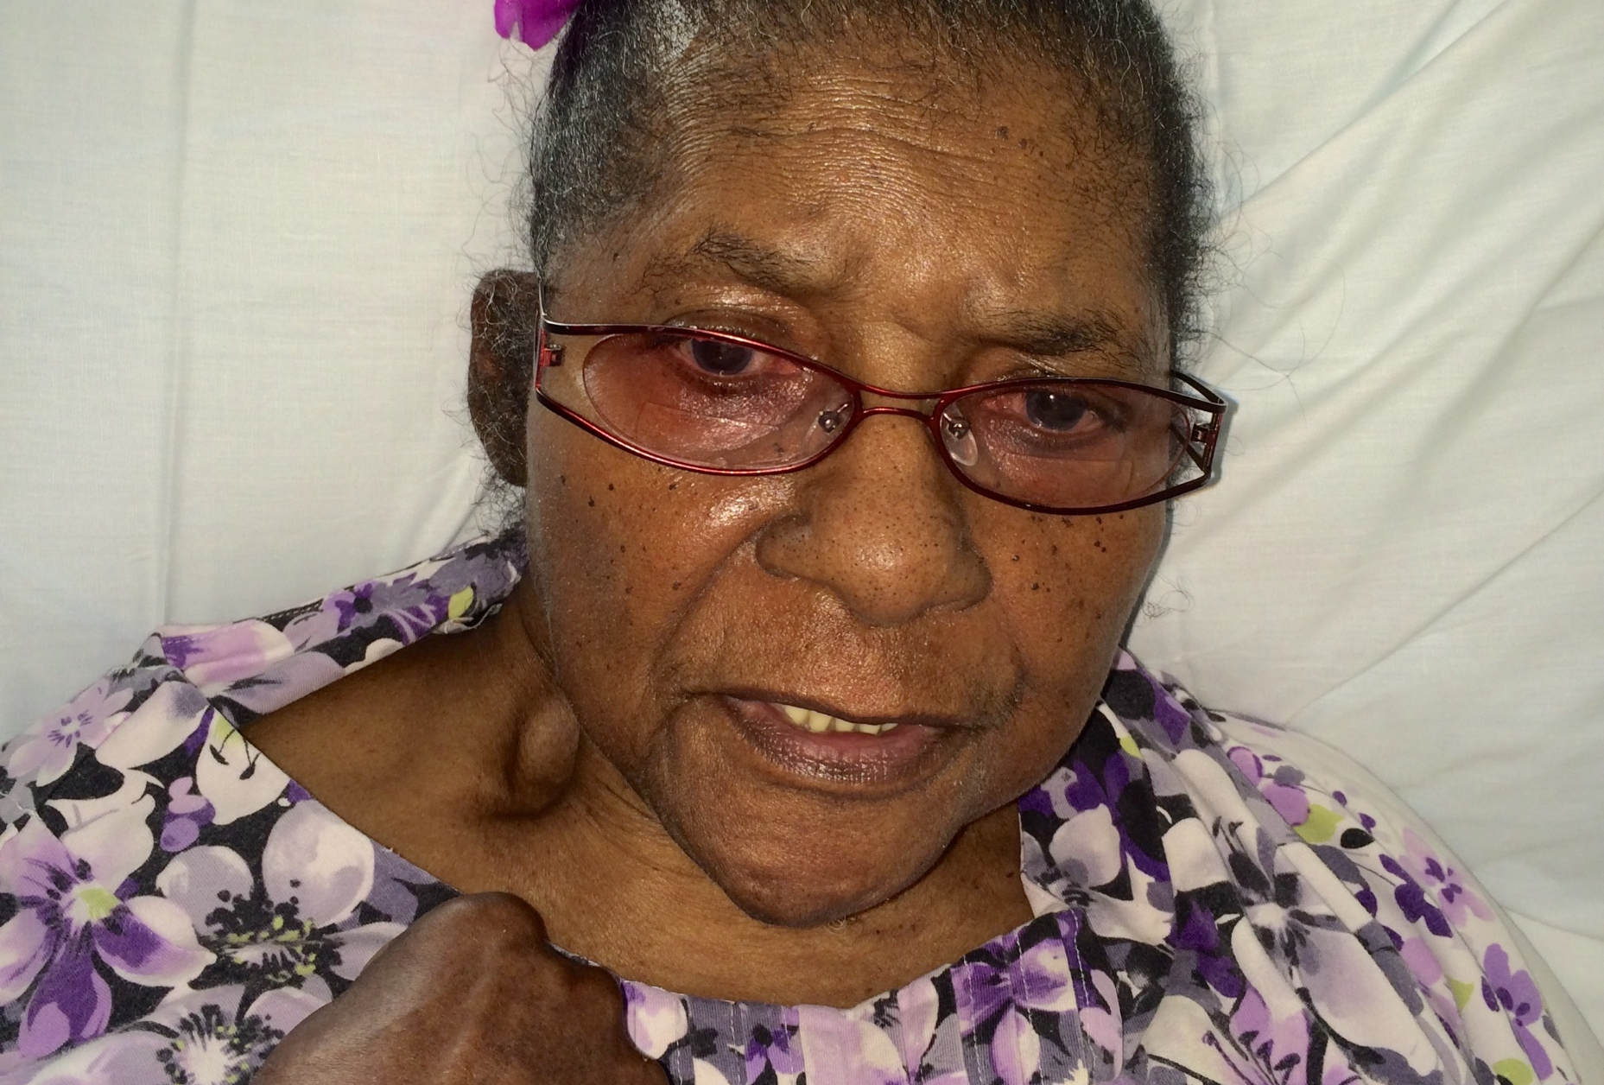
Ethel Matthews
My mother Loved & Sacrificed for her family.
Janice Chance

Slide 10
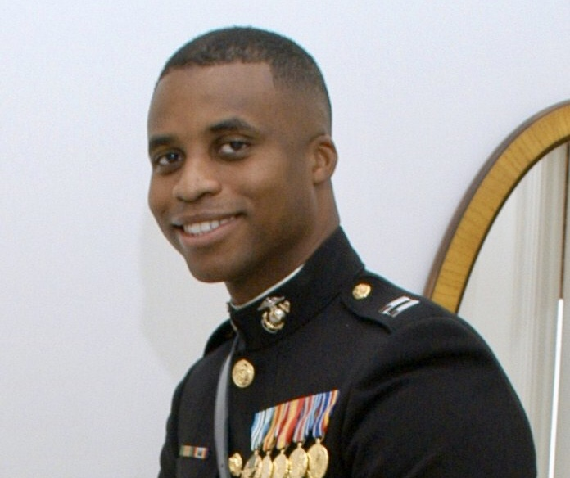
Captain Jesse Melton III U. S Marine Corps, Beloved Eldest Son
Janice Chance
“Made Ultimate Sacrifice 9/9/2008, Is w/Jesus”

Slide 11
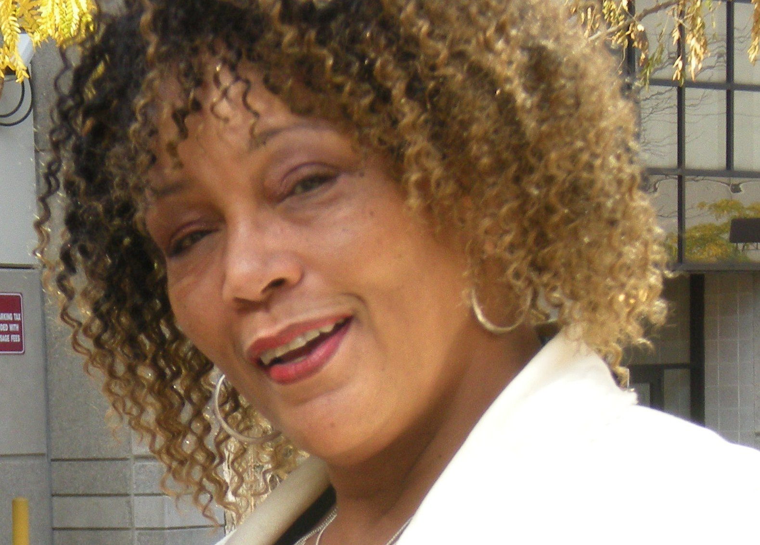
Michelle Smith,
Beloved Cousin
The DeBerry Family

Slide 12
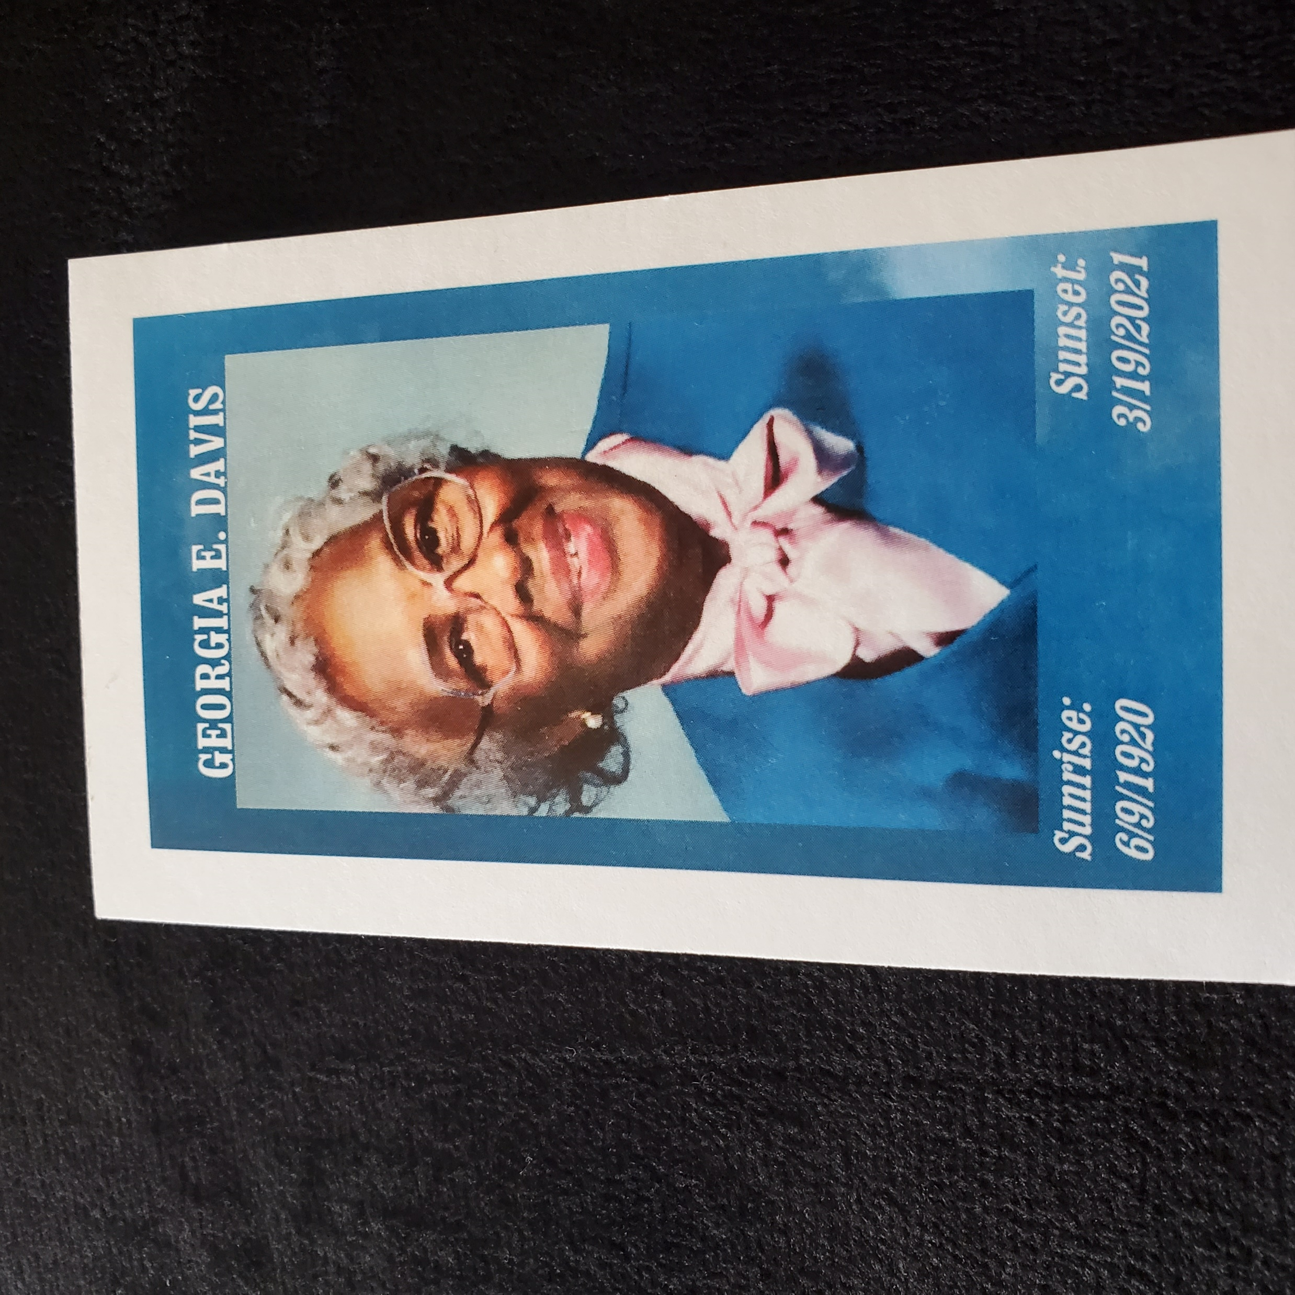
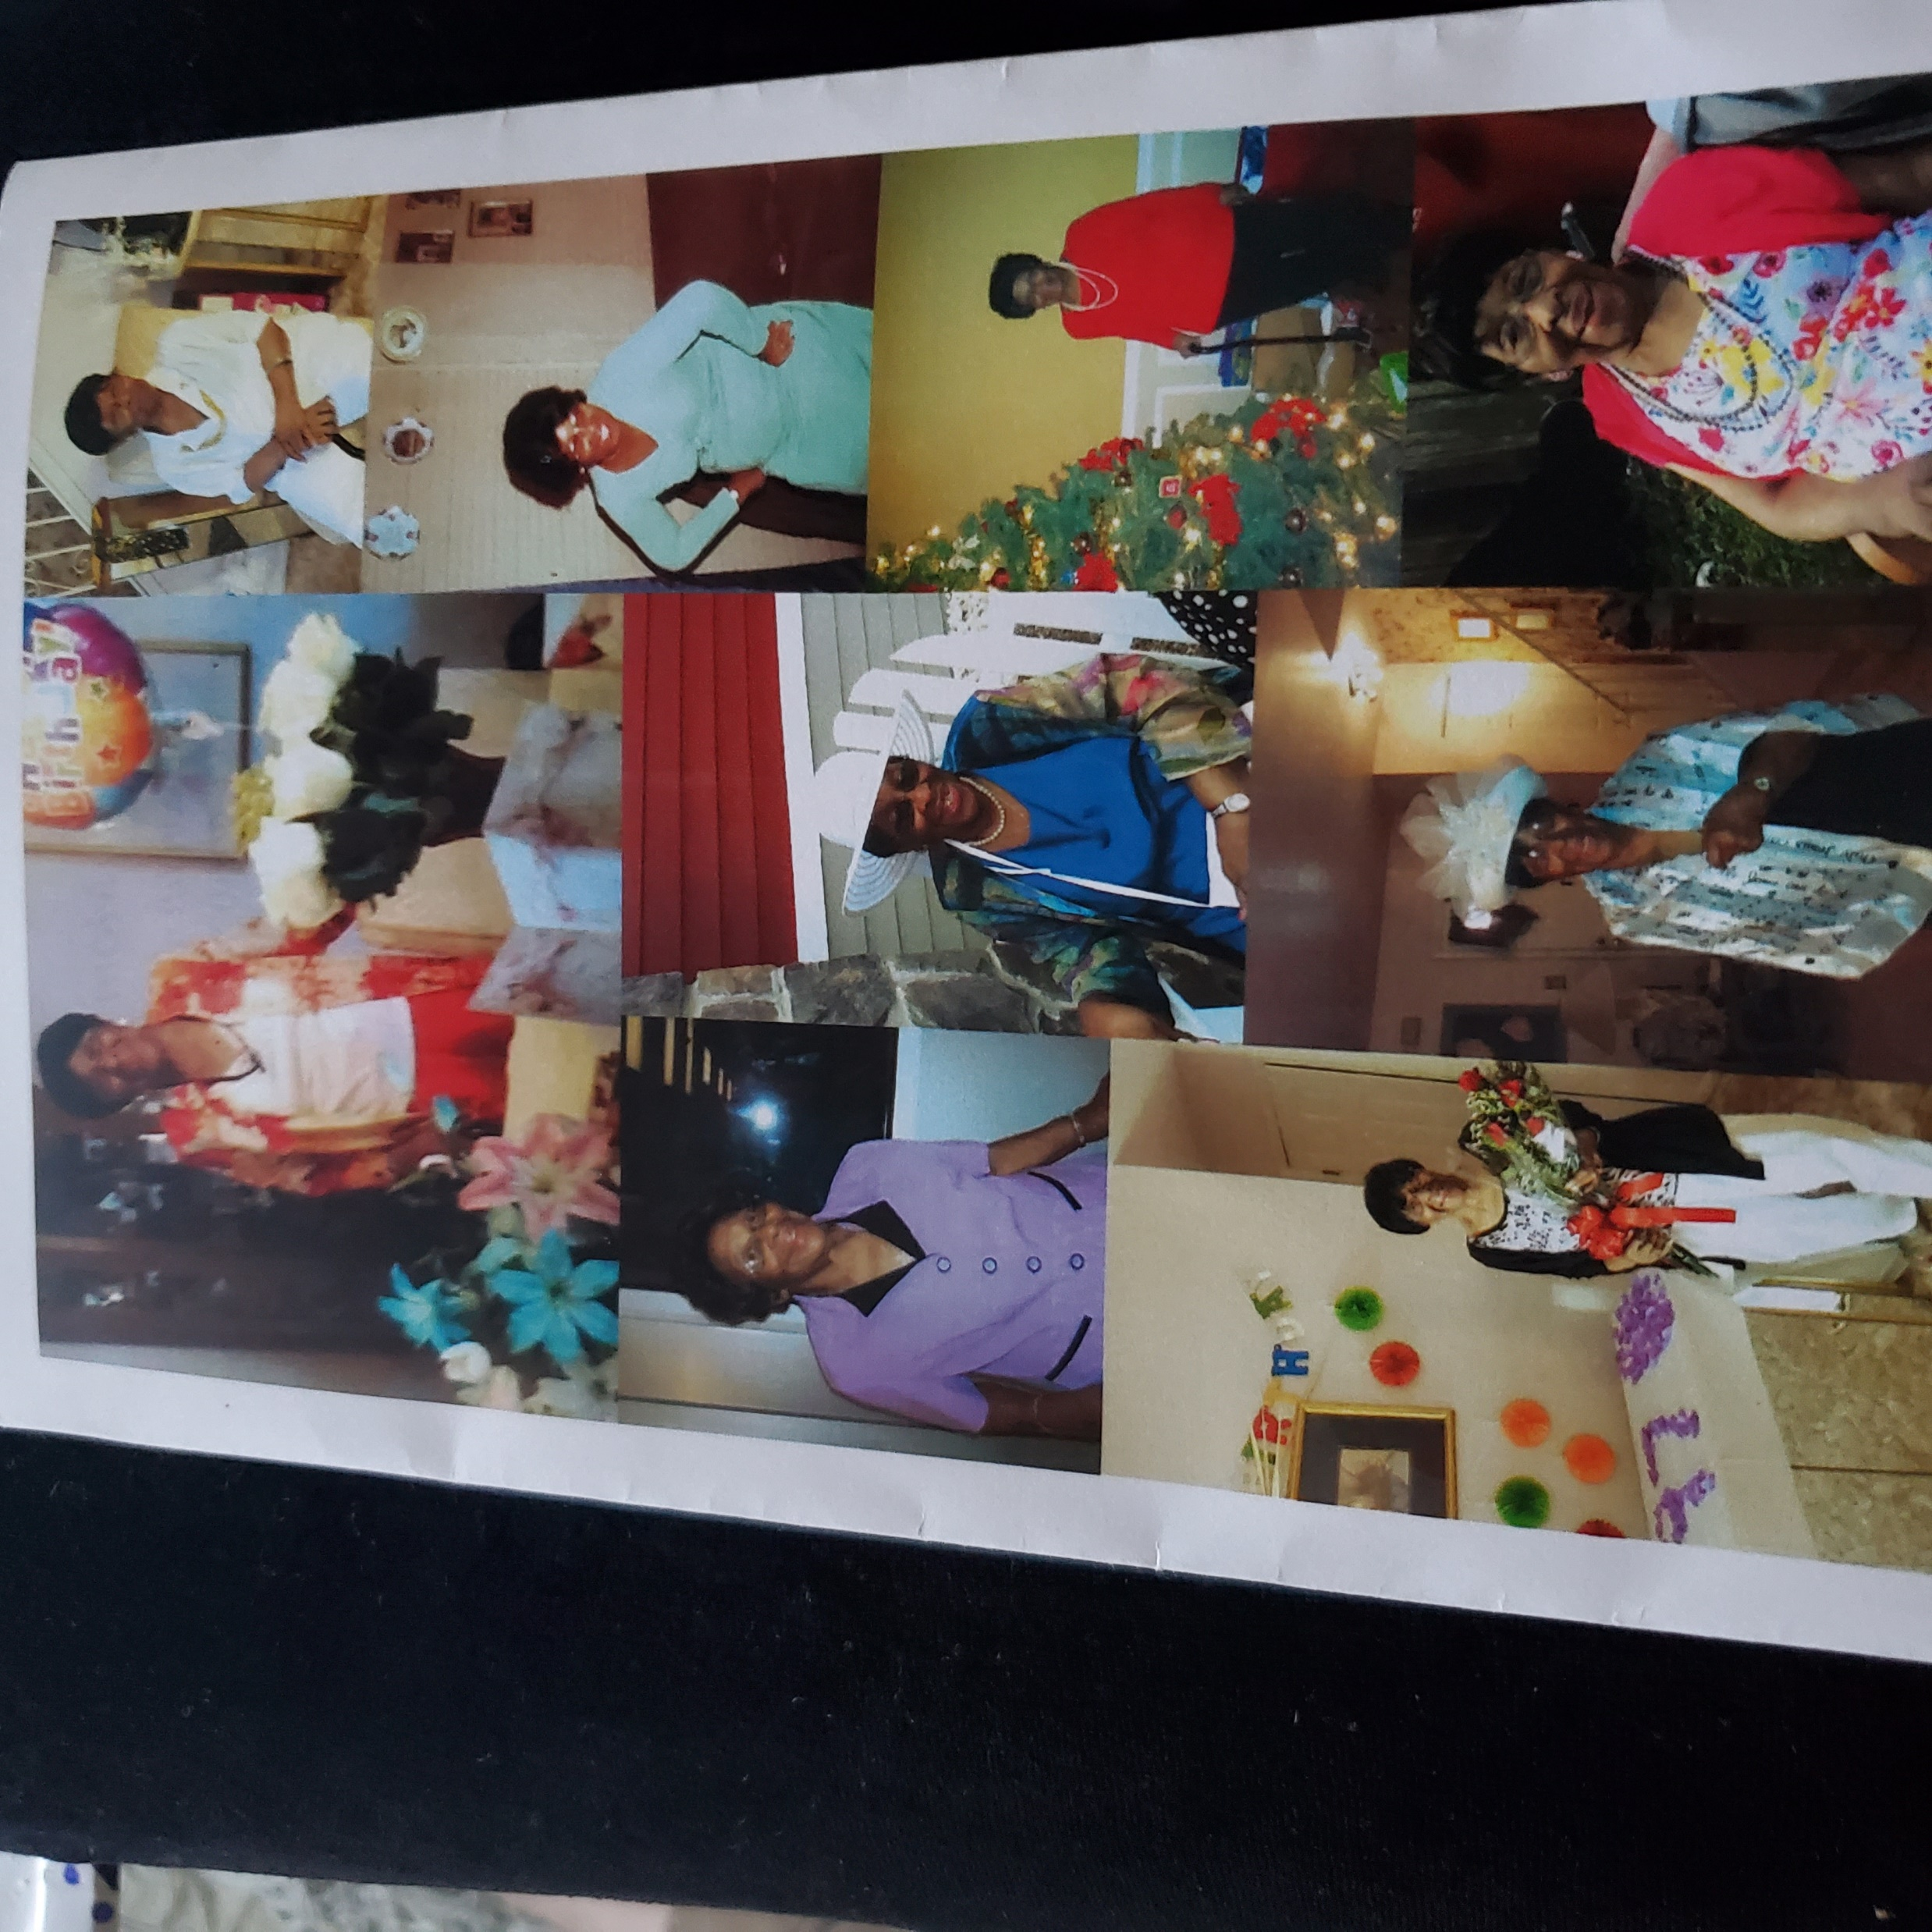
“100 years of Life”- Georgia E. Davis
“Missing You, Aunt Georgetta”
Love,
The DeBerry Family

Slide 13
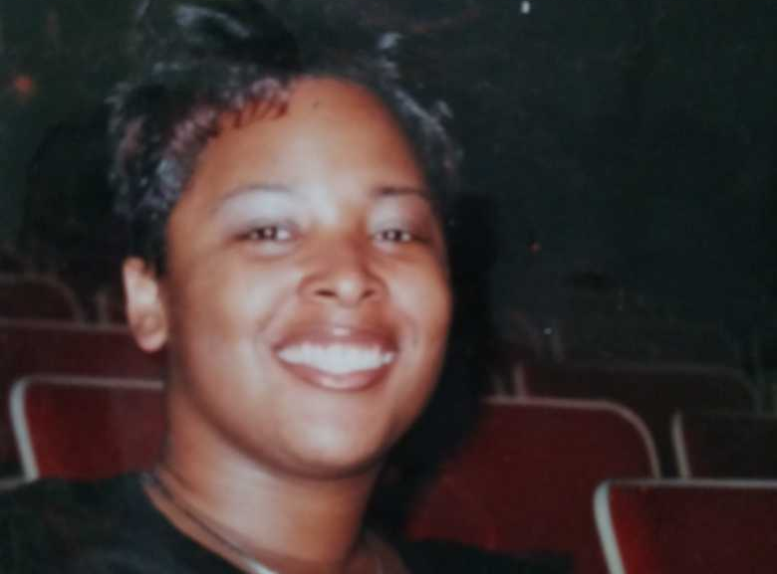
Allisha Coleman, My Daughter
“Allisha, you were 1 in a million” 3/11/1983-11/22/2005
Dollene Stegman

Slide 14
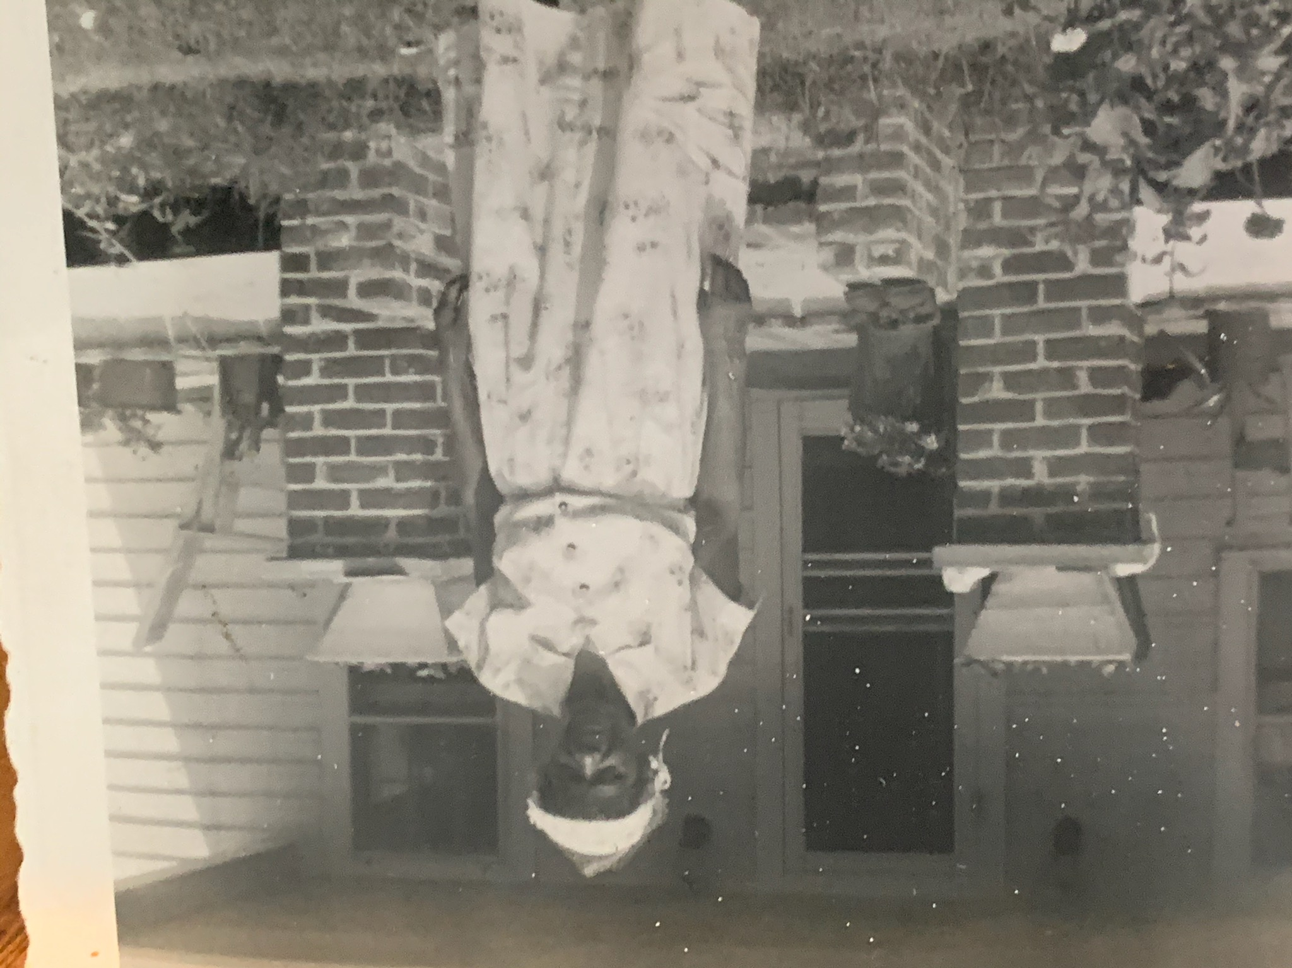
Maime Logan Butler,
Grandmother
“You left a spiritual legacy.”
Alice Gaskins

Slide 15
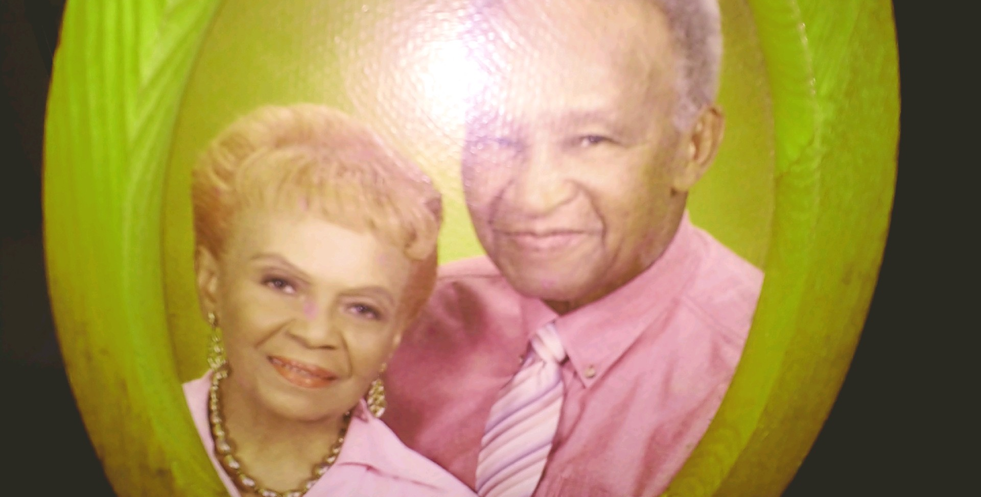
Mervin & Vera Garner
Brother & Sister-In-Law
“Thanks for filling a gap. Miss you!” Alice Gaskins

Slide 16
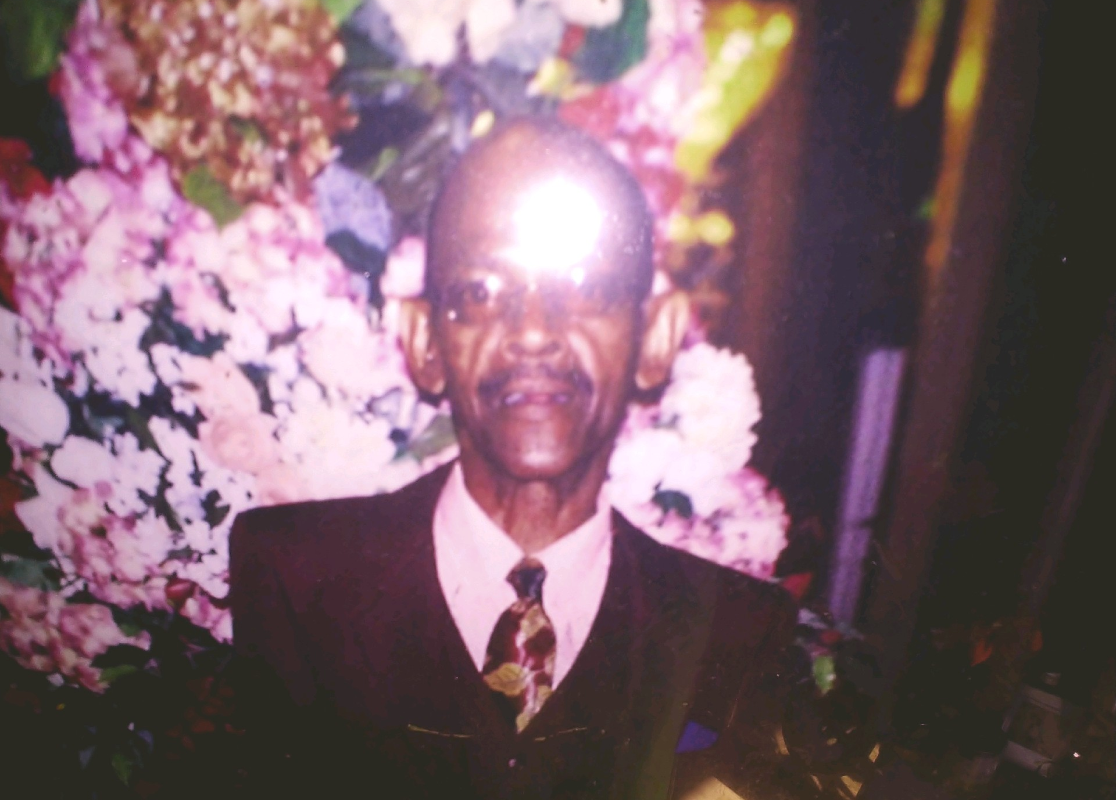
“Forever in my heart”.
Eugene Garner,
My Brother
Alice Gaskins

Slide 17
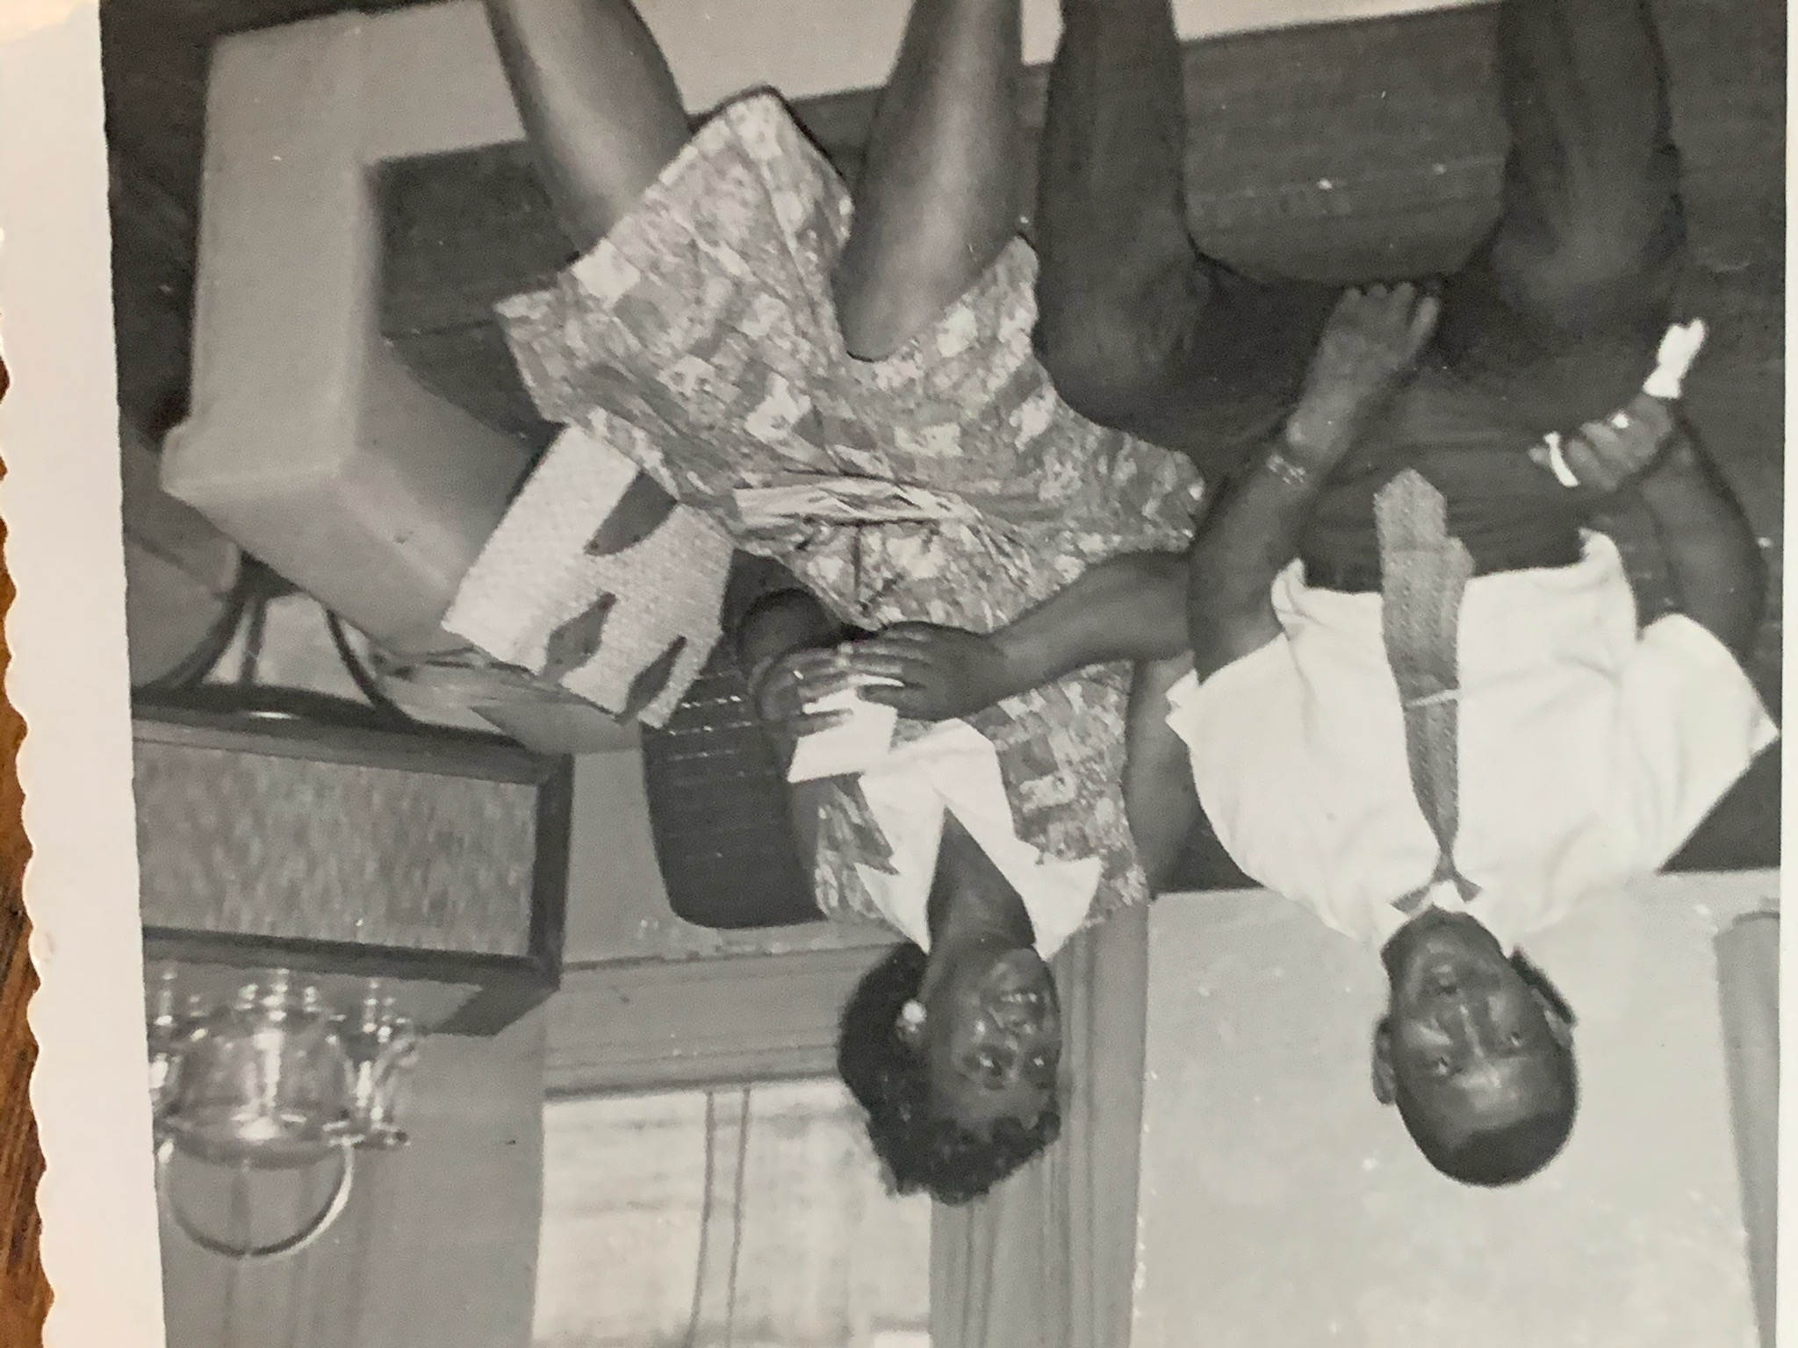
Irene Garner Nicholas, Mother and Step-Father, Maynard Nicholas
“Gone but never forgotten.” Alice Gaskins

Slide 18
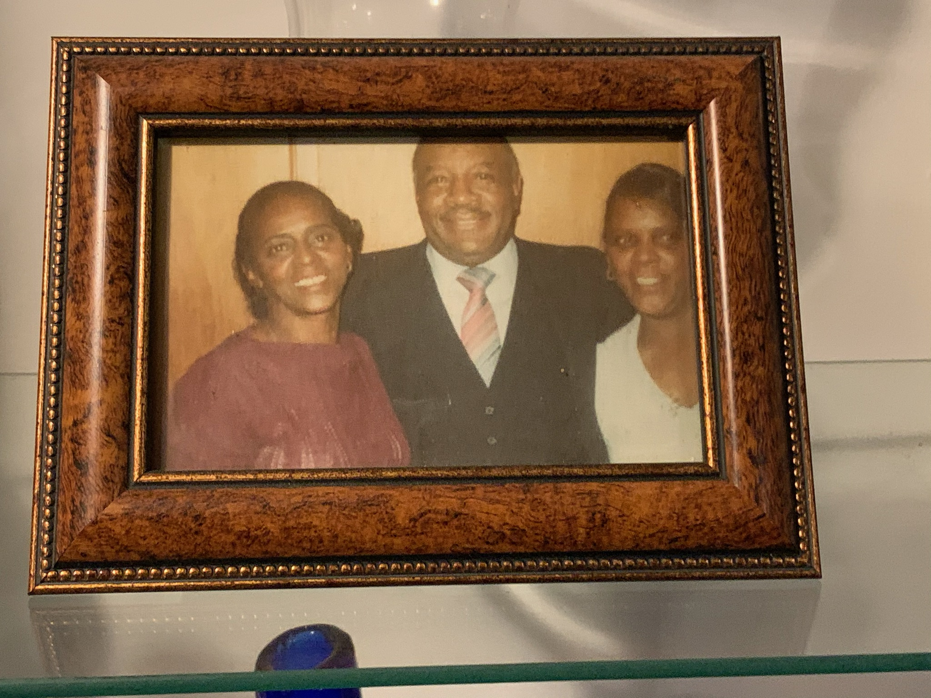
Mertina Fleming, sister, brother-in-law, Jack and sister, Florine Powell
“Miss you all.”
Alice Gaskins

Slide 19
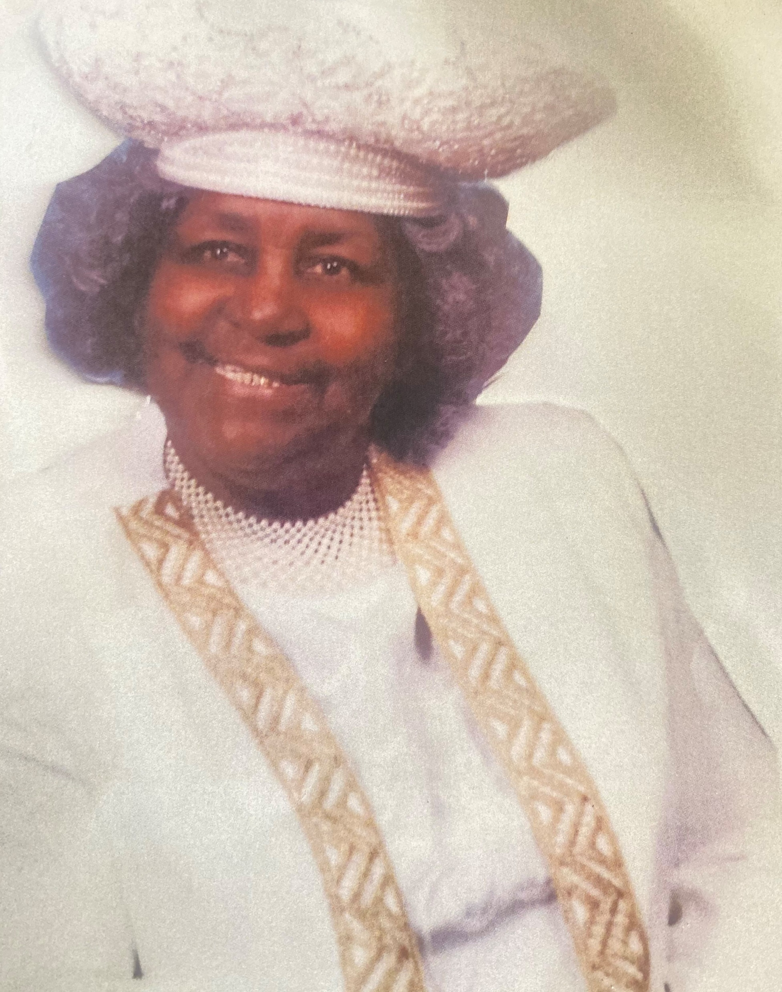
Gladys Brockington Key
“Beloved Mother, Grandmother and Great Grandmother”
Love,
Von, Toni, Sydney and Nigel

Slide 20
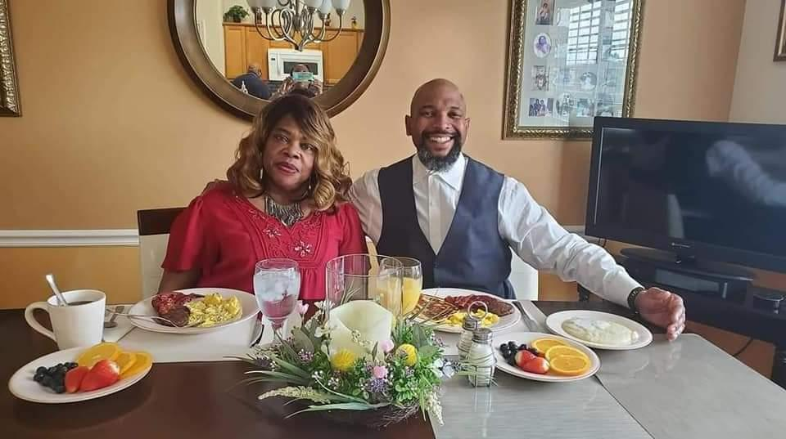
Toni and Von Key
Mom and Dad, we miss you and will always carry your love with us.
Love you always
Your Children,
Sydney and Nigel

Slide 21
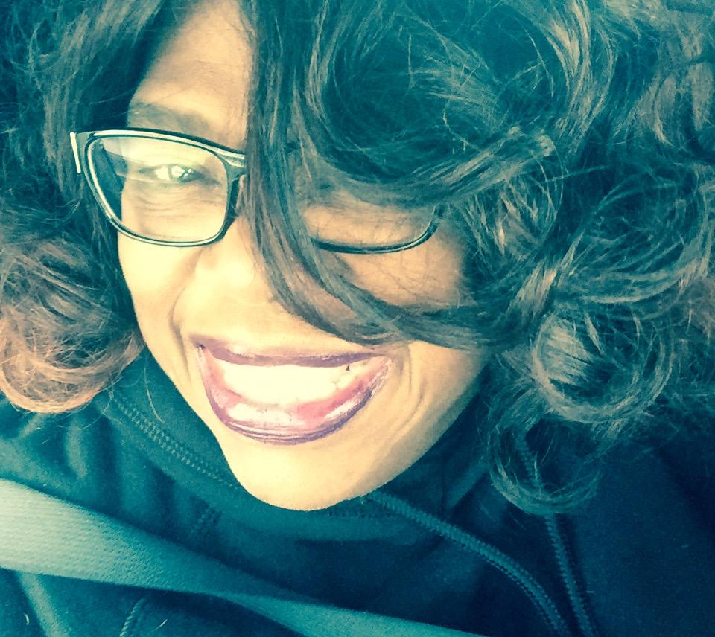
Toni Letitia Jones-Key
Toni, our third sister, was a beautiful happy, joyful, loving spirited woman of God who cared deeply for and about her family. Her smile was infectious and she made everyone feel welcomed and comfortable.
We miss our dear sister and will always remember her beautiful spirit.
Your Sisters: Sandra, Phyllis, Marcella, and Julia

Slide 22
“Praise be to the God and Father of our Lord Jesus Christ, the Father of compassion and the God of all comfort, who comforts us in all our troubles, so that we can comfort those in any trouble with the comfort we ourselves receive from God.” 2 Cor 1:3
Others Remembered:
Joseph Brown Jr., son of Ruth Brown
Skye Richardson, niece of Carla Lofland
Alonzo G. DeBerry, Jr. Father/Grandfather/Great-grandfather
The DeBerry Family
Bayette Turner, nephew of Linda Richardson
Wayne, Keith and Elbert Turner, brothers of
Linda Richardson
Trish Morris-Yamba, cousin of Linda Richardson
Arlene Henson, neighbor and friend of Phyllis Cephas and Linda Richardson
Leedonis Garner and Allois Garner brothers of
Alice Gaskins
Sonya Lewis and Sheila Hebron, sisters of
Ocola Keelen
William Lewis and James Lewis, brothers of
Ocola Keelen
John H. Cephas, cherished & beloved 1st husband of Phyllis Cephas
Eugene & Eugenia Garner(Twins), family of Alice Gaskins

Slide 23
Others Remembered:
Christopher Cason, son of Kim Cason
Rev. Anita Maxine Poindexter, cousin of
The DeBerry Family
Sandra Taylor, Lois Parrish and Derrick Griffin, friends of Linda Richardson
Julia Mae (Shirley) Ervin, sister of Rena Ranger
Edward Linzy Burton, brother-in-law of Rena Ranger
William Lewis, family of Ocola “OC” Keelen
Joseph Jackson
Marvin Kellen,
family of Ocola “OC” Keelen
Corinthia Tate (sister), Yolanda Jones (sister cousin), family of
Joanna Owens
Brian Davis, cousin of
The DeBerry Family
Raeford Gaskins, Jr., son of Raeford Sr. and Alice Gaskins
Geraldine Torian (mom), Dorothy Robinson (aunt), family of
Joanna Owens

Slide 24
Always & Forever

