Slide 1
Life with Mommy… and her Girlfriend
Written by Noreen Spagnol
Illustrated by Hannah and Tayleigh Spagnol
- Book Sales Kit -

Slide 2

About the Book
Book Synopsis:
Sometimes life looks like this...
Everyone loves each other in this family. The book was illustrated by two young girls. It is an interactive story representing their viewpoint on what day-to-day life looks like when their mommy is dating a woman. This book is intended to help teachers share details about diversity in families, as well as mothers assisting their children to understand and appreciate the relationship between their mother and her new girlfriend.

Slide 3
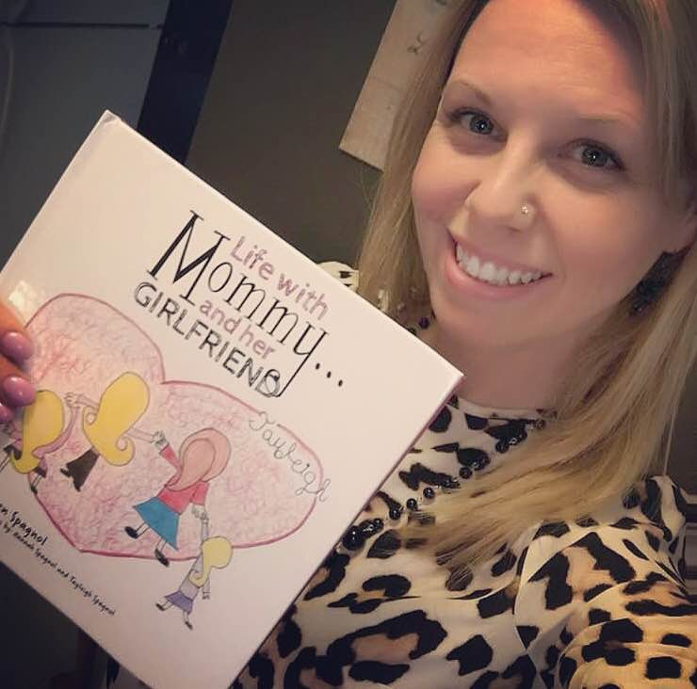
About the Author/Illustrators
About the Author:
Noreen Spagnol is a proud mother of two incredible, talented daughters, named Hannah and Tayleigh. She is also an elementary French teacher and has been teaching for 14 years now. She has a degree in French and has studied Spanish, Italian, German and Latin at different points in her life. Studying languages is a passion for her. She is excited to work with her loving daughters and to get the chance to share details about diversity in the dating process through her writing.
About the Illustrators:
Hannah and Tayleigh are loving sisters, looking to share their view of the wonderful world they live in full of diversity. They want everyone to know that we are all different in our own ways and because of this, we all have something special to offer in order to fill this world with a rainbow of different types of strengths and love, making life an incredible journey.

Slide 4
Executive Summary
To Any Interested Book Buyers/Bookstore Managers:
Thank you for taking the time to check out the website for “Life with Kids’ Books”. I am hoping that you would see the value in carrying this book on your shelves in that there is a great need for the message of diversity in families that is evident in this storyline. I believe that the number of buyers that are looking for a book of this subject matter is growing daily and that this large demand will bring about a great amount of sales. Being that this book is designed to help not only families, but also teachers, mental health facilitators and others, I believe that “Life with Mommy… and her Girlfriend” is going to be a great seller!
For promotional ideas, I am currently using several social media sources to inform buyers that my books are available and I intend to represent any and all individual bookstore locations on my social media platforms the moment that “Life with Mommy… and her Girlfriend” can be found on their shelves. If at all possible, I would also like to be present at the bookstore for an author signing to help promote the book. As well, I will also update the book website in order to ensure that each individual bookstore is included in the list of where the book is available for purchase.
I am consistently posting on several social media sites in order to keep reaching out to more possible buyers and will connect with your social media platforms to promote your endeavours so that a healthy union will exist between my book and all individual bookstore locations carrying “Life with Mommy… and her Girlfriend”. I also intend to consistently promote the book through the purchase of online ads and I will make sure to include any individual bookstore locations carrying the book in these ads.
I would greatly appreciate the opportunity to sell my book to the public through any and all venues possible in order to spread the acceptance of diversity in families.
Thank you so much for checking out the sales kit for “Life with Mommy… and her Girlfriend”. I look forward to hearing from and hopefully working with you in the future.
Noreen Spagnol
~ Life is a journey… Explore, inspire and enjoy it to the fullest! ~

Slide 5

Life with Mommy…and her Girlfriend
~ Written by Noreen Spagnol and Illustrated by Hannah and Tayleigh Spagnol ~
www.friesenpress.com
1-888-378-6793
Title
Life with Mommy… and her Girlfriend
Author
Noreen Spagnol
Illustrators
Hannah Spagnol
Tayleigh Spagnol
ISBN
Paperback: 978-1-5255-0269-9
Hardcover: 978-1-5255-0270-5
E-book: 978-1-5255-0268-2
Suggested Price
$7.99 USD
Publication Date
April 11, 2017
Genre
JNF001000
Juvenile Nonfiction/Activity Books
JNF053080
Juvenile Nonfiction,/LGBT
JNF053020
Juvenile Nonfiction/Social Topics/Dating and Relationships
Page Count
36 pages
Trim Size
8.5 x 8.5
Publisher
FriesenPress
Wholesale
INGRAM Catalogue
Individual Order
http://www.friesenpress.com/bookstore/title/119734000033039011
About the Book
Sometimes life looks like this…
Everyone loves each other in this family. The book was illustrated by two young girls. It is an interactive story representing their viewpoint on what life looks like when their mommy is dating a woman. This book is intended to help teachers share details about diversity in families, as well as mothers assisting their children to understand and appreciate the relationship between their mother and her new girlfriend.
What does your family look like?
Book Cover
Book Review/Quote
“My wonderful friend Noreen, alongside her two amazing daughters, wrote and designed a lovely book about how some families may look different yet have the same ideals as everyone else. Being a Child and Youth major with a passion for LGBTQ youth/families, having a book like this available is important and educational.”
~ Adam Coleman
For more information, please visit:
www.lifewithkidsbooks.com

Slide 6
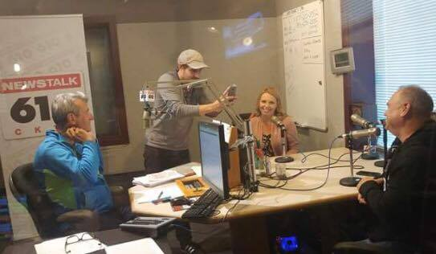
Media Outline
Events completed:
~ Book Signing and Sales ~
June 10th, 2017
Pride in the Park Festival
Montebello Park, St. Catharines, ON
~ Radio Interview ~
August 29th, 2017
610 AM CKTB
Phone interview with Larry Fedoruk
St. Catharines, ON
~ Book Signing and Launch Party ~
September 3rd, 2017, 1-4pm
Mahtay Café
St. Catharines, ON
~ Radio Roundtable Discussion ~
September 5th, 2017
610 AM CKTB
Roundtable Segment with Larry Fedoruk
St. Catharines, ON
~ Book Signing and Sales ~
September 24th, 2017, 1-4pm
Indigo Bookstore
Stoney Creek, ON
~ Radio Roundtable Discussion ~
October 13th, 2017
610 AM CKTB
Roundtable Segment with Larry Fedoruk
St. Catharines, ON

Slide 7
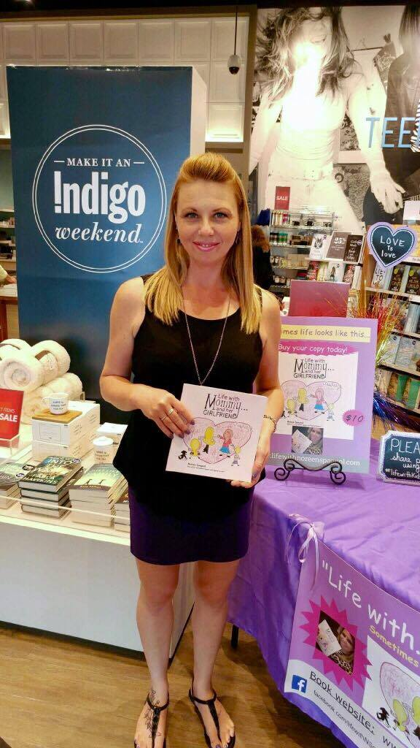
Media Outline
Events completed (cont’d):
~ Radio Roundtable Discussion ~
January 3rd, 2018
610 AM CKTB
Roundtable Segment with Larry Fedoruk
St. Catharines, ON
~ Book Signing and Sales ~
January 13th, 2018, 1-4pm
Coles Bookstore – Seaway Mall
St. Catharines, ON
~ Book Signing and Sales ~
January 20th, 2018, 1-4pm
Coles Bookstore – Pen Centre
St. Catharines, ON
~ Book Signing and Sales ~
February 3rd, 2018, 1-4pm
Chapters Bookstore – Fairview Mall
St. Catharines, ON

Slide 8
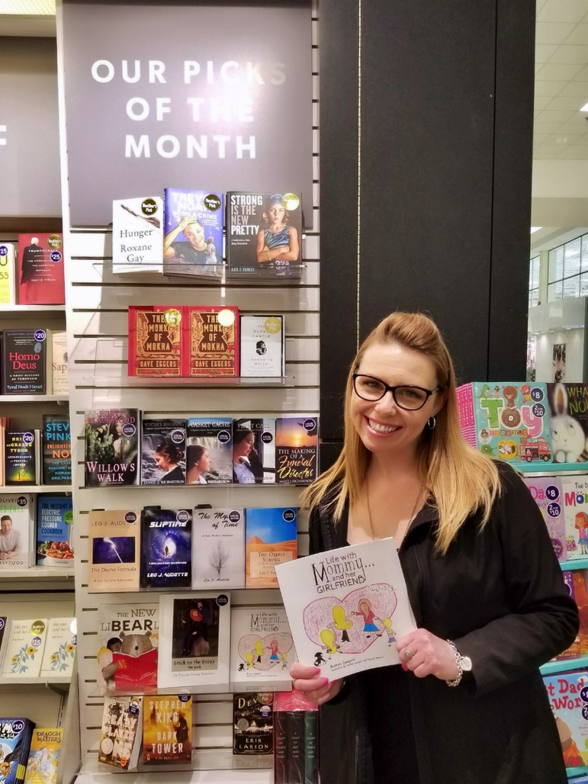
Media Outline
Events completed (cont’d):
~ Book Signing and Sales ~
June 9th, 2018
Pride in the Park Festival
Montebello Park, St. Catharines, ON
~ Book Signing and Sales ~
June 17th, 2018
Pride in the Park Festival
Hamilton Gage Park, Hamilton, ON
~ Book Signing and Sales ~
December 1st, 2018, 12-4pm
Coles Bookstore – Seaway Mall
St. Catharines, ON

Slide 9
Social Media Platforms
Email:
lifewithkidsbooks@gmail.com
Website:
http://www.lifewithkidsbooks.com
Facebook:
http://www.facebook.com/lifewithkidsbooks/
Instagram:
@lifewith_kidsbooks
Twitter:
@Lifewith_KBooks
YouTube:
www.goo.gl/ZgGdP8

Slide 10

Also available…
~ Check out www.lifewithkidsbooks.com to find out where
“Life with Kids’ Books” can be purchased ~

Slide 11
Thank you for your time!
~ Life with Mommy… and her Girlfriend ~

