Slide 1


Terminology and Concepts
© 2020 Pride in the Triangle
www.prideinthetriangle.org

Slide 2
Purpose
Create a shared understanding of equity, diversity, inclusion, and LGBTQ+-related terminology and concepts
© 2020 Pride in the Triangle

Slide 3
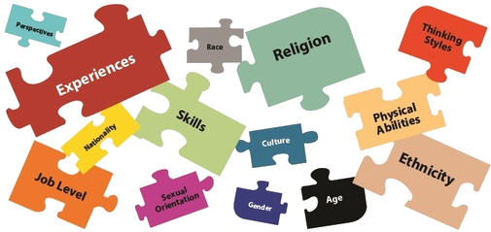
Diversity
Diversity: Characteristics that make individuals and groups unique and different from each other, including identity markers, personalities, ways of thinking, ideas, and perspectives.
A diverse workplace includes a mix of coworkers with different socially-relevant
A diverse workplace includes a mix of coworkers with different socially-relevant identities and experiences working together..
© 2020 Global Citizen, LLC for use by Pride in the Triangle
Image from https://health.usf.edu/publichealth/diversity-inclusion
Notes:
IMAGE FROM: https://health.usf.edu/publichealth/diversity-inclusion

Slide 4
Identity Markers and Characteristics
Identity markers may include: Race, ethnicity, socioeconomics, gender identity and expression, sexual orientation, national origin, indigenous heritage, religion, language, marital and family status, age, body type, educational level, dis/ability, geographic location, political affiliation, citizenship, and veteran status.
Characteristics may include: personality type and diversity of thought.
© 2020 Global Citizen, LLC for use by Pride in the Triangle
Image from https://health.usf.edu/publichealth/diversity-inclusion

Slide 5
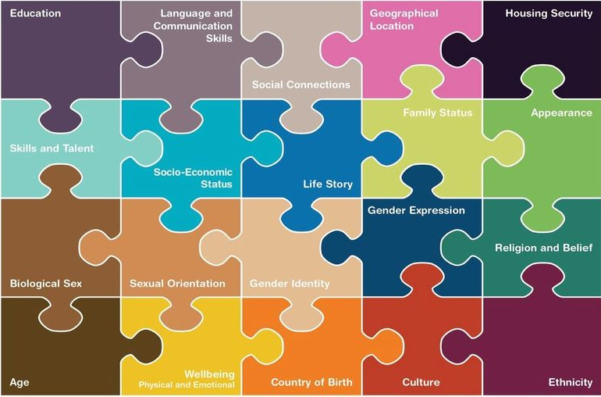
Inclusion
Inclusion: Actions to create an environment in which everyone is and feels welcomed, respected, valued, and supported to fully participate.
© 2020 Global Citizen, LLC for use by Pride in the Triangle
Image from https://health.usf.edu/publichealth/diversity-inclusion
Notes:
IMAGE FROM: https://health.usf.edu/publichealth/diversity-inclusion

Slide 6
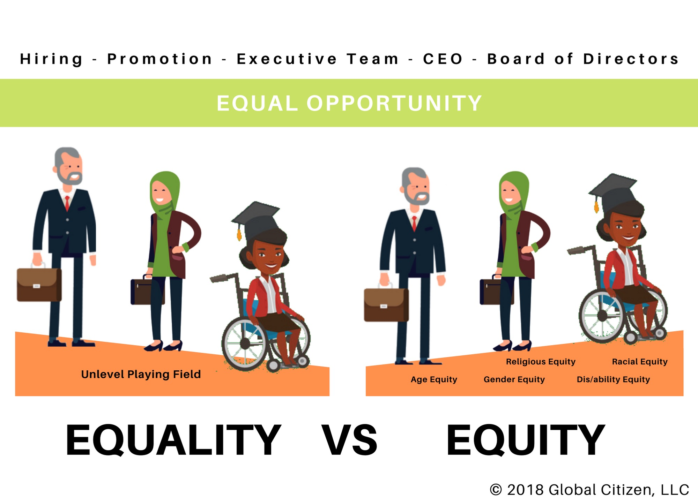
Equity
Equity: Fair treatment, access, opportunity, and advancement for all people, while identifying and shifting power structures, eliminating systemic barriers, and providing needed resources to ensure the full agency, participation, and benefit of people who have experienced discrimination and oppression.
Equality: The state of being considered inherently the same worth and accorded the same status, rights, resources, and opportunities, regardless of unique identities and characteristics.
© 2020 Global Citizen, LLC for use by Pride in the Triangle

Slide 7
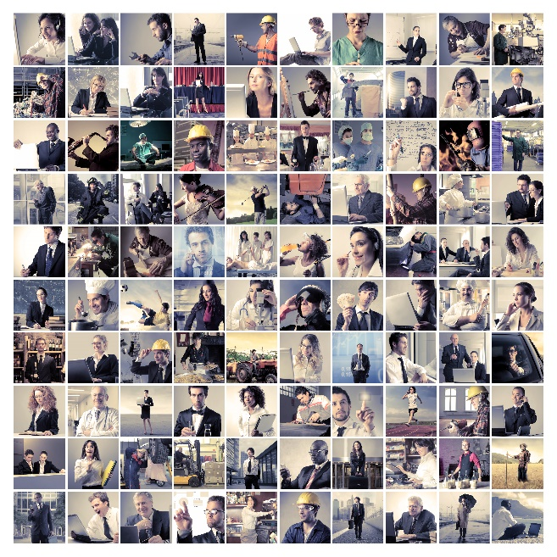

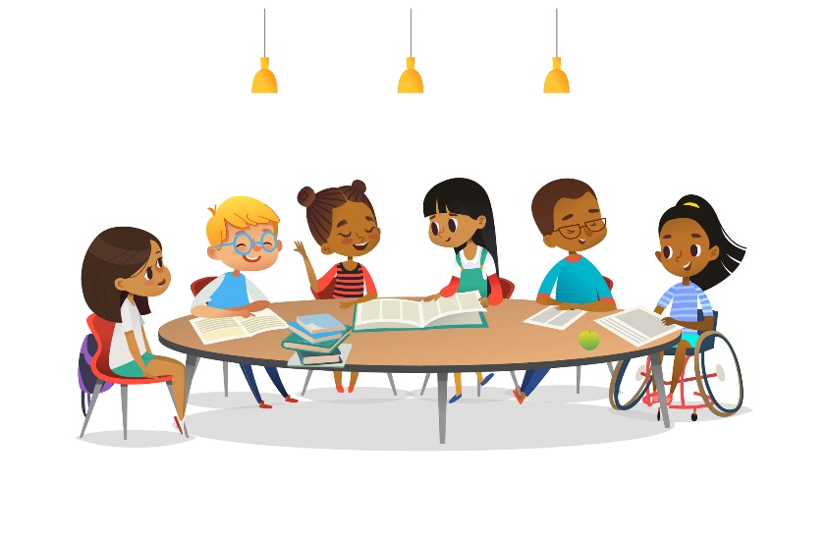
Moving to Belonging
Inclusion – everyone is at the table
Belonging - everyone is truly heard and fully valued
Diversity – it’s a fact of life
© 2020 Pride in the Triangle

Slide 8
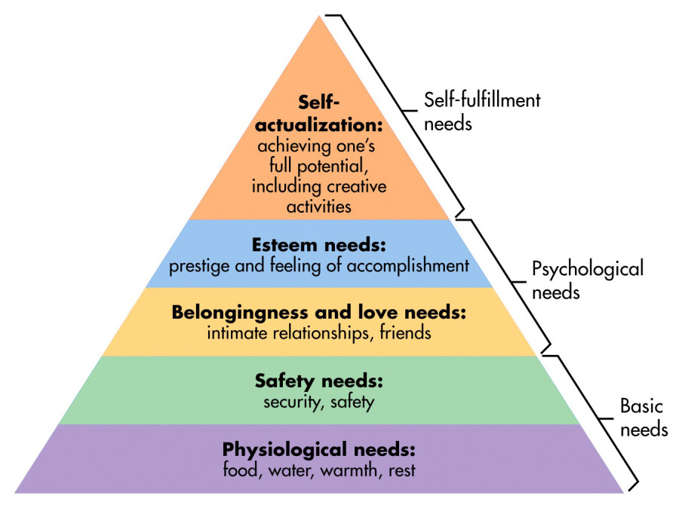
The Importance of Belonging
A strong human need
The fast-changing, global economy and workforce
Practical actions can be taken
An environment of belonging can help prevent “covering”
Maslow’s Hierarchy of Needs. Model graphic Sam McLeod, https://www.simplypsychology.org/maslow.html
© 2020 Pride in the Triangle

Slide 9
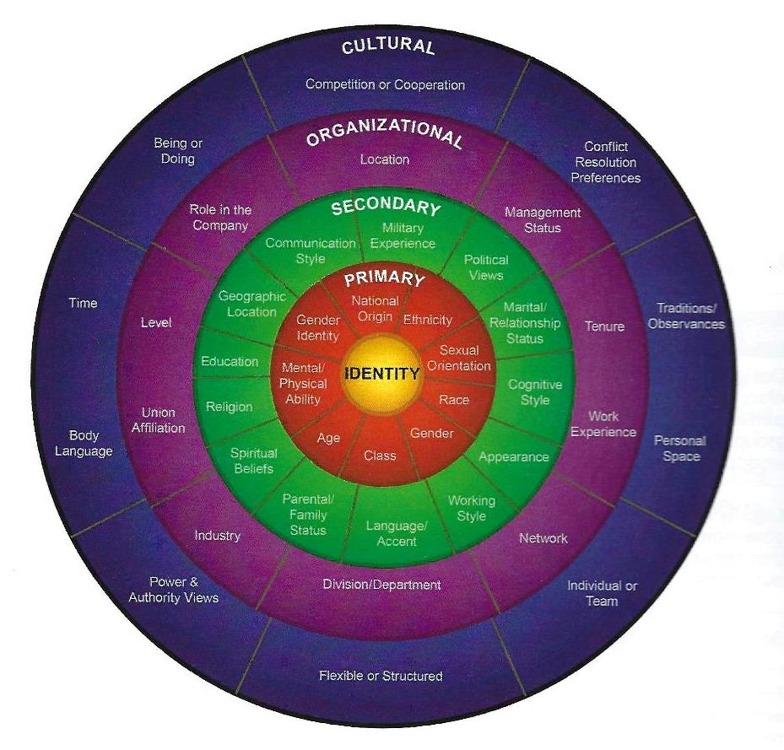
Everyone Needs to Belong
Every person is unique and part of this diversity, inclusion, and belonging discussion
This is not an “us versus them” discussion, but an “all of us” discussion
This training focuses on one aspect of the diverse workforce – LGBTQ+ people
Source: Adapted from “Workforce America!” by Marilyn Loden and Judy Rosener, 1991; “Diverse Teams at Work” by Lee Gardenswartz and Anita Rowe, 2003; and “Global Diversity Puts New Spin on Loden’s Diversity Wheel” by Kimberly Lou and Barbara Dean, 2010
© 2020 Pride in the Triangle

Slide 10
LGBTQ+ Terminology
Ally
Androgynous
Asexual
Bi-curious
Biological sex
Biphobia
Bisexual
Butch
Cisgender
Coming Out
Drag/King/Queen
Family of choice
Femme
Gay
Gender expression
Gender identity
Genderqueer
Heteronormative
Heterosexism
Homophobia
Homosexual
Internalized homophobia
Intersex
Lesbian
LGBTQ+
MSM
Out of the closet
Pansexual
Passing
Poly/amorous
Queer
Questioning
Sexual Orientation
Stud
Trans/gender
Transition
Transphobia
Transvestite
WSW
Other terms: _____________
*Outdated, potentially offensive
© 2020 Global Citizen, LLC for use by Pride in the Triangle
Notes:
Find your match and discuss the term and definition. Submit a sticky note for any that you would like to discuss in the large group.

Slide 11
Proper Versus Outdated and Offensive Terms
Group | Proper Term | Outdated/ Unacceptable | Offensive
LGBTQ+ Same-gender couple | Gay, LGBTQ+, Lesbian Sexual orientation Partner, Spouse Significant Other Husband /Wife | Homosexual | Dyke, F-word Queer (1) Sexual Preference “Lifestyle” Room-mate, friend
Transgender people | Transgender, Transperson | Transvestite Transexual | Not using their chosen name or pronoun, trannie, she-male, shim
Intersexed people | Intersexed | Hermaphrodite | She-male
Gender non-binary people | Genderqueer, Gender non-binary/fluid/nonconforming/expansive, two-spirited |  | Shim
Dyke and queer may be offensive to some LGBTQ+ people, but some people have re-claimed and embraced the terms (2) New salutation gaining some acceptance: Mx.
© 2020 Total Engagement Consulting by Kimer, Inc. for use by Pride in the Triangle

Slide 12
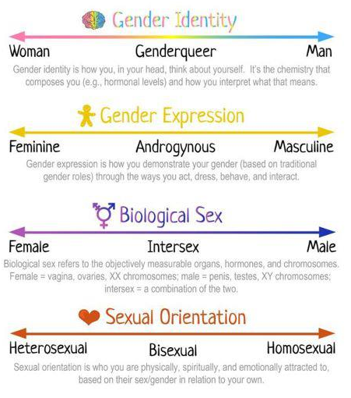
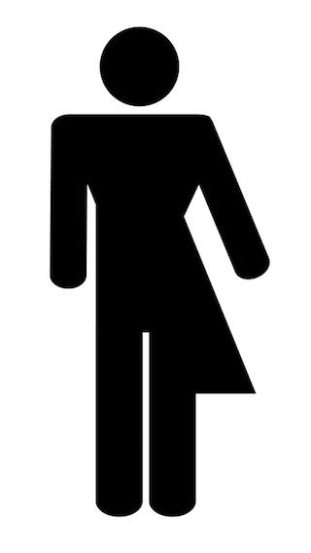
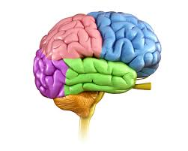
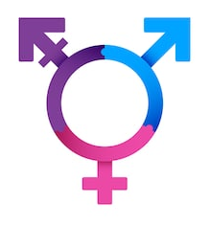

Gender and Sexuality
Asexual
© 2020 Global Citizen, LLC for use by Pride in the Triangle
Notes:
Graphics: brain: Verywell mind; trans symbol: Shutterstock; gender expression symbol: Western City Magazine; heart symbol: Wikipedia

Slide 13
Transgender
An umbrella term for people whose gender identities, expressions, and/or behaviors are different from those typically associated with people with their assigned sex at birth.
© 2020 Global Citizen, LLC for use by Pride in the Triangle

Slide 14
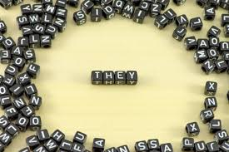
Pronouns
Third-person pronouns in English: She/her/hers, they/their/theirs, he/him/his, etc.
People often make incorrect assumptions about a person’s gender
Transgender, gender non-conforming, and nonbinary people use pronouns other than those they were assigned at birth
Being “misgendered” is disturbing, exhausting, and can even cause intense feelings of dysphoria
Using correct pronouns is an important and easy way to show respect
You can model providing your pronouns during introductions
Pronouns, like gender, can be fluid and change over time
Many workplaces encourage employees to include their pronouns and use gender-neutral language in job descriptions to avoid gender bias
© 2020 Global Citizen, LLC for use by Pride in the Triangle

Slide 15
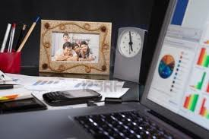
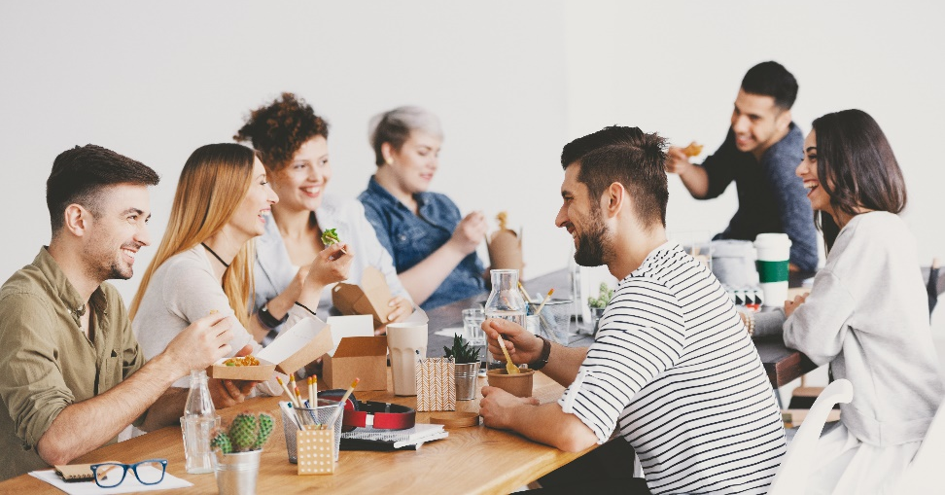
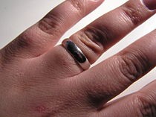
“But I don’t tell people I’m straight.”
What are we wearing?
What comes up in daily conversation?
From “What your desk says about you” Photographs of family and friends are perhaps the most common desktop embellishments.
© 2020 Pride in the Triangle
Source: Out and Equal Workplace Advocates

Slide 16
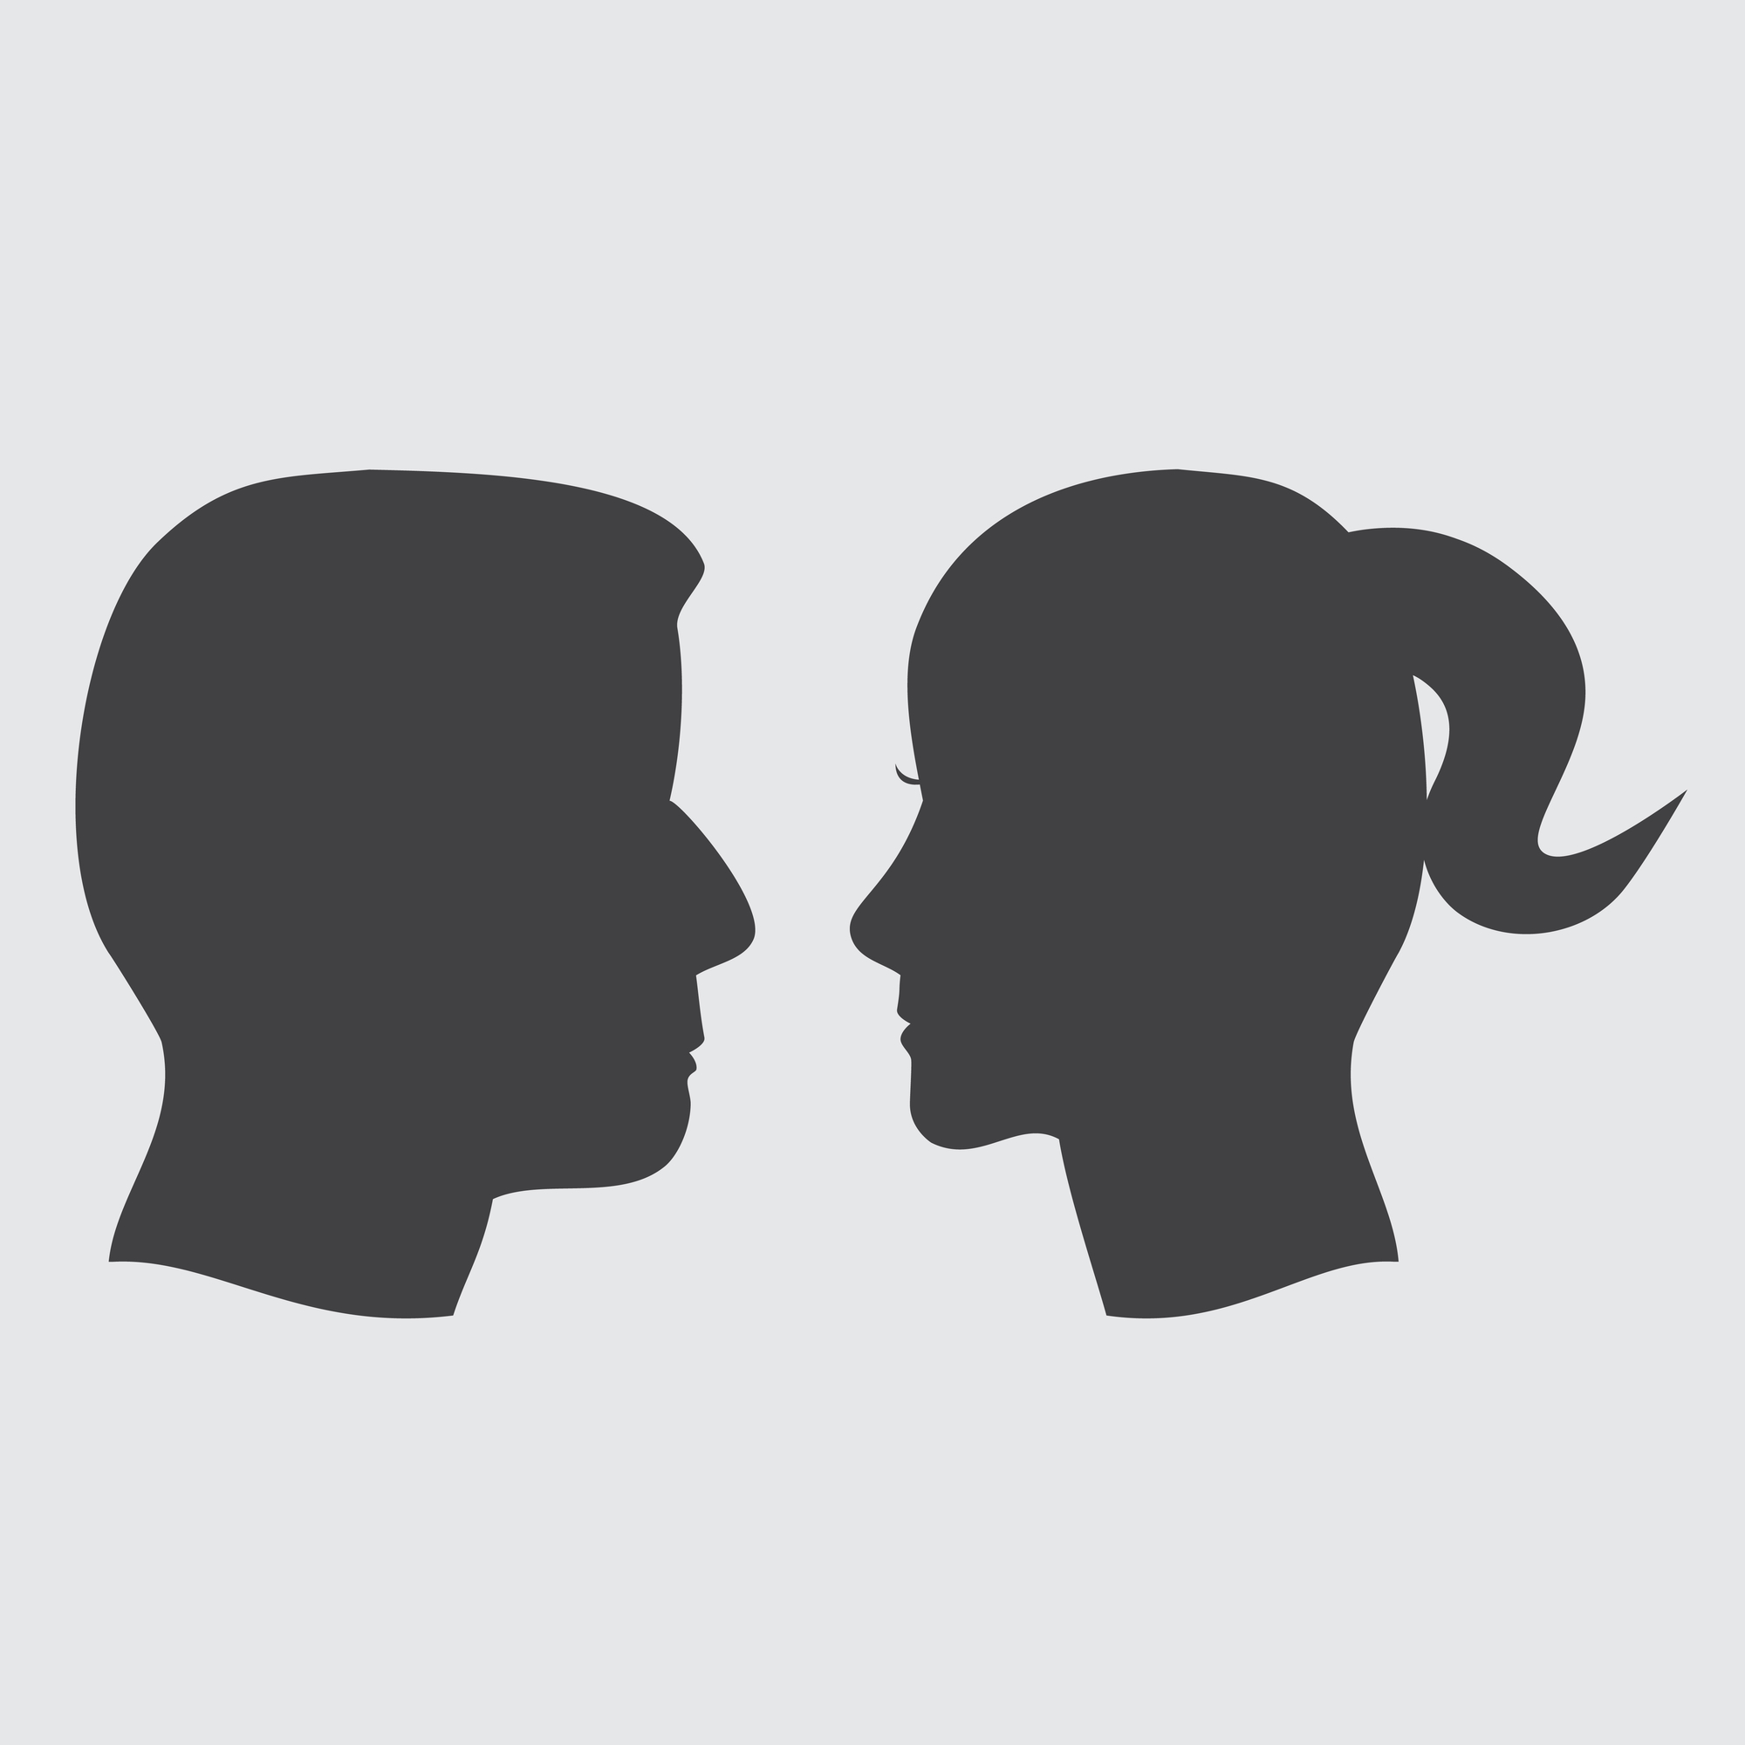

Story Sharing Activity
When you can’t just tell the story
Pronouns:
She, her, hers
They, their, theirs
He, him, his
© 2020 Pride in the Triangle
Courtesy of Out and Equal Workplace Advocates

Slide 17
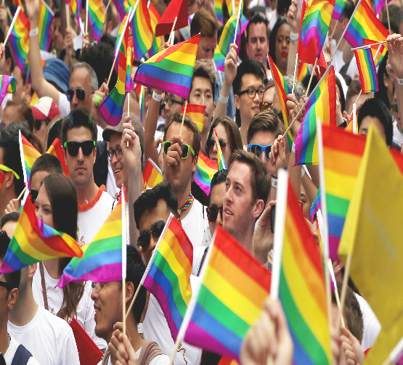
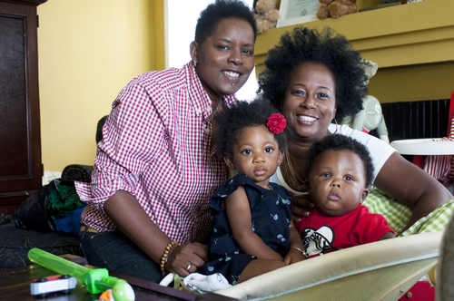
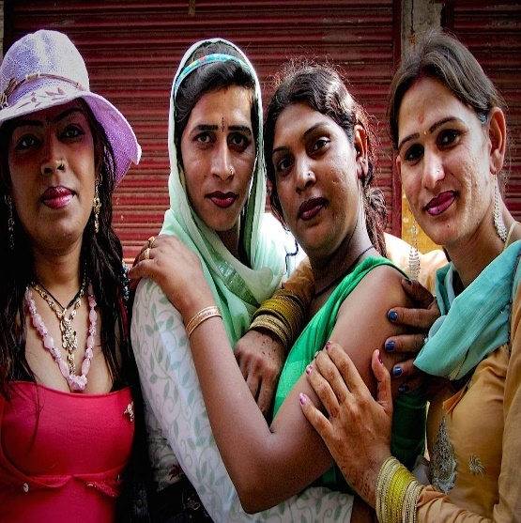
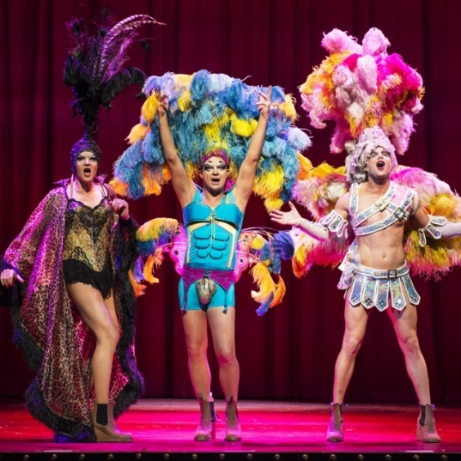
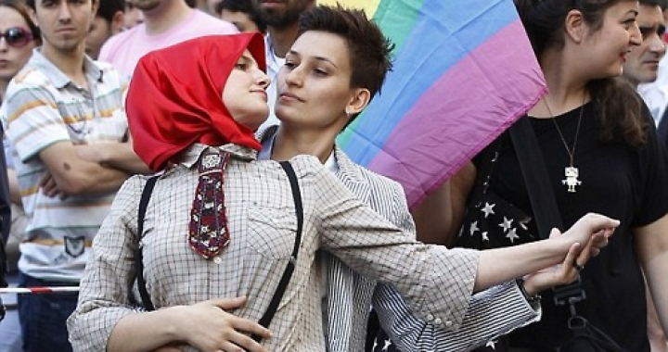
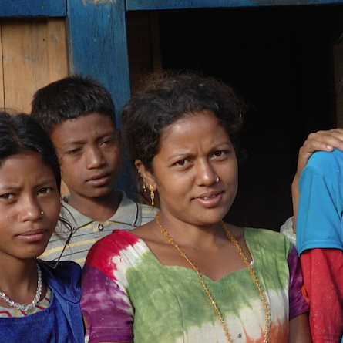
Despite media optics that would have us think otherwise…
LGBTQ+ people are
Diverse
© 2020 Global Citizen, LLC for use by Pride in the Triangle

Slide 18
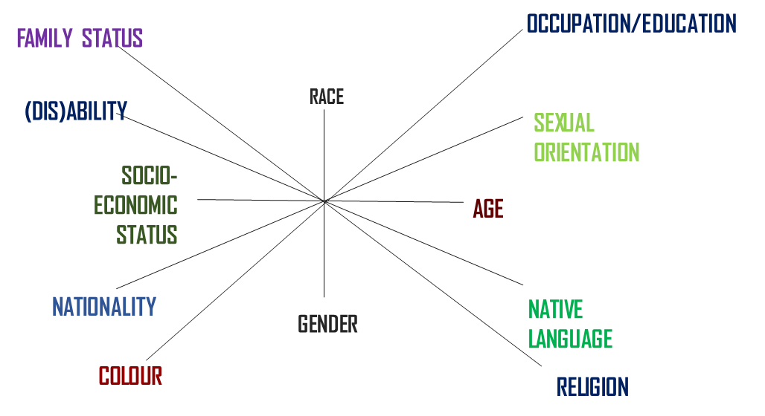
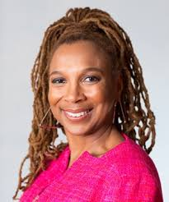
Intersectionality
A framework for conceptualizing a person, group of people, or social issue that takes into account people’s complex, overlapping identities and relative power, privilege, and marginalization to gain a more nuanced understanding of their lived experiences and needs.
A critical approach to equity, diversity, and inclusion.
Adapted from Kimberlé Williams Crenshaw
© 2018 Global Citizen, LLC
© 2020 Global Citizen, LLC for use by Pride in the Triangle
Kimberlé Williams Crenshaw

Slide 19
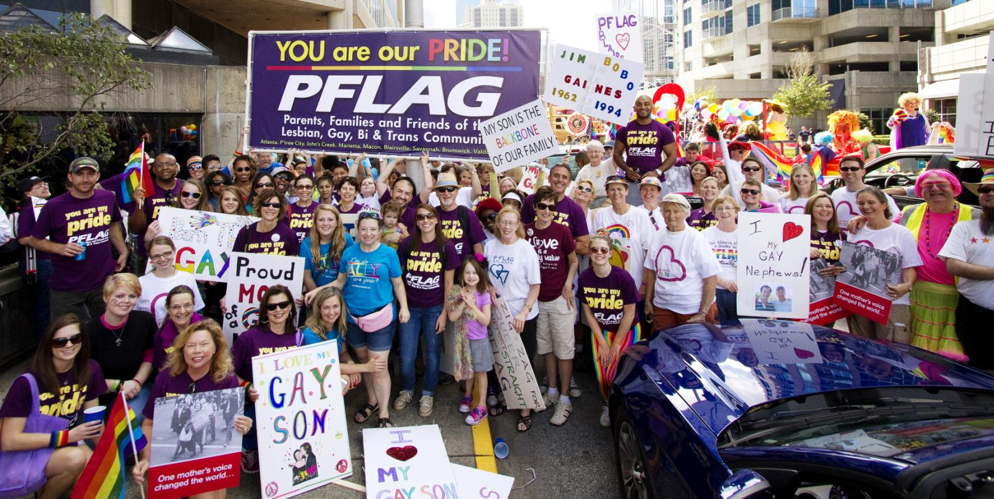
Ally
Ally: A person with relative privilege and power who builds trusting relationships and acts in solidarity and with accountability to people and/or groups with marginalized identities without detracting from their power and voices.
© 2018 Global Citizen, LLC
© 2020 Global Citizen, LLC for use by Pride in the Triangle

Slide 20
Summary and Next Section: Business Case
© 2020 Pride in the Triangle

