Slide 1
Business Case for LGBTQ+ Workplace Equity

Slide 2
Business Case for LGBQ+ Workplace Equity
Purpose:
To understand why there is a particular focus on LGBTQ+ people in the workplace.
To understand the compelling business case for LGBTQ+ inclusion and equity in the workplace.
To be able to articulate the business case to others.
© 2020 Pride in the Triangle

Slide 3
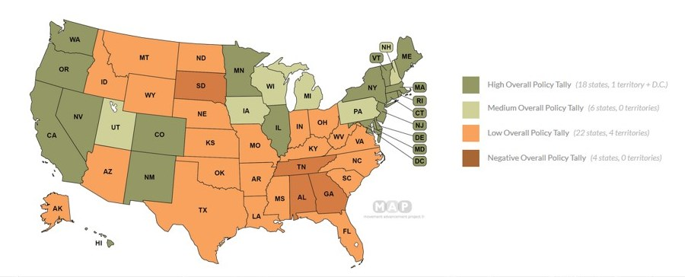
LGBTQ+ People Can be Fired for “No Cause”
There is no US federal legislation that protects employment of LGBTQ people.
In a majority of US states, you can be fired for being LGBTQ.
Source: MAP (Movement Advancement Project)
© 2020 Pride in the Triangle

Slide 4
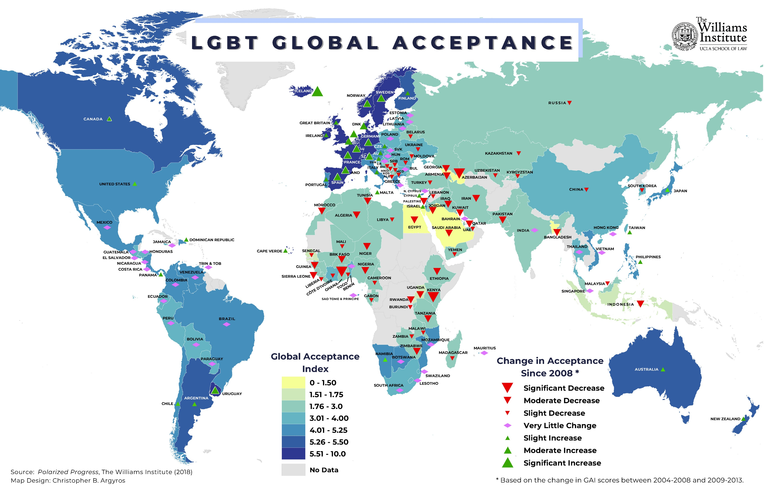
Global View of LGBTQ+ Equality
© 2020 Pride in the Triangle
Source: The Williams Institute

Slide 5
Challenges in the Workplace
Typical challenges faced by LGBTQ+ people in the workplace:
Being fired for being LGBTQ+ instead of for performance or action-based reasons.
Avoidance or ostracizing by team members.
Impact on work assignments, performance evaluations or promotions by management.
Stress and negative impact on engagement due to “covering.”
Inequality of benefits or lack of recognition of family.
© 2020 Pride in the Triangle

Slide 6
Business Case for LGBQ+ Workplace Equity
LGBTQ+ equity in organizations matters strategically for:
Recruiting
Retention & Performance
Diversity of Ideas & Talent
Marketing / Sales / Customer Service
Social Responsibility & Community Reputation
Diversity – the bridge between the workplace and the marketplace
© 2020 Pride in the Triangle

Slide 7
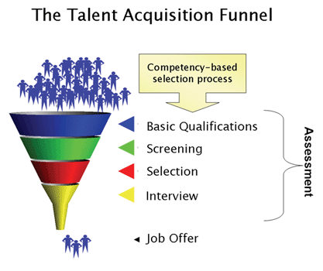
Recruiting
Recruiting the best
Corporate Social Responsibility - benchmark
Criteria for LGBTQ+ Employees
Reputation
Corporate Equality Index (CEI)
Benefit Package: DP benefits and Transgender Health benefits
“Litmus test” for prospective employees who value diversity
© 2020 Pride in the Triangle
Graphic from Out & Equal Workplace Advocates

Slide 8
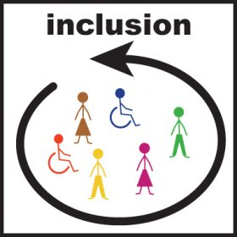
Retention and Performance
Leaving a job
#1 reason to leave: negative relationship
Replacement employee costs up to 150% of annual salary
Successful Performers:
Are in the right job – right skills, talents & interests
Understand the organization’s mission/values
Are valued for their unique contributions on the team
Bring their whole selves to work every day
Focused on their job, not workplace distractions
Goal is 100% engaged at work
© 2020 Pride in the Triangle

Slide 9
Diversity of Ideas and Talent
The most successful organizations are:
Diverse and inclusive
Team oriented
Goal focused
Diversity brings
More new ideas for products, services, solutions
Awareness of LGBTQ+ consumer/client needs
Higher productivity when 100% engaged
© 2020 Pride in the Triangle

Slide 10
Marketing/Sales/Customer Service
(for profit companies)
LGBTQ+ consumers and decision makers - a target market
Checking companies out
Evaluate vendors prior to purchasing
Look for visible presence in ads/online
Use HRC Buying for Equality annual guide
Potential customers
Opportunity to expand market
Sensitive to customer service response
Support LGBTQ+ visible brands
US Federal Government Contracting requirement (updates to executive orders 11478 and 11246)
In addition, don’t forget LGBTQ+ decision makers and procurement professionals in B2B businesses!
© 2020 Pride in the Triangle

Slide 11
Marketing/Sales/Customer Service
(for non-profit companies and governmental agencies)
Most nonprofit organizations have a mandate to serve diverse communities
Governmental agencies must serve the entire diverse population
LGBTQ+ pay taxes like everyone else and should receive equal treatment
Many cities, countries, states include LGBTQ+ in their services nondiscrimination policies
Need to understand the particular needs to the LGBTQ+ community
© 2020 Pride in the Triangle

Slide 12
Community Reputation
More than your products and services: most consumers expect organizations to support their communities
Example: Where do you stand on
Environment
Global economics
Supporting emerging groups
Ethics & fair policies
Opportunity to impact in a positive way for change
Identify ways to get involved in LGBTQ+ equality
© 2020 Pride in the Triangle

Slide 13
Financial Business Case
(for-profit companies)
Example: executing a comprehensive LGBTQ+ diversity initiative in a company with 2,000 employees, average annual salary $50,000, $400M annual revenue
If 6% of your employees are LGBTQ+ and the initiatives make them 5% more productive: Productivity gain: $300,000 (2,000 x .06 x .05 x $50,000)
If 6% of your employees are LGBTQ+ and the initiative can keep 5% of them from departing, the savings in recruiting / training new employees (assume cost is 80% of a year’s of salary): Potential savings: $240,000 (2,000 x .06 x .05 x $50,000 x .8)
If 6% of your sales revenue comes from the LGBTQ+ constituency and these efforts can drive just a 5% increase in sales to that segment: Potential additional revenue: $1.2M ($400,000,000 x .06 x .05)
Additional Benefits:
Higher employee morale
Easier to recruit top talent – word spreads, become the “employer of choice.”
Community good will
© 2020 Total Engagement Consulting by Kimer, Inc. for use by Pride in the Triangle

Slide 14
Financial Business Case
(for nonprofit companies and governmental agencies)
Example: executing a comprehensive LGBTQ+ diversity initiative in a company with 2,000 employees, average annual salary $50,000, $400M annual revenue
If 6% of your employees are LGBTQ+ and the initiatives make them 5% more productive: Productivity gain: $300,000 (2,000 x .06 x .05 x $50,000)
If 6% of your employees are LGBTQ+ and the initiative can keep 5% of them from departing, the savings in recruiting / training new employees (assume cost is 80% of a year’s of salary): Potential savings: $240,000 (2,000 x .06 x .05 x $50,000 x .8)
Additional Benefits:
Higher employee morale
Easier to recruit top talent – word spreads, become the “employer of choice.”
Community good will
© 2020 Total Engagement Consulting by Kimer, Inc. for use by Pride in the Triangle

Slide 15
Next Section: Unconscious Bias and Solidarity
© 2020 Pride in the Triangle

