Slide 1
Unconscious Bias and Solidarity

Slide 2
Unconscious Bias and Solidarity
Purpose:
To learn how people may be excluding or not supporting LGBTQ+ coworkers due to unconscious bias
The purpose is not to shame and blame colleagues
To build and demonstrate strong solidarity with LGBTQ+ employees and communities and engage as effective allies.
© 2020 Pride in the Triangle

Slide 3
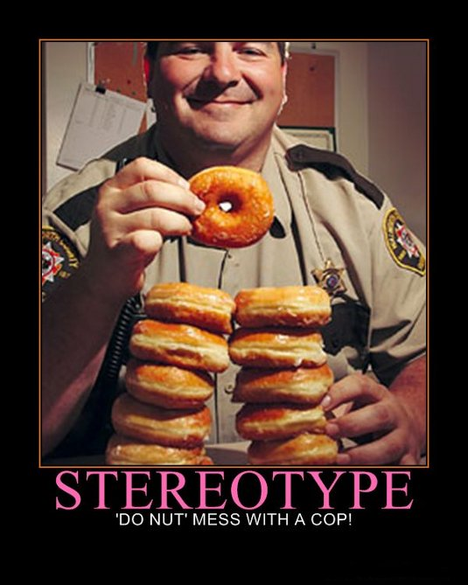
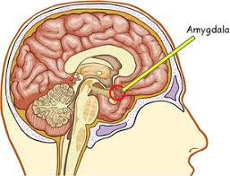
Unconscious Bias and Stereotyping
Unconscious Bias and Stereotyping: frequent inhibitors to full inclusion and belonging, including with LGBTQ+ people
Unconscious Bias: attitudes or stereotypes that affect our understanding, actions, and decisions in an unconscious manner.
A stereotype: a preconceived, standardized, group-shared idea about the alleged essential nature of a whole category of persons without regard to individual differences within the category
© 2020 Pride in the Triangle

Slide 4
What is Unconscious Bias?
The vast body of research on unconscious bias, also known as implicit or hidden bias, shows that:
Many of our behaviors are rooted in the unconscious mind.
Unconscious biases form the basis of a great deal of our behavior patterns about diversity.
Unconscious biases are pervasive.
Unconscious biases have real-world impact on our behavior.
Our unconscious biases may not align with our proclaimed beliefs
Material from the National Diversity Council DiversityFIRST Certification Program
© 2020 Pride in the Triangle

Slide 5
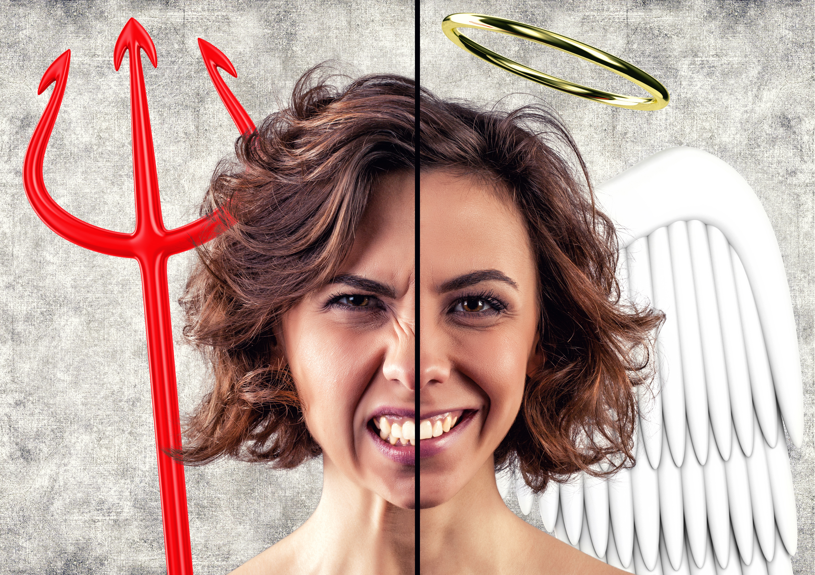
Ways Unconscious Bias is Manifested
Affinity bias
Halo effect / Pitchfork effect
Confirmation bias
Performance attribution
Group think
Microaggressions (also called microinequities): Brief, commonplace verbal, behavioral, and/or environmental slights, indignities, and insults, whether unintentional or intentional, that communicate negative perceptions about someone based solely on their socially-marginalized group membership.
© 2020 Pride in the Triangle

Slide 6
LGBTQ+ Microaggressions - Examples
Calling someone’s spouse or significant other “roommate,” “friend,” or some other term other than what they use.
Repeatedly referring to a transgender or gender-fluid person by the wrong pronoun even after being corrected.
Doing the “limp wrist” movement when talking about a gay man.
Issuing event invitations that include husbands and wives versus gender-neutral language like “spouses and partners”
Not including a trans person in group activities with others of their same gender identity.
Assuming everyone is straight and/or cisgender in a group discussion.
What are other examples?
© 2020 Total Engagement Consulting by Kimer, Inc. for use by Pride in the Triangle

Slide 7
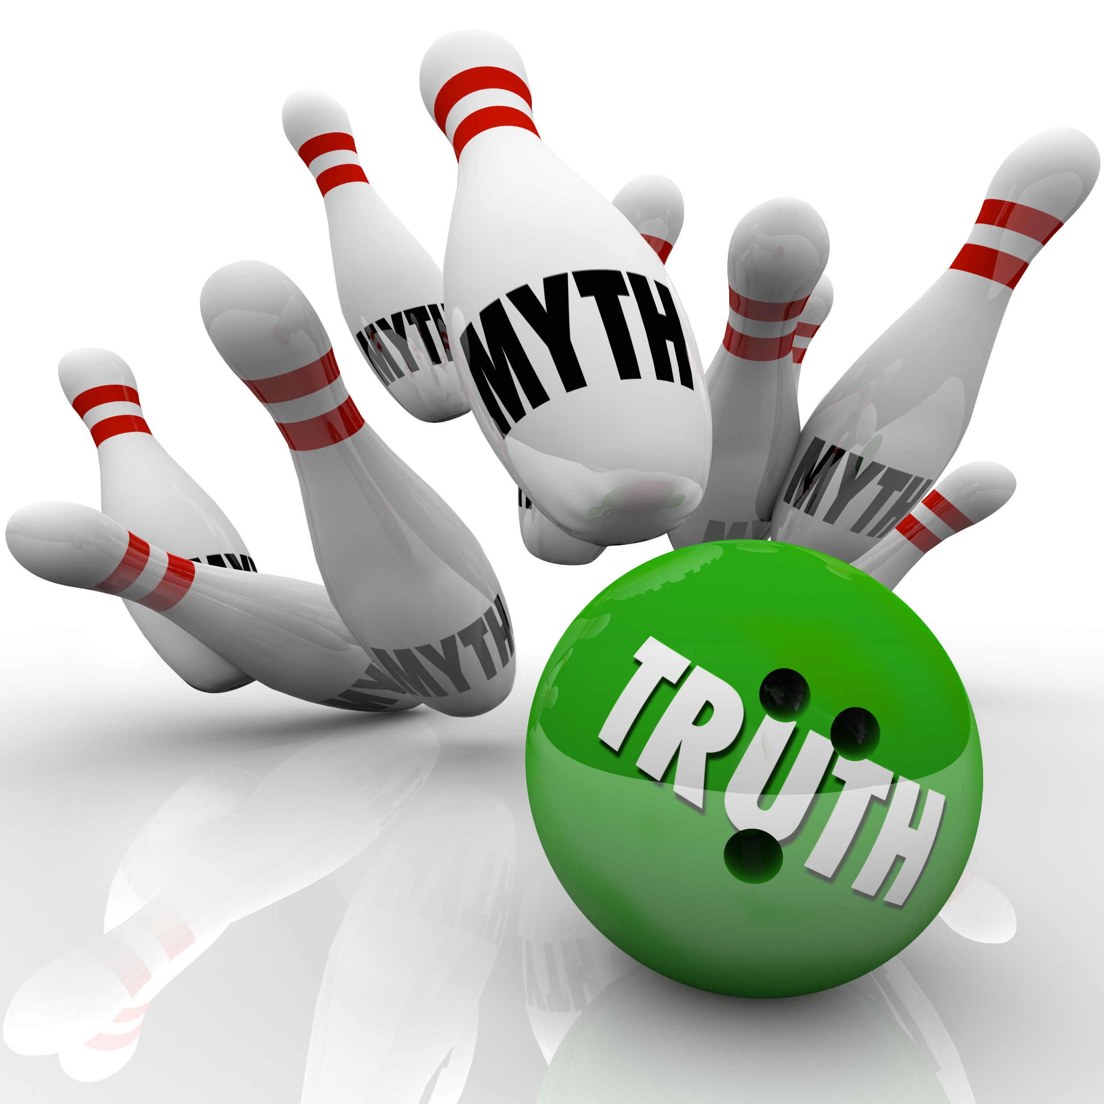
Deeper Look at Stereotyping
Since unchecked unconscious bias leads to stereotyping, let’s take a deeper look at stereotyping
Stereotypes can be harmful when we:
Place people in the wrong group
Incorrectly describe the group norm
Inappropriately evaluate the group
Confuse the stereotype with the individual
Fail to interrupt the stereotype
Act on stereotypes as though they are true
© 2020 Pride in the Triangle

Slide 8
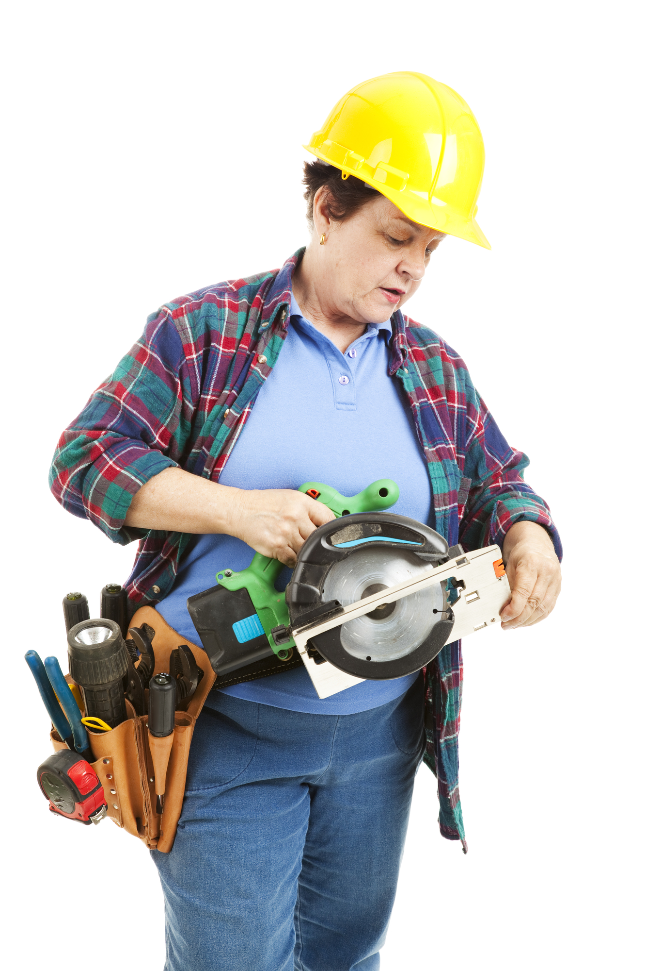
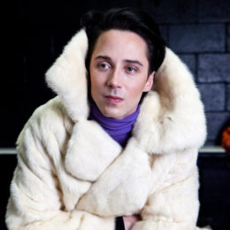
Stereotypes and Misperceptions of LGBTQ+ People
Photo from Johnny Weir’s “To Russia with Love” photo shoot
© 2020 Pride in the Triangle

Slide 9
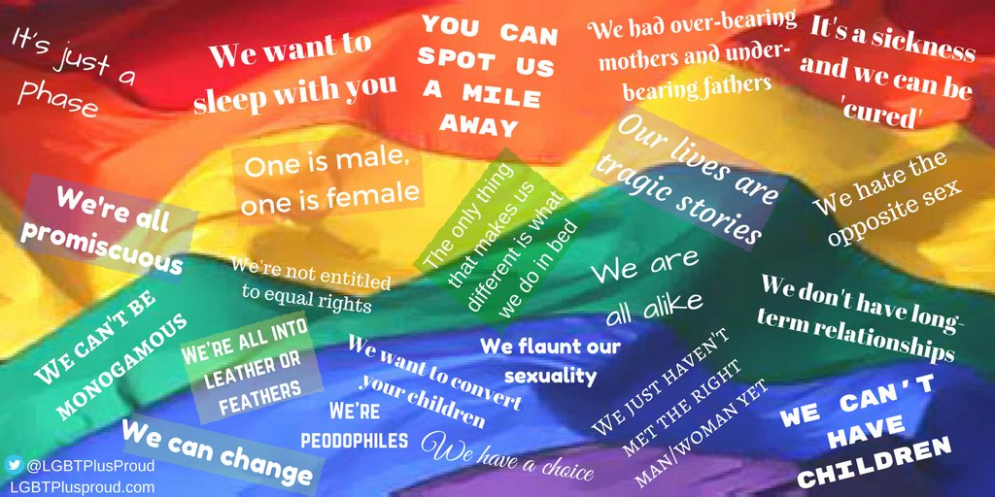
Myths and Misperceptions
These are some stereotypes, myths, and misperceptions about LGBTQ+ people.
© 2020 Pride in the Triangle
Notes:
Graphic: lgbtmyths on Twitter

Slide 10
Levels of Support and Allyship
Hostile
Neutral
Tolerant
Affirming
Advocating
© 2020 Global Citizen, LLC for use by Pride in the Triangle

Slide 11
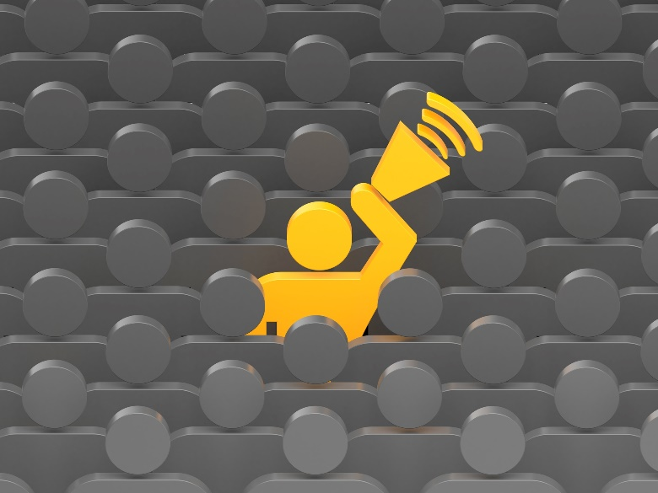
Solidarity: Being an Ally
Allies believe that all people, regardless of sexual orientation, gender identity, and gender expression, should be treated equally with dignity and respect
An ally is not expected to have all the answers to LGBTQ+ issues, but maintains a commitment to learning and educating others to foster an inclusive environment for all
Source: Simma Lieberman, The Inclusionist
© Pride in the Triangle 2019
© 2020 Pride in the Triangle

Slide 12
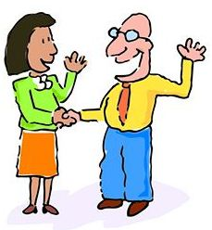
Taking Action as an Ally
Workplace leaders set an example and model the behavior
Hear a joke about LGBTQ+ people or any other group – intervene!
Zero tolerance for harassment, discrimination, and any other anti-LGBTQ+ behavior
Source: Simma Lieberman, The Inclusionist
Our allies are very important, and we thank you for being here and standing with us!
© 2020 Pride in the Triangle

Slide 13
Do a Self Check
If someone were to come out to you as LGBTQ+, what would your first thought be?
How would you feel if your child came out to you as LGBTQ+? Or a sibling or close cousin?
How would you feel about seeing a health care provider you believed was your gender and LGBTQ+?
Have you ever been to an LGBTQ+ social event or public march?
Can you think of three historical figures who were lesbian, gay or bisexual?
Can you think of three historical figures who were transgender?
Can you think of three historical figures who were LGBTQ+ people of color?
Have you ever laughed at or made a joke at the expense of LGBTQ+ people?
Have you ever stood up for an LGBTQ+ person who was being harassed? Why or why not?
If you do not identify as LGBTQ+, how would you feel if people thought you were LGBTQ+?
Adapted from: GLSEN.org
© 2020 Pride in the Triangle

Slide 14
Be an Ally in Action!
Be visible
Educate yourself about available resources online and in the community
Share the resources readily (don’t wait to make them visible until someone comes out to you)
Use inclusive language, examples, and make sure programs are inclusive
Avoid making assumptions about sexual orientation and gender identity based on someone’s gender expression
Attend and support LGBTQ+ events
Source: GLSEN.org
© 2020 Pride in the Triangle

Slide 15
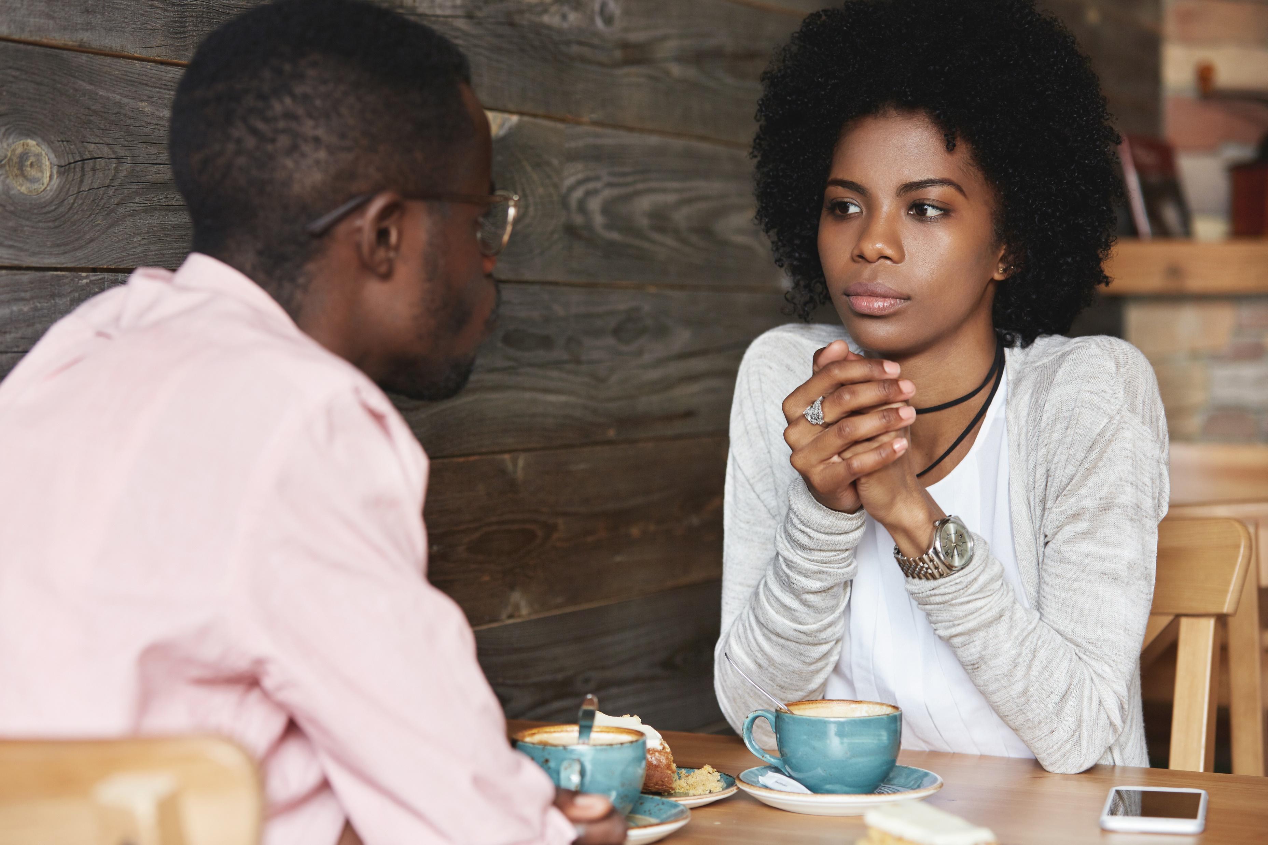
Having Challenging Conversations
As an ally, you may at times need to have some tough conversations with people who may not agree with or understand LGBTQ+ respect and equality
Do not do it when you are angry, as it could be seen as lashing out.
Be gentle and vulnerable.
Be relatable by sharing a personal story.
Do not expect immediate agreement. Someone may need time to think about it.
Tie to the business. “This is best for the business and for your own professional growth.”
© 2020 Total Engagement Consulting by Kimer, Inc. for use by Pride in the Triangle

Slide 16
Bystander Intervention
The act of recognizing a potentially harmful interaction or situation for a person from a marginalized identity and choosing to intervene in a way that is intended to positively influence the outcome.
©2019 Global Citizen, LLC for use by Pride in the Triangle

Slide 17
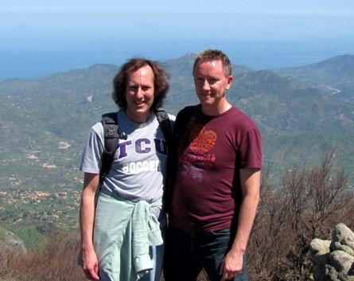
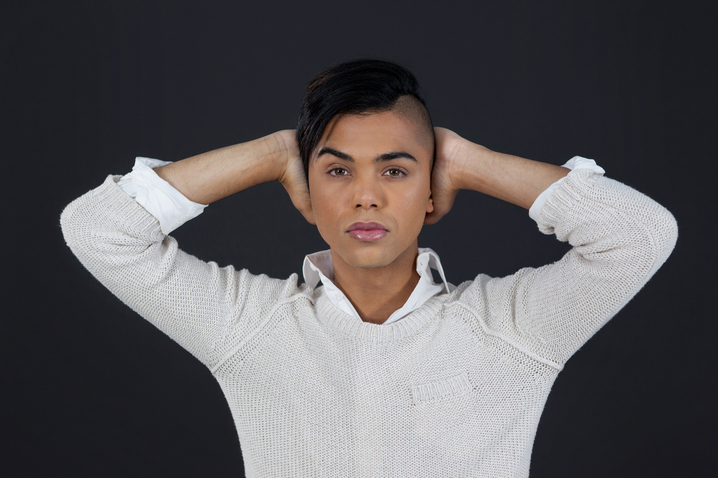
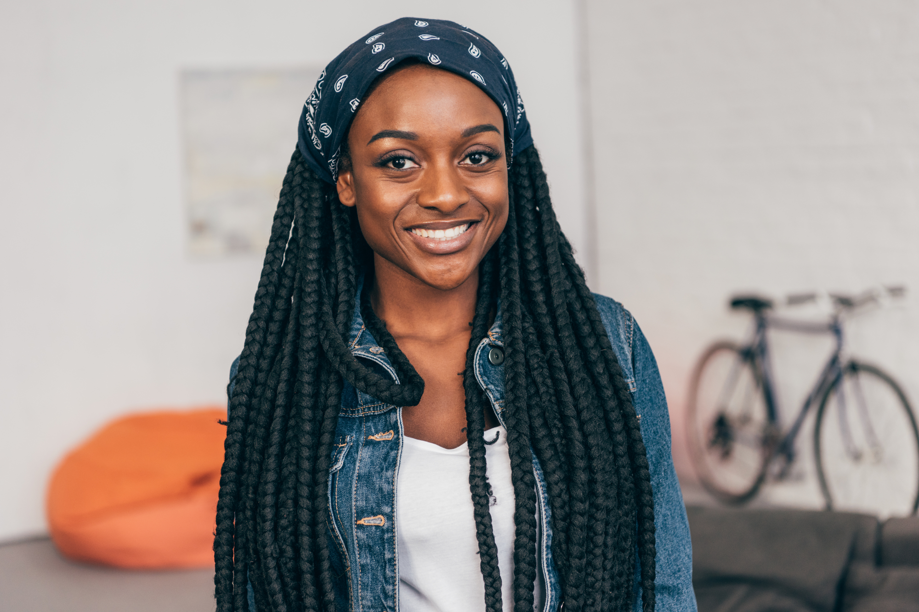
Challenging Conversations: Let’s Practice
Three roles:
the commenter
the responder
the observer
© 2020 Pride in the Triangle

Slide 18
Be an Ally to Trans People
Call them by their name and use their gender pronoun – normally the gender they are “presenting” in. Ask if you’re unsure.
Recognize that we all make mistakes.
Include them fully in all corporate and everyday social activities. Invite them to lunch and breaks as usual.
Continue to use the same professional treatment. This person still has the same valuable skills and expertise / or is a paying customer
Be an up-stander, not a by-stander
Be genuinely kind and personable
© 2020 Pride in the Triangle

Slide 19
Names and Pronouns
Mistakes with names and pronouns are something trans people expect to have to deal with, unfortunately.
When you make a mistake, apologize, correct yourself, and move on.
If you have difficulty remembering their correct pronouns, practice before seeing the person.
Even if you are not doing it intentionally and the trans person knows this, it is still painful
They / them / theirs
She / her / hers
He / him / his
Thank you to Ames Simmons, Equality North Carolina, for these points.
© 2020 Pride in the Triangle

Slide 20
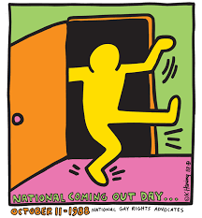
What if Someone Comes Out to You?
Offer support but don’t assume they need help
Don’t overdo your reaction as that could be embarrassing to LGBTQ+ people.
Be a role model of acceptance
Appreciate the person’s courage
Listen! Listen! Listen!
Assure and respect confidentiality
Ask questions that demonstrate your understanding, acceptance, compassion:
Have you been able to tell anyone else?
Has this been a secret you have had to keep from others, or have you told other people?
Do you feel safe here? Supported by your fellow employees and the leadership?
Do you need help of any kind? Resources or someone to listen?
Have I ever offended you unknowingly?
Source: GLSEN.org
© 2020 Pride in the Triangle
Prideinthetriangle.org

Slide 21
What Not to Say
What not to say when a someone comes out to you:
“I knew it! I thought so!”
(This makes it about you, not them)
“Are you sure? Maybe it’s just a phase. It will pass.”
(This assumes the person does not know who they are)
“You just haven’t found a good woman/man.”
(This assumes everyone is straight or should be)
“Shhh, don’t tell anyone”
(This assumes there is something bad about being LGBTQ+)
Source: GLSEN.org
© 2020 Pride in the Triangle

Slide 22
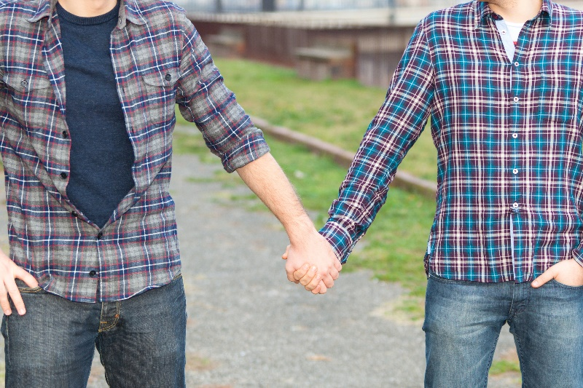
Responding to Anti-LGBTQ+ Behavior
How to respond to anti-LGBTQ+ behavior:
Address the name-calling, bullying, and harassment immediately
Name the behavior: describe what you saw and that it is unacceptable
Use it as a teachable moment (or create one)
Support the targeted person
Hold others accountable
Source: GLSEN.org
© 2020 Pride in the Triangle

Slide 23
Summary
We should recognize that unconscious bias exists in everyone, and we should identify and mitigate it.
Being a strong ally is one of the most important steps you can take in supporting the LGBTQ+ community and will be much appreciated.
Consider what steps you can take to better engage your circle in meaningful discussions about LGBTQ+ people, including in the workplace.
© 2020 Pride in the Triangle

Slide 24
Next Section: Case Studies
© 2020 Pride in the Triangle

