Slide 1
Case Studies
© 2020 Pride in the Triangle
www.prideinthetriangle.org

Slide 2
Purpose
The purpose of this section is for participants to apply their knowledge to reality-based case studies involving LGBTQ+ people and, based on their role in their company, develop effective responses to create a more inclusive and equitable workplace.
© 2020 Global Citizen, LLC for use by Pride in the Triangle

Slide 3
Case Studies: Instructions
In small groups:
Read the selected case study
Discuss and answer the questions:
What are the particular concerns for LGBTQ+ employees?
What initial steps should company leaders take to address these concerns?
What can you do in your current company role to support LGBTQ+ employees and create a more inclusive and equitable workplace?
Prepare your report out
© 2020 Global Citizen, LLC for use by Pride in the Triangle

Slide 4
Case 1: Employee Discrimination
Over the past year, numerous LGBTQ+ employees have registered anonymous complaints about feeling excluded as well as experiencing microaggressions and perceived discrimination by their coworkers, including supervisors.
© 2020 Global Citizen, LLC for use by Pride in the Triangle

Slide 5
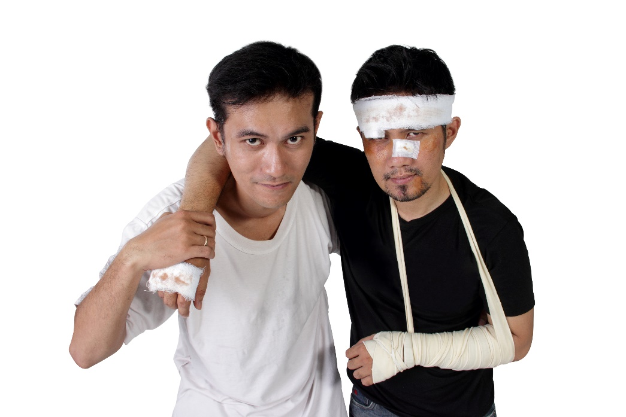
Case 2: Policies and Procedures
Several LGBTQ+ employees have raised concerns with Human Resources that the company’s benefits package discriminates against LGBTQ+ employees because it does not equitably cover same-gender partners and family members not related by marriage or biology, such as their partner’s children by a previous relationship.
© 2020 Global Citizen, LLC for use by Pride in the Triangle

Slide 6
Case 3: Partners and Vendors
Recently, several of your company’s partners and vendors have been featured in the news for their opposition to LGBTQ+ people’s rights. Some LGBTQ+ employees and customers have asked company leaders to stop doing business with them.
x
© 2020 Global Citizen, LLC for use by Pride in the Triangle

Slide 7
Case 4: Client Relations
A leader at one of your company’s largest clients recently complained to your company’s CEO about the team assigned to them because it included LGBTQ+ people who made them “feel uncomfortable.”
© 2020 Global Citizen, LLC for use by Pride in the Triangle

Slide 8
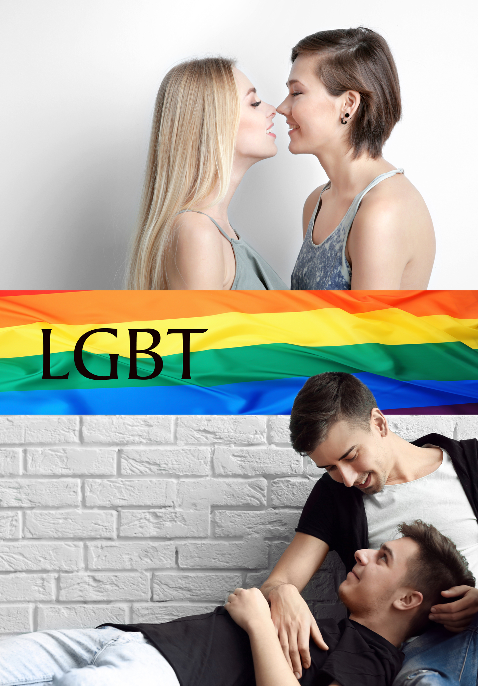
Case 5: Branding and Marketing
Your company’s website and marketing materials include information about your progressive polices on sexual orientation and gender identity and expression and images of same-gender couples. Recently, several anti-LGBTQ+ organizations with considerable influence have complained to your CEO and threatened to mount a boycott against your company unless you retract them.
© 2020 Global Citizen, LLC for use by Pride in the Triangle

Slide 9
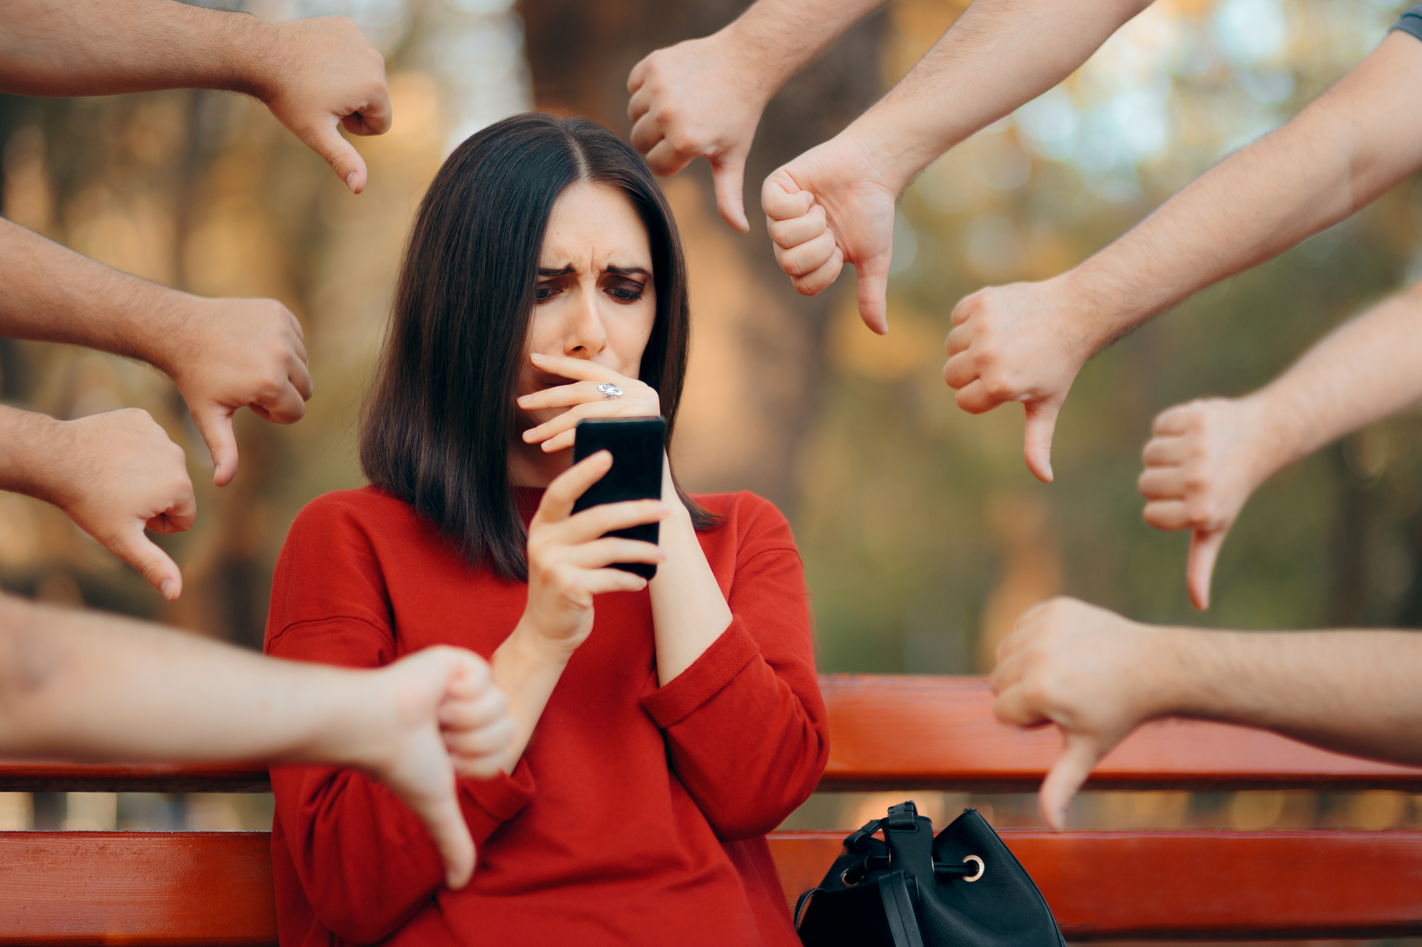
Case 6: Cultural Context
Your company recently formed Pride (LGBTQ+) employee resource groups (ERGs) in several socially-conservative settings. One of the Pride ERG chairs, a lesbian, was outed to her family and community by a local reporter when they aired her interview about the Pride ERG. She is now being harassed and threatened by some of her neighbors and on social media.
© 2020 Global Citizen, LLC for use by Pride in the Triangle

Slide 10
Case 7: Recruiting and Hiring
Several different employees have complained to your company’s Human Resources department about losing out on qualified candidates who were repeatedly addressed by the incorrect gender during the screening and interviewing process and subsequently withdrew their applications.
© 2020 Global Citizen, LLC for use by Pride in the Triangle

Slide 11
Next Section: Commitments
© 2020 Pride in the Triangle

