Slide 1
Commitments,
Action Steps, and Closure
www.prideinthetriangle.org

Slide 2
Commitment: Workplace Inclusion and Equity
By ________________ [date], in my current role, I commit to do the following to advance LGBTQ+ inclusion and equity in my workplace.
© 2020 Pride in the Triangle

Slide 3
Action Steps
I will take the following 3-5 action steps to follow through on my commitment to advance LGBTQ+ inclusion and equity in my workplace.
© 2020 Pride in the Triangle

Slide 4
Meeting with Accountability Partner
Accountability partners set a follow-up meeting date and plan for how you will support each other in following through with your commitments.
© 2020 Pride in the Triangle

Slide 5
Summary
© 2020 Pride in the Triangle

Slide 6
Evaluation
© 2020 Pride in the Triangle

Slide 7
Closure
© 2020 Pride in the Triangle

Slide 8
Thank You
for Your Participation!
The photographs used in this presentation are for illustrative purposes only. They do not imply any particular attitudes, behaviors, or actions on the part of the any person who appears in the photographs.
© 2020 Pride in the Triangle

Slide 9
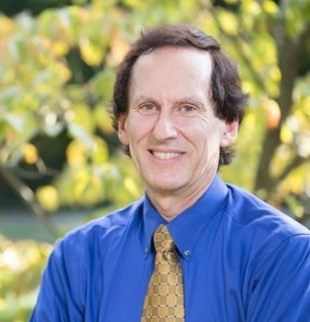
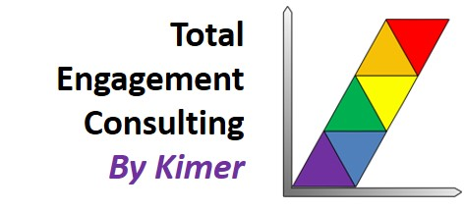
Meet Your Toolkit Authors
Katherine Turner, President, Global Citizen, LLC
Email: katherine@globalcitizenllc.com
Website: www.globalcitizenllc.com
Facebook: www.facebook.com/GlobalCitizenLLC/
Twitter: @GlobalCitizenKT
LinkedIn: www.linkedin.com/in/katherineturnergc/
Stan Kimer, President, Total Engagement Consulting by Kimer
Email: stan@totalengagementconsulting.com
Website: www.totalengagementconsulting.com
Facebook: www.facebook.com/Total-Engagement-Consulting-by-Kimer-Inc/ LinkedIn: www.linkedin.com/in/stankimer/
Working in collaboration with: Prideinthetriangle.org
© 2020 Pride in the Triangle

Slide 10
Toolkit License and Citation
This Toolkit was licensed on May 4, 2020 under a Creative Commons attribution 4.0 international license. Please use freely, cite the source, and refer to the adaptation guidance on page 5 of the Facilitator’s Guide.
The terms of this license are as follows:
Attribution: You must give appropriate credit, provide a link to the license, and indicate if changes were made. You may do so in any reasonable manner, but not in any way that suggests the licensor endorses you or your use.
Non-commercial: You may not use the material for commercial purposes.
No derivatives: If you remix, transform, or build upon the material, you may not distribute the modified material.
The Facilitator’s Guide and Participant’s Guide are distributed in pdf format and are not intended to be adapted. The PowerPoint presentation and Training and Planning Supporting Documents are intended to be customized with organization-specific information. Please cite the source.
© 2020 Pride in the Triangle

