Slide 1
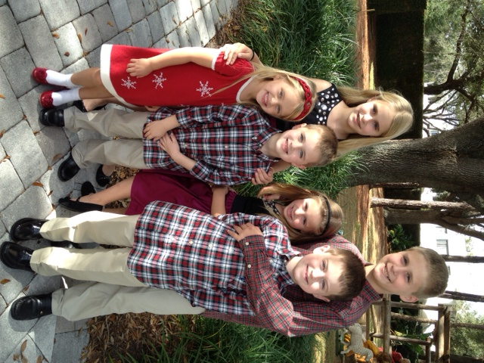
Pediatric Jeopardy
Created by Deb and Christy Tauber 4/2012

Slide 2
Risky Business | “Hark! What sound is that?” | “That didn’t hurt” | Communication Conundrums
100 | 100 | 100 | 100
200 | 200 | 200 | 200
300 | 300 | 300 | 300
400 | 400 | 400 | 400

Slide 3
Risky Business for 100 points
Demonstrate how you can you quickly determine the correct size Endotracheal tube and other resuscitation equipment for Annie

Slide 4
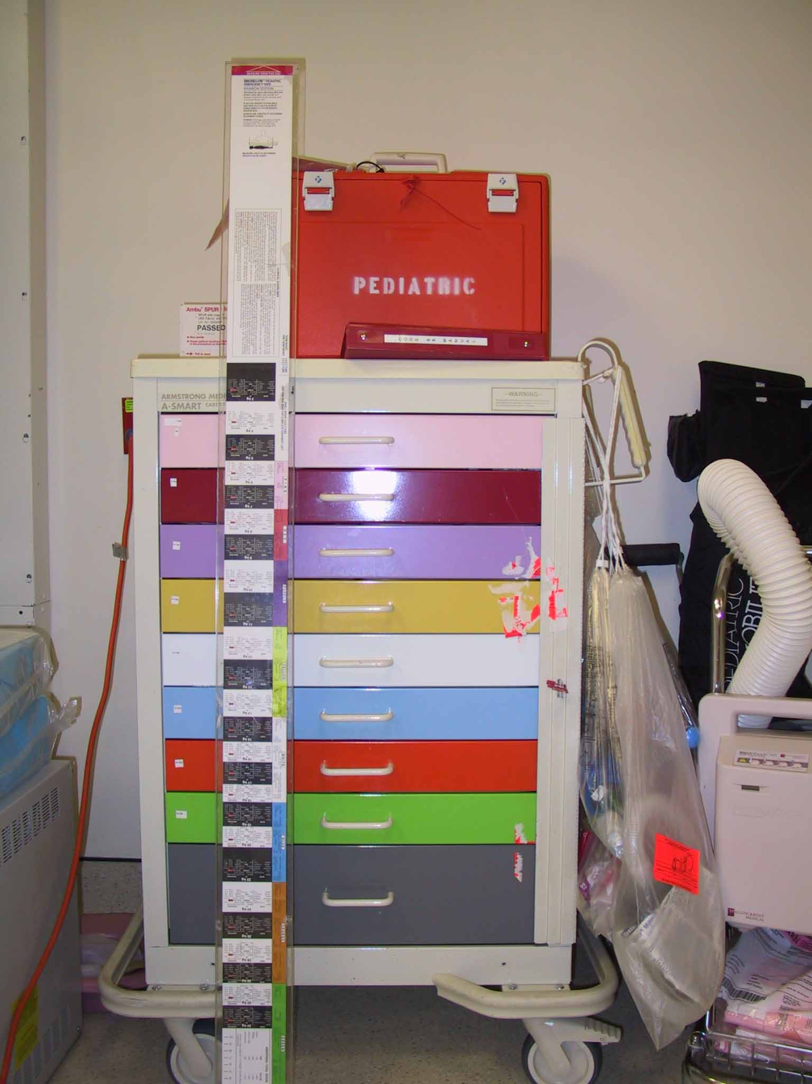
What is the Broselow Tape

Slide 5
Risky Business for 200 points
In this game, pre-teens and teens try to strangulate each other to get a brief high

Slide 6
What is the Choking Game
Also called: space monkey, fainting, pass-out game, black-out game, American dream, flatliner, space cowboy, knock out, gasp, rising sun or airplaining.
http://www.youtube.com/watch?v=gwc5kCAP8fU
According to one website, more than 50 children nationally, have lost their lives to the choking game in one year alone. Symptoms of this dangerous activity. Watch for the following:
Unexplained marks or bruises on the throat
Frequent or severe headaches
Unexplained cuts or bruises caused by falling
Belts, leashes, ropes or shoelaces tied in strange knots or found in unusual locations

Slide 7
Risky Business for 300 points
In this game teens bring medications from their home and pour them in a bowl and each take some.

Slide 8

What is a Pharm Party

Slide 9
Risky Business for 400 points
In this game teens scratch letters into each others skin

Slide 10
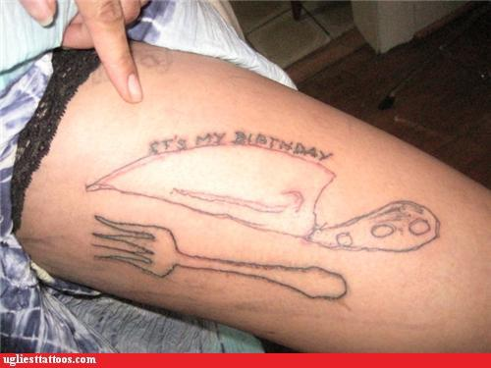
What is the ABC or Scratch Game?

Slide 11
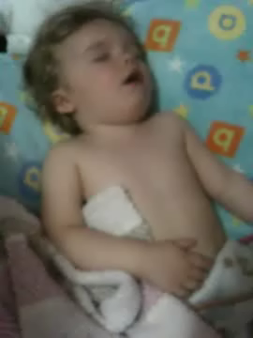
Breath Sounds for 100 points

Slide 12
What is Croup?

Slide 13

Breath Sounds for 200

Slide 14
What is Asthma/Wheezes?

Slide 15

Breath Sounds for 300

Slide 16
What are Rhonchi?

Slide 17
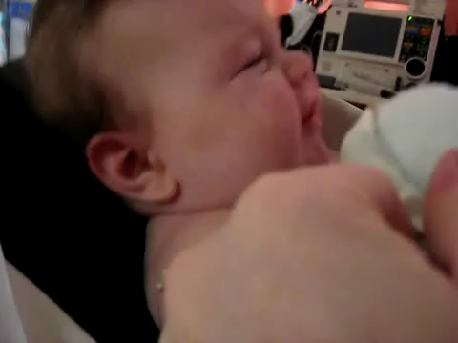
Breath Sounds for 400

Slide 18
What is Stridor?

Slide 19
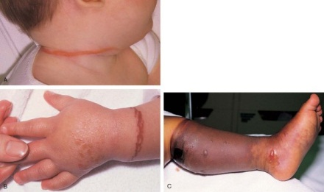
“That didn't hurt” for 100

Slide 20
What is Child Abuse?
Electrical cord around the neck
Inflicted burn to wrist
Circumferential burn to leg

Slide 21
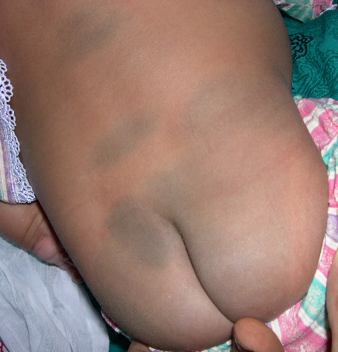
“That didn’t hurt” for 200

Slide 22
What are Mongolian Spots?

Slide 23
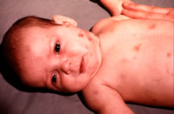
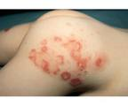
“That didn’t Hurt” for 300

Slide 24
What are cigarette burns?

Slide 25
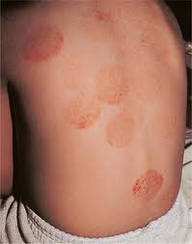
“That didn’t hurt” for 400

Slide 26
What is Cupping?

Slide 27
Communication Conundrums for 100 points
Explain the use of Dye in Testing to children.
Hint:
(they may think they are going to die).

Slide 28
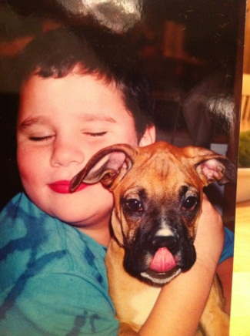
Key communication points
Use kid friendly dialogue
  “We are going to take some pictures of your insides.” (“Test” is a scary word)
  Use words such as “adding some color into your blood”
  “The color in your blood will make it easier for the doctor to see what is going on in the pictures.”

Slide 29
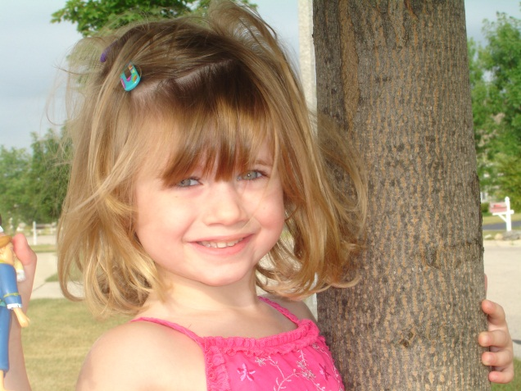
Communication Conundrums for 200 points
                Describe how you can explain to a child you are going to start an intravenous solution for rehydration.

Slide 30
Communication Conundrums for 200
Did you ever see a plant that was really dry?
When you give it some water it perks up?
That is what we are going to do with you, we are going to take one of your branches (point to their veins) and we are going to put a little straw inside of it, (give them an IV plastic catheter)
We are going to fill you all up with water and your are going to feel so much better, it might hurt just a little bit, you will need hold really still and it won’t hurt that much.”

Slide 31
Communication Conundrums for 300 points
Describe giving a “shot” to a child.
Hint:
They may associate gun shots with shot

Slide 32
Key communication points
When discussing administration of an injection tell the child that he or she will feel a small sting like a bee sting and it will hurt just a little bit.
Tell them that they can cry if they want, but if they stay still it will hurt much less.
Let them pick the site when possible and decide who will hold them.

Slide 33
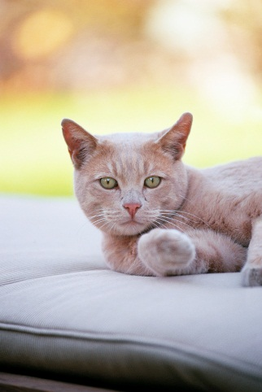
Communication Conundrums for 400 points
Describe the CT (cat) scan process to a child.
Hint:
They may think you are talking about a Cat.

Slide 34
Key communication points
We are going to take some pictures of you with a special camera
It looks like a big tube, almost like one of those slides you go on through, you will need to lie very still so we can all the pictures of your insides when you are in the tube.

