Slide 1
Architectural Enhancement of Bitcoin Core
https://www.youtube.com/watch?v=o97mUQ1y9bg

Slide 2
Architectural Enhancement of Bitcoin Core
Group 20 - GoDaddy
Arsh Kochhar (Proposed Enhancement, Implementation #1)
Brian Cho (Presenter, Abstract, Test Plans #1, Use Cases, Conclusion, Implementation #1)
Julian Wei (Evaluation, Potential Risks, Lessons Learned, Implementation #1)
Junhui Zong (Team Leader, Implementation #2)
Ye Shen (Implementation #2)
Yuchen Li (Presenter, Current State, Implementation #2)

Slide 3
Overview
Proposed Enhancement
Current State of the Architecture
Implementation #1
Implementation #2
Evaluating the Implementations
Potential Risks
Use Cases
Lessons Learned
Conclusion

Slide 4

Proposed Enhancement
The proposed enhancement aims to provide limited access to node services to a subset of peers in the Bitcoin Core network

Slide 5
Proposed Enhancement: Examples of New Services
These restricted services mostly deal with sending sensitive data
  Show keys
  Show bandwidth
  Show balance
  Mining stats
  Show spending

Slide 6
Proposed Enhancement: Applications
Bitcoin inheritance
Backup management

Slide 7
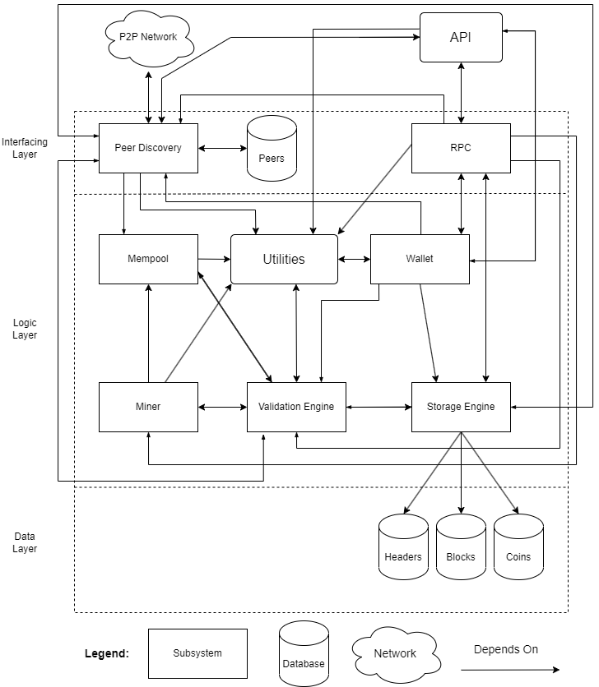
Current Architecture
Has undergone several modifications that enhanced its functionality.
Critical subsystem for enhancement:
  API
  Peer Discovery
  Validation Engine
  RPC

Slide 8
Implementation #1
Generate and share secret keys between two peers via a different platform (e.g. email) and use an authentication mechanism to allow services between those peers
This implementation does not impact the architecture at a high-level

Slide 9
Implementation #1:
Sequence of Actions
The user generates a random ID pair with source and destination IDs as the entries
User sends the ID pair and their public IP address to the peer via a different platform (e.g. email)
Configure the visibility of services for that peer
Before the peer sends a request for the restricted service, Bitcoin Core establishes a secure channel
The peer attaches the ID pair and sends a request. The user uses that ID pair to authenticate the user and provides service

Slide 10
Implementation #1:
Impacted Subsystems
API
  Needs to expose interface for generating ID pair
Validation Engine
  User authentication component will be stored here
Peer Discovery
  Maintains a database for peers who are authorized to use the restricted services. Queries using the ID pair
RPC
  New RPC commands are placed inside whichever RPC file it mostly relates to
  New RPC files can be created if it doesn’t fit into any existing files

Slide 11
Implementation #1:
Stakeholders
Bitcoin Core Users
  Primarily concerned with the security of their sensitive data
  Concerned with the benefits they gain from the new feature
Developers
  Need to ensure the security, as well as maintainability and manageability to allow the feature to expand

Slide 12
Implementation #1:
NFRs for Users
Security
  Users don’t want their bitcoin information to be compromised
Accuracy
  Users expect requests for the restricted service to return accurate results
Performance
  Users don’t want to be kept waiting for their requests to be fulfilled

Slide 13
Implementation #1:
NFRs for Developers
Security
  Developers want to avoid legal actions
Testability
  Developers want to ensure security and correctness
Evolvability
  Developers want to be able to add new services
Maintainability
  Developers want to be able to update or add new services without much rework
Manageability
  Developers want to be able to review logs and analyze security issues

Slide 14
Implementation #1:
Plans for Testing
Infeasible to have someone manually send messages to test feature
  Fake receiving messages by passing the message directly into ProcessMessage()
Peer authentication tests
  New file called peer_authentication.cpp should be placed inside src/test/fuzz
  Attempts requesting service using randomly generated ID pairs
  Attempts requesting service with the correct ID pair
RPC command tests
  Safe RPC commands are inserted inside RPC_COMMANDS_SAFE_FOR_FUZZING inside src/test/fuzz/rpc.cpp

Slide 15
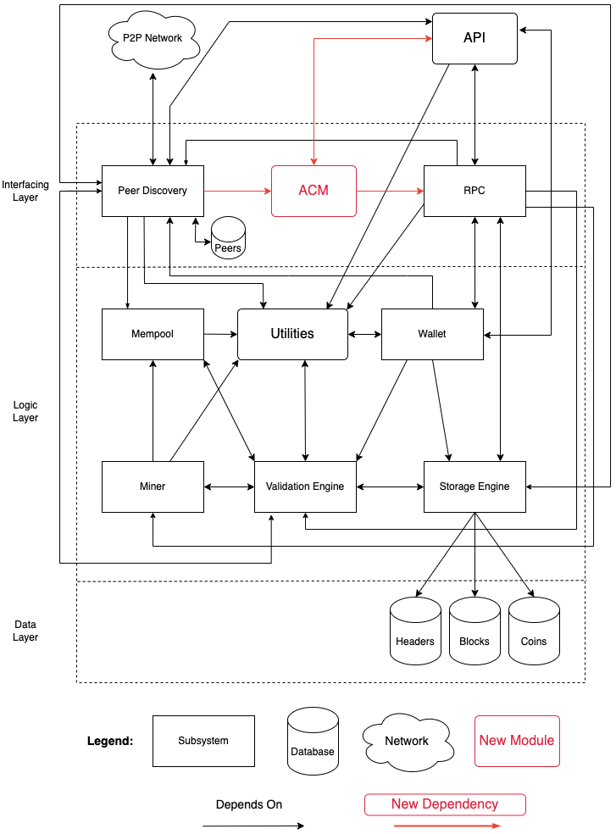
Implementation #2
Create a new module called ACM (Access Control Manager).
Several components that will be impacted by the implementation.

Slide 16
Implementation #2:
Impacted Subsystems
ACM (New Module):
  Works by providing APIs to control access to functionalities to related modules.
API
  Call the appropriate APIs in the ACM module to authenticate and authorize.
Peer Discovery
  Is responsible for discovering and connecting to other peers that can be authenticated by the ACM subsystem.
RPC
  ACM will control who can use RPC commands and what they can do.

Slide 17
Implementation #2:
Stakeholders for the
Proposed Enhancement
Bitcoin Core Users
  Are primarily concerned with the security of their sensitive data
Developers
  Need to ensure the security of the proposed enhancement and consider its maintainability and manageability

Slide 18
Implementation #2:
NFRs for Stakeholders
Bitcoin Core Users
  Security
  Accuracy
  Performance
Developers
  Security
  Testability
  Evolvability
  Maintainability

Slide 19
Implementation #2:
Plan for Testing
Focus:
  Correctness & reliability of acm.cpp & acm.h
Components:
  Authentication, Authorization, Policy Management, Logging
Test cases:
  Normal, Boundary, Error conditions
Framework:
  Google Test (C++)
Goal:
  Solid foundation, works as intended for customers

Slide 20

Evaluating the Implementations
Both implementations have the same NFRs and stakeholders (with manageability being the exception)
Both implementations affect the stakeholders and NFRs in similar ways
Implementation 1 makes no changes to the high-level architecture, whereas implementation 2 adds a new high-level component
Implementation 1 is preferred

Slide 21

Potential Risks
Security
  Use errors
  Compromised privileged peers
  Possible safety nets & checks needed
Performance
  Efficient encryption & decryption algorithms
  Scalability for peer communication traffic
Usability
  Procedure for lost keys
  Key & peer management system
  Options to freeze keys & remove privileged peers

Slide 22
Use Cases
Generating a unique ID pair
Retrieving a peer’s list of transactions

Slide 23
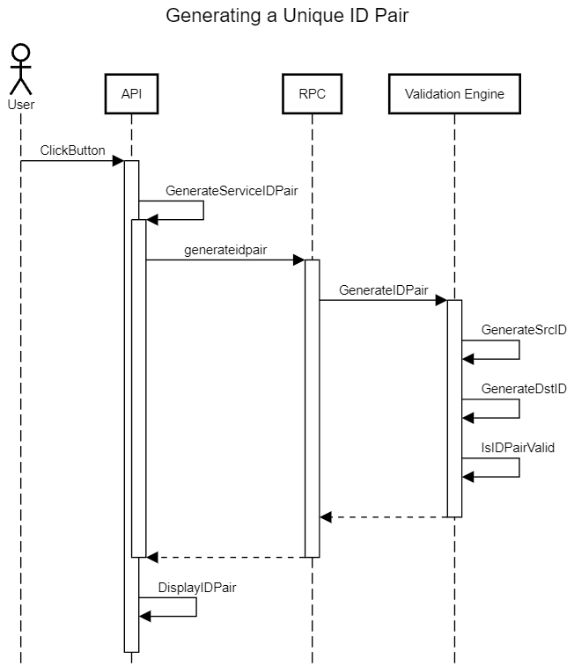
Use Case #1:
Generating a unique ID pair

Slide 25
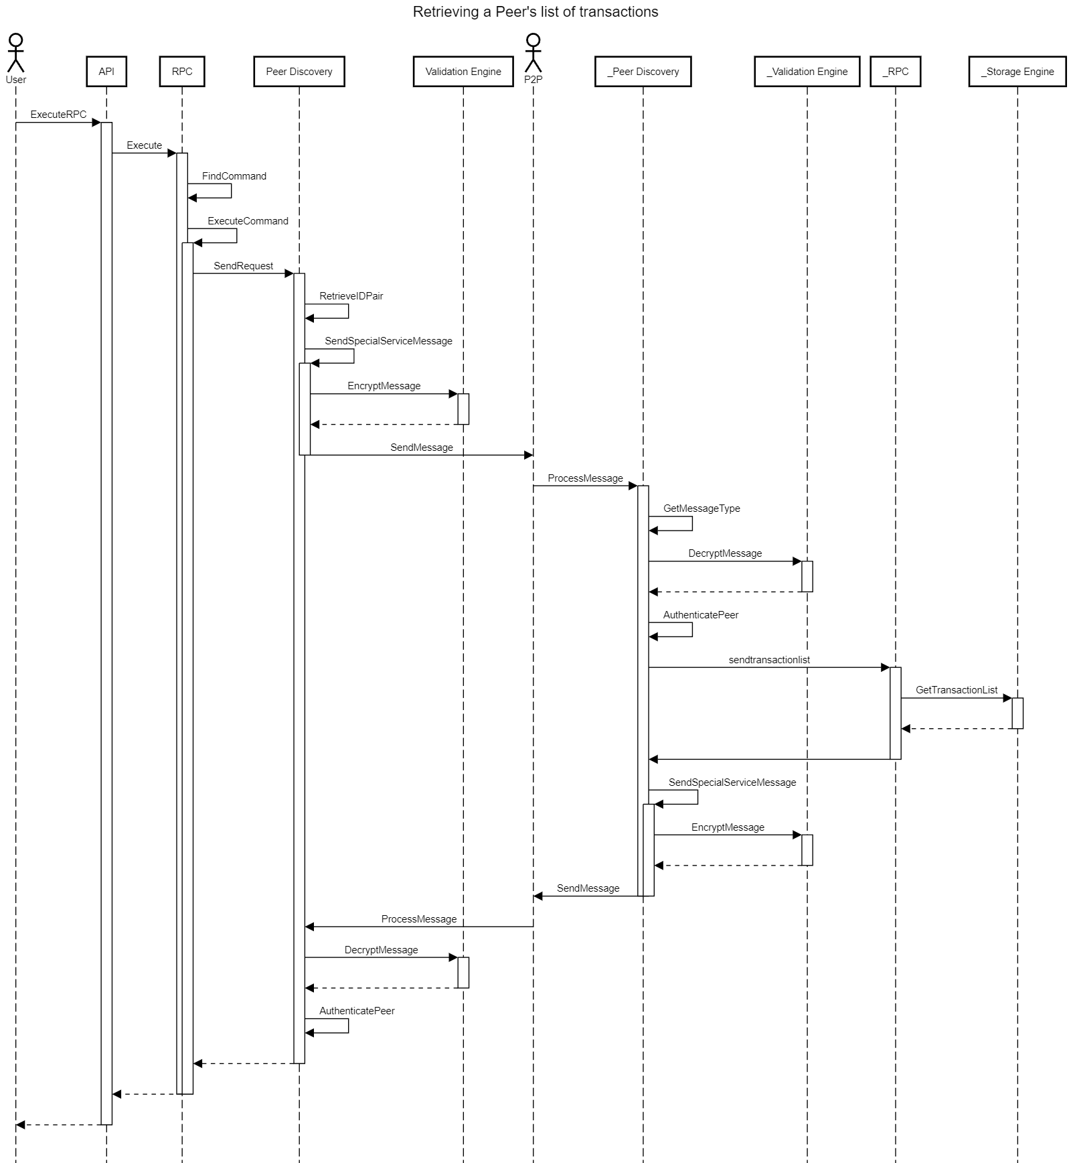
Use Case #2:
Retrieving a peer’s list of transactions

Slide 28
Conclusion
The current architecture allows the addition of our new proposed feature
Although both implementations were found to affect mostly the same stakeholders and NFRs, implementation 1 was determined to be the better option as keeps the high-level architecture the same
However, security remains a major risk for both implementations due to the nature of the feature

Slide 29
Lessons Learned
Work was streamlined by incorporating the lessons we learned from past assignments
Coming up with the enhancement idea was difficult
  We browsed some Bitcoin Improvement Protocols (BIPs) to look for inspiration
  An example was BIP 150 which talks about user authentication

Slide 30
References
Bitcoin RPC Reference: RPC API reference. Bitcoin. (n.d.). Retrieved March 19, 2023, from https://developer.bitcoin.org/reference/rpc/
Peer Discovery: Bitcoin Core 0.11 (CH 4): P2p network. Bitcoin Core 0.11 (ch 4): P2P Network - Bitcoin Wiki. Retrieved February 10, 2023, from https://en.bitcoin.it/wiki/Bitcoin_Core_0.11_(ch_4):_P2P_Network
Github Repo: Bitcoin. (n.d.). Bitcoin/Bitcoin: Bitcoin Core Integration/Staging tree. GitHub. Retrieved March 19, 2023, from https://github.com/bitcoin/bitcoin

Slide 31
Thanks for listening!

