Slide 1
Conceptual Architecture of Bitcoin Core
https://www.youtube.com/watch?v=Aiji5g99ZkQ

Slide 2
Conceptual Architecture of Bitcoin Core
Group 20 - GoDaddy
Arsh Kochhar (Introduction, Wallet, Storage Engine)
Brian Cho (Presenter, Miner, Use Case #1, Sequence Diagram, Conceptual Architecture Diagram)
Julian Wei (Derivation Process, Alternatives, Peer Discovery, Connection Manager, Lessons Learned)
Junhui Zong (Team Leader, Abstract, Validation Engine, External Interfaces, Conclusion)
Ye Shen (RPC, Use Case #2, Sequence Diagram)
Yuchen Li (Presenter, Mempool, Architecture Styles)

Slide 3
Overview
History and Background
Architecture Styles
Derivation Process
Alternatives
Subsystems and Relationships
External Interface
Concurrent Development and Issues
Use Cases
Conclusion
Lessons Learned

Slide 4

History and Background
A decentralized peer-to-peer electronic cash system proposed by Satoshi Nakamoto in 2008
Bitcoin Core is the original implementation of Bitcoin protocol

Slide 5
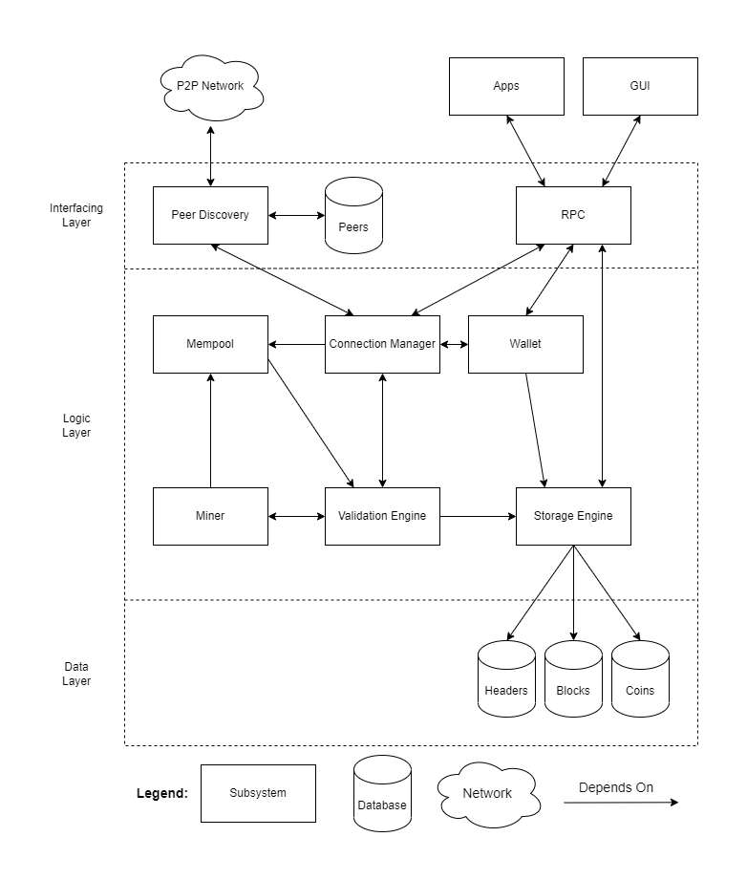
Architecture Styles
3 architecture styles
  Peer-to-Peer Style
  Layered Style
  Client-Server Style

Slide 6
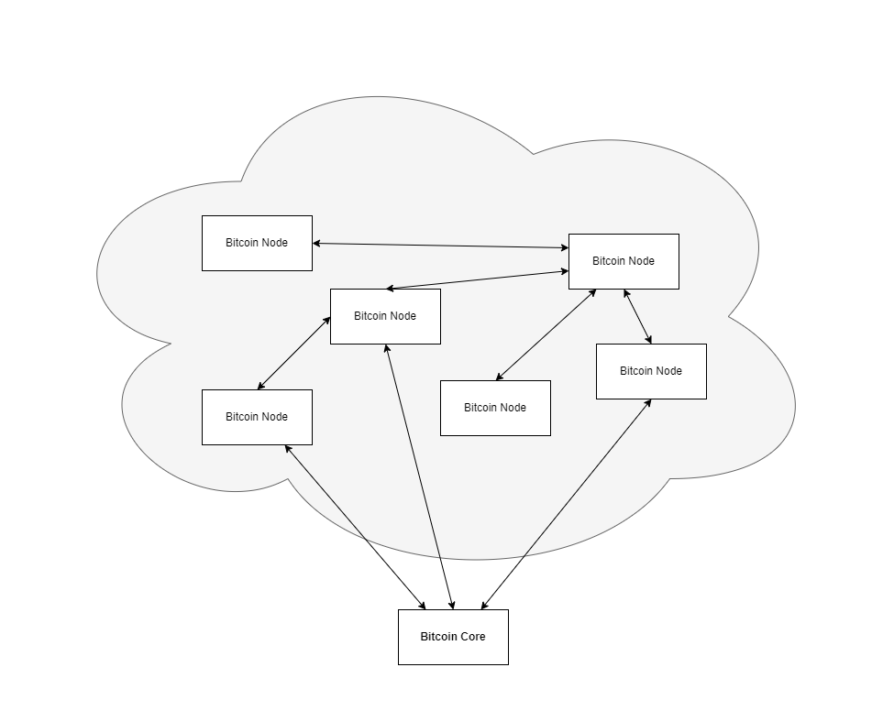
Architecture Styles - P2P
Nodes in the network both provide and consume services at the same time.
A Bitcoin node is a program that implements the Bitcoin protocol.
  Not necessarily Bitcoin Core
Yo should i make a diagram for p2p?
Sure, I think a diagram would be better
Smth like this but not this shit
Yap! At least not so empty

Slide 7
Architecture Styles - Layered
Interfacing Layer:
  Connects the Bitcoin network and user interactions with Bitcoin Core.
Logic Layer:
  Responsible for executing the main logic regarding transactions and the blockchain
Database Layer:
  Holds data relating to the blockchain.

Slide 8
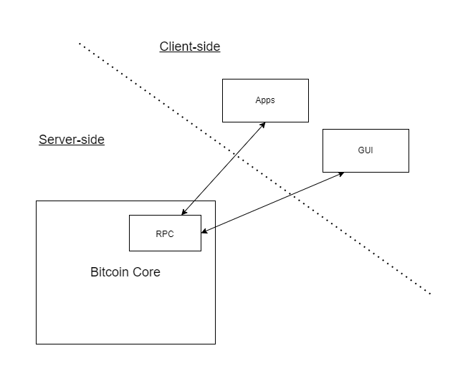
Architecture Styles -
Client-Server
Clients: External applications
Server: Bitcoin Core
Interacts through the RPC interface

Slide 9
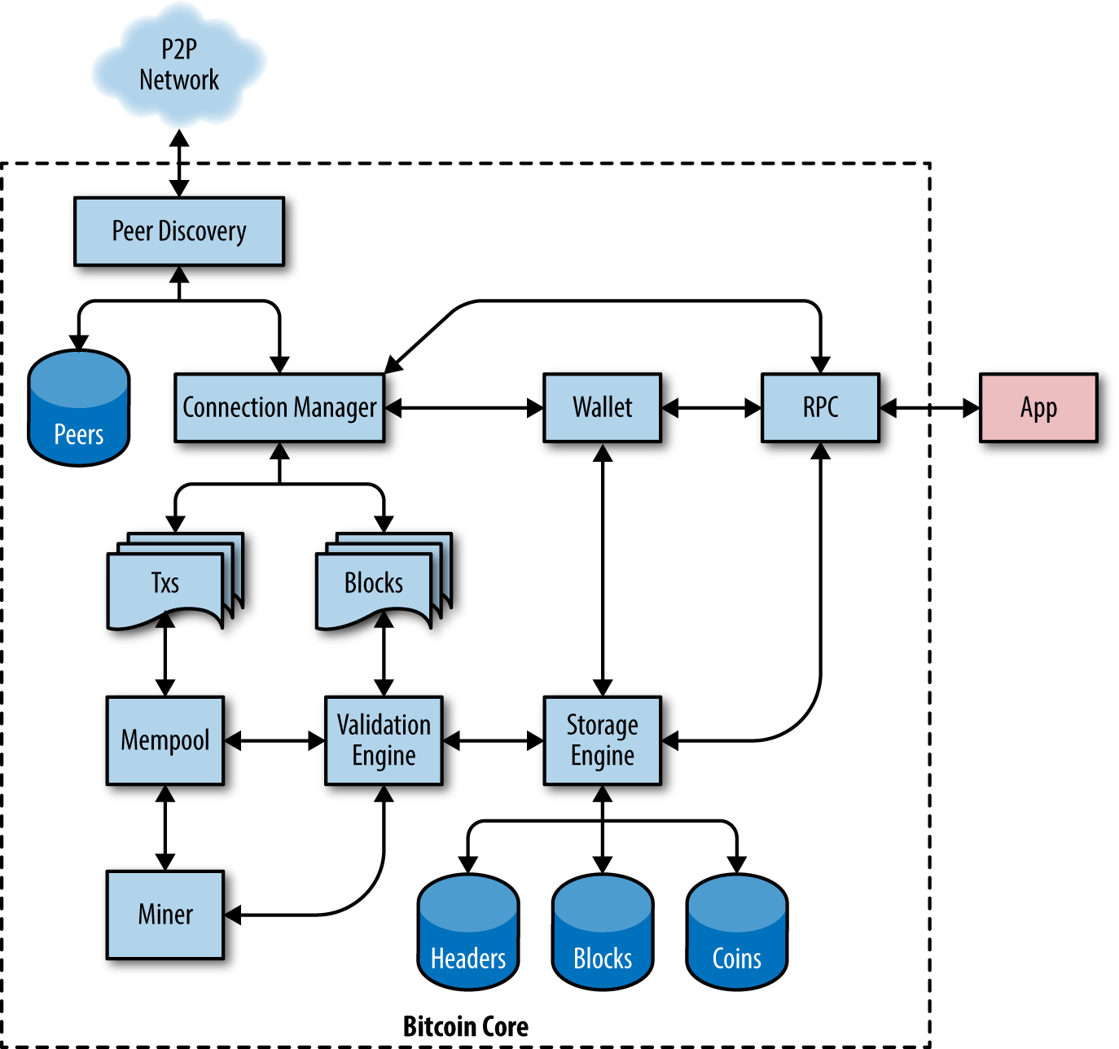
Derivation Process
Based off of the diagram provided in the open-source book.
Improved on the initial diagram
  Remove the Txs and Blocks components below the Connection Manager.
  Added abstract layers that group components with similar characteristics and functionalities

Slide 11
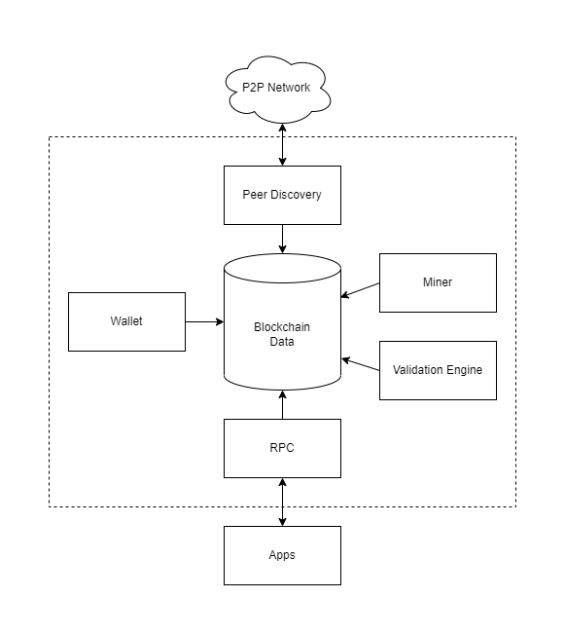
Alternatives
The Repository style
Repository contains the entire blockchain
Other components would act on the repository
Not all components need to act on the database

Slide 12
Architecture
8 subsystems identified
  Peer Discovery
  Connection Manager
  Wallet
  Validation Engine
  Mempool
  Storage Engine
  Miner
  Remote Procedure Call
External Interfaces
  P2P Network
  External Applications
    GUI

Slide 13
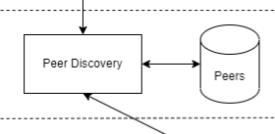
Architecture - Peer Discovery
The point of contact between the Bitcoin network and the Bitcoin Core node.
Is heavily involved in discovering IP addresses of peer nodes.
Receiving and broadcasting of data.
The Peers Database stores the IP address of all known peer nodes.

Slide 14
Architecture -
Connection Manager
Serves as a central controller.
Controls the flow of data.
Reading each type of inbound/outbound data and reacting accordingly.
Interacts with Peer Discovery, Wallet, RPC, Validation Engine, and the Mempool.

Slide 15
Architecture - Wallet
Is used to store, manage, and track the ownership of Bitcoins.
Is responsible for generating and storing a pair of cryptographic keys.
The connection between the wallet and the node are managed by the connection manager.

Slide 16
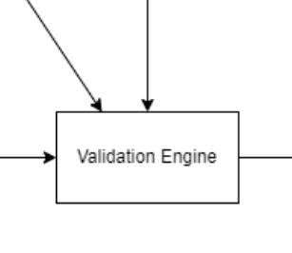
Architecture - Validation Engine
Maintaining the security and integrity of the Bitcoin network.
Verifying transactions.
Checking block structure.
Protecting against double-spending.
Validating the blockchain

Slide 17
Architecture - Mempool
Stores a queue of unconfirmed transactions which are waiting to be validated by the Miner
Mempool checks with Validation Engine before enqueuing the transactions

Slide 18
Architecture - Storage Engine
Is responsible for managing the permanent storage of all the data.
These data include blockchain, blocks, transactions, and addresses.
The storage engine component accesses three main databases in the Data layer: Headers, Blocks, and Coins.

Slide 19
Architecture - Miner
Attempts to find an input to a cryptographic hash function such that the output is less than the target hash.

Slide 20
Architecture - Remote Procedure Call (RPC)
Provides a set of commands that can be used by external applications to interact with the Bitcoin Core program.

Slide 21
External Interfaces
P2P network
Includes the other nodes in the network
Inflow and outflow of information
  Update to blockchain
  New transactions
  New peers
  Validation between peers

Slide 22
External Interfaces
External Apps
Are connected to Bitcoin Core through RPC
Use RPC interface to send commands to the full nodes and retrieve information.
The official Bitcoin Core GUI is downloaded separately
  GUI maps GUI actions to procedure calls

Slide 23
Concurrent Development and Issues
Architecture enables concurrent development
  Miner does not need to know the implementation of Validation Engine’s cryptographic hash function
  Storage Engine encapsulates the logic of retrieving data from the database
Development issues
  Connection Manager is highly coupled with many subsystems

Slide 24
Use Cases
Mining Bitcoins using the built-in Miner
Creating transactions through the RPC interface

Slide 25
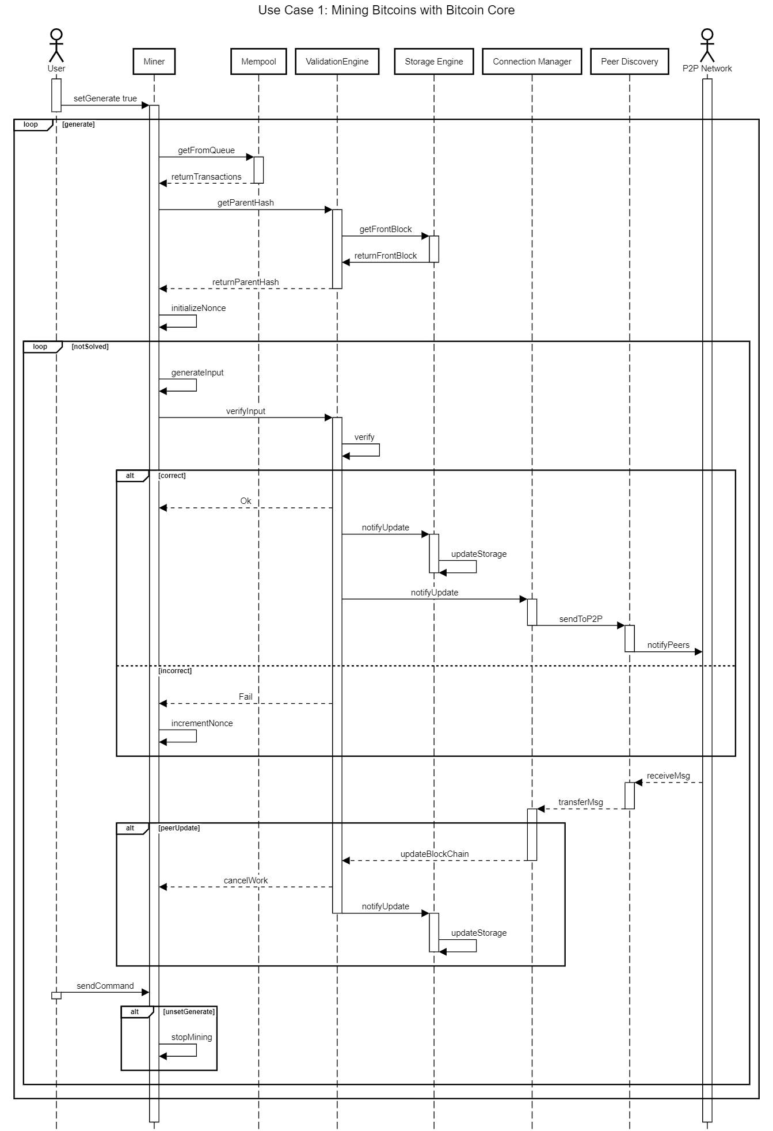
Use Case #1:
Mining Bitcoins with Bitcoin Core

Slide 28
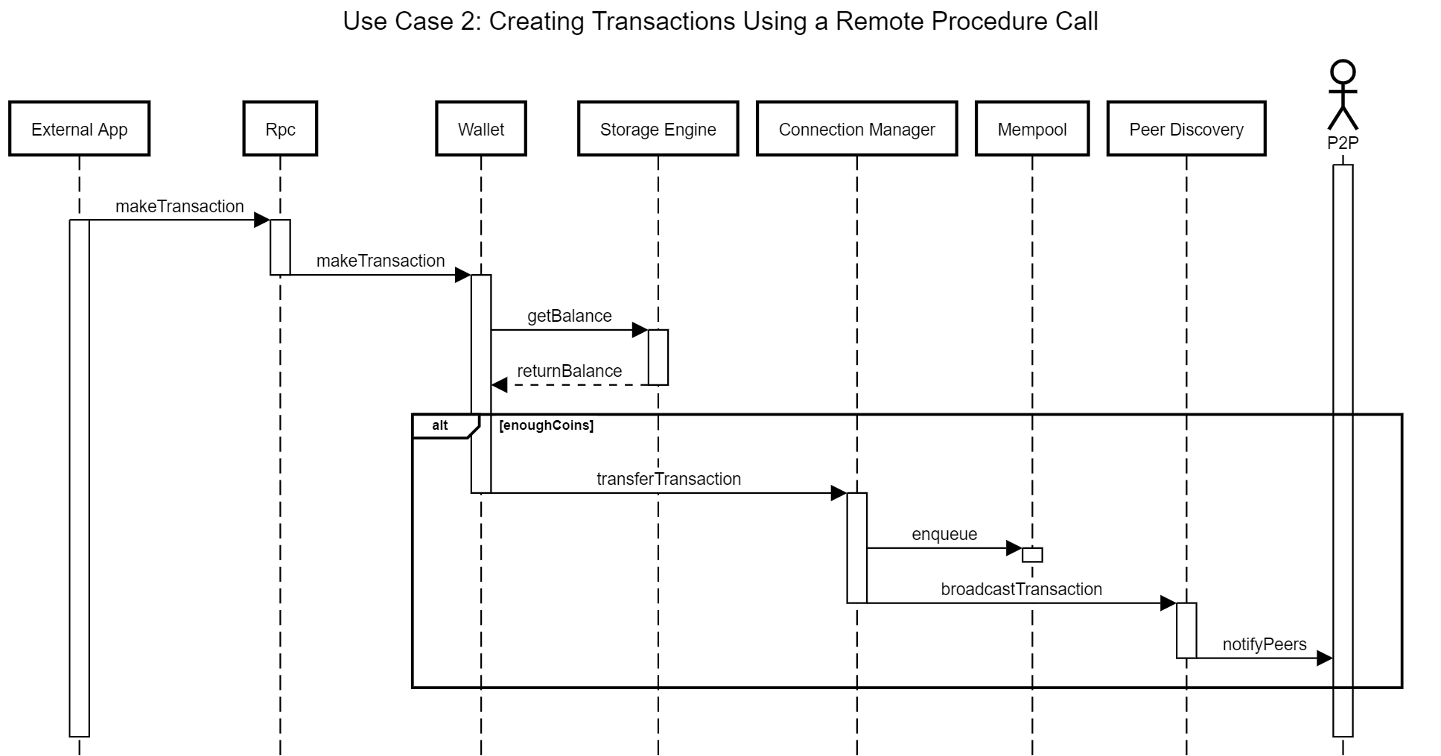
Use Case #2: Creating Transactions through RPC

Slide 30
Conclusion
Bitcoin Core utilizes the P2P, Layered, and Client-Server architecture styles
P2P and Client-Server can co-exist
The relationship between Validation Engine and other subsystems makes Bitcoin Core secure and reliable for managing Bitcoin transactions

Slide 31
Lessons Learned
Make sure everyone is on the same page before writeup
Find pieces of information that helps us get started quickly

Slide 32
References
Antonopoulos, A. M. Chapter 3: 'bitcoin core: The reference implementation'. GitBook. Retrieved February 10, 2023, from https://cypherpunks-core.github.io/bitcoinbook/ch03.html
Mining with Bitcoin Core. Packt. Retrieved February 10, 2023, from https://subscription.packtpub.com/book/hardware-and-creative/9781785281976/2/ch02lvl1sec12/mining-with-bitcoin-core
Antonopoulos, A. M. M. Chapter 6: The Bitcoin Network. O'Reilly Online Learning. Retrieved February 10, 2023, from https://www.oreilly.com/library/view/mastering-bitcoin/9781491902639/ch06.html
P2P network. bitcoindeveloper. Retrieved February 10, 2023, from https://developer.bitcoin.org/devguide/p2p_network.html
Bitcoin Core 0.11 (CH 4): P2p network. Bitcoin Core 0.11 (ch 4): P2P Network - Bitcoin Wiki. Retrieved February 10, 2023, from https://en.bitcoin.it/wiki/Bitcoin_Core_0.11_(ch_4):_P2P_Network
Mempool Size (Bytes). Blockchain.com. Retrieved February 10, 2023, from https://www.blockchain.com/explorer/charts/mempool-size
Coinguides. (2021, August 28). What is Bitcoin Mempool? memory pool size, Fees & Transactions explained. Coin Guides. Retrieved February 12, 2023, from https://coinguides.org/bitcoin-mempool/

Slide 33
References
Bitcoin Core. Encyclopedia. Retrieved February 12, 2023, from https://encyclopedia.pub/entry/33603
Coinbase. Crypto basics - what is a crypto wallet? Coinbase. Retrieved February 13, 2023, from https://www.coinbase.com/learn/crypto-basics/what-is-a-crypto-wallet
Josh. (2021, March 26). Where are unspent transaction outputs (UTXOs) stored? CryptoChamp. Retrieved February 13, 2023, from https://cryptochamp.com/where-are-unspent-transaction-outputs-utxo-stored/
Zhang, C. A Blockchain Network node. ResearchGate. Retrieved February 14, 2023, from https://www.researchgate.net/figure/A-Blockchain-Network-node-A-full-node-stores-all-the-data-in-the-blockchain-including_fig1_329464413
Eli5: Blockchain explained in simple terms. crypto.bi. Retrieved February 13, 2023, from https://crypto.bi/eli5-blockchain/
(2019, May 5). Transaction verification engine. Stack Exchange. Retrieved February 14, 2023, from https://bitcoin.stackexchange.com/questions/87487/transaction-verification-engineAntonopoulos, A. M. Chapter 11: 'Bitcoin Security'. GitBook. Retrieved February 10, 2023, from https://cypherpunks-core.github.io/bitcoinbook/ch11.html

Slide 34
Thanks for listening!

