Slide 1
Concrete Architecture of Bitcoin Core
https://youtu.be/Fe7lV9tERXE

Slide 2
Concrete Architecture of Bitcoin Core
Group 20 - GoDaddy
Arsh Kochhar (Abstract, Introduction, Conclusion)
Brian Cho (Presenter, 2nd-level Reflexion Analysis, Use Case #1, Use Case #2, Sequence Diagrams)
Julian Wei (Derivation Process, Lessons Learned, 2nd-level Subsystem Description)
Junhui Zong (Team Leader, Concrete Subsystems, Unexpected Dependencies)
Ye Shen (Concrete Subsystems, Unexpected Dependencies)
Yuchen Li (Presenter, Concrete Subsystems, Unexpected Dependencies)

Slide 3
Overview
Derivation Process
Top-Level Architecture
  Concrete Architecture
  Subsystems
  Reflexion Analysis
Inner Architecture of Miner
  Concrete Architecture
  Reflexion Analysis
Concurrent Development and Issues
Limitations
Use Cases
Lessons Learned
Conclusion

Slide 4

Derivation Process
Used Understand to generate dependency graph
Used the dependency browser to analyze the functions/constants in dependencies.
Similar for the 2nd-level subsystem, but the source code was analyzed in greater detail

Slide 5
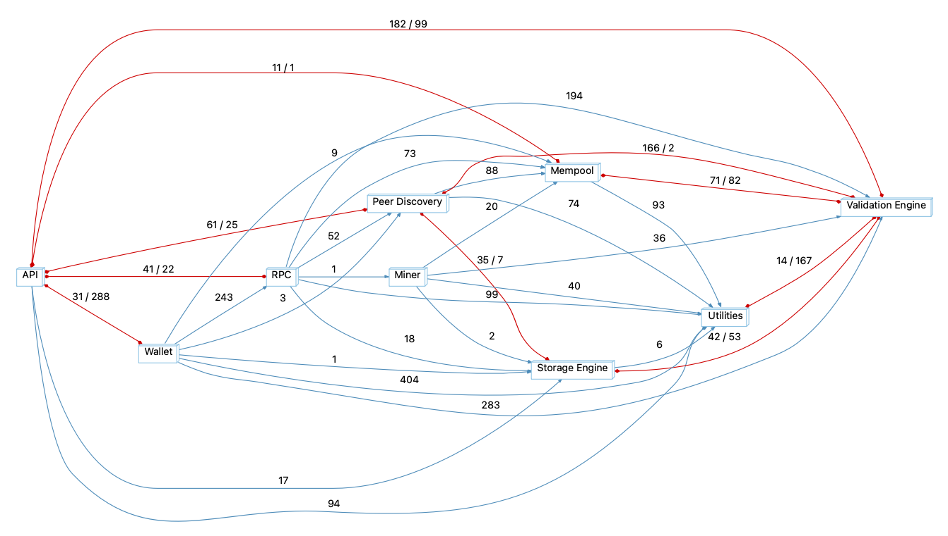
Top-Level Architecture
Dependency Diagram

Slide 6
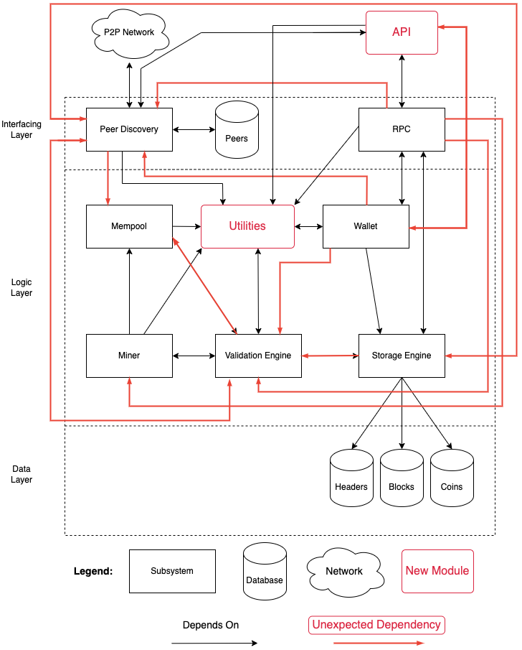
Top-Level Architecture
Concrete Architecture
  Two New Modules:
    API
    Utilities
  One Missing Module:
    Connection Manager

Slide 7
Concrete Subsystems - Mempool
Stores unconfirmed transactions in “txmempool.cpp”
Transactions are verified using “validation.cpp” in Validation Engine

Slide 8
Concrete Subsystems - Wallet
Generates public keys - CPubKey in src/pubkey.h and private keys - CKey at src/key.h included in bitcoin-wallet.cpp.
The private key is used to sign transactions using Sign() and control access to the wallet's bitcoins.
Communicates with a Bitcoin Core node using an RPC interface - src/rpc/mempool.cpp to validate transactions using “validation.cpp” in Validation Engine

Slide 9
Concrete Subsystems - Peer Discovery
The acquisition and storage of new ip addresses
  File addrman.cpp serves as the central controller.
The processing of data inflow and outflow
  File net_processing is important in both inflow and outflow.

Slide 10
Concrete Subsystems - RPC
rpc/server.cpp handles the bootup and shutdown of RPC
  provides an interface to pass in commands

Slide 11
Concrete Subsystems - Miner
Dealing with the creation of new blocks.
Accessing txmempool.cpp of Mempool to gain access to new transactions
Using validation.cpp of Validation Engine to verify the newly created block.

Slide 12
Concrete Subsystems - Validation Engine
It verifies the validity of blocks and transactions on the Bitcoin Work
It interacts with blockstorage.h of Storage Engine to read from disk as well as verify the database.

Slide 13
Concrete Subsystems - Storage Engine
Serves as a database management subsystem which deals with the storage of transaction data in src/node/blockstorage.cpp.
Features transaction indexing that speeds up the process of verifying new blocks in the blockchain using “validation.cpp”

Slide 14
Concrete Subsystems - Utilities
It aids other subsystems in their implementation.
It is mostly made up of the util folder and the primitives folder which contains block.h and transaction.h to represent blocks and transactions.

Slide 15
Concrete Subsystems - API
It provides an interface for other programs to interact with Bitcoin Core.
It is made up of the interfaces folder.

Slide 16
Unexpected Dependencies
One-way Dependency
  Peer Discovery → Mempool
  Validation Engine → Mempool
  Wallet → Validation Engine
  Wallet → Peer Discovery
  Storage Engine → Validation Engine
  RPC → Peer Discovery
  RPC → Miner
Bidirectional Dependency
  Peer Discovery ↔ Storage Engine
  Peer Discovery ↔Validation Engine
  API ↔ Wallet

Slide 17
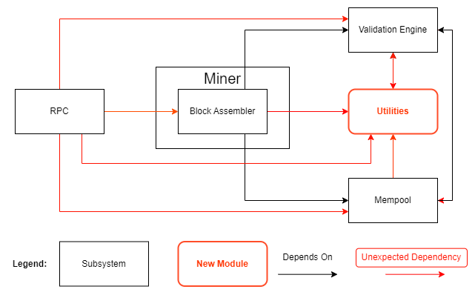
Inner Architecture: Miner
Descriptions and Interactions
Reflexion Analysis

Slide 18
Miner
Composed of only two files: node/miner.cpp and node/miner.h
The two files make up the only subcomponent of Miner called Block Assembler
Block Assembler is responsible for the creation of new blocks
Miner is not responsible for mining bitcoins

Slide 19
Miner: Interactions
Miner depends on Validation Engine, Utilities, and Mempool
  Validation Engine is used to retrieve the block subsidy and work difficulty
  Utilities used to access primitive data types such as blocks and transactions
  Mempool is accessed to retrieve the unconfirmed transactions that are to be added into the new block
RPC depends on Miner
  Mining RPC commands use Miner to assemble new blocks before mining

Slide 20
Miner: Reflexion Analysis
Miner does not perform any mining actions
Mining actions are implemented inside RPC which uses Block Assembler
  Previous commits suggest that the miner transitioned to only be used for testing
  Lack of commit messages make it difficult to reason out why mining is performed in RPC
  Possible guess is simplicity since mining is only performed through the RPC

Slide 21
Miner: Reflexion Analysis
Miner depends on Validation Engine to get the block subsidy
  Initially thought to be calculated inside Miner
  However, the current placement makes sense since block subsidy relates to consensus and policy
Dependency on Utilities is another divergence
  Expected since Utilities is made to be used by many components

Slide 22
Concurrent Development and Issues
Architecture enables concurrent development
  Adding new RPC command is easy as the command execution behaviour is encapsulated inside CRPCCommand
Development issues
  Either difficult or practically impossible to refactor highly coupled subsystems such as Utilities.

Slide 23
Limitations
Due to the high coupling, refactoring of subsystems is difficult
Much more difficult to have a mental model of the architecture

Slide 24
Use Cases
Executing an RPC Command
Mining a block using the generateblock command

Slide 25
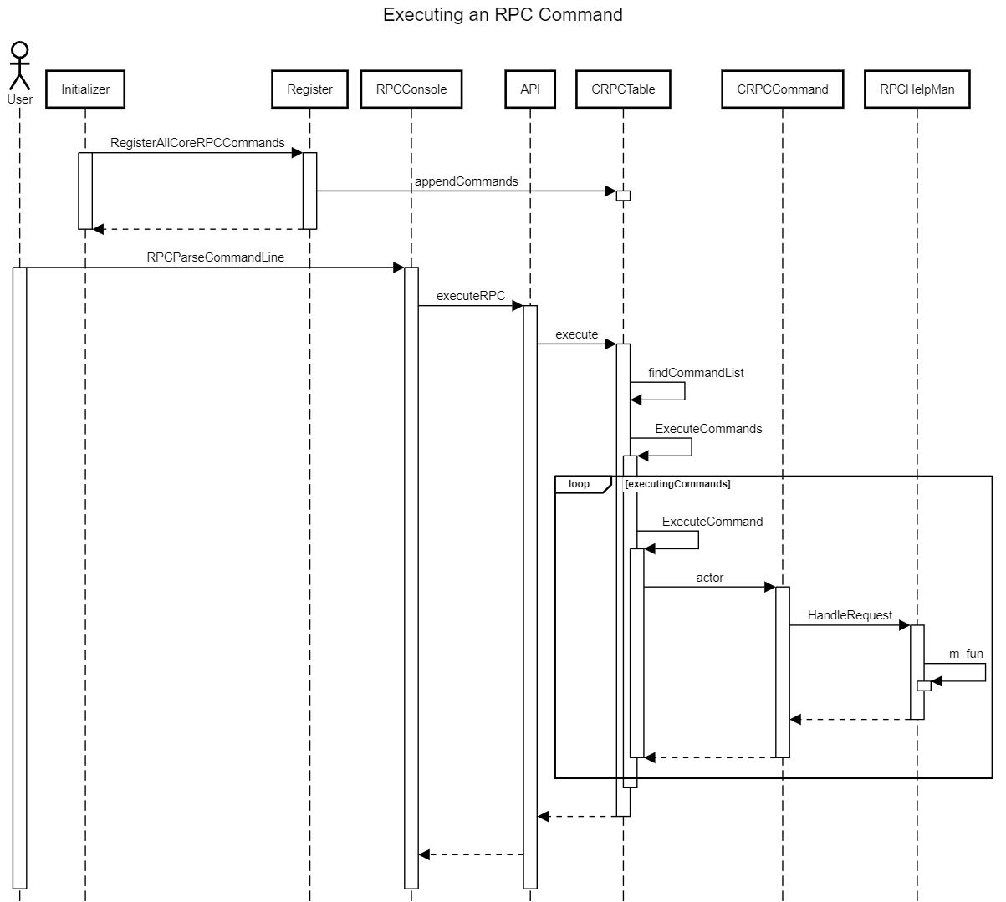
Use Case #1:
Executing an RPC Command

Slide 27
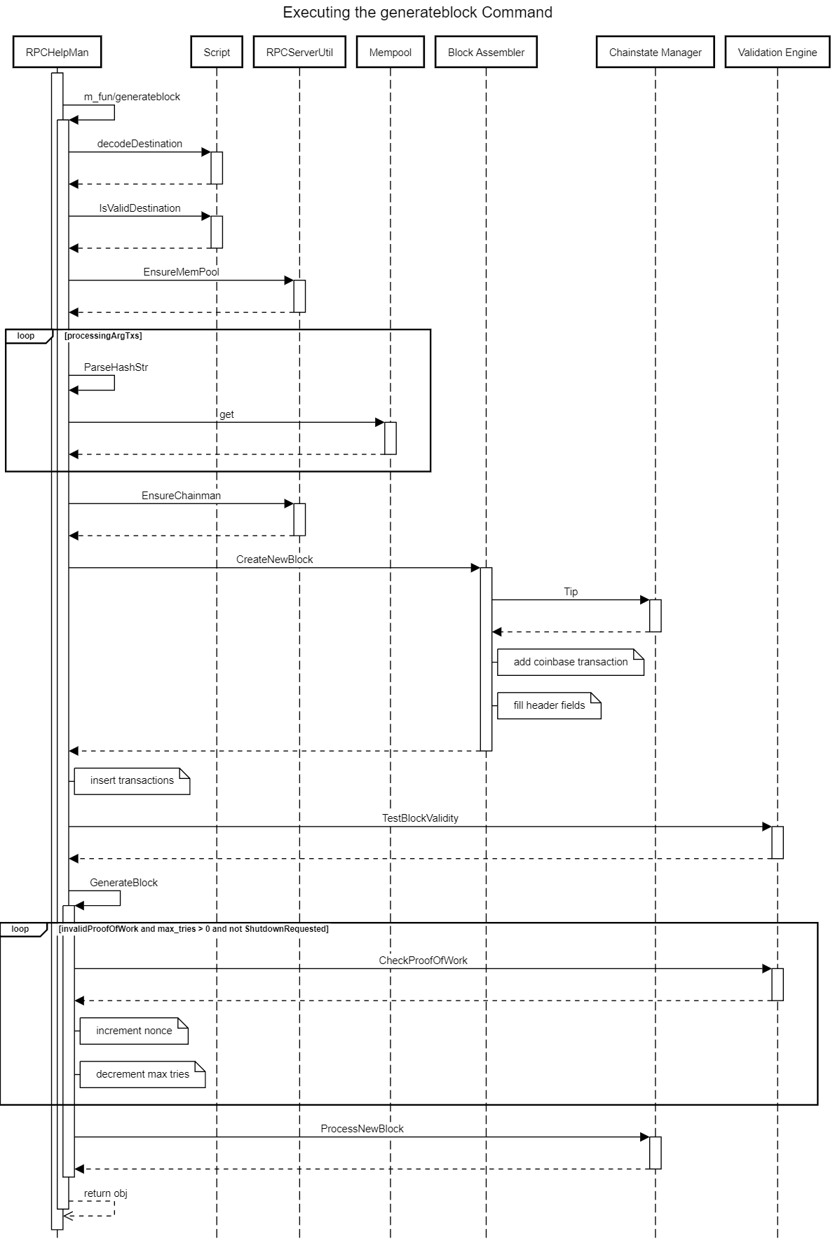
Use Case #2:
Mining a Block using the generateblock Command

Slide 30
Conclusion
Bitcoin Core’s concrete architecture includes the API and Utilities subsystems that were not present in our conceptual architecture
Numerous unexpected dependencies were found that made the architecture much more coupled compared to our conceptual architecture
Miner contains only a single subcomponent called Block Assembler
Miner is not responsible for mining bitcoins

Slide 31
Lessons Learned
Analyzing the source code without prior knowledge of the code base is difficult
  Easier to grasp if you analyze a simpler subsystem first
Even when work is split into subgroups, progress should be communicated clearly to all members

Slide 32
References
Bitcoin RPC Reference: RPC API reference. Bitcoin. (n.d.). Retrieved March 19, 2023, from https://developer.bitcoin.org/reference/rpc/
Peer Discovery: Bitcoin Core 0.11 (CH 4): P2p network. Bitcoin Core 0.11 (ch 4): P2P Network - Bitcoin Wiki. Retrieved February 10, 2023, from https://en.bitcoin.it/wiki/Bitcoin_Core_0.11_(ch_4):_P2P_Network
Github Repo: Bitcoin. (n.d.). Bitcoin/Bitcoin: Bitcoin Core Integration/Staging tree. GitHub. Retrieved March 19, 2023, from https://github.com/bitcoin/bitcoin

Slide 33
Thanks for listening!

