Slide 1

Foster Orientation [insert slogan] [add/delete slides as desired. This is only a template.]
[foster/adoption photos, delete this box]
[foster/adoption photos, delete this box]
[foster/adoption photos, delete this box]
[insert logo, delete this box]
Edited x/xx/2025

Slide 2
Welcome
Volunteer Resources –
[insert volunteer info/resource page on organization website if available]
Username: [if member login is required]
Password: [if member login is required]
Complete the participation survey in the Welcome/Orientation email at the end of this presentation [if applicable]
When will my foster arrive?
[for orientations done as a presentation, replay this information verbally. For orientations done by providing this powerpoint to fosters by email etc, add bullets here.]

Slide 3
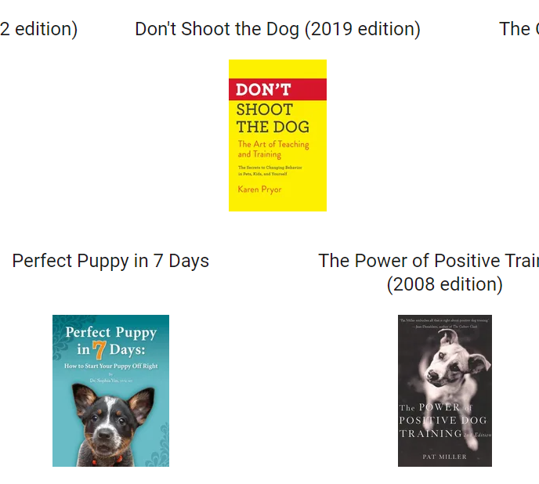
Volunteer Resources
Contacts Documents Additional Resources
[insert screenshot of contacts area on organization’s website or list here, delete this box]
[insert screenshot of foster documents area on organization’s website, delete this box]
^^^^[list or photos of approved training/husbandry resources, above are good examples. delete this text box]

Slide 4
Introduction to Pet Fostering
Current pets in your home must be healthy to begin fostering
Prepare
Food and water bowls
Long line or long leash
Determine separate room/area
[insert any additional supplies/preparations]
Questions while preparing or actively fostering
[insert contact]
Need supplies while preparing or actively fostering?
[insert contact]
Know your closest 24/7 Emergency Veterinarian

Slide 5
First Days – Dog Arrival
Foster has just been through a lot during transport. Assume all dogs are flight risks.
Two points of contact during transport and first few days – martingale and slip lead.
Foster dog must ALWAYS be leashed in unfenced areas
Best to have foster dog drag a long line in fenced areas until known if dog will try to escape or be unsure or unwilling when it’s time to come back inside
Cool, calm, collected
Set up designated decompression area
Go slow, no quick or sudden movements
Do not force your foster
Even if housebroken, assume they are not and supervise
Drag a leash in the house
Limit access to home to one room or area and increase over days-a week
If they do not eat a lot in the first few days that is ok
No visitors, large gatherings, parties

Slide 6
First Days – Days to Weeks After Arrival
If your foster seems uncomfortable, take your time. Baby steps
Reward good and brave behaviors. Do NOT shout
Resident pets – plan to keep separate and introduce slowly
Do not leave foster and other pets together unsupervised
Get to know your foster dog
After [insert recommended time period], your foster pet may be listed for adoption
Feeding: Dogs – 2x/day; Puppies under 6mo – 3x/day; don’t free feed
No bones/toys unsupervised until sure dog will not consume pieces
Long line even in fenced yard until sure dog will go under or over
Heartworm/flea/tick preventatives
If you are not sure about something– DON’T do it. Ask your coordinator.

Slide 7
Lost Dog Prevention
Step 1: Prevention!
Assume your foster dog will always take off

Slide 8
Lost Dog Prevention
Step 1: Prevention!
Assume your foster dog will always take off
Properly fitted martingale collar
Never let your foster off leash in unfenced areas
Long line in fenced areas until sure they will not go under/over
Do not open doors around your foster. Keep bottoms of windows closed.
Children under 13y should never walk a foster
Children over 13 y should be intensely supervised, using a second leash that the adult holds for several walks until sure. No children under 18y should walk a dog over 40lb without an adult holding a second leash
Visiting with friends at your house or theirs, fosters should always be on leash
Any dog walkers must be approved by your coordinator prior to their first session

Slide 9
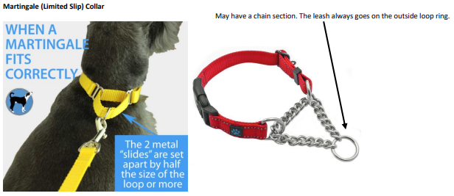
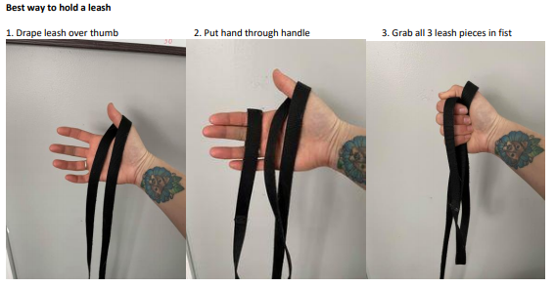
Leash Handling and Equipment

Slide 10
Loose/Lost Dog Procedure
DO NOT CHASE YOUR FOSTER DOG. YOU WILL NOT CATCH THEM.
Do not call a search party. Do not shout your foster’s name at any point in search. You are expected to have a sense of urgency and responsibility to help until the dog is found if you lose your foster dog regardless of the reason. We will not always be able to assist you in person.
1. Foster is still in view: Food, leash, toss food, YOU run away from dog to create a game.
Dogs that are particularly fearful, this will not work and scare them more. Remain still and toss food.
2. Contact foster coordinator
3. Contact Police department local number. Inform them NOT to chase dog
4. WALK 5 mins in dog’s direction of travel
5. DRIVE 5 mins in dog’s direction of travel
6. Fire up grill with meat or warm up food and set or put out fast food or wet food
7. Work with your foster coordinator for next steps

Slide 11
Household Items/Foods
Dog food/treat brands to avoid
[Insert applicable brands]
No rawhide
Other supply brands to avoid
[Insert applicable brands]
Ingredients to avoid
[Insert applicable ingredients]
Human foods to never feed
ONION, GRAPE/RAISIN, CHOCOLATE/coffee/caffine, some nuts, XYLITOL, any COOKED bone, fat trim/raw meat, yeast dough
House plants – research and contain if needed
Essential Oils - research
Approved Human Food Items

Slide 12
Medical
[for orientations done as a presentation, replay this information verbally. For orientations done by providing this powerpoint to fosters by email etc, add bullets here.]
Minor Scrape/Irritation/Limping/Itching
Coughing/Sneezing
Diarrhea
Urination Issues
Vomiting/Appetite
Deep Laceration/Infected or Inflamed Wound
Foreign Body Ingestion
Difficulty Breathing/Lethargy/Fainting
Seizure-Like Episodes
Animal Attack (toss treats, PetSafe spray shield, mini umbrella)
Hit By Car
Know your nearest 24/7 Emergency Vet
We work directly with the vet office for treatment needs. The office should call us, not ask you.

Slide 13

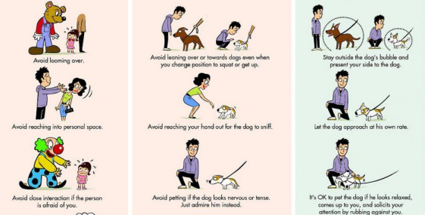
How to Greet/Interact

Slide 14
Aggression
STOP
MOVE AWAY to safety
ASSESS the situation
If safe, calmly and gently coax your foster into their crate or a separate room and close door
Or calmly place a slip lead on your foster and lead them to their crate or separate room and close door
BREATHE
Seek medical attention if needed
CALL your foster coordinator or dog behavior contact
Even if you can identify the reason and you feel you were in the wrong, we still need to know
Do not interact with your foster dog until you speak with your foster coordinator

Slide 15
Listing for Adoption
[insert steps for listing foster dog for adoption including required information/forms/photos/etc]

Slide 16
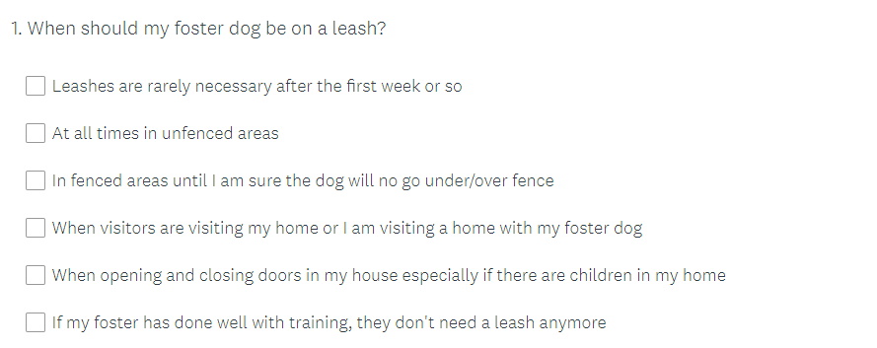
Survey
[if requiring a foster orientation quiz/survey, insert quiz/survey link here with instructions. Example question below. Delete example question and insert your organization’s if applicable.]

Slide 17
Questions?
[[for orientations done as a presentation, take questions. For orientations done by providing this powerpoint to fosters by email etc, insert how questions can be submitted.]

