Slide 1
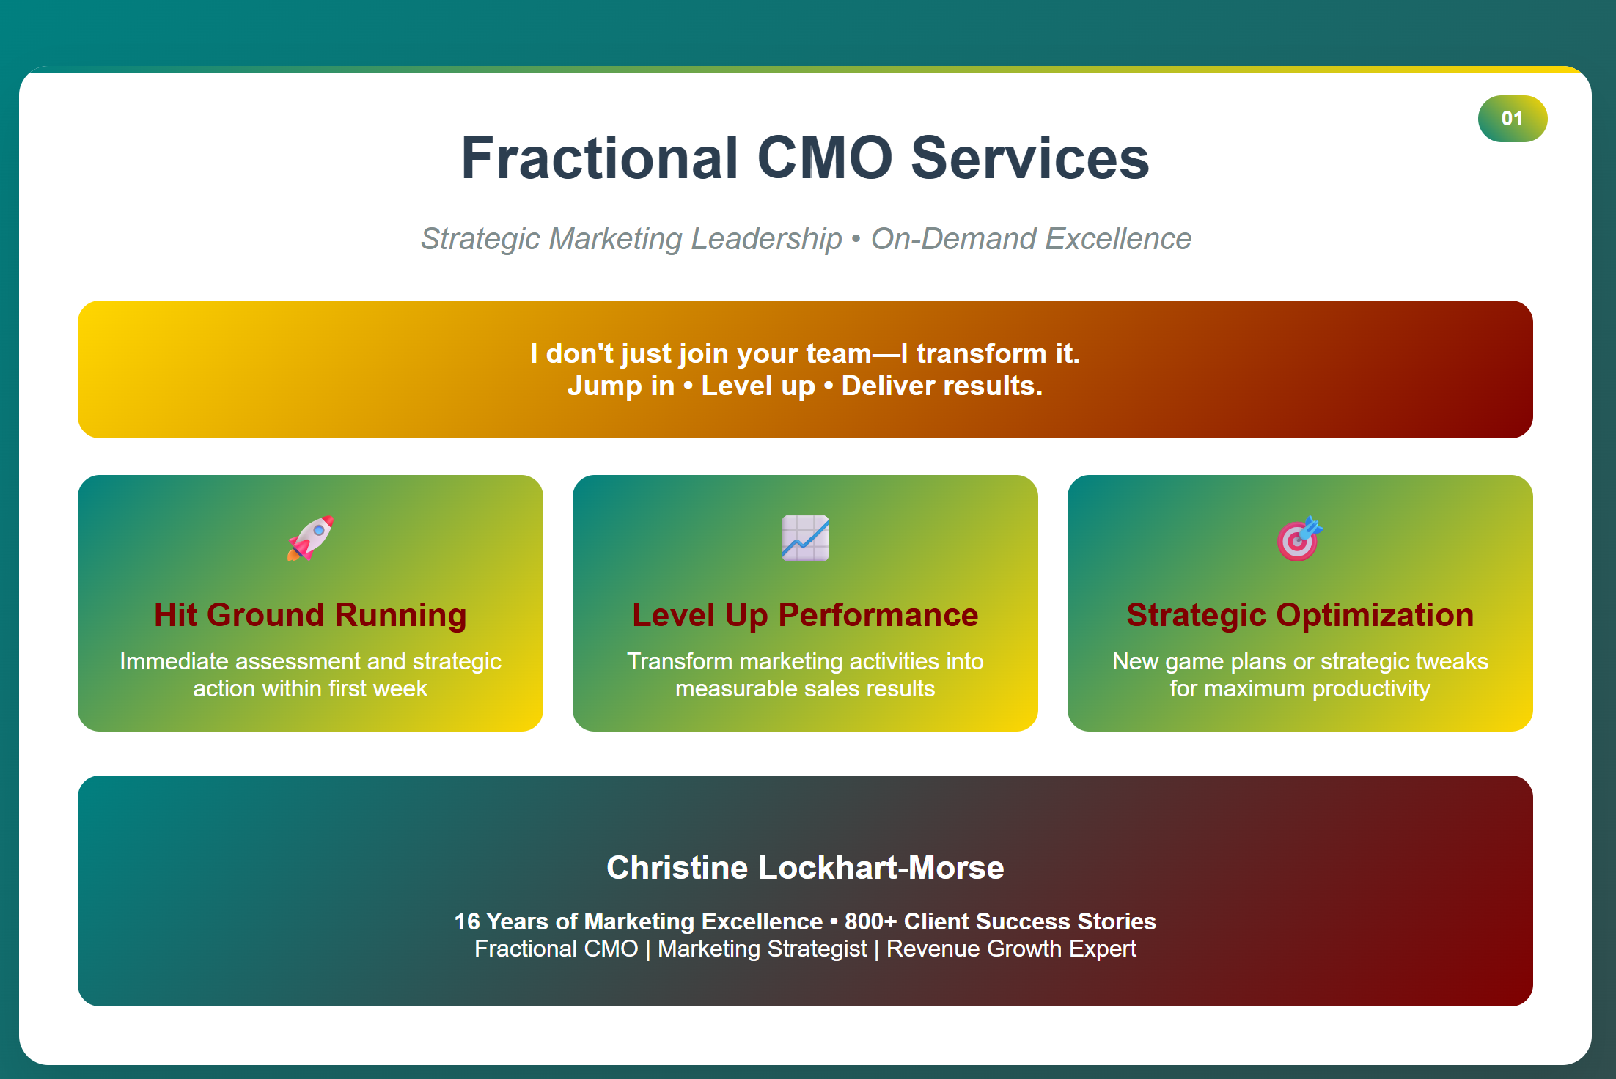
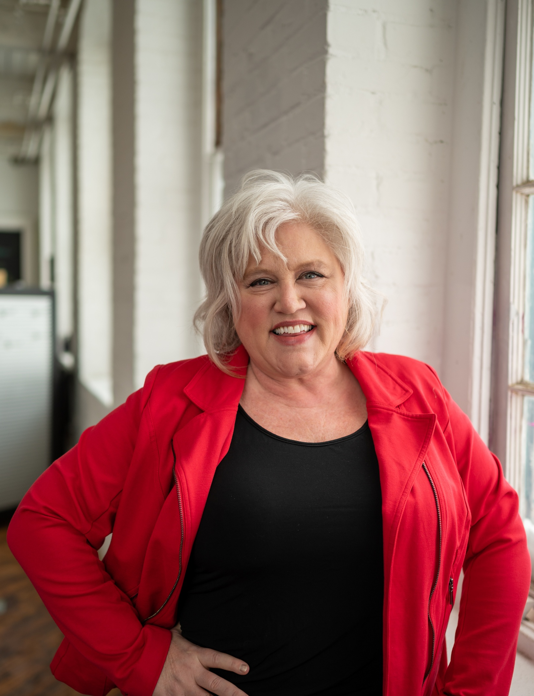

Slide 2
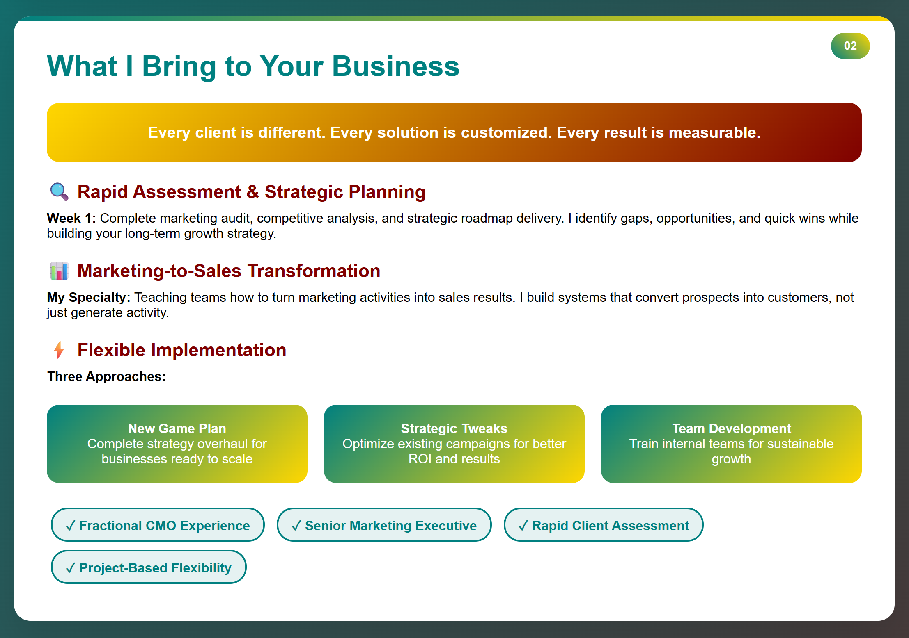

Slide 3
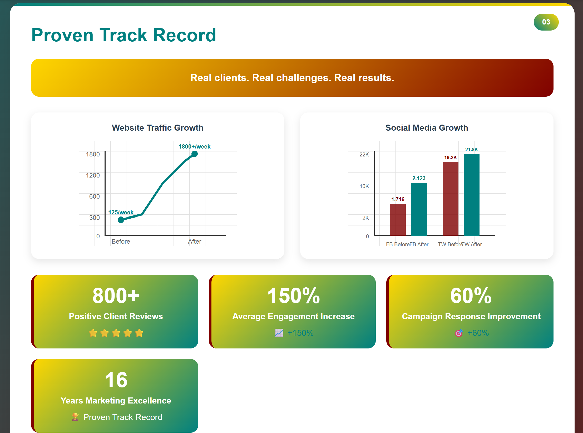
Success Story Highlights:
One campaign generated $750,000 in revenue
Our SEO services have helped gain accounts leading to 1.2M in sales
One campaign gained $300,000 in donations and we are close to hitting our goal of $500,000
Took client from basement church events to standing-room-only big venues. Grew contact database from 1,226 to 3,125 contacts. Increased media hits from 6 to 55 per year—all with budget-conscious strategies.

Slide 4
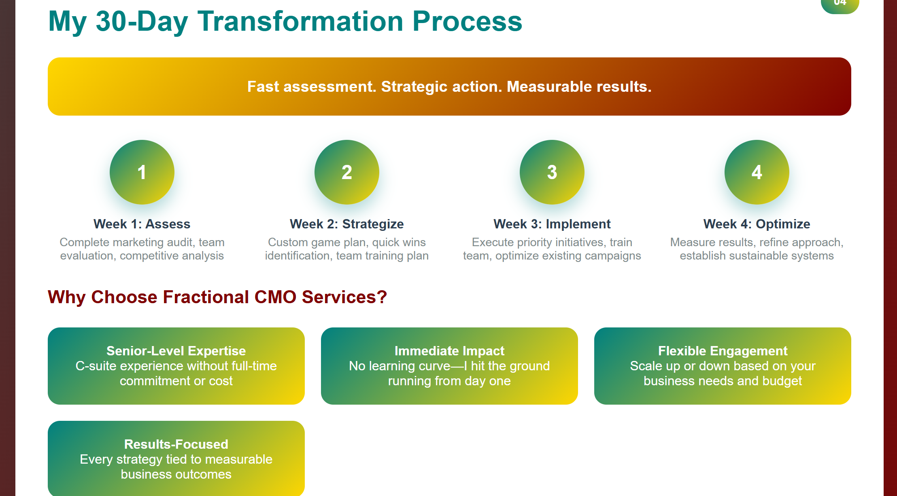

Slide 5
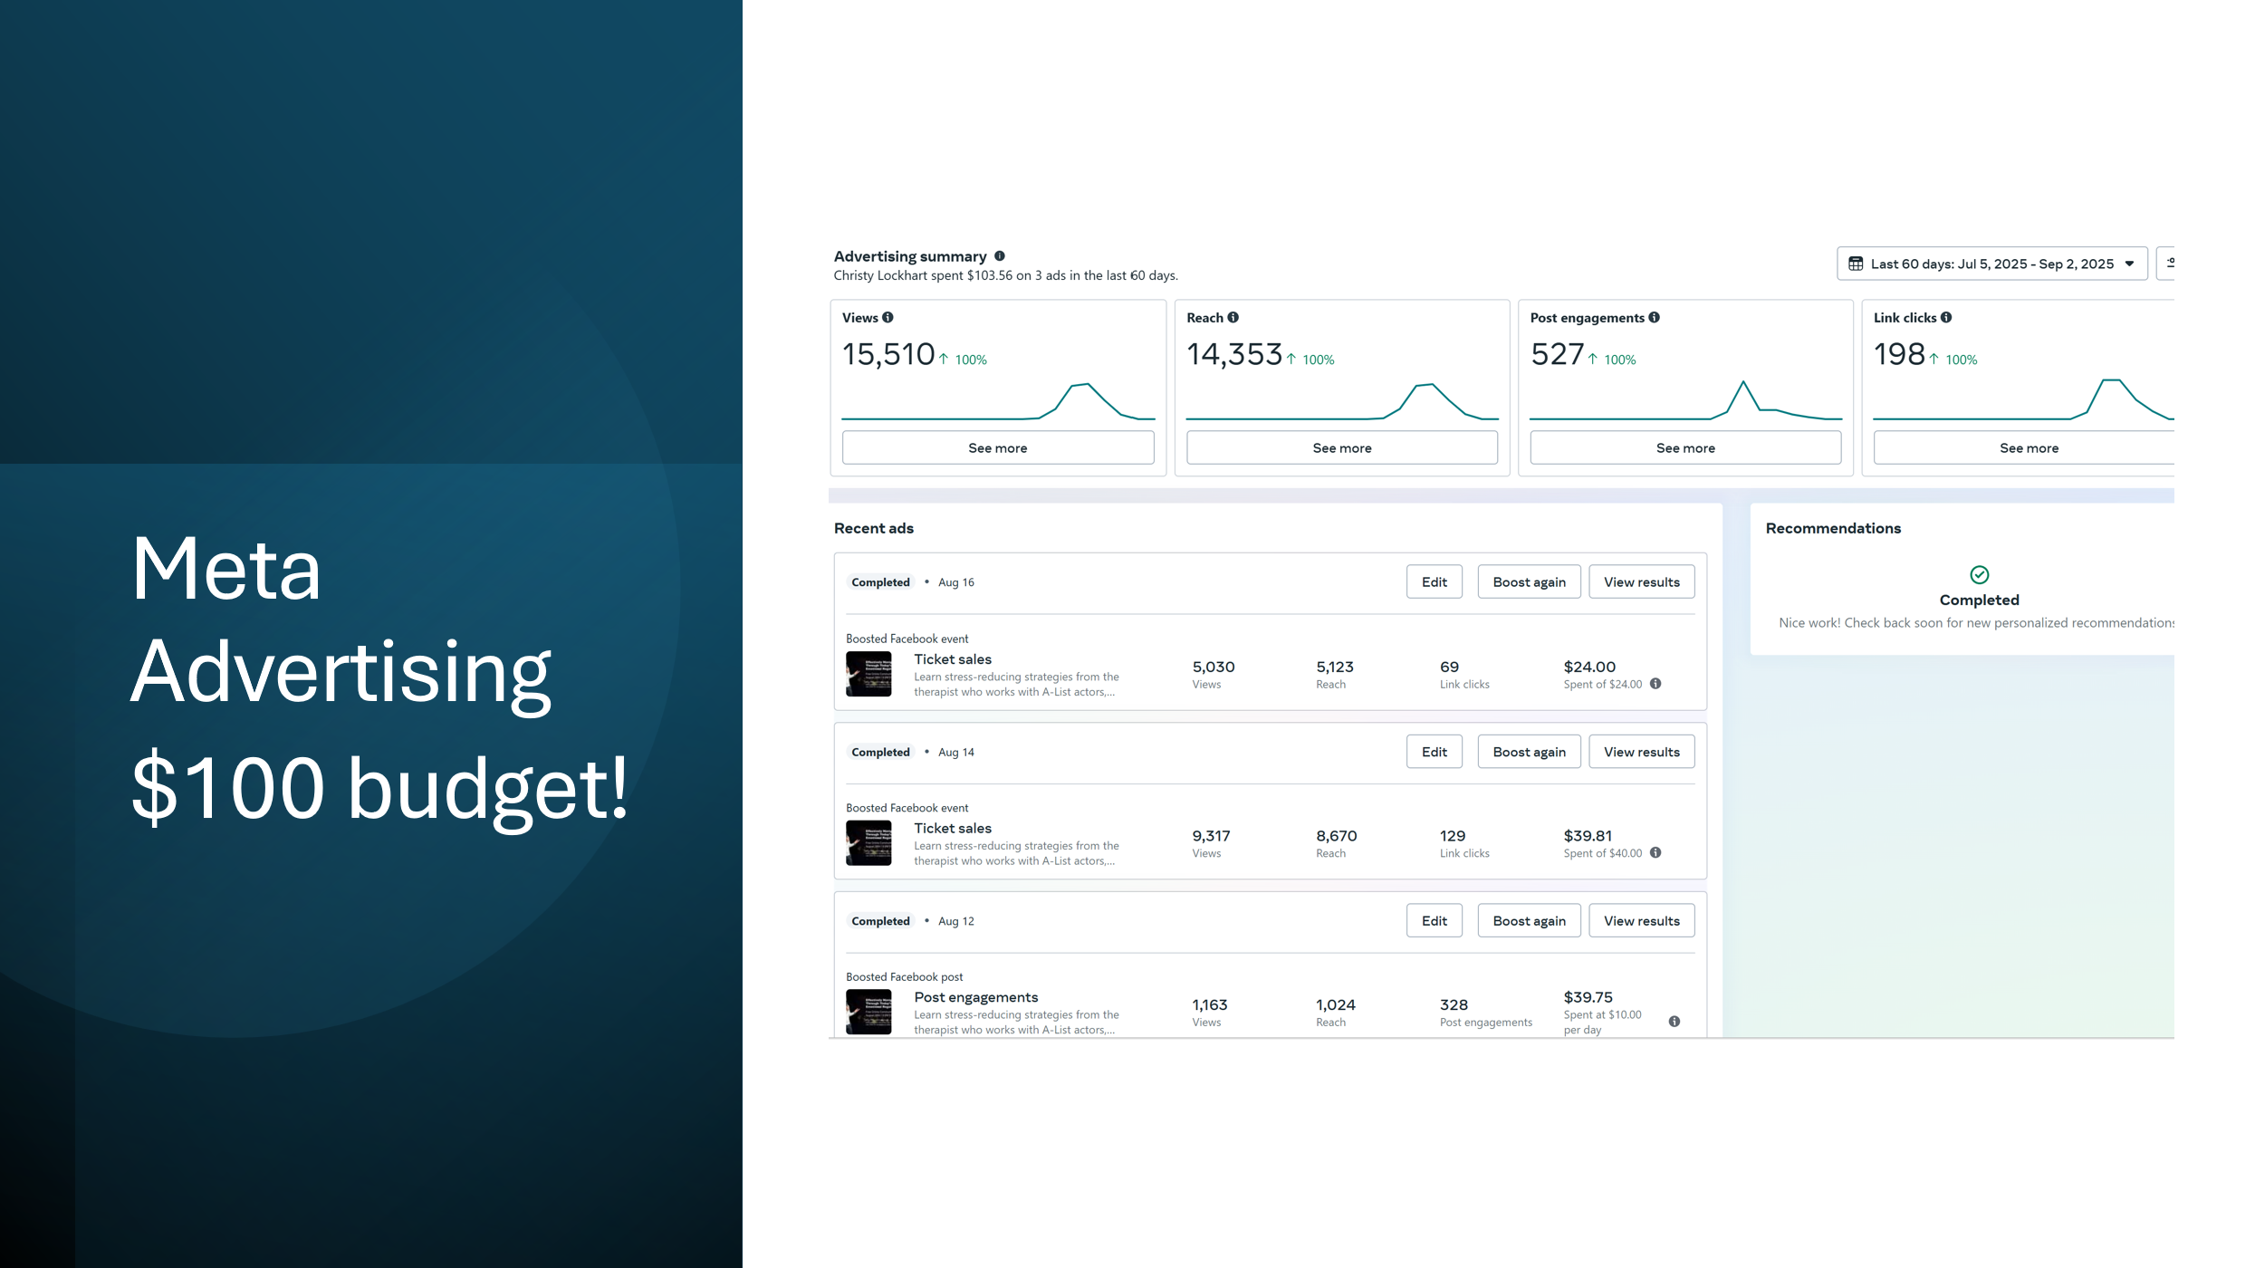
A few more success story highlights

Slide 6
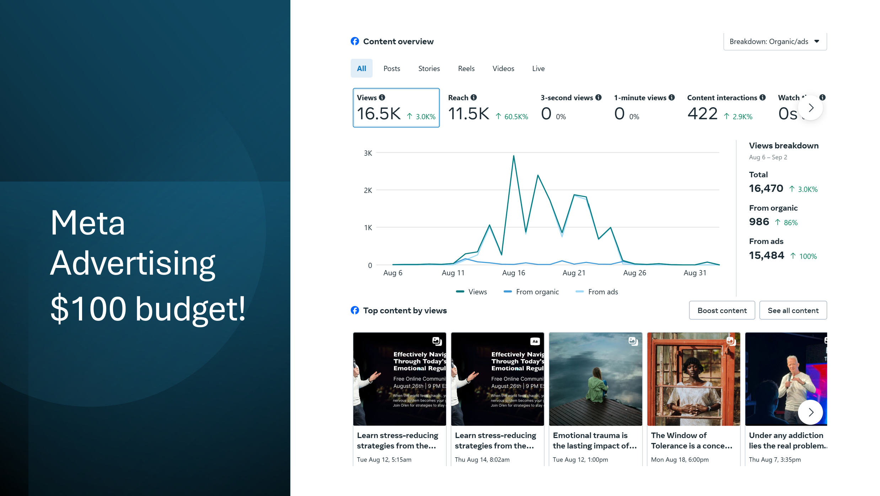

Slide 7
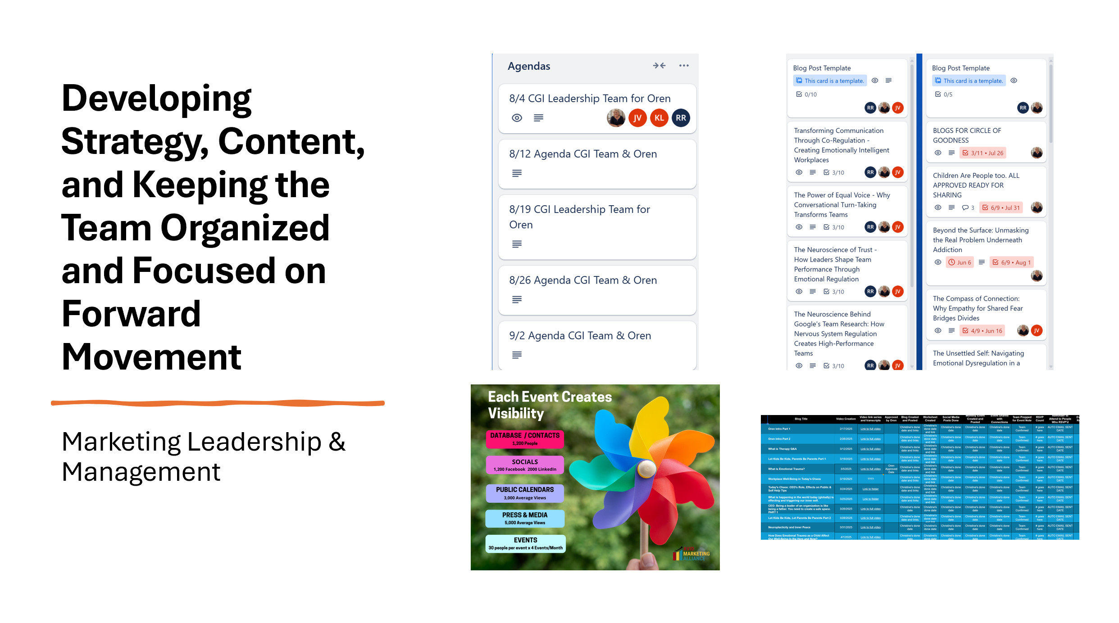
Team organizational skills so we are all on the same page

Slide 8
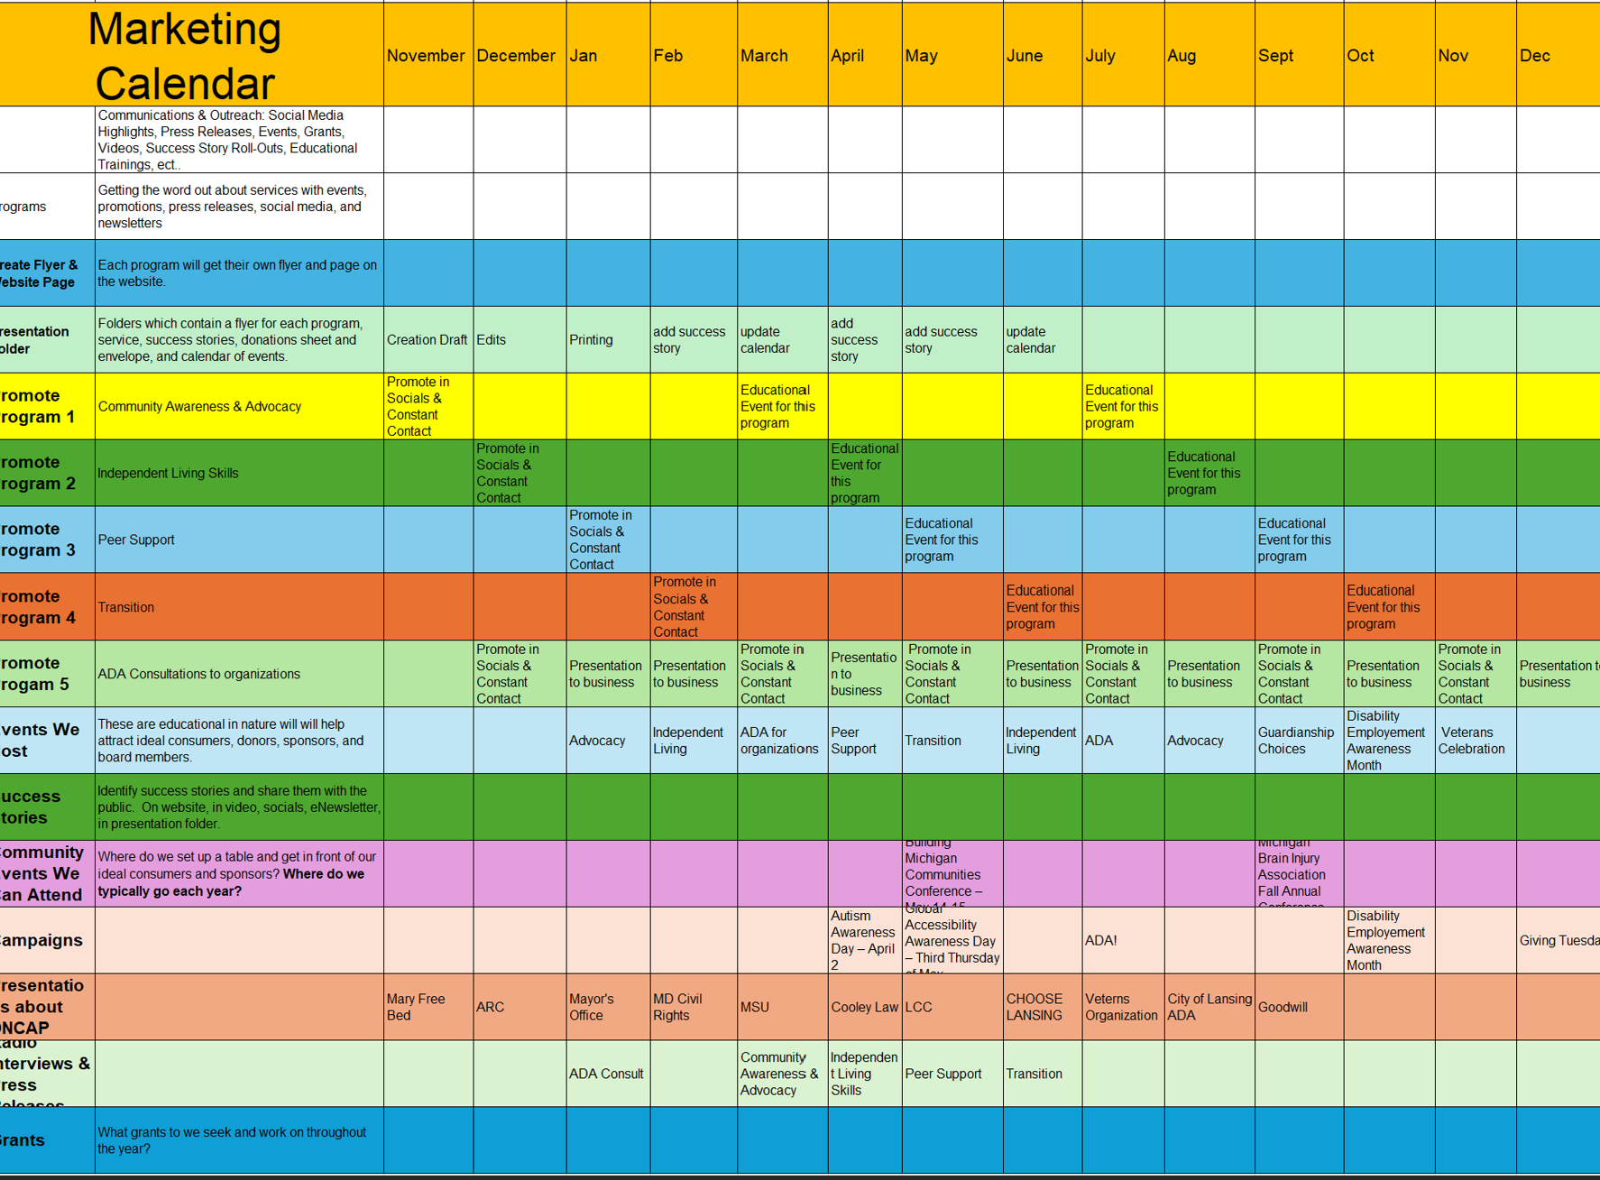
Keeping everyone on track and this also this helps us to decide what needs to be created.

Slide 9
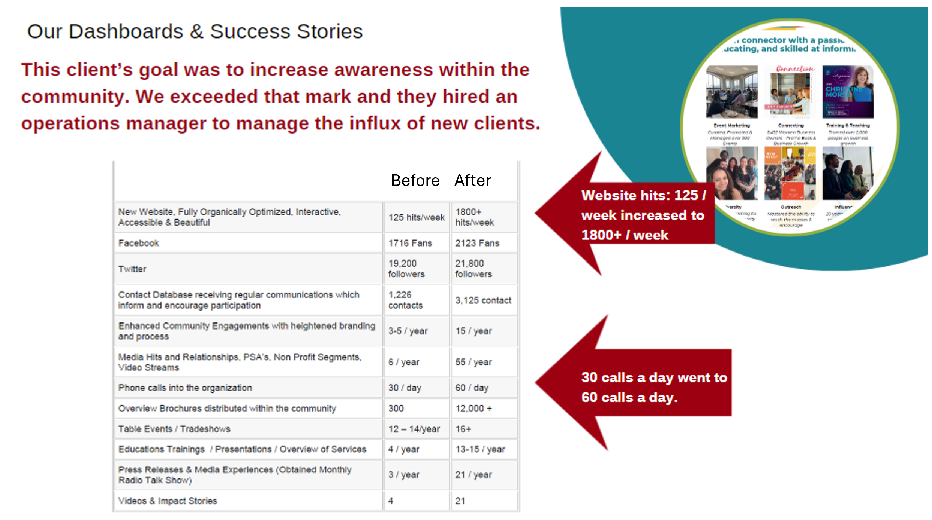

Slide 10


Slide 11
