Slide 1
Annual Parent Meeting April 8th
Agenda :
Kick off from Head Coach - Patrick Snow
(Coaching Staff ) Joe Evans , Jim Dunleavy , Steve Mageri Jr. , Matt Pongrace , Dylan McLaughlin
Booster Info
Parent Q&A

Slide 2
Booster Board Members
Pam Chase
Terry Kimball
Heather Ziolkowski
Renee Fisher
Kim Renaud
*Looking for 2-3 more board members to join by end of the 2021 season

Slide 3
WHS Boosters Website
https://whslacrosse.org/
Schedules :
https://winnacunnetathletics.bigteams.com/
Facebook: Winnacunnet Lacrosse https://www.facebook.com/search/top?q=winnacunnet%20lacrosse
Instagram: WHS Lacrosse
https://www.instagram.com/winnalax/
Twitter: Winnacunnet Lacrosse

Slide 4
2021 Booster Happenings
Preseason player kickoff ( last week )
Preseason Scrimmages ( this week )
Team Photo’s & Senior Pictures w/ Matt Parker ( next week )
Signups for Snacks / Drinks away games only
https://www.signupgenius.com/go/70a084cabad2ca2ff2-whsboys
Signups Team Dinners – WED nights prior to home games on Thursdays
https://m.signupgenius.com/#!/showSignUp/70a084cabad2ca2ff2-whsboys1
Senior Night - tentatively Tuesday May 18th moving time to 6:00PM – looking for 2 more volunteers
Playoffs – TBD will try to do something special that week
Banquet - TBD will likely do outdoors and will need 3 volunteers
Community night / Alumni game to resume 2022
Kickoff to the WEFUND4U fundraiser ( this week )
https://wefund4u.com/fundraiser/winn21/c/106522

Slide 5
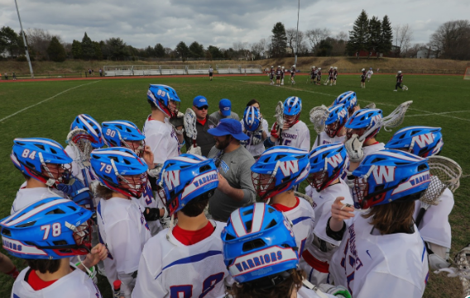
Why Fundraise ?
Food
Indoor Turf Time
Help program w/ Cascade school issued helmets
ALL the nice to have extra’s the not in the budget

Slide 6
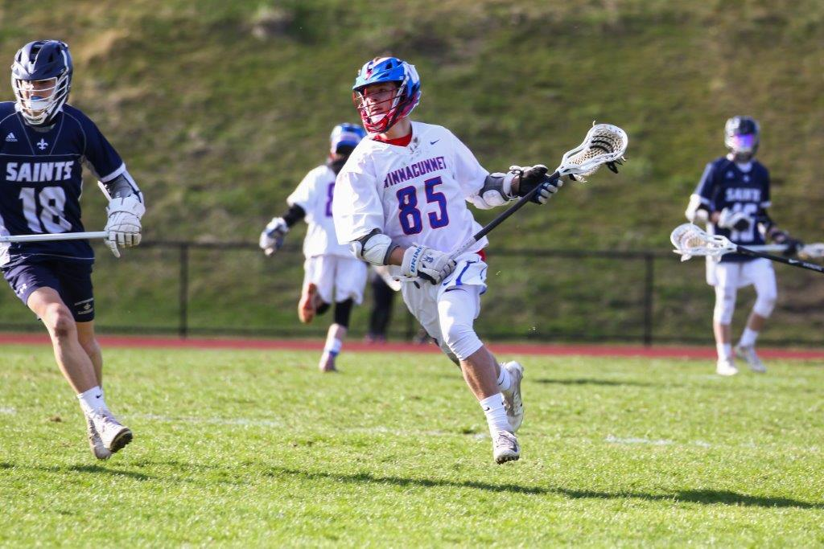
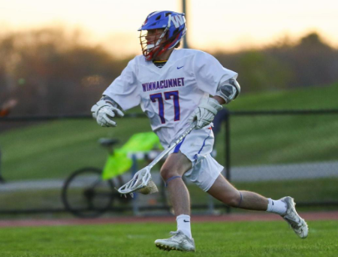
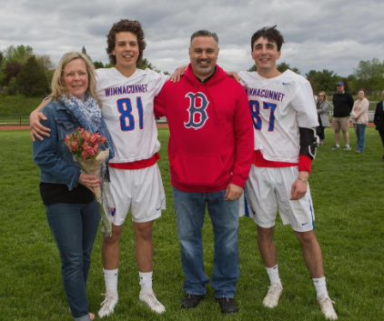
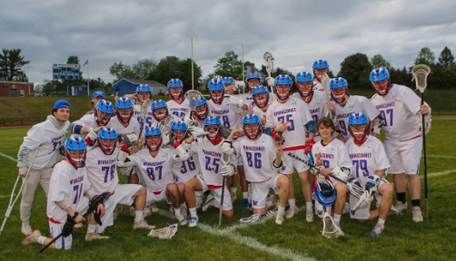
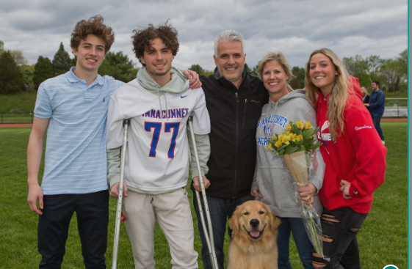
Senior Night
Matt Parker Photos
https://mattparkerphotos.smugmug.com/

Slide 7
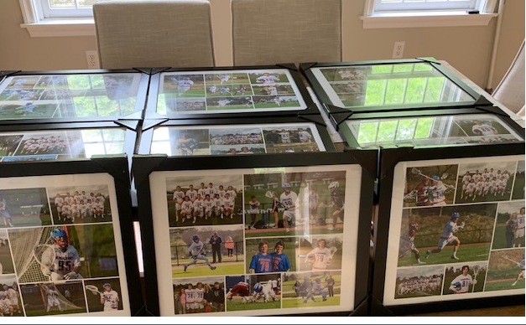
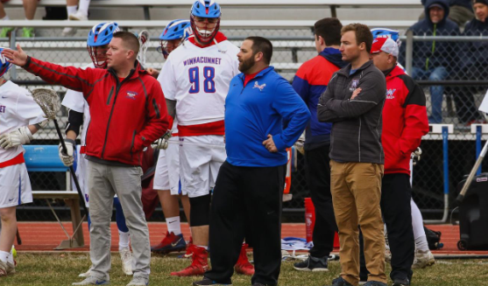
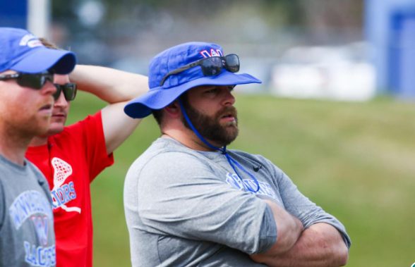
Senior Banners
Banquet & awards
Coaches Gifts

Slide 8
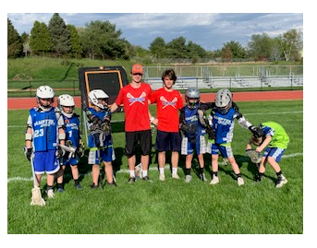
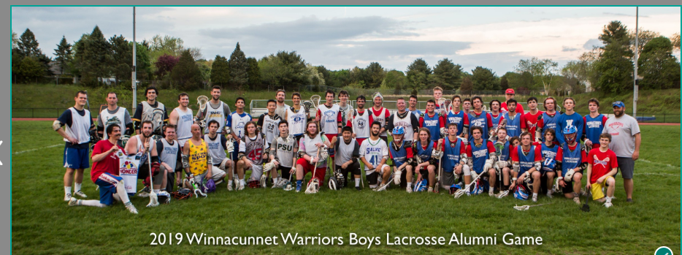
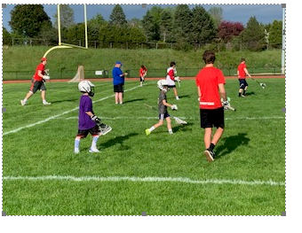
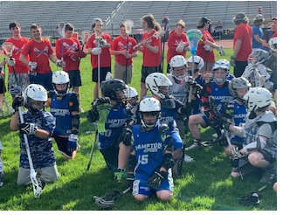
Community Night & Alumni Game

Slide 9
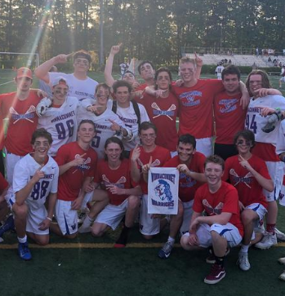
Want to volunteer this year or next ?
E-mail : admin@whslacrosse.org
GO warriors Lacrosse !

