Slide 1
How do we improve learning environments with student voice and action?
Aja J. Jackson, M.Ed
MindUteach.org
Presented at the National Honor Society State Summit
Massachusetts

Slide 2
This is the sense in which I am obliged to be a listener. To listen to the student's doubts, fears, and incompetencies that are part of the learning process. It is in listening to the student that I learn to speak with him or her.
~ Paulo Freire, Pedagogy of Freedom
“There’s a radical – and wonderful – new idea here… that all children could and should be inventors of their own theories, critics of other people’s ideas, analyzers of evidence, and makers of their own personal marks on the world. Its an idea with revolutionary implications. If we take it seriously.” — Deborah Meier
Notes:
Introductions:
Aja--I was a member of the National Honor Society at Cathedral High School, where I developed my leadership voice. -Faculty at Brandeis, former History/Humanities teacher in Boston Public Schools. As a teacher, I learned most from listening to my students. They were eager scholars, thoughtful community members and became interested in being changemakers in their communities. Our Essential Question was, ”How do I participate in the communities that I am a part of? They led through poetry, music, writing, public speaking, and modeling for peers. Everyday, I witnessed growth and re-invigorated my passion for co-learning with my students. I am excited to be inspired by your voices today.

Slide 3
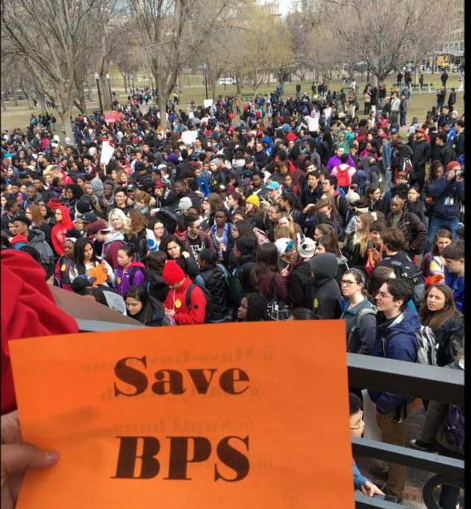
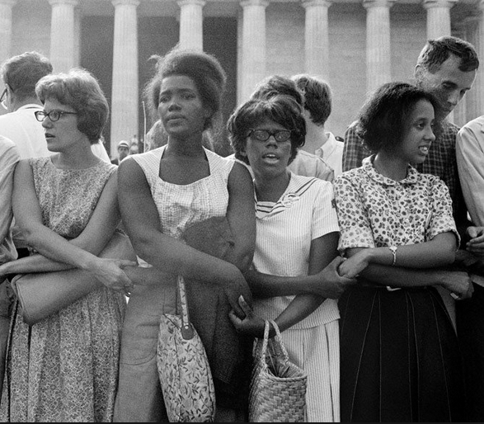
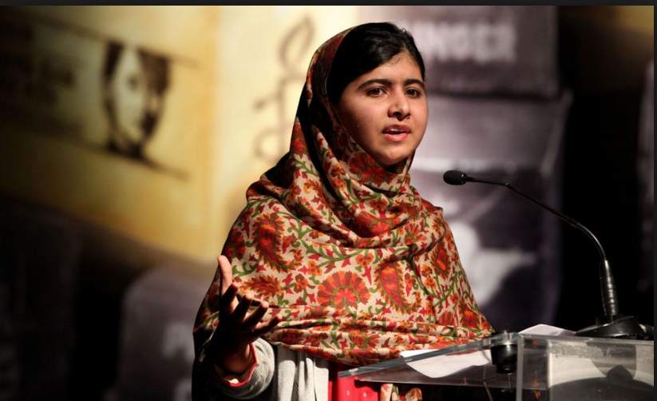
Student impact
April 2017: Inclusivity in Mass schools
King: “What you do this day will have an impact on children yet unborn.”
2016: 3,500 Boston high school students protest funding cuts that would have closed some public schools, cut extracurricular activities and reduced the number of Advanced Placement classes.
After they organized….Mayor Marty Walsh announced the addition of $4.7 million in school funding.
Malala Yousafza
Malala Yousafza: “One child, one teacher, one book, one pen can change the world.”
Notes:
Civil Rights Movement: Student sit ins

Slide 4
Burning Question:
In what ways can we lead and support a positive school culture that values all?
Notes:
Industrial Revolution

Slide 5
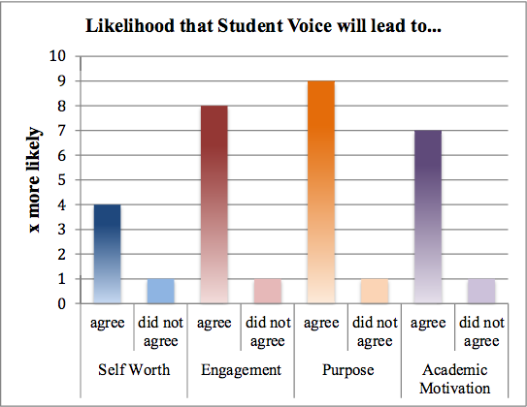
Quaglia Institute for School Voice and Aspirations
Students who believe they have a voice in school are 7x more likely to be academically motivated than students who do not believe they have a voice.
Commitment to promoting and putting into practice the conditions that foster STUDENT & TEACHER VOICE and ASPIRATIONS in SCHOOLS and learning COMMUNITIES around the WORLD.
During the 2015-2016 academic year, Quaglia School Voice Student Surveys were taken by 48,185 students in grades 6-12 in 14 states, including Massachusetts.

Slide 6
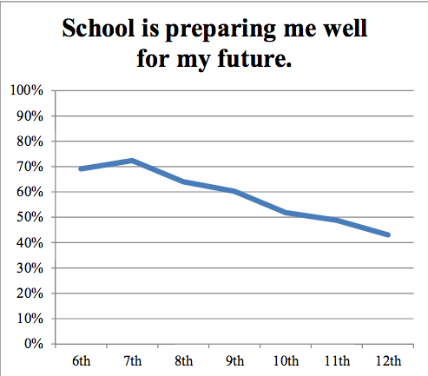
How can we prepare for a world that doesn’t exist yet?

Slide 7
Wisdom from Geese
Share the Load
Communicate with each other
Stand with those who need support.
Assess and [Re] Align

Slide 8
THINK TANK
”Make Like Geese” Think Tank Protocol™️

Slide 9
“Make Like Geese” Student Led Think Tank Protocol
Method:
Think: Take a moment to imagine a school community where everyone is ENGAGED, LEARNING & GROWING, SUPPORTIVE, SUPPORTED and PREPARED. (2 min)
Listen: Share & Listen to ideas! (10)
Learn: What are some key areas and factors that would better promote a positive school climate? Brainstorm ideas on chart paper. (10 min)
Lead: How can I In what ways can we lead
and support a positive school culture
that values all? (10 min).
What actionable step[s] can I take now?
Groups of 4
1-2 Facilitators (Monitor Time and Maintains Goals)
1-2 Speakers (Presents Key Points)
1-2 Scribes
(takes notes & documents salient ideas on chart paper)

Slide 10
