Slide 1


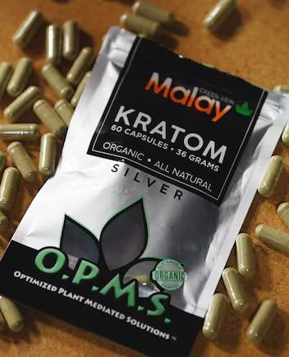
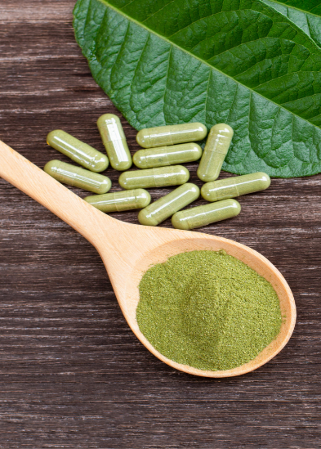
Kratom: Herbal Tea or Gas Station Heroin?
Randall Beaupre, MD
Adnan Celjo, MD

Slide 2



Adnan Celjo, MD
Board-Certified Psychiatry
Randall Beaupre, MD
Board-Certified Emergency Medicine
& Addiction Medicine

Slide 3


Slide 4
Herbal speedball
Seven
K-train
Kratom
7-OH
Thang
Boosters

Slide 5
Kratom: Herbal Tea or Gas Station Heroin?
MOA/
Pharmacokinetics
Response
Considerations
History
Current Uses
Clinical Presentation

Slide 6

What is Kratom?
Mitragyna speciosa (Kratom)
Tropical evergreen tree indigenous to Southeast Asia
Leaves contain over 40 alkaloids
Two main psychoactive compounds:
  Mitragynine (primary alkaloid)
  7-hydroxymitragynine (more potent metabolite)
Available as: leaves, teas, powders, capsules, extracts, liquid shots
Currently legal federally but regulated in some states

Slide 7
What is Kratom?
Traditional Uses
Combat fatigue
Traditional pain management
Mood enhancement
Management of opioid withdrawal symptoms

Slide 8
What is Kratom?
Traditional Uses
Combat fatigue
Traditional pain management
Mood enhancement
Management of opioid withdrawal symptoms
Recent U.S. History
Emerged in U.S. over past 10-20 years
Gained popularity during opioid epidemic
Sold as dietary supplement (not FDA approved)

Slide 9
What is Kratom?
Traditional Uses
Combat fatigue
Traditional pain management
Mood enhancement
Management of opioid withdrawal symptoms
Recent U.S. History
Emerged in U.S. over past 10-20 years
Gained popularity during opioid epidemic
Sold as dietary supplement (not FDA approved)
2016: DEA attempted Schedule I classification
(withdrawn due to public resistance)

Slide 10

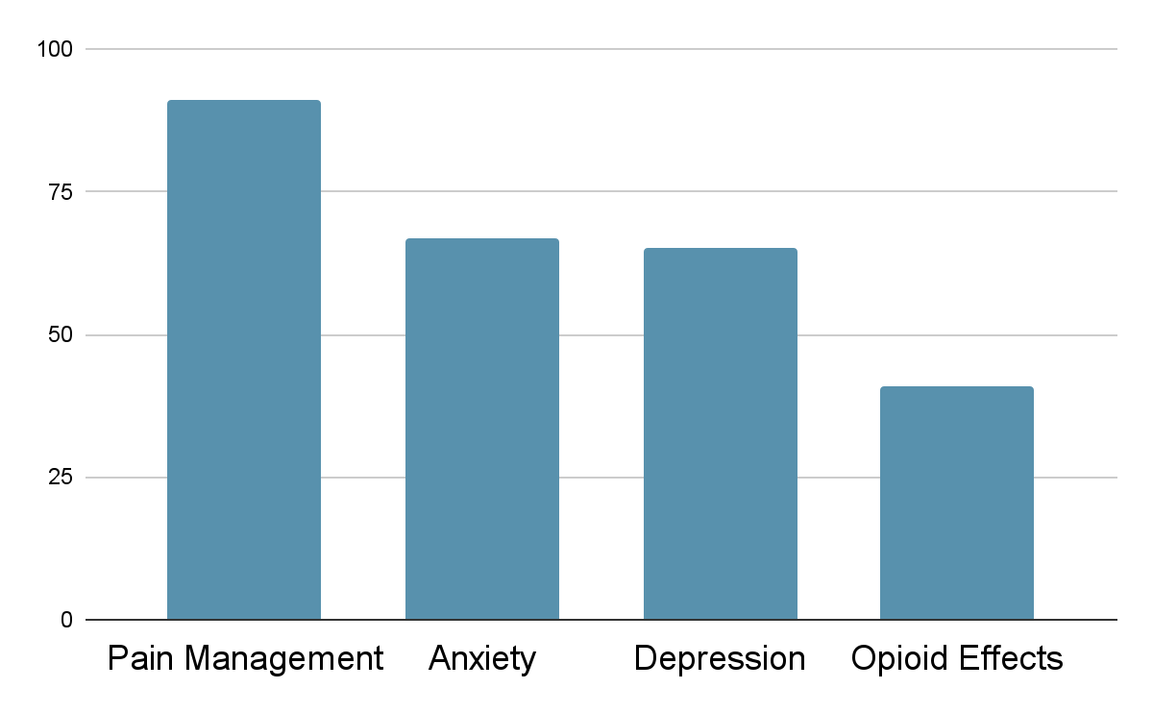
Current Uses
Other:
Energy
Focus
Mood

Slide 11
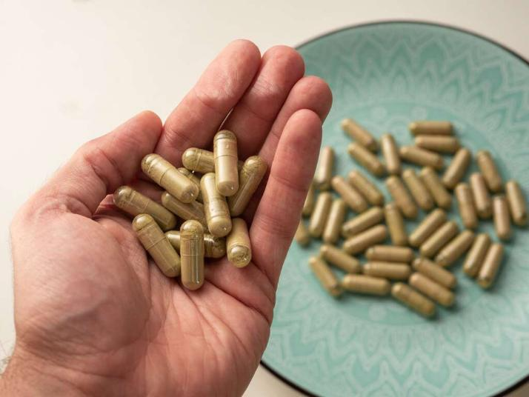
Dosing Patterns
Common doses: 1-3 grams
Daily use reported in 59% of users
Primarily oral route
Dose-dependent effects (stimulant at low doses, opioid-like at higher doses)

Slide 12
Dosing Patterns
Common doses: 1-3 grams
Daily use reported in 59% of users
Primarily oral route
Dose-dependent effects (stimulant at low doses, opioid-like at higher doses)

Slide 13
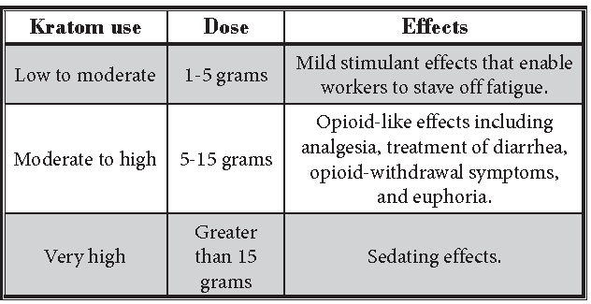
Dosing Patterns

Slide 14

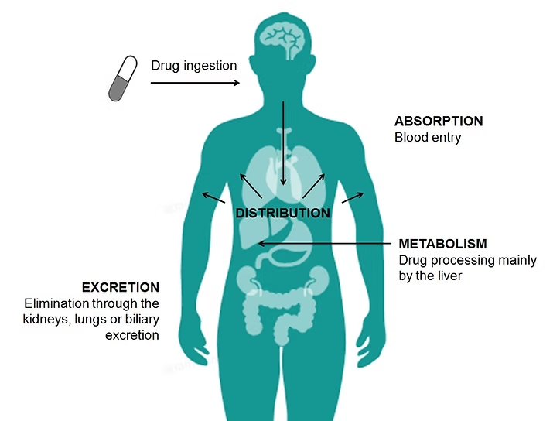
Mechanism of Action and Pharmacokinetics

Slide 15
Receptor System | Alkaloid | Activity Type | Clinical Effect
μ-Opioid Receptor | Mitragynine | Weak agonist | Mild analgesia, minimal respiratory depression
μ-Opioid Receptor | 7-OH | Strong partial agonist (G-protein biased) | Strong analgesia, respiratory depression
κ-Opioid Receptor | Both alkaloids | Antagonist | Reduces dysphoria, opposes sedation
δ-Opioid Receptor | Both alkaloids | Antagonist | Unclear clinical significance
α2-Adrenergic Receptors | Mitragynine | Agonist | Sedation at high doses Hypertension at low doses
Serotonin Receptors | Mitragynine | Modulator | Mood elevation Potential serotonin syndrome risk
Dopamine Receptors | Mitragynine | Modulator | Stimulation, mood effects, reward activation

Slide 16

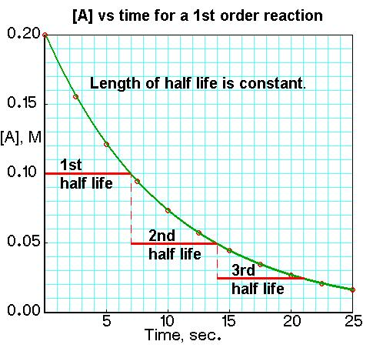
Peak concentration
40 min - 4.5 hrs
1/2 Life
~24 hrs

Slide 17
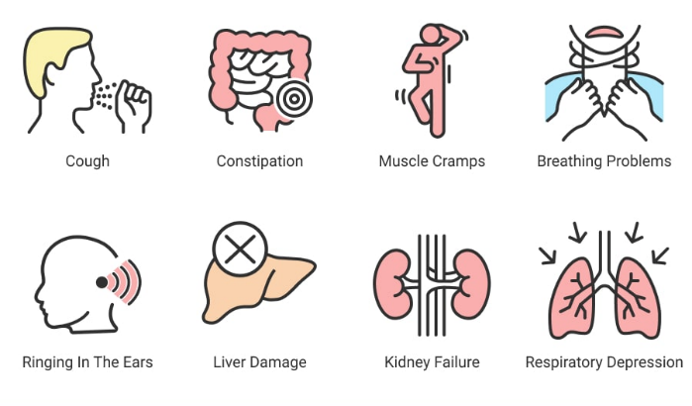
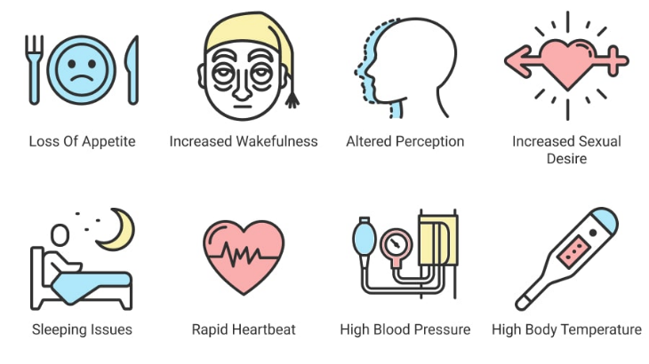
Clinical Signs and Symptoms
Stimulant Effects
+
Opioid Effects

Slide 18
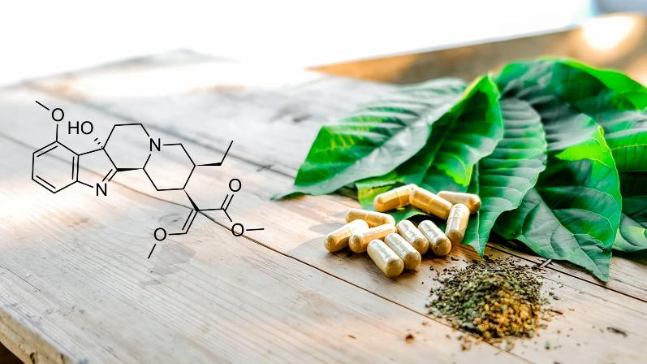
7-hydroxymitragynine - what’s the big deal?
Mitragyna speciosa
Mitragynine
liver
7-Hydroxymitragynine
(trace amounts)

Slide 19
Receptor System | Alkaloid | Activity Type | Clinical Effect
μ-Opioid Receptor | Mitragynine | Weak agonist | Mild analgesia, minimal respiratory depression
μ-Opioid Receptor | 7-OH | Strong partial agonist (G-protein biased) | Strong analgesia, respiratory depression
κ-Opioid Receptor | Both alkaloids | Antagonist | Reduces dysphoria, opposes sedation
δ-Opioid Receptor | Both alkaloids | Antagonist | Unclear clinical significance
α2-Adrenergic Receptors | Mitragynine | Agonist | Sedation at high doses Hypertension at low doses
Serotonin Receptors | Mitragynine | Modulator | Mood elevation Potential serotonin syndrome risk
Dopamine Receptors | Mitragynine | Modulator | Stimulation, mood effects, reward activation

Slide 20
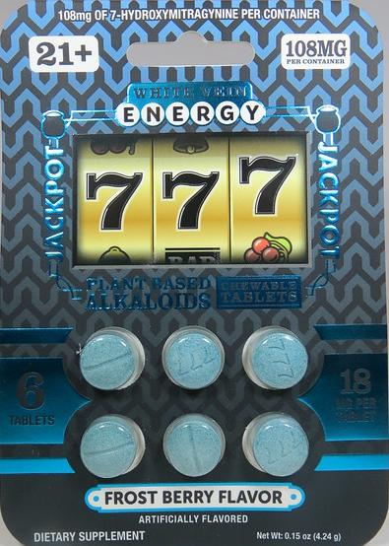
7-hydroxymitragynine - what’s the big deal?
Severe respiratory depression
Tolerance and physical dependence
Fatal overdoses,
Escalating use patterns (similar to traditional opioids)
Degradation to potentially toxic byproducts
*** Opioid effects are 13-40x Morphine Equiv

Slide 21

7-hydroxymitragynine - what’s the big deal?
Severe respiratory depression
Tolerance and physical dependence
Fatal overdoses,
Escalating use patterns (similar to traditional opioids)
Degradation to potentially toxic byproducts
*** Opioid effects are 13-40x Morphine Equiv

Slide 22
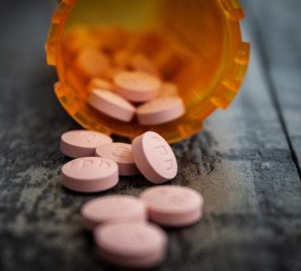
7-hydroxymitragynine - what’s the big deal?
Drug Interactions
Inhibits CYP450 enzymes and P-glycoprotein
Can potentiate effects of:
  Other opioids
  CNS depressants
  Medications metabolized by CYP450

Slide 23

How popular is kratom?
# US Poison Center Cases
3434
1200%
258
2015
2025

Slide 24
How popular is kratom?
Estimated
24 million kratom users in the US
(~9% of US pop)
# US Poison Center Cases
3434
1200%
258
2015
2025

Slide 25
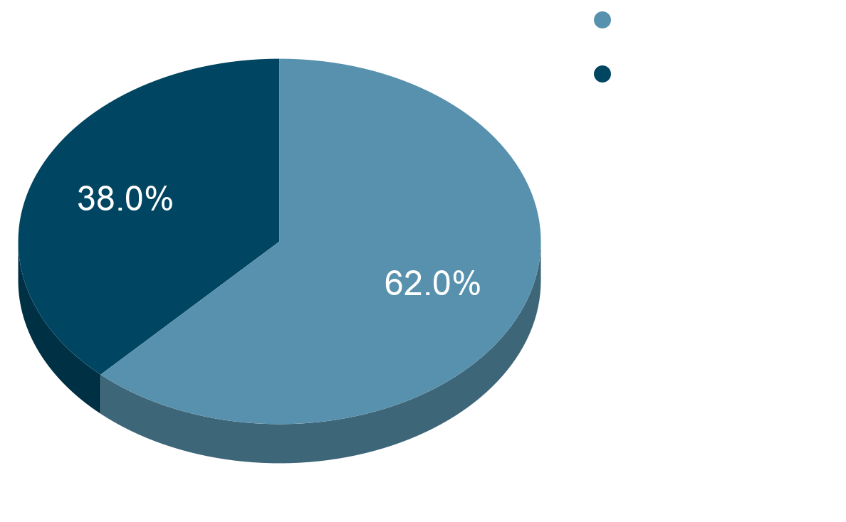
Kratom as an Only Substance

Slide 26
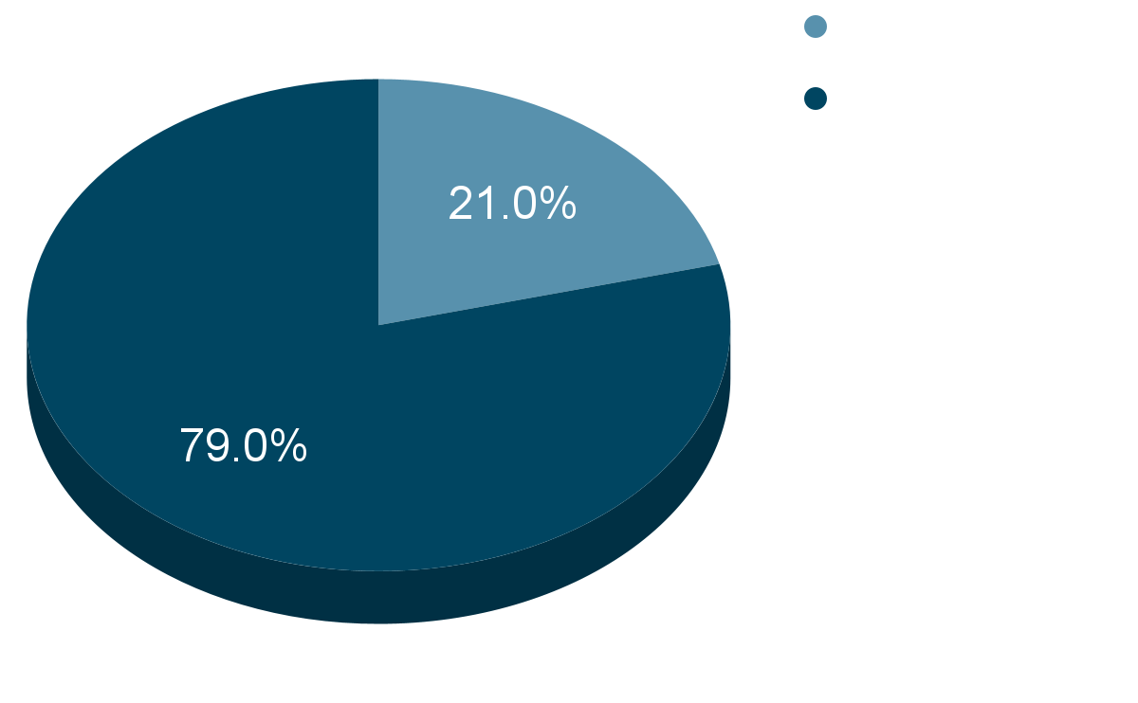
Deaths from Kratom

Slide 27
Is it Regulated?

Slide 28
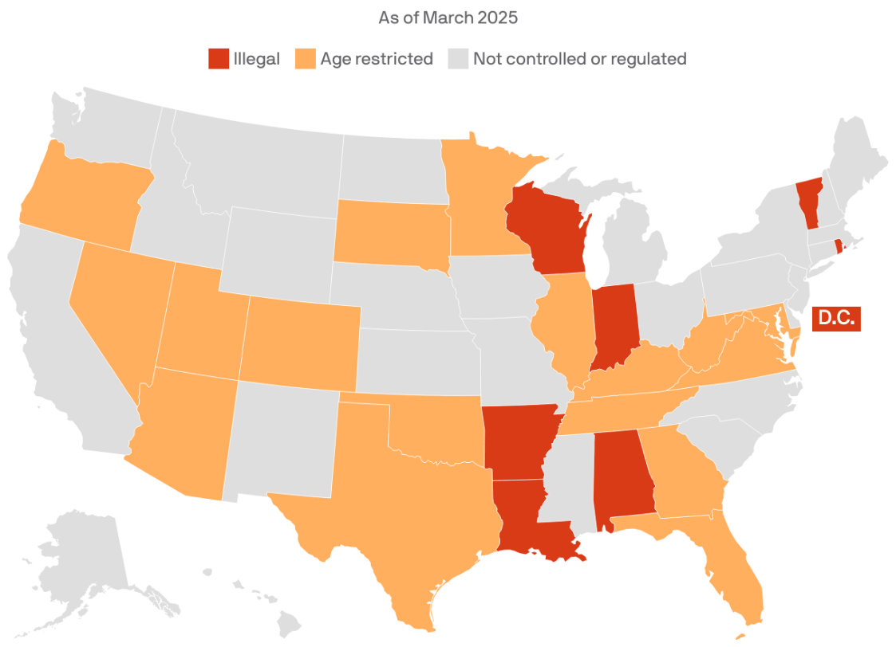
Is it Regulated?

Slide 29
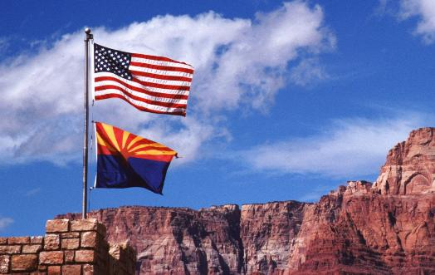
Trends
Legal Status in Arizona
Currently legal for adults in Arizona
Not regulated as controlled substance at state level
Available in smoke shops, online, specialty stores

Slide 30

Emergency Response Considerations
Look for kratom products: powders, capsules, teas, liquid shots
Often labeled as "Mitragyna speciosa" or brand names (e.g., OPMS)
May be combined with other substances
Naloxone: Variable response
Supportive care is primary Tx
Monitor vital signs (BP, HR can be variable)
Assess for polysubstance use
Effects typically resolve within 24-48 hours
Does NOT show on standard drug screens
Ask specifically about kratom/herbal supplement use
Document product information if available
Consider drug interactions with other medications
Scene Assessment
Key Points
Clinical Management

Slide 31

High-Risk EMS Scenarios
Polysubstance use (especially with opioids, benzodiazepines, alcohol)
Older adults (increased adverse reactions, falls risk)
Patients on multiple medications
High-potency extract products vs. traditional leaf preparations

Slide 32
EMS Takeaways
Kratom is an emerging substance with 1,200% increase in poison center reports
Does NOT appear on standard drug screens - must ask specifically
Half-life of ~24 hours - prolonged effects possible
Variable presentation: opioid-like, stimulant, or mixed toxidrome
Naloxone may or may not be effective - try if opioid-like presentation
Most dangerous when combined with other substances (79% of deaths)
Supportive care is primary treatment
Effects typically resolve within 24-48 hours

Slide 33
EMS Questions to Ask
(in addition to normal H&P ?s)
Have you used any kratom?
Full-spectrum/leaf?
7-OH?
Have you taken any herbal supplements or natural products?
Have you taken any other substances?

Slide 34

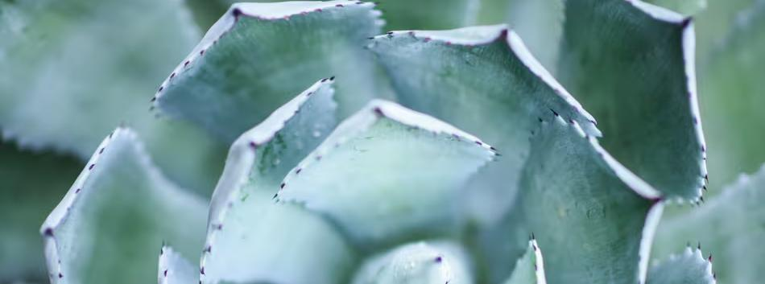
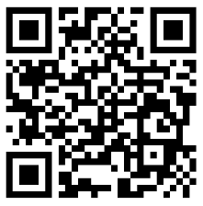
Interventional Wellness: Optimize. Excel. Sustain.
Ketamine-Assisted Psychotherapy
Stellate Ganglion Blocks
TMS (EXOMind technology)
EMSculpt
EMSella
Psychiatric Care
Addiction Treatment
Packages Available
Services provided by board-certified physicians
Special First Responder Pricing

Slide 35
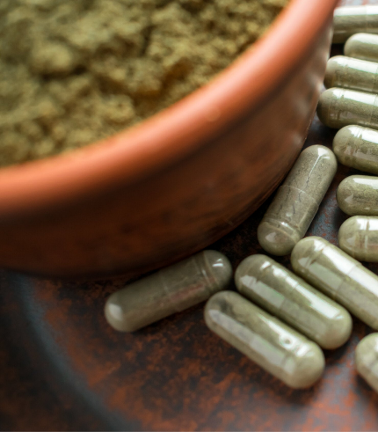
Kratom: Herbal Tea or Gas Station Heroin?
Questions?
Comments?
Randall Beaupre, MD
Adnan Celjo, MD

