Slide 1
BrainTap for Firefighter Wellness
A Practical Tool for Stress, Sleep, and Recovery
Notes:
Introduce topic.
My Experience
Vityana
Participant

Slide 2
Why This Matters
Constant activation in the job
The challenge of coming back down
Recovery is not automatic—it must be trained
Notes:
Firefighters are highly activated—this is about coming back down.

Slide 3
Firefighter Reality
Adrenaline spikes
Interrupted sleep
Carryover stress
Difficulty shutting down
Notes:
Connect to their lived experience on shift.

Slide 4
The Nervous System
Gas pedal = activation
Brake pedal = recovery
Most firefighters run heavy on the gas
Notes:
Explain gas vs brake in simple terms.

Slide 5
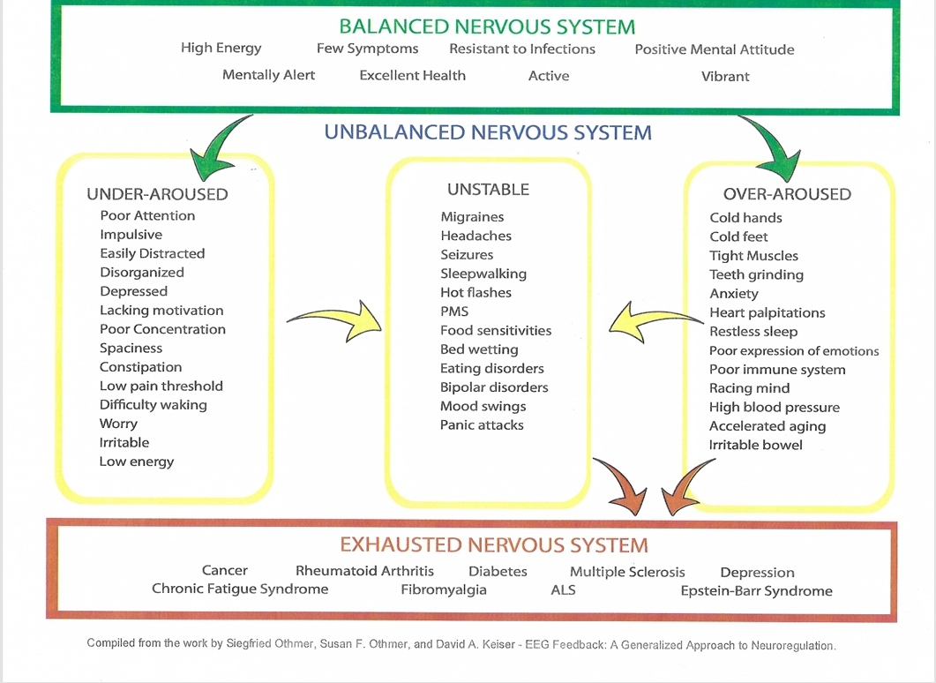

Slide 6
What Happens Without Recovery
Poor sleep
Irritability
Anxiety
Mental fatigue
Notes:
Highlight consequences of poor recovery.

Slide 7
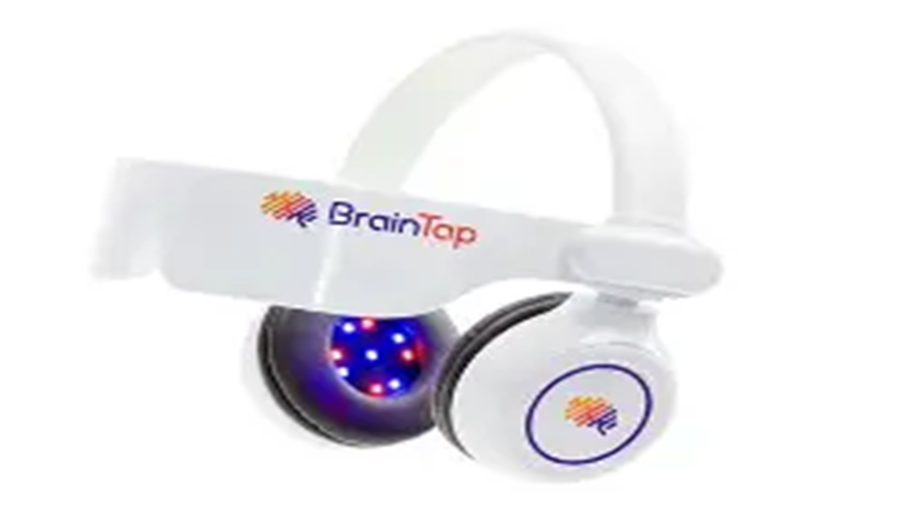
What Is BrainTap?
Headset + app
Guided sessions synchronized audio, light, binaural beats
Helps shift brain state quickly
Notes:
Explain BrainTap simply.

Slide 8
Dr Patrick Porter on Braintap
https://www.youtube.com/watch?v=SSpX_x9x4wk

Slide 9
What It Does
Promotes relaxation
Supports deeper recovery
Helps downshift on demand
Notes:
Describe what it does in plain language.

Slide 10
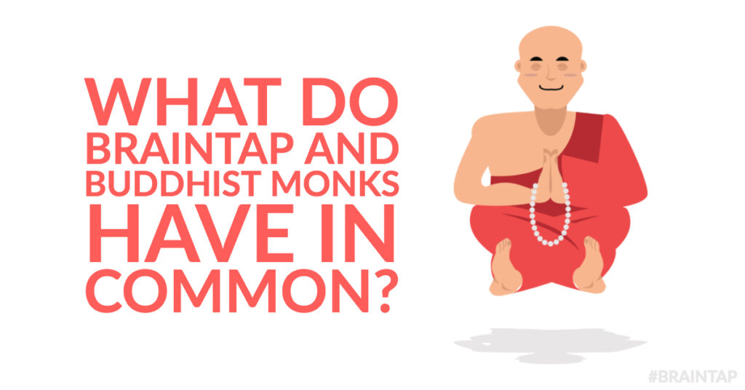

Slide 11
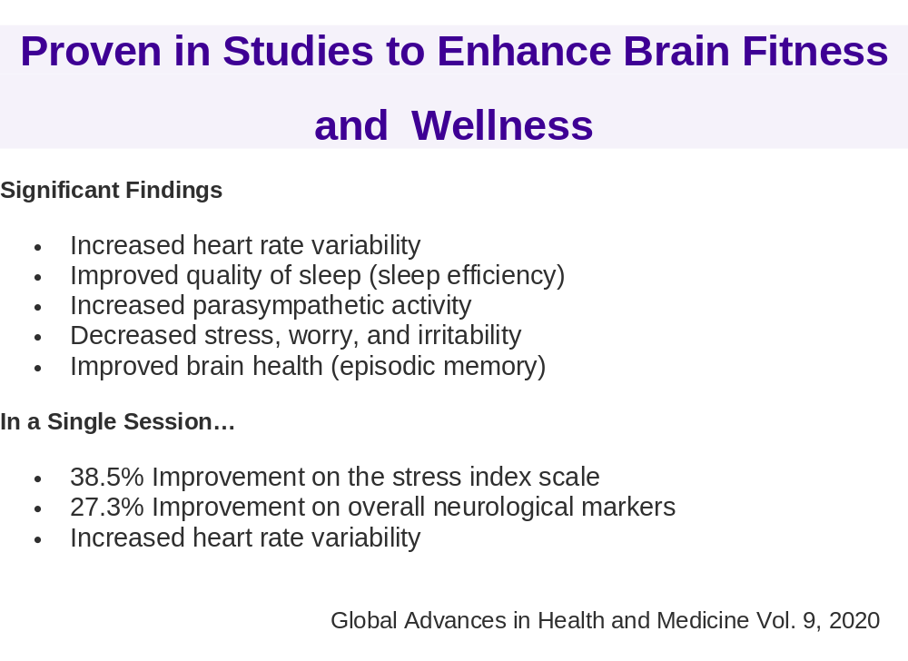

Slide 12
Why It Helps
Reduces stress
Improves regulation
Supports sleep
Decreases anxiety
Guided, brief sessions
Passive
Notes:
Brief benefits overview.

Slide 13
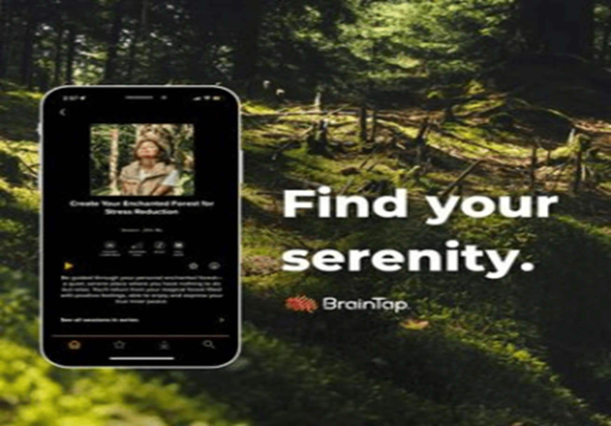
Braintap App

Slide 14
Session Selection
Morning, afternoon or night (sleep)
Voice, music or Binaural Beats only
Presenter
Length of session
Series-cognitive decline, weight loss, addiction, sleep

Slide 15
Session Categories
Brain Training
Breathwork
Chiropractic
Christian
Life Improvement
Learning
Meditation
Menopause
Nutrition
Pain
Sleep
Sports & Athletic Performance
Notes:
Briefly describe sessions they can recommend.

Slide 16
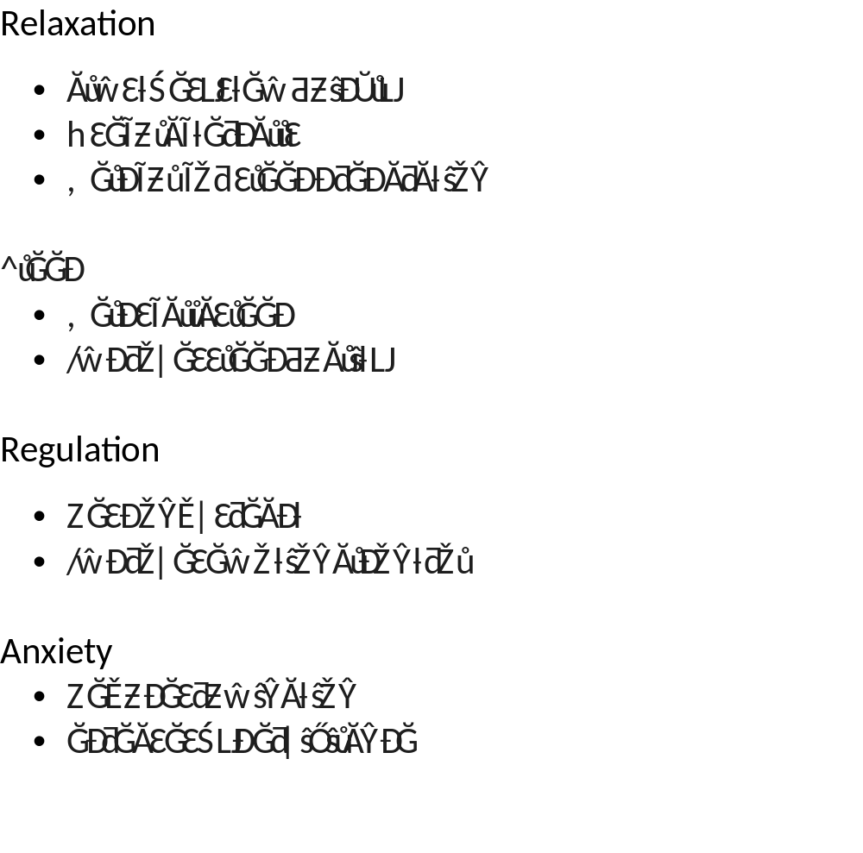
Key Benefits
Notes:
Tie directly to sleep struggles.

Slide 17
Key Takeaways
Recovery needs to be intentional, but it doesn’t have to be difficult
BrainTap is portable, passive and pleasant
Simple, practical tool, no counterindications
Stack with other modalities
Notes:
Reinforce main points.

Slide 18
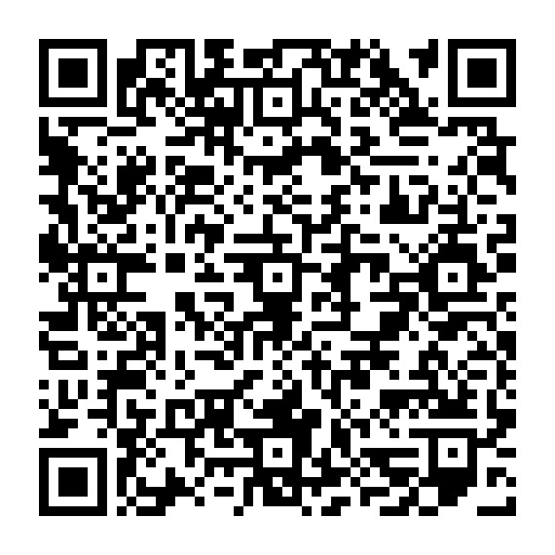
100 Club Benefit

Slide 19
Questions

