Slide 1
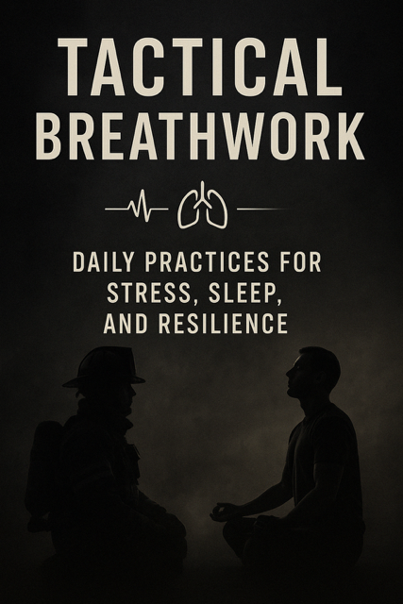
Breathing as it applies to the fire service.
Fire fighter/ breathwork facilitator
Darien Gibson

Slide 2
My journey with breathing
Introduced to breathwork class in 2023 by 343 fund.
Mandatory class where I was relatively uninterested yet open minded.
Recognized immediate benefits
FDNY breath facilitator
Loka school for breathwork
Online classes once a month for first responders and military a crossed the country.
Slow integration into Glendale FD. My crew to rovers then Fitness Cadre and soon to be academy.

Slide 3
What is breath work?
Holotropic breathwork: rhythmic breathing combined with sound.
Wim hof: cycle of hyperventilation and breath holding, can be combined with cold exposure.
Pranayama- ancient yogic techniques for grounding to self and earth.
Tactical breathwork: used in military, firefighting and law enforcement settings to rapidly lower stress and improve focus.
Sports related breathwork: often combines multiple techniques tailored to what actionis being taken.

Slide 4
How does it apply to us?
Acute stressful situations
Post stressful incident
Emotional regulation with difficult patient or environment
Patient condition: anxiety, pregnancy, emotional distress
Workouts
FIRE FIGHTING (bottle control, mayday, B.O.A, etc…)

Slide 5
How does it apply to us Cont.
Health
Lets break down breath work to the molecular level. Your foundation of health for your entire body comes down to you are only as healthy as the cells that make you up.
We can all agree on that how healthy your cells is directly related to your blood stream.
Every cell must grow and live by a healthy blood stream. If that is polluted, then your cells are weak.
The Prescence of oxygen is the absence of disease.

Slide 6
How can we clean the pollution
Breath is the control button to the mechanism that controls your circulatory system. It gives oxygen to your cells which is obviously necessary for survival
your LYMPH system produces white blood cells that clean your circulatory system. It is the bodies sewage system
Unlike the heart, the lymph has no pump
The only way lymph can move around is by deep breathing and moving your body.
Digestion, ATP (how we produce energy), brain fog, circulation.

Slide 7
Nervous System
Why do we tell anxiety patients to control and slow their breathing?
Deep slow controlled diaphragmatic breathing is a control switch between fight or flight or rest and digest.
For high risk high stress professions there are times where the only tool we have left is breathing.
Exp: extreme fatigue, lost or trapped, over stimulation, emotional regulation, etc….

Slide 8
Breathing Mechanics
Diaphragm controls your breathing autonomically.
Circular shaped and expands.
Close your eyes and take a deep breath. Pay attention to your diaphragm.
Did you breathe towards your spine or away?
Babies and animals belly breathe.
Somewhere along the way… we stop.

Slide 9
Common techniques for high stress professions
When to use these techniques?
CAUTION: Never do any breathing techniques while driving or operating vehicle. Sit/lay down for more intense techniques.
Box breathing
In through the nose x 4, hold x 4, out x 4, hold x 4.
This creates a structured and regulated routine for signaling to our nervous system that “we got this!”
Skip breathing: bottle preservation.

Slide 10
Controlling breathing patterns
When to use these techniques? Every day.
Breath of fire: ab work out, intercostal workout, CO2 to oxygen ratio laying dormant in the lower lobes. (2 minutes)
Signals fight or flight response.
Then bring it down.
We are in control!
Shamanic breathing: Belly, Chest, out.
Full circular motion. No natural pause.

Slide 11
Sleep. Cortisol. Anxiety.
Set your intention before.
Extended exhales.
Make it easy. Double the length of breath when exhaling.
Observe everything.
4-6-8 method.
If mind is racing, you focus on the breath!

Slide 12
conclusion
Breathwork is necessary
Stay open minded
Reach out for any info or to schedule a class.
Remember to laugh and remember to breathe

Slide 13
Contact info
Email: Stoicbreathwork@gmail.com
Cell: 623-606-3433
Darien Gibson

