Slide 1
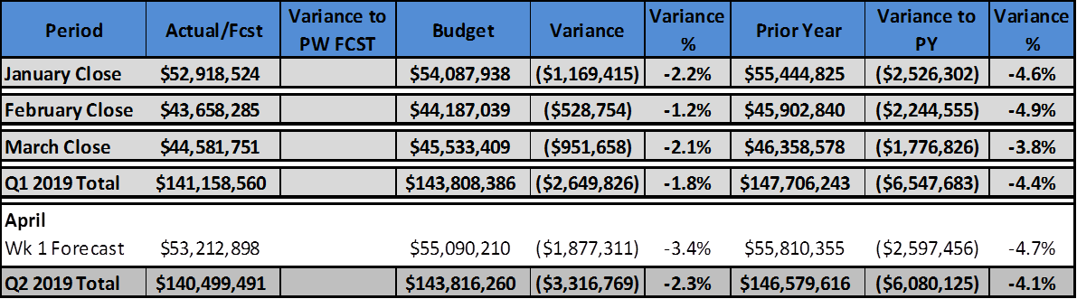
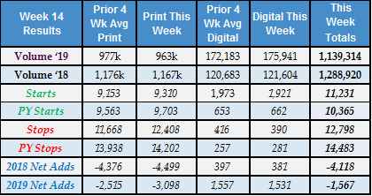
Consumer Revenue
CONSUMER MARKETING
Note: Revenue reflects Pro-forma results including all acquisitions with the exception of Oklahoma City and Schurz..
Revenue Review (Pro-forma)
    SC ended March at $260.3k (-4.3%) under budget and $313.7k (-5.2%) below PY.
    Total HD+Other revenue in the Mar. was $691.3k (-1.7%) under budget and $1.46MM (-3.6%) below PY.
Top 16 Newspapers (see detail on page 2)
    Overall revenue at the top 16 newspapers improved $158.5k from the March week 4 forecast to end the month $212.7k (-0.9%) under budget and $73.6k (-0.3%) below PY.
    SC ended March down $36.3k (-1.3%) to budget and $23.7k (-0.8%) below PY.
    HD+Other improved $190.1k WoW with most of the improvement in Columbus (+$115.7k); HD+Other ended the month under budget $176.4k (-0.9%) and $50.0k (-0.2%) below PY.
Newspapers Outside Top 16 (see detail on page 2)
    For non top 16 newspapers, total circulation revenue ended March $739.0k (-3.3%) under budget and $1.70MM (-7.4%) below PY.
    SC in March was $224.1k (-7.0%) under budget and $290.0k (-8.9%) below PY.
    HD+Other finished March $514.9k (-2.7%) under budget and $1.41MM (-7.1%) below PY.
Note: Digital subscribers include all properties on Piano VX & MPG properties. Print reflects only “Top 60”markets. The 2018 net adds are adjusted to include Austin, WPB, Akron, Eugene and Pueblo activity.
Key Drivers
Net adds again improved YoY in print (+1,401), digital (+1,150), and in total (+2,551).
Digital starts and net adds picked up in week 14 with 1,921 starts and 1,531 net adds; unusually high stops in WPB tied to non-pays are being investigated and we expect the in-app purchase flow meter to be enabled this week across top tier markets.
Print starts in the top 60 were down 393 (-4%) YoY due primarily to a decline in other starts (-351). Declines in OTM (-158) and voluntary (-152) were offset by an increase in DM (+196). In the top 16, print starts were up 300 (+6%) YoY driven by DM (+197) and payment restarts (+127). DM starts were up 122% YoY while OTM was up 15% YoY.
Top 60 print stops were down 1,794 (-13%) YoY and down 2,673 (-18%) WoW. Non pay stops declined by 1,374 (-17%) which drove both YoY and WoW declines. Compared to PY, service stops were up 79% and price stops were up 14%; all other stop codes were favorable. At the top 16, total print stops were down 477 (-7%) YoY which was also driven by non pay (-608). Service stops are an issue at +53% YoY in week 14 and +23% YTD vs PY.
Digital paid campaigns (social, search and display) delivered 52K impressions to Piano campaign landing pages with 60 directly-attributed starts.

Slide 2
Consumer Revenue
CONSUMER MARKETING
Top 16 Newspapers
    The March miss to budget at the top 16 newspapers was driven by Austin (-$140.1k) and Providence (-$136.4k). Ten other top 16 papers were under budget by amounts ranging from $50 to $67.8k. These misses were partially offset by a large budget excess in Columbus (+$309.4k) and smaller excesses in Jacksonville (+$51.1k), Erie (+$43.8k) and Sarasota (+$23.1k)
    The excess to budget in Columbus is primarily due to a premium edition moved to March from later in the year which generated an additional $424.7k.
    Erie also added a premium edition to add $67.6k in unbudgeted revenue.
    The decline to PY was driven primarily by Providence (-$256.2k), Middletown (-$136.6k), and Peoria (-$123.7k) but these were significantly offset by excesses in Columbus (+$280.1k), WPB (+$141.3k), and Jacksonville (+$124.1k).
    Revenue excesses in Columbus, WPB and Jacksonville were all due to added premium editions. These generated revenue of +$367.3k in Columbus, +$205.3K in WPB, and +$351.9k in Jacksonville versus PY.
Newspapers Outside the Top 16 (excluding OKC)
NOTE: The breakdown between HD and Online in these charts is not yet 100% accurate due to inconsistencies in the accounts used by the individual newspapers. We therefore provide a separate “HD+Other/Online” breakout beneath each chart.

Slide 3
Consumer Revenue
CONSUMER MARKETING
Planning
Continue to work on the consolidation of regions 3 & 6 and regions 1 & 10.
Worked with Pueblo and GH teams on continued migration to GH systems; migration to GH DTI Cloud has been postponed to June.
Acquisition
Recruitment: Three phone interviews scheduled this week for Platform Sales Manager and one final interview scheduled for Email Marketing Specialist role.
Subscribe with Google: Pending Piano fixing “SwG” branding on login flow and IE 11 related to auto-login issues, we are cleared to go live with Sarasota and expect go-live push early next week. Next group of test sites to be worked on has been identified → Providence, Canton & Worcester and dev team to begin working on engineering and documentation. These sites will not go live until Piano fixes the engineering to allow for “trial” rates at 0.99/first month.
In-App Purchase flow: All 15 mobile apps with in-app functionality are now approved and live on stores. We are in the process of getting Canton app live with the meter to test any UX related cutomer service issues to guage overall CS impact; after successful testing, we will turn the meter on for all the apps. The GoErie app is now live in both stores and promotion has begun to migrate users from legacy app to Now app. The Austin app is being tested by internal user group, will be pushed live shortly thereafter.
GNI Columbus Digital Subscriptions Lab: Collaborating with Digital/Product team on initial data gathering stage for the GNI initiative for Columbus; on-site workshop being scheduled for June 6-7 in Columbus.
Customer Care
Total call volume was up 5% WoW to 138k which was 3k over forecast; high Monday volume was driven by Sarasota snowbirds leaving, Erie going live on Piano, and premium letters. Abandon rate was over goal at 7.6%.
STS rose 4.5% to 49.4%. The contests at AAS and WPB (with NIIT) are having an impact.
ATK is sending RFP to customer care providers that are not current GHM providers. We remain on track to have a decision by the end of April.
Launched mobile/online self-help portal for NC newspapers; top 16 are seeing 7% of Q1 transactions occurring through this new portal.
Ten properties were audited by ChatterBox in March and best practices in call flow were applied; as a result, the 10 are experiencing a 10% increase in capture rate (30% to 40%). We have ChatterBox working on lowest performers first to conduct audits over the next three months until this effort is completed.
Marketing Services/Piano-Digital
The top locations for digital-only starts this week were Austin (154), Worcester (120), Columbus (102), West Palm Beach (84) and Providence (77).
Moved Pueblo to Piano; Erie is now live in Piano and has moved to ⅖ experience.
Completed disclaimers for Top 60 to max of $9.00/edition giving us room to increase prices in the future.

Slide 4
Consumer Revenue
CONSUMER MARKETING
Budget Gap Remediation Plans
General:
Overall circulation revenue at the top 16 newspapers improved $158.5k (0.7%) versus week 4 with $190.1k (0.9%) of that improvement in HD+Other revenue. Approximately $80k of the improvement was due to an underestimate of premium edition revenue in Columbus with much of the remainder from lower credit totals than expected.
Austin (-$140.1k): HD+Other revenue improved $12.8k (+0.6%) WoW with about half due to improved Sunday HD average pricing and half due to an increase in digital revenue.
Compared to budget, daily volume improved to -7.0% and Sunday improved to -8.0%.
CPM for the week was 8.28, about the same as last week’s 8.15.
Total net adds were +37 due to a good week in digital net adds at +44.
Providence (-$136.4k): WoW HD+Other results improved by another $11.0k (+0.6%) from the continued impact of Mather pricing adjustments.
The time between pricing actions was reduced from nine to six months and the average price increase was raised from 25% to 35% effective in Feb. Subscribers not being charged for premium editions now receive an additional 10% average price increase. Also, the MBP control group was reduced from 10% to 5% to increase the number of subscribers priced.
Middletown (-$67.8k): HD+Other revenue dropped $11.3k (-1.3%) WoW. We continue to work with the Mather team to understand why their revenue estimates from pricing actions continue to drop each week so we can determine the steps we need to take to correct any issues.
Changes to Mather business rules have been made to help close the revenue gap including increased caps and shortening timing between pricing actions.
Changed retention vendor in P2 and continue to see improvement in average retention for all channels.
Peoria (-$65.7k): HD+Other revenue improved $1.9k (+0.2%) WoW after a small drop last week. Start pressure remains suspended due to poor delivery service, but service credits for the month were lower than expected.
Circulation ops will bring delivery in-house which is expected to take another 8-12 weeks.
W. Palm Beach (-$58.1k): HD+Other improved $10.3k (+0.5%) WoW.
The average price increase was raised from 28% to 30% which should yield roughly $275k in additional revenue.
The 7-day subscription acquisition price was increased from $23.99 to $25.99 per month plus tax to generate $120k more revenue.
Jacksonville (+$51.1k): HD+Other improved $102.5k WoW as credits came in about $33k less than expected. There were other adjustments made based on mapping corrections made by central processing, but we still believe March results may be overstated by as much as $65k. If so, we’ll likely get hit with a correction in P4.
Raised the average price increase from 35% to 40%, are immediately targeting all subscribers who have not been priced in the past 12 months, and reduced the control group to 2%.
Premium editions were moved up to Q1 from later in the year; in all likelihood we will need to add these back to later months to help close the revenue gap.
Working with customer service / call centers to significantly reduce credits by changing how we resolve subscriber complaints about premium and other charges.

