Slide 1

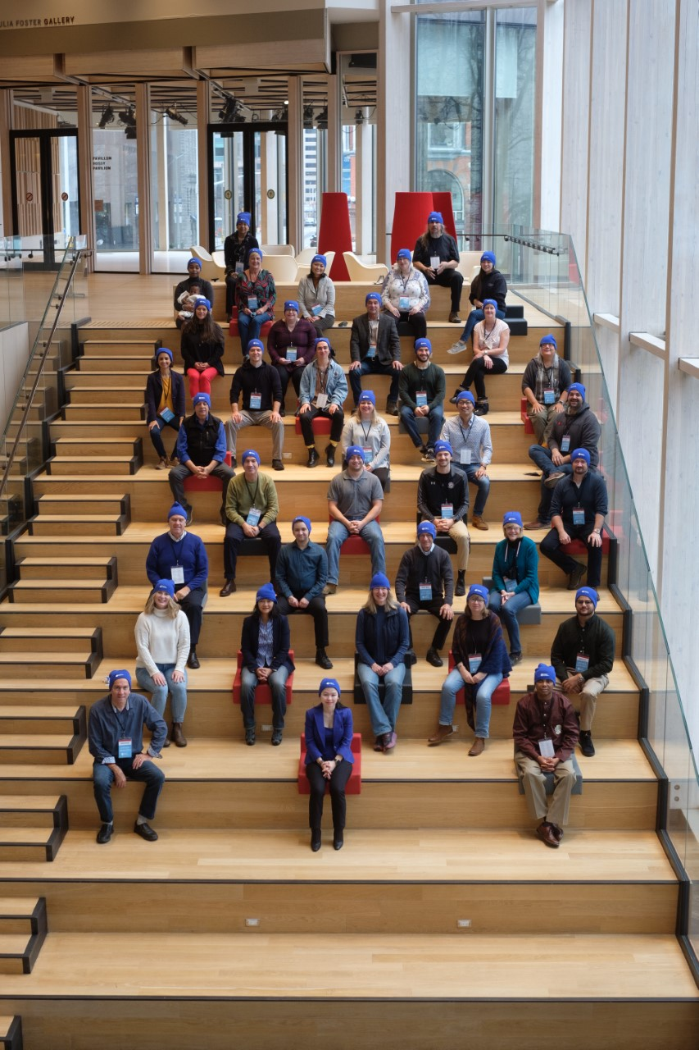
Democratic
Innovations
The Transformative Potential of Citizens’ Assemblies On Participants
Considerations for Design and Implementation
Dr. Marjan H. Ehsassi
May 2023

Slide 2
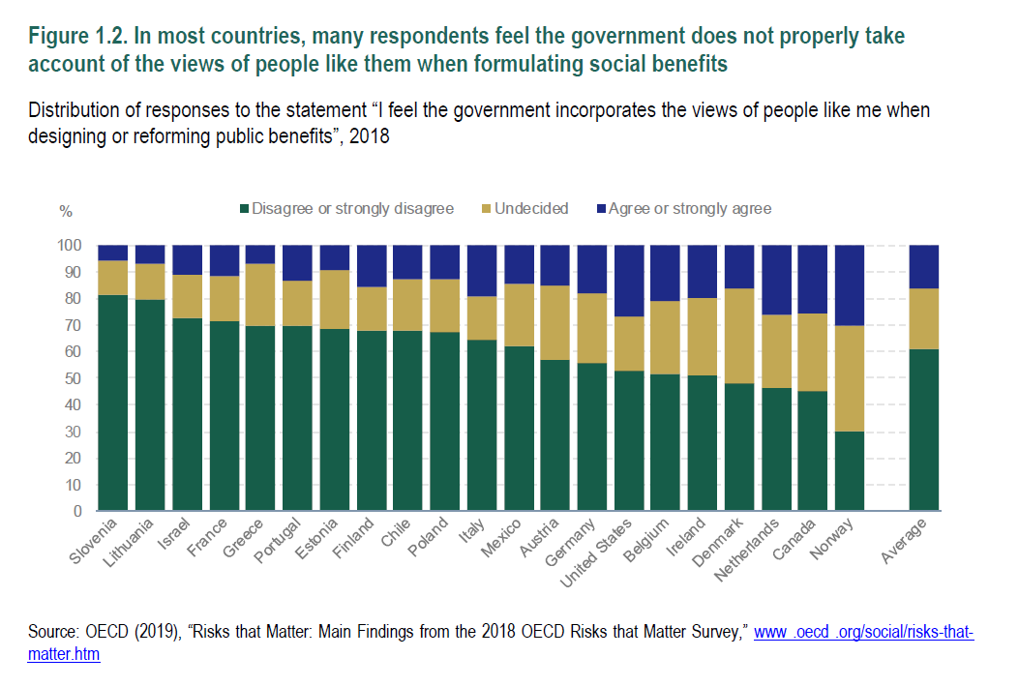
Are citizens’ preferences reflected in public benefits?
OECD 2019

Slide 3
“OF” THE PEOPLE
Adequacy of Elections
Do you think in the United States today:
Elections have proven to be a fully adequate means for the people to express their views on what the government should do, and to set a direction for the country until the next election.
Elections alone are not enough. The government should make an active effort in between elections to find out how the people view the issues the government is dealing with.

Slide 4
“FOR” THE PEOPLE?
Is the government run by a few big interests looking
out for themselves or is it run for the benefit of all the people?
A few big interests
Benefit of all the people
Source: American National Election Survey, CBS News, New York Times, Pew Research Center, Program for Public Consultation

Slide 5
“BY” THE PEOPLE
Adequate System for The People to be Heard (Program for Public Consultation, 2022)
Do you believe that currently there is or is not an adequate system in place for
the voice of the American people to be heard in Congress?

Slide 6
Largely in response to the disconnect between citizens and political institutions, bold and innovative elected representatives have been searching for impactful solutions.
As a result, we have witnessed an explosion in democratic innovations worldwide with a concentration on Citizens’ Assemblies in Europe. OECD records over 600 examples of Government-initiated deliberative platforms (Mini-Publics, citizens’ panels and juries) = Deliberative Surge
What elements constitute a Citizens’ Assembly:
Sortition - Democratic/Civic Lottery
Learning
Deliberation and Considered Judgment
Recommendations and Final Deliverable
Follow-up and Accountability
What it is not:
Educational Campaign
Panel Discussion
Focus Group with interest groups
A Public Meeting/Public Consultation with usual suspects

Slide 7
Benefits of the Deliberative Surge
Questions that are
not consistently
asked or studied
Better Outcomes
Quality of Decision Making
Quality of Policy – Reflect Citizen Preferences
Government
    Greater Legitimacy
    Enhanced Public Trust
    More Inclusive Governance
4. Society
    Division and Reduced Polarization
What’s in it for citizens?
How are citizens impacted by their participation?

Slide 8
Citizens’ Assemblies that I have played a role in as Researcher, Guarantor or on the Oversight Committee of:
1. France’s Citizens’ Convention on the Climate (2020-2021)
2. Brussels Deliberative Committee on Homelessness (2021)
3. Canada’s Citizens’ Assembly on Democratic Expression (2021-2022)
4. California’s Petaluma Fairgrounds Advisory Panel (2022)
5. France’s Convention Citoyenne sur la Fin de Vie (December 2022-April 2023)
6. Belgium’s G1000 We Need to Talk Citizens’ Panel (January 2023 – present)

Slide 9
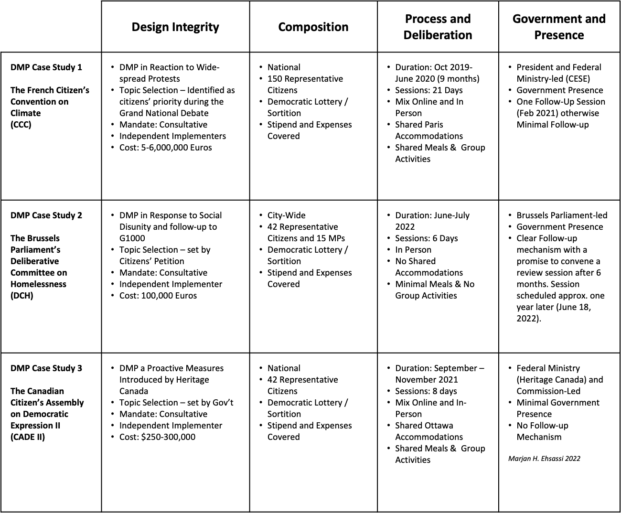
Research & Data
3 Government-Initiated
Deliberative Mini-Publics (DMPs)
2020 – 2022
Studied three citizens’ assemblies in Paris, Brussels and Ottawa
179 Surveys
51 In-Depth Interviews

Slide 10
Five essential variables for an Engaged Citizenry

Slide 11
Importance of Citizen-Centered Design and Implementation
Variable |  | Requires
EPISTEMIC | Learning (issue-specific and government) | Clear and concise mandate/remit: balance between not too broad and not too narrow (pros and cons) Allow for visioning and outside the box thinking Some cases limit the number of proposals Government presence
CONNECTEDNESS | Social Cohesion | Values and principles workshop Begin with issues of consensus Sufficient time for group to build a sense of community: lunches, site visits, hotel stay Alum networks and post-assembly working groups
EFFERVESCENCE | Enthusiasm | Government presence (balance) Clear Messaging, strong deliberative facilitation and inclusion Develops ideas for post-assembly participation

Slide 12
Importance of Citizen-Centered Design and Implementation
Variable |  | Requires
POLITICAL ACTIVITY | Interest and Engagement in Political Issues | Government presence and promise Hybrid (pros and cons) Is our focus on trust outdated vs. trust in one’s place and subsequent role in democracy
VOICE | Sense of Meaningful Input | Agenda-setting (topic selection), co-responsibility and co-creation – where possible allow for role in governance structure “Consultative/advisory” - consistency of communication and setting expectations Government Presence – beginning and presentation Clear follow-up mechanism on accountability

Slide 13
Are Citizens’ Assemblies Transformative?
In Conclusion:
Based on my work, there is little doubt that deliberative platforms - such as Citizens’ Assemblies - can be transformative BUT in practice they are sometimes not.
Important to separate the promise of Citizens’ Assemblies from the practice.
To ensure that we are supporting citizens who are informed, enthusiastic, connected, politically active, and have a sense of meaningful voice:
We cannot make assumptions, we must take the time to focus on Consequential Voice, incorporate citizen-centric and agenda setting measures at every step in the design and implementation of deliberative platforms.

Slide 14
Consequential Voice & Agenda-Setting Power
10 Questions to Guide Implementers and Government Representatives
1. Have government champions of citizens’ assemblies been identified?
2. Did citizens select the topic and the wording of the mandate/remit?
3. Does the citizens’ assembly have a consultative or a binding decision-making mandate? What is the voting threshold and government’s commitment to adopt proposals?
4. Is the process, the roles and responsibilities of stakeholders and expectations clearly articulated and consistently communicated?
5. Is sufficient time allocated for learning, deliberation and the drafting of the deliverable?
6. Is the format for the final report cohesive, the number of proposals realistic and is the writing driven by participants?
7. Are all process-related details well thought-out and professionalized (ie. selection of experts, spaces, shared meals, group activities, and deliberation-trained facilitation).
8. Is government present at the start and at the end of the process? Do participants’ present their final report and recommendations to government?
9. Are follow-up mechanisms to ensure accountability clearly laid out by the government, including frequency of written/verbal communications and justifications for adoption/rejection of proposals within six months? Is there a process for the appeal of government’s decisions?
10. What measures have been introduced for greater connection with the general public? Initial public education campaigns, media and public outreach, post-assembly referendum are positive steps for enhanced impact and legitimacy.
Marjan H. Ehsassi 2023

Slide 15
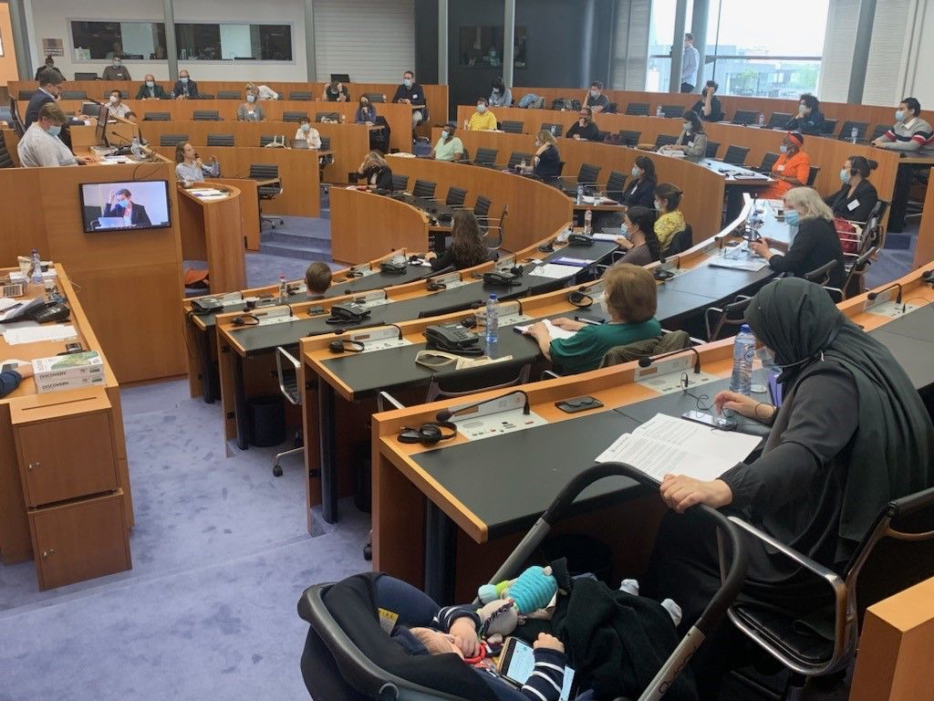
Thank you!
Marjan H. Ehsassi
mehsassi@Berggruen.org

