Slide 1
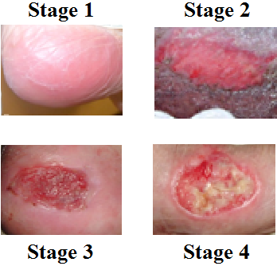
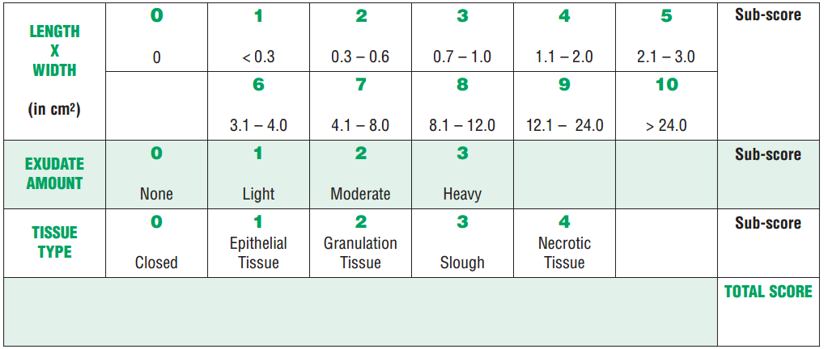
Pilot Study to Evaluate Clinical Education as a Means to Improve Pressure Injury Documentation by Hospital Staff Nurses
By: Arturo González, DNP, ARNP, ANP-BC, CWCN-AP
Introduction
Hypothesis
The National Pressure Ulcer Advisory Panel (NPUAP) recommends the use of standardized measures for pressure injury documentation. A retrospective review of patient chart data from a large metropolitan hospital was undertaken between January and February 2016 and indicated lack of standardized pressure injury assessment by staff nurses.
Nursing students working at the hospital will be able to more accurately assess pressure injuries than staff nurses when compared to assessments made by a wound care expert.
Ten Hospital Staff Nurses Recruited
Ten Nursing Students Recruited
10 Patients with Pressure Injuries Recruited
Patients Evaluated Using PUSH Tool
Results from Staff and Students Compared
PUSH Results Compared with Wound Care Expert Assessment
Methodology
Results
Background to the Issue
Nursing students working at the facility are required, as part of their clinical rotation, to complete a comprehensive wound training program. The program includes the following:
Comparison of Staff and Student Nurses
Statistically Significant Differences ( = 0.02)
Comparison of Nursing Staff and Wound Expert
Comparison of Students and Wound Expert
No Significant Differences (p = 0.32)
Statistically Significant Differences ( = 0.01)
Education and Training
Evaluation of the Wound Bed
Effective Wound Measurement
Evaluation of the Wound Edges
Assessment of Exudate/ Infection
Evaluation of Surrounding Skin
Pain Management
PUSH Tool
Conclusions
The results demonstrate:
PUSH scores similar for nursing students and wound care expert.
Staff nurse PUSH scores significantly different than student nurses and wound care expert.
Nursing students may be better prepared to assess pressure injuries.
Student training should be provided to staff nurses.
Instructions:
Observe and measure the pressure injury.
Categorize the pressure injury based on surface area, exudate, and type of wound tissue.
Record score for each measure.
Add sub-scores to get total: 0-17.
The training provided for nursing students should enable them to provide a high level of care for patients with pressure injuries.

