Slide 1
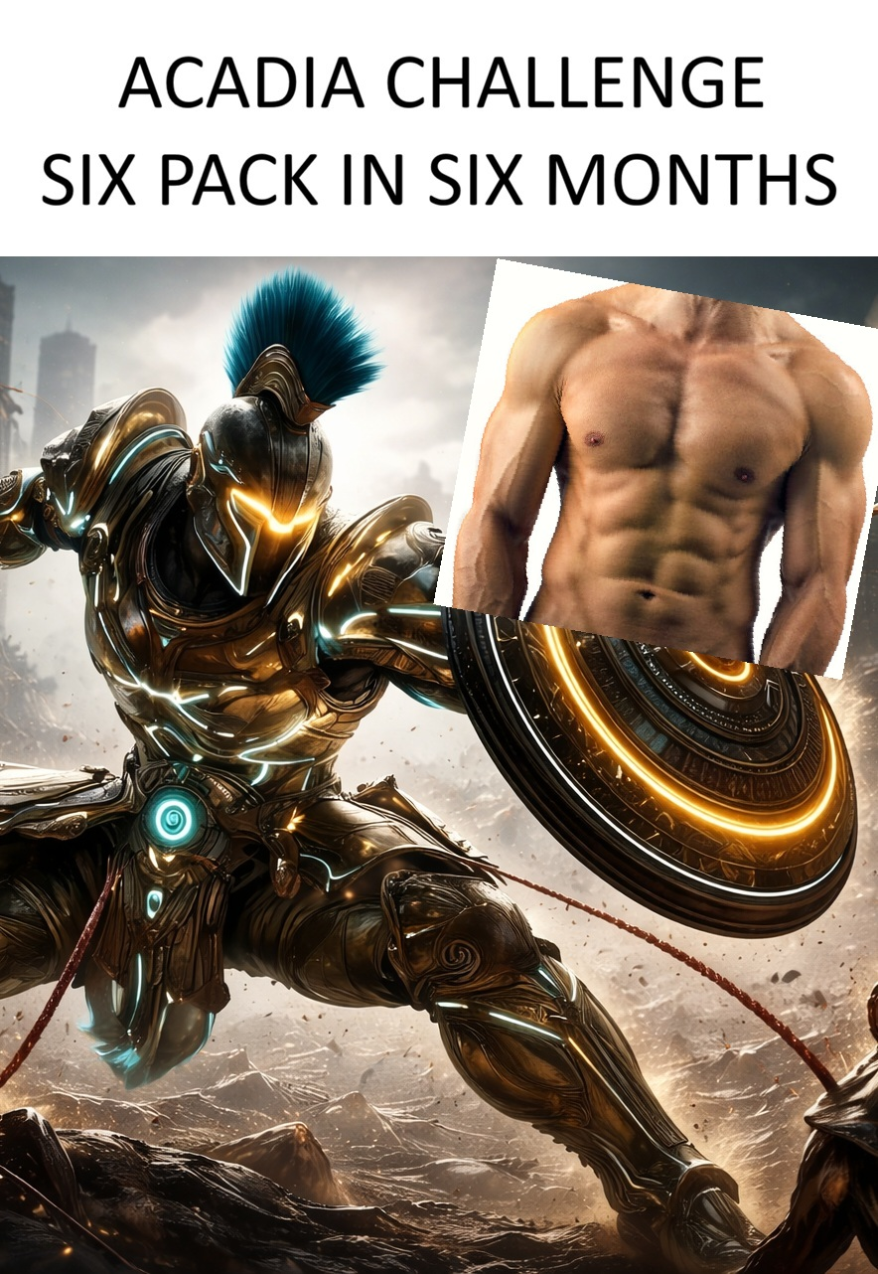
CLASSIFIED // OPERATOR FITNESS PROTOCOL
ACADIA
SIX-PACK PROTOCOL
A six-month training & nutrition operation
26
6
2K
WEEKS
TRAINING DAYS
DAILY CALORIES
PREPARED BY S. NIXON
PREPARED BY S. NIXON

Slide 2


Slide 3
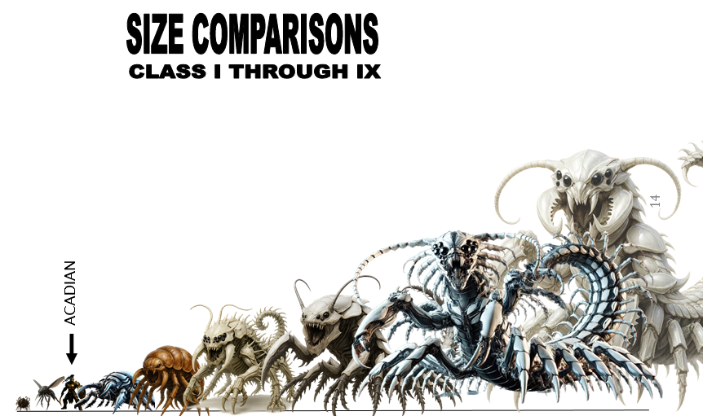
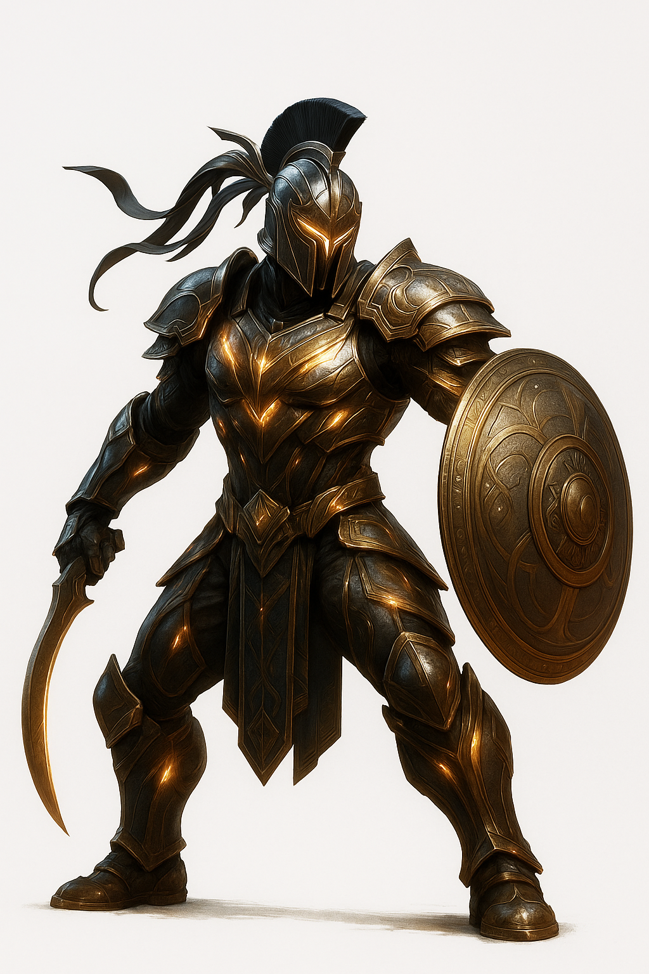
CLASSIFIED // OPERATOR FITNESS PROTOCOL
ACADIA
SIX-PACK PROTOCOL
A six-month training & nutrition operation
26
6
2K
WEEKS
TRAINING DAYS
DAILY CALORIES
PREPARED BY S. NIXON
PREPARED BY S. NIXON

Slide 4
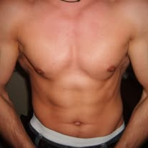
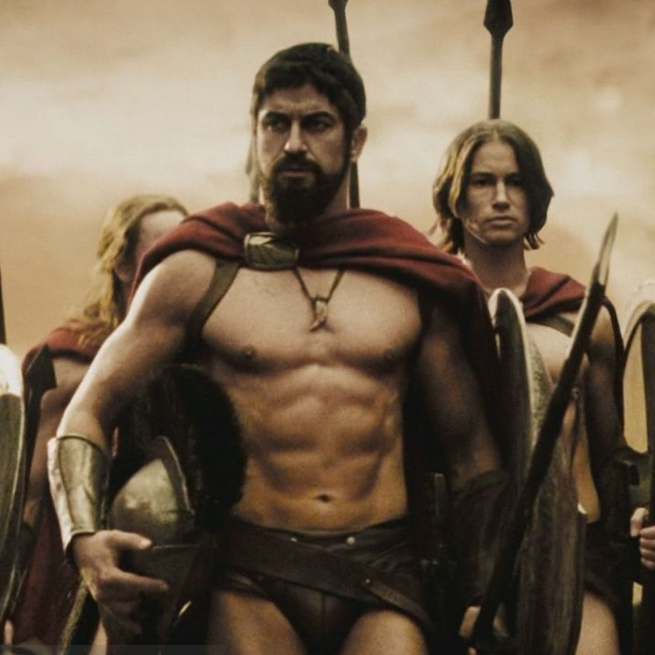
18 years ago. . .
In a far away land and several thousand cheeseburgers ago. . .
I think
I can do
better

Slide 5
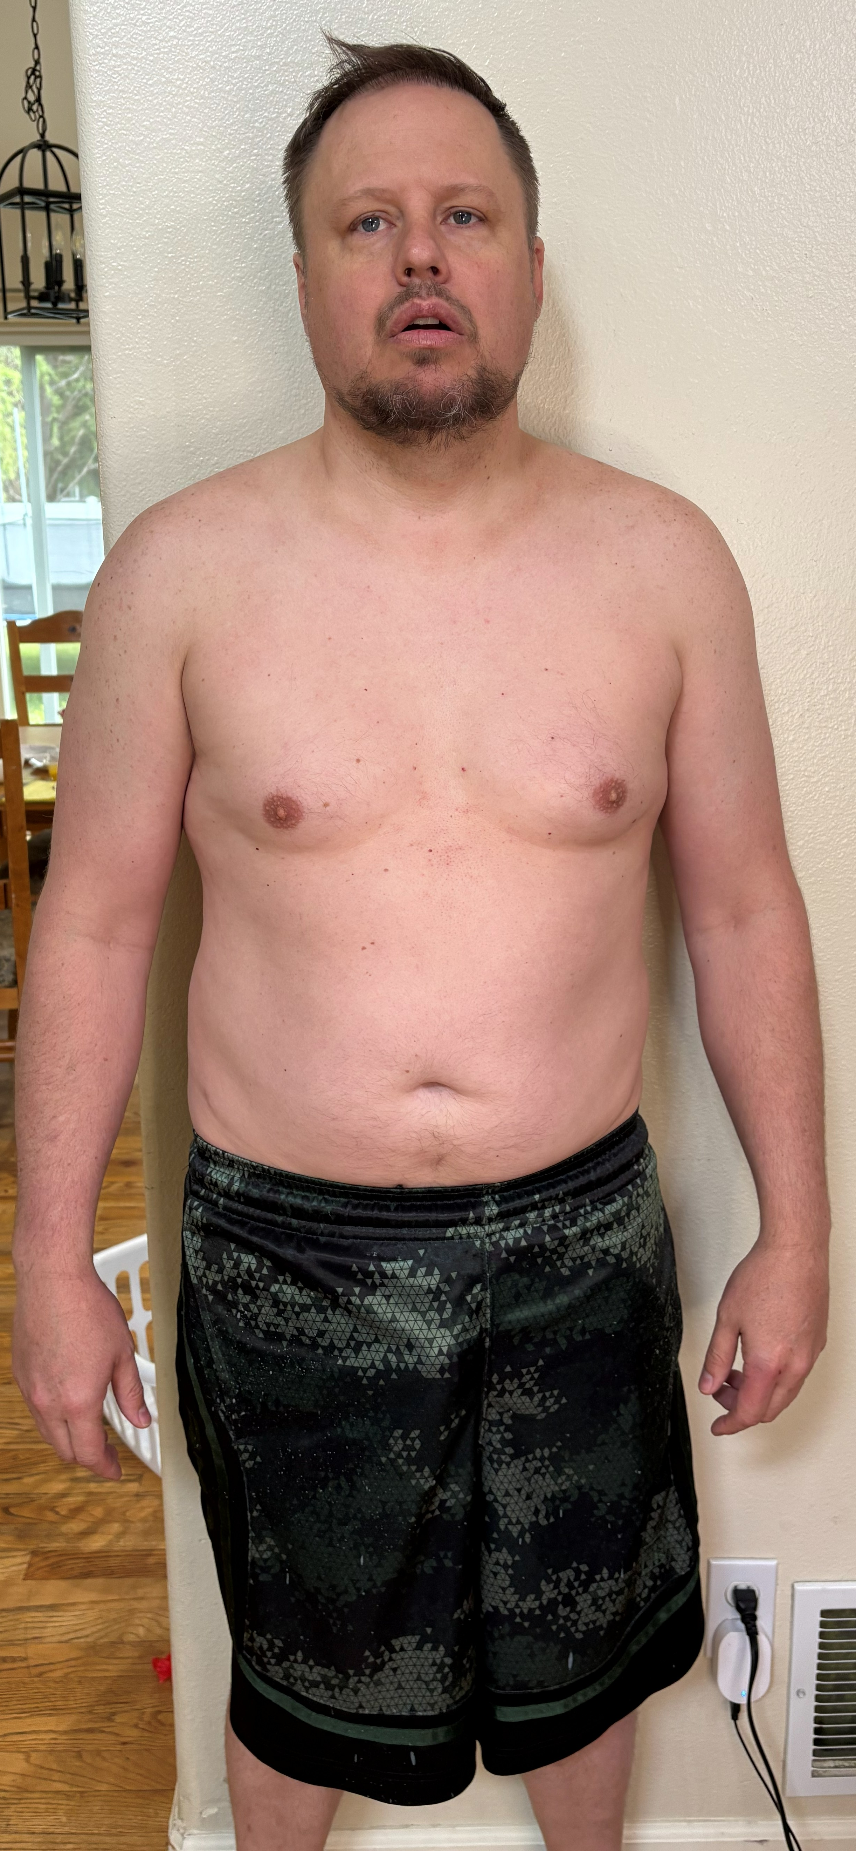
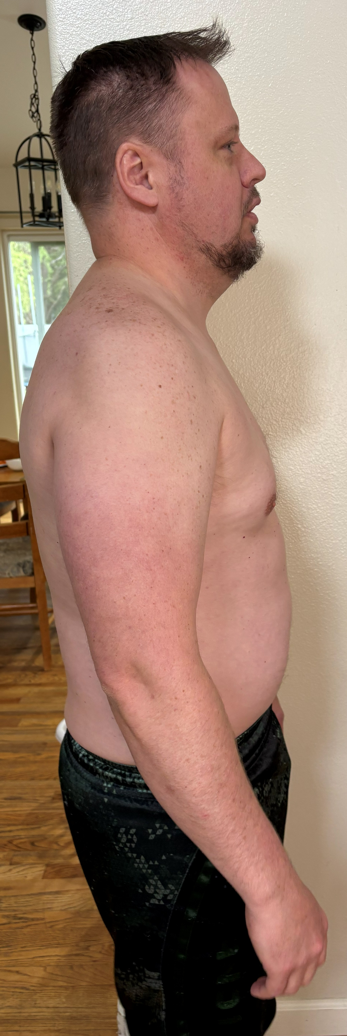
Starting numbers
Waist
Hips
41.5
41 .25
Chest
WEIGHT
41.5
204

Slide 6
START DAY 5/16/2026 –
END DAY 10/16/2026

Slide 7
02 — WEEKLY OPERATIONS
The Seven-Day Combat Cycle
MON
TUE
WED
THU
FRI
SAT
SUN
PUSH
PULL
BURN
COMPOUND
BURN
MAX BURN
RECOVERY
CHEST + CORE
BACK + SHOULDERS
T25 CARDIO
CARDIO + CORE
ARMS + LEGS
T25 CARDIO
HIIT FULL BODY
FULL REST
Six training days, one full rest — muscle is built during recovery, not during the workout.
ACADIA // SIX-PACK PROTOCOL
03 / 12

Slide 8
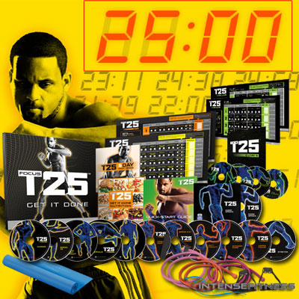






03 — TRAINING DETAIL
Movements & Sets Per Day
MONDAY
TUESDAY
WEDNESDAY
CHEST + CORE
BACK + SHOULDERS
CARDIO + CORE
4×12 Bench Press (rotate angle)
3×12 Dumbbell Flys
3×15 Push-Ups
3×20 Hanging Leg Raises
3×20 Bicycle Crunches + 1 min Plank
T25 Ab Workout (warm-up)
4×10 Pull-Ups or Lat Pulldowns
3×12 Bent-Over Rows
3×12 Overhead Press
3×15 Face Pulls
5-Mile Walk / Run
3×15 Cable Crunches or Weighted Sit-Ups
3×30s Side Plank (each side)
3×20 Russian Twists
Stretch & Foam Roll
THURSDAY
FRIDAY
SATURDAY
ARMS + LEGS
T25 CARDIO
HIIT — MAX BURN
3×12 Barbell / DB Curls
3×12 Tricep Pushdowns + Overhead Ext.
4×10 Squats
3×12 Romanian Deadlifts
3×15 Lunges
T25 Cardio Session
10-min low-intensity cool-down walk
20–30 min HIIT circuit
Burpees, jump squats, mountain climbers, box jumps
OR 20 min jump rope (30s on / 15s off)
Optional 10-min core finisher
ACADIA // SIX-PACK PROTOCOL
04 / 12

Slide 9

04 — FUEL CALCULATION
The 2,000-Calorie Equation
600
200
2,000
WELL CALIBRATED
+
=
Moderate deficit for an active adult male. Sustainable. Protects muscle while burning fat.
× 3 MEALS
SNACKS
KCAL / DAY
DAILY MACRO TARGETS
170g
180g
55g
PROTEIN
CARBS
FATS
Lean meats • eggs • Greek yogurt • whey
Oats • brown rice • sweet potato • quinoa
Avocado • nuts • olive oil • egg yolks
ACADIA // SIX-PACK PROTOCOL
05 / 12

Slide 10
05 — DAILY RATIONS
Sample 2,000-Calorie Meal Plan
07:00
12:00
—
18:30
BREAKFAST
LUNCH
PRE/POST SNACK
DINNER
600 KCAL
600 KCAL
200 KCAL
600 KCAL
4-egg omelet — spinach, peppers, 1 oz feta
1 cup oatmeal with cinnamon (no sugar)
Large glass of water with lemon
6 oz grilled chicken breast or salmon
1 cup brown rice or quinoa
Dark greens salad — olive oil & vinegar
1 apple or orange
Greek yogurt + handful of almonds
OR protein shake + banana (lift days)
6 oz lean protein — steak, turkey, shrimp, tilapia
Sweet potato or 1 cup lentils
2 cups roasted vegetables with olive oil & garlic
No bread
ACADIA // SIX-PACK PROTOCOL
06 / 12

Slide 11
06 — RULES OF ENGAGEMENT
Non-Negotiable Diet Protocols
ZERO LIQUID CALORIES
1G PROTEIN PER POUND
Water only (1 Mountain Dew Daily). No juice, no soda, no alcohol.
Hit your bodyweight in grams daily. Muscle retention reveals the six-pack, not just fat loss. Ideal weight, 170 grams of protein
CUT SUGAR RUTHLESSLY
STOP EATING 2–3 HRS BEFORE BED
No added sugar. No sweets. No white bread or white rice. Brown rice and sweet potato cleared.
Late eating stalls fat loss faster than almost anything else on this list.
3–4 LITERS WATER DAILY
MEAL PREP SUNDAYS
Dehydration masks muscle definition and slows fat metabolism. Non-optional.
Cook proteins and carbs in bulk. The fight isn't won at the dinner table — it's won in the kitchen.
ACADIA // SIX-PACK PROTOCOL
07 / 12

Slide 12

07 — INTELLIGENCE BRIEF
The Truth About a Six-Pack
BODY FAT TARGET
10–13%
70–80%
OF THE RESULT IS DIET
Training builds the muscle underneath. Nutrition uncovers it. One bad weekend can cost four days of deficit — discipline outside the gym is the entire game.
Where abs become fully visible on the average adult male.
Training builds it. Diet reveals it.
A SIX-PACK IS A FAT-LOSS GOAL, NOT A TRAINING GOAL. CONSISTENCY BEATS INTENSITY.
ACADIA // SIX-PACK PROTOCOL
08 / 12

Slide 13
08 — OPERATIONAL TIMELINE
Six-Month Mission Roadmap
PHASE 01
PHASE 02
PHASE 03
PHASE 04
PHASE 05
MONTHS 1–2
MONTHS 2–3
MONTHS 3–4
MONTHS 4–5
MONTH 6
1
2
3
4
5
ADAPTATION
FAT LOSS
UPPER ABS
DEFINITION
OBJECTIVE
Habits forming. 1–3 lb fat loss / month. No visible abs yet — foundation phase.
Waist shrinking. Clothes fitting differently. 3–5 lb more lost. Shoulders & arms defining.
Top two rows visible, especially post-workout. Diet discipline locks in. Strength climbing.
Four to six abs visible at rest in good light. Obliques showing. Photos look dramatically different.
Six-pack fully visible at rest. All rows defined. Mission complete — with zero cheating.
ACADIA // SIX-PACK PROTOCOL
09 / 12

Slide 14



09 — RECON & METRICS
Weekly Surveillance Targets
WAIST MEASUREMENT
PROGRESS PHOTOS
Track this — not the scale. Muscle gain masks fat loss in pounds. Inches tell the truth.
Every 2 weeks. Same lighting. Same angle. The mirror lies; side-by-sides don't.
DAILY CALORIES
SLEEP — 7 TO 8 HRS
Cronometer or MyFitnessPal. Stay at or under 2,000. The day you stop tracking is the day it stalls.
Non-optional. Poor sleep spikes cortisol, which blocks abdominal fat loss specifically.
ACADIA // SIX-PACK PROTOCOL
10 / 12

Slide 15
10 — FINAL ASSESSMENT
Is a Six-Pack in Six Months Realistic?
YES.
THREAT ASSESSMENT
THE BIGGEST RISK
Not the workout plan.
A weekend of bad eating.
The workout is excellent. Diet consistency is the only variable left in the equation. Train hard. Eat clean. Don't cheat on Saturday night.
If you start at a normal weight with some existing muscle, and don't cheat the diet.
ACADIA // SIX-PACK PROTOCOL
11 / 12

Slide 16
END TRANSMISSION
TRAIN HARD.
EAT CLEAN.
STAY THE COURSE.
Six months. Twenty-six weeks. One outcome.
ACADIA // SIX-PACK PROTOCOL

Slide 17
END TRANSMISSION
TRAIN HARD.
EAT CLEAN.
STAY THE COURSE.
Six months. Twenty-six weeks. One outcome.
ACADIA // SIX-PACK PROTOCOL

