Slide 1
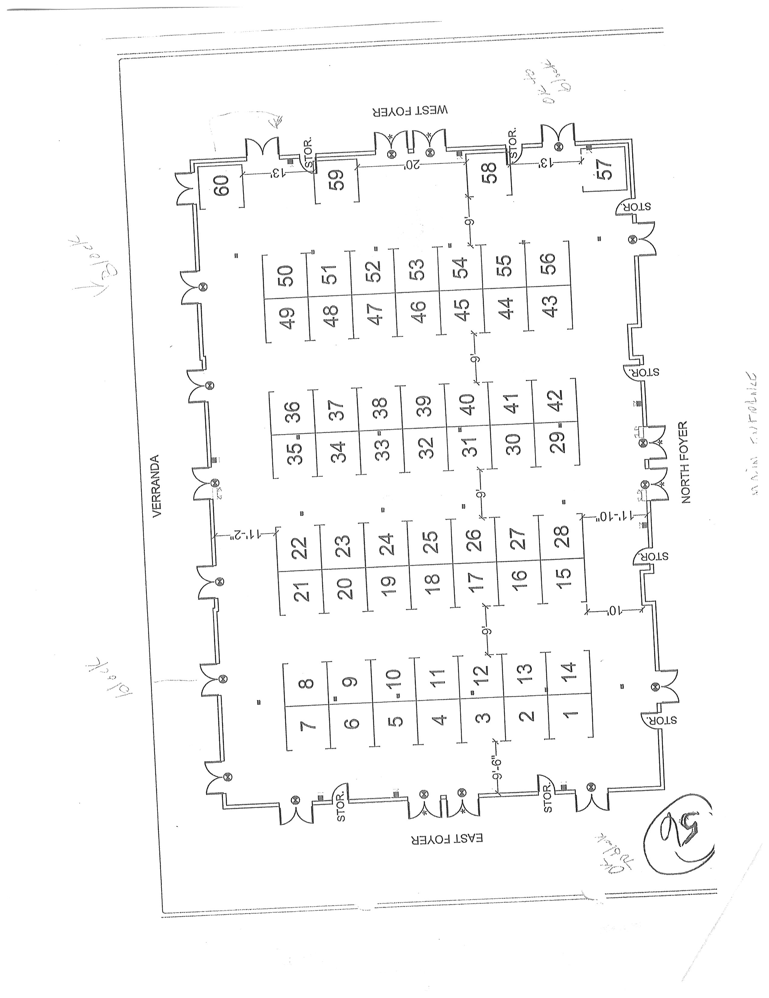
GILBERT DOUBLETREE HOTEL ELEGANTE’ CONFERENCE CENTER
121’
16
81’
MAIN ENTRANCE

