Slide 1
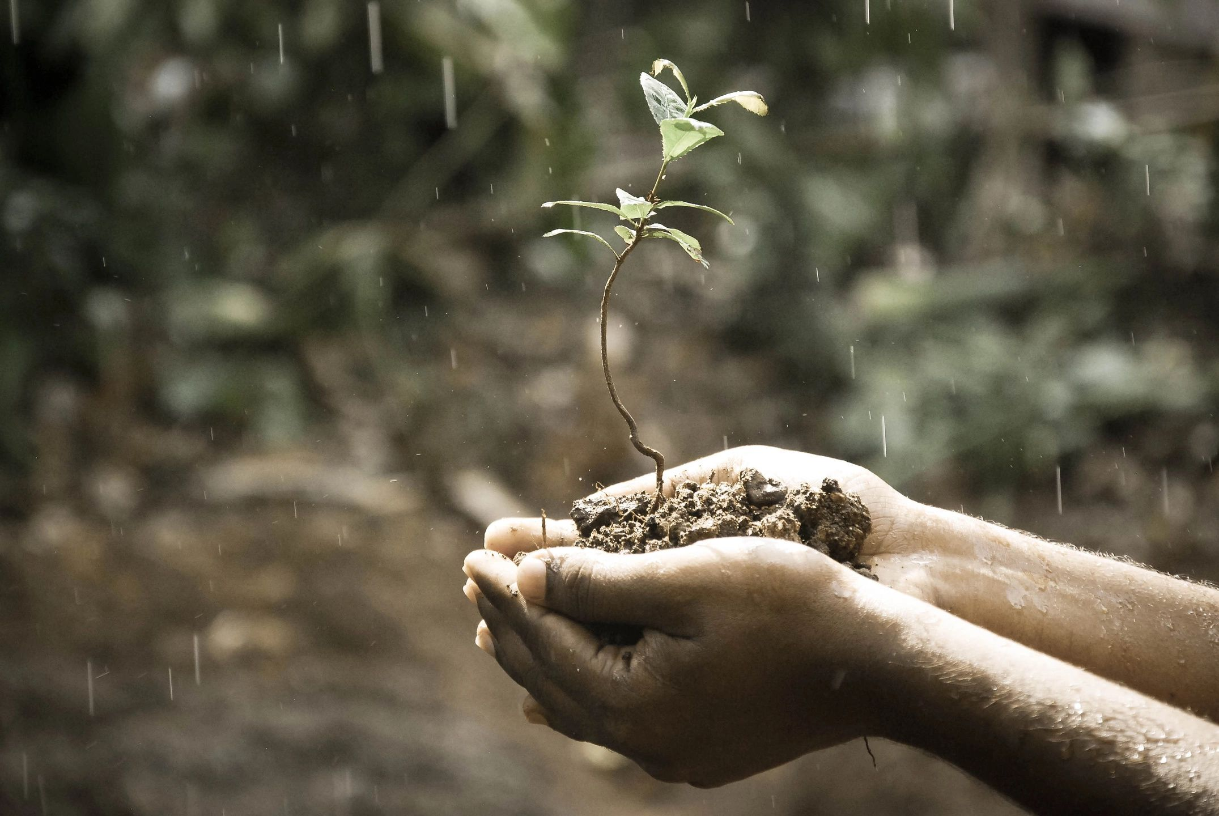
The Developing Self
Alexander in Education
Training and Community

Slide 2
Our Aims
Alexander in Education
To integrate the Alexander Technique into every school and college.

Slide 3
Our Aims
Training
To provide an excellent training resource for any Alexander Teacher who wants to work in education or is already working in education.

Slide 4
Our Aims
Community
To help build a community of like-minded folk both within and without the Alexander Technique profession.

Slide 5
Alexander in Education
To integrate the Alexander Technique into every school and college
Curricula
By creating standardised Alexander Technique curricula for each level and thus presenting a very professional, unified approach to educational institutions.

Slide 6
Alexander in Education
To integrate the Alexander Technique into every school and college
Training
By training Alexander Teachers to deliver these curricula, but also to use their skills flexibly to create on-going individual programs as required.

Slide 7
Alexander in Education
To integrate the Alexander Technique into every school and college
Linking
By linking with and fully supporting the Alexander in Education Special Interest Group and website and any other similar bodies world-wide.

Slide 8
Alexander in Education
To integrate the Alexander Technique into every school and college
Organising
By organising/supporting a regular Alexander in Education Conference aimed at sharing the work both within and without the Alexander profession. First one will be in London in 2020.

Slide 9
Alexander in Education
To integrate the Alexander Technique into every school and college
Writing
By (one day!) writing a book on Alexander in Education specifically for the general public. By also including more information for the public on the DS website.

Slide 10
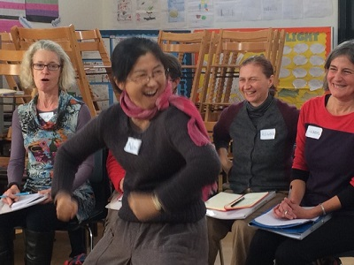
Training
The Developing Self Education Training Course
"I just wanted to say how the work over the weekend has changed my thinking about the technique. Something, many things, clicked during the weekend but I think mainly it was the importance to find it for myself, to own it as Sue put it, to stop trying to use other people's language and to really say NO to the need to get it right!
The fundamental change in thinking for me was not simply what is the Alexander Technique but what it could be for that individual in order to move forward. It's so liberating to work in the present and every time I rediscover it, it's a revelation!"
Ellie Rouse MSTAT

Slide 11
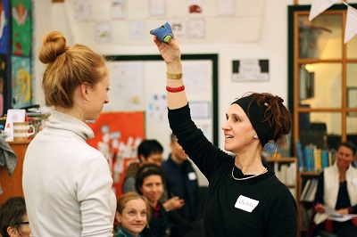
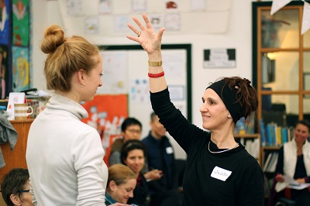

Slide 12
“The course is very interactive and includes not only how one might work with a toddler or teenager but also how to approach a school, how to plan an inset day and how a curriculum might look like.
Of course the learning continues even after the course had ended, so it is very encouraging to become part of a supportive community of teachers who are working towards a common goal."
Regina Stratil MSTAT

Slide 13
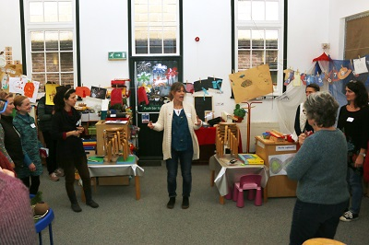
Workshop One
The Developing Self Education Training Course
A two-day workshop. Learning includes:
Standard AT curricula for schools and colleges.
What you might include in a preliminary training for classroom teachers.
How to structure initial sessions with classes of children or young adults.
Hands-on work with children and young adults. Plus tips for managing groups of children and young adults.

Slide 14
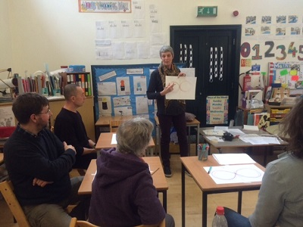
Workshop Two
The Developing Self Education Training Course
A two-day workshop. Learning includes:
Educare Movement Circle and Educare Quiet Time.
Body Mapping.
Games for different age groups.
Writing skills
Engaging with technology, especially phones.
Moving to learn

Slide 15
And the most important skill of all….

Slide 16
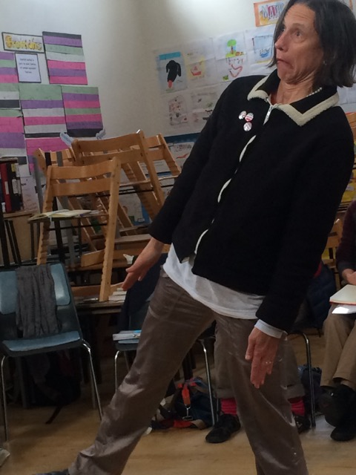
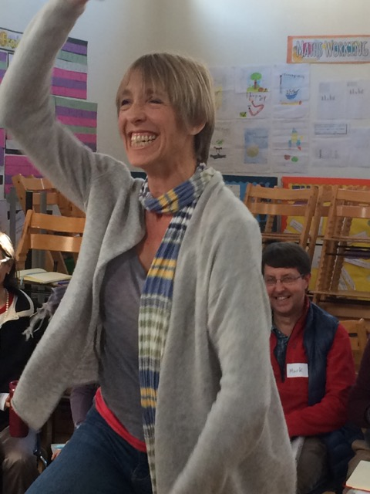
Having fun!

Slide 17
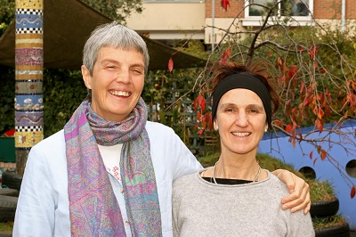
Course Devised and Taught by
Sue Merry MSTAT and Judith Kleinman AGSM MSTAT
Assisted by Esther Miltiadous MSTAT

Slide 18
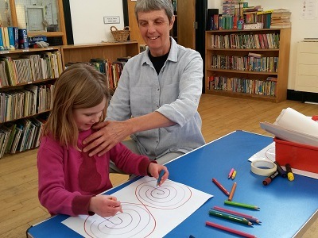
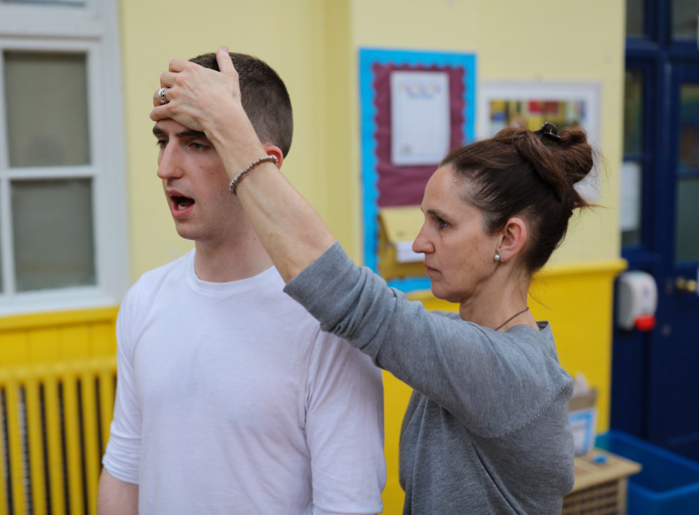
Mentoring
Visit Sue at Educare Small School and Judith at the Royal College of Music and the Junior Royal Academy of Music

Slide 19


Next Courses
Contact us via our website to book a place
London, England
Workshop One: November 10th & 11th 2018
Workshop Two: February 23rd & 24th 2018
New York
Workshops One & Two: March 28th to 31st 2019
San Diego
Workshops One & Two: April 4th to 7th 2019

Slide 20
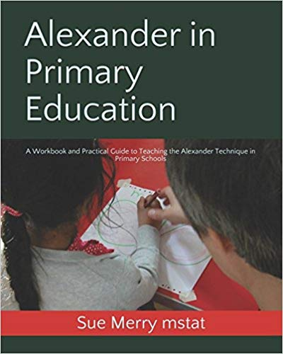
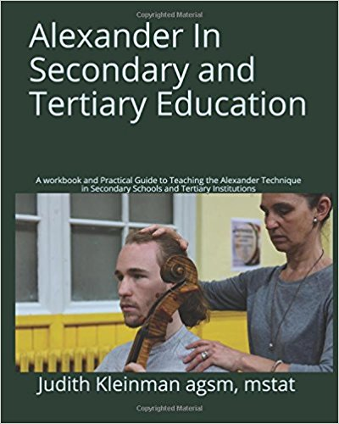
Training Resources
Included in the tuition fee for The Developing Self Education Training Course

Slide 21
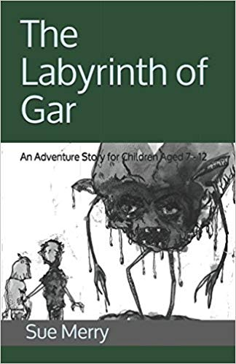
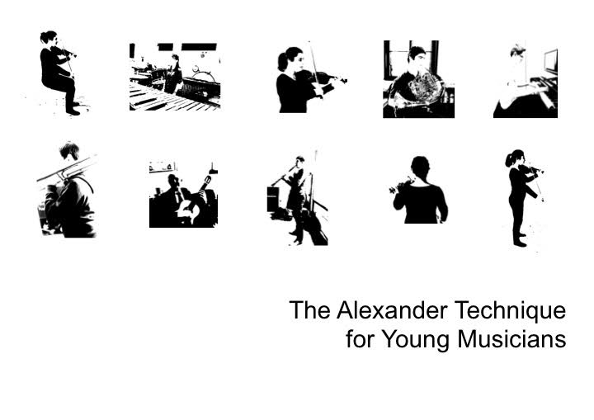
Other resources available include:
Produced by:
Fuensanta Zambrana, Peter Buckoke & Judith Kleinman
For children aged 7-12 years

Slide 22
Community
The Alexander in Education website lists 276 educational institutions world-wide that offer the Alexander Technique to their students
www.education.alexandertechnique.co.uk
If you are already working in education then please let us know.

Slide 23
Consider joining the Alexander in Education Special Interest Group. Contact Esther Miltiadous for more information about how to do this:
esthermiltiadous@hotmail.co.uk

Slide 24
Join our mailing list and keep up to date with the latest info from The Developing Self – including:
Free resources & books to buy
Latest courses
Training dates
The 2020 Alexander in Education Conference
www.thedevelopingself.net

Slide 25
