Slide 1

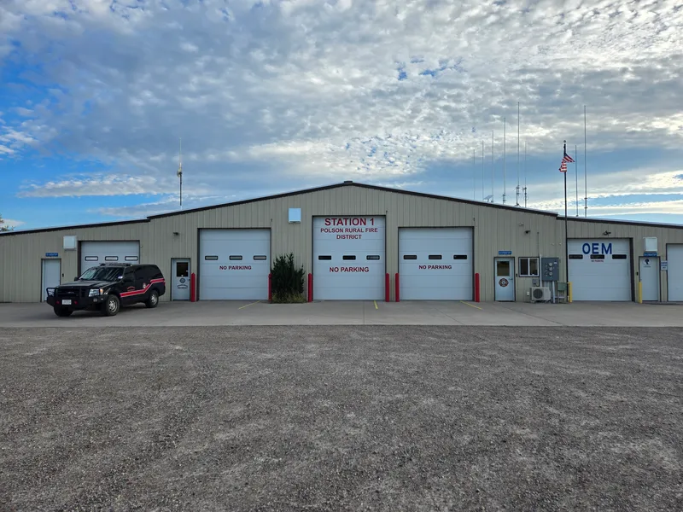
Polson Rural Fire District
Serving our community with dedication and professionalism
Serving our community with dedication and professionalism.

Slide 2
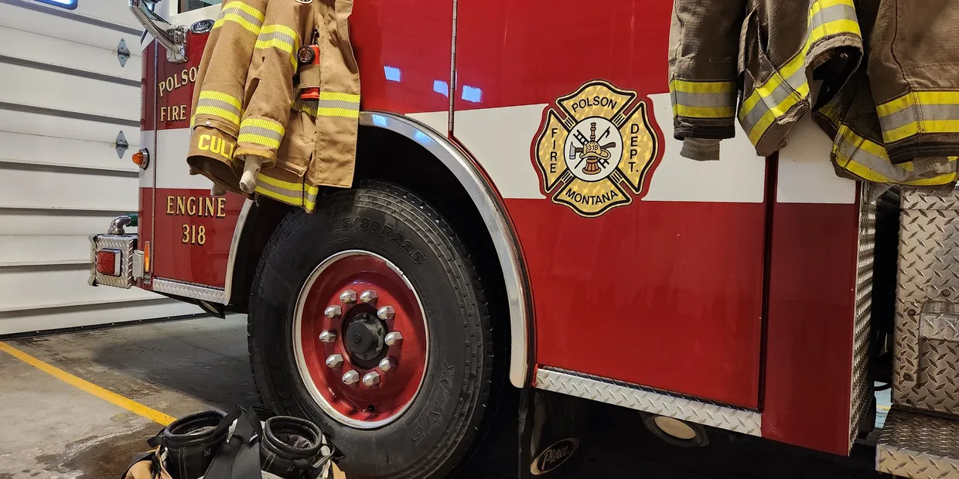
The Polson Rural Fire District was established in 1960.
The Polson Rural Fire District is comprised of a full-time Fire Chief and 37 volunteer Firefighters. We currently respond to an average of 300 calls for service per year. This includes structure fires, wildland fires, car accidents, rescue operations(ice,water,confined space), drone operations, EMS assist, Law Enforcement assist and public assist calls. We operate out of 4 stations to cover a roughly 200 square mile area surrounding the City of Polson. Your volunteer Firefighters dedicate substantial time to protecting our district, responding to calls and training 24/7. Polson Rural Fire District has trainings on the 1st, 2nd, and 4th Tuesday of every month in the evenings.
Polson Rural Fire District Facts

Slide 3
Polson Rural Fire District Station 1
25b Regatta Rd, Polson
16 primary responders
1 Honorary Firefighter
Polson Rural Fire District Station 2
28565 7th St, Big Arm
8 primary responders
1 Junior Firefighter
Polson Rural Fire District Station 3
55459 Irvine Flats Rd, Polson
4 primary responders
Polson Rural Fire District Station 4
36500 Caffrey Road, Polson
6 primary responders
1 Junior Firefighter
**Responders will cover areas within the full district as requested
Station Locations and Number of Responders**

Slide 4
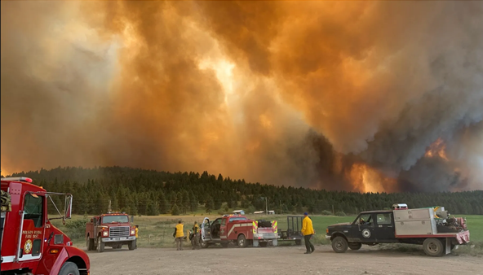
2024 Responses In The Rocky Point Area
Polson Rural Fire District responded to the following calls in the Rocky Point area in 2024:
Six fire calls
Two motor vehicle accident calls
Six medical assistance calls
Ten home fire alarms
Two wind-related calls
Two utility-related calls
One law enforcement assistance call

Slide 5
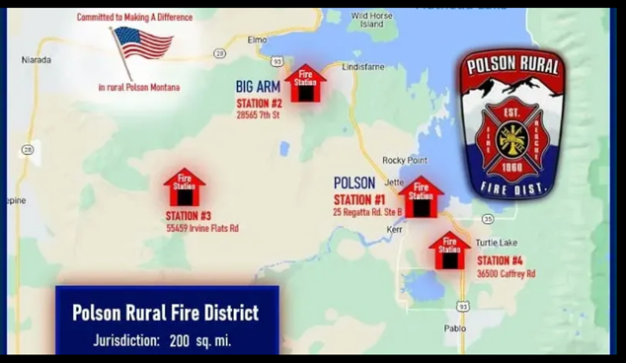
Stations and Apparatus
Polson Rural Fire District currently operates out of four stations and runs command vehicles, Type 1 structure engines, Type 2 water tenders, Type 3 water tenders, Type 5 wildland engines, Type 6 wildland engines and an aerial (ladder) truck. The fire district has plans to add a fifth station which will primarily cover the Rocky Point area of Polson.

Slide 6
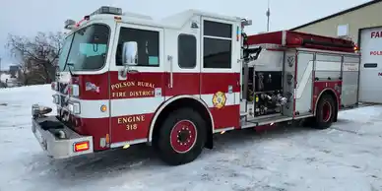
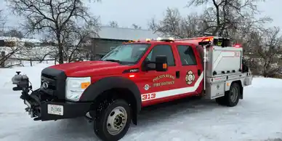
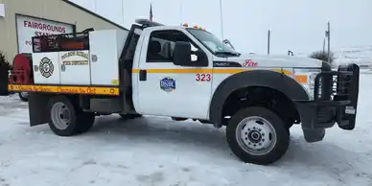
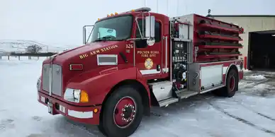
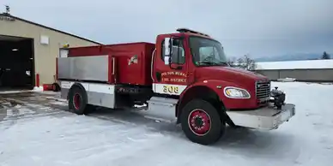
Station 1 Apparatus (Regatta Rd)
318 (Type 1, Structure,) 313 (Type 5, Wildland,) 315 (Type 5, Wildland,) 326 (Type 3, Tender/Engine,) 308 (Type 3, Tender)
PRFD engines are designed to respond to all types of incidents including wildfires, structure fires, medical assistance calls, motor vehicle accidents, etc.

Slide 7
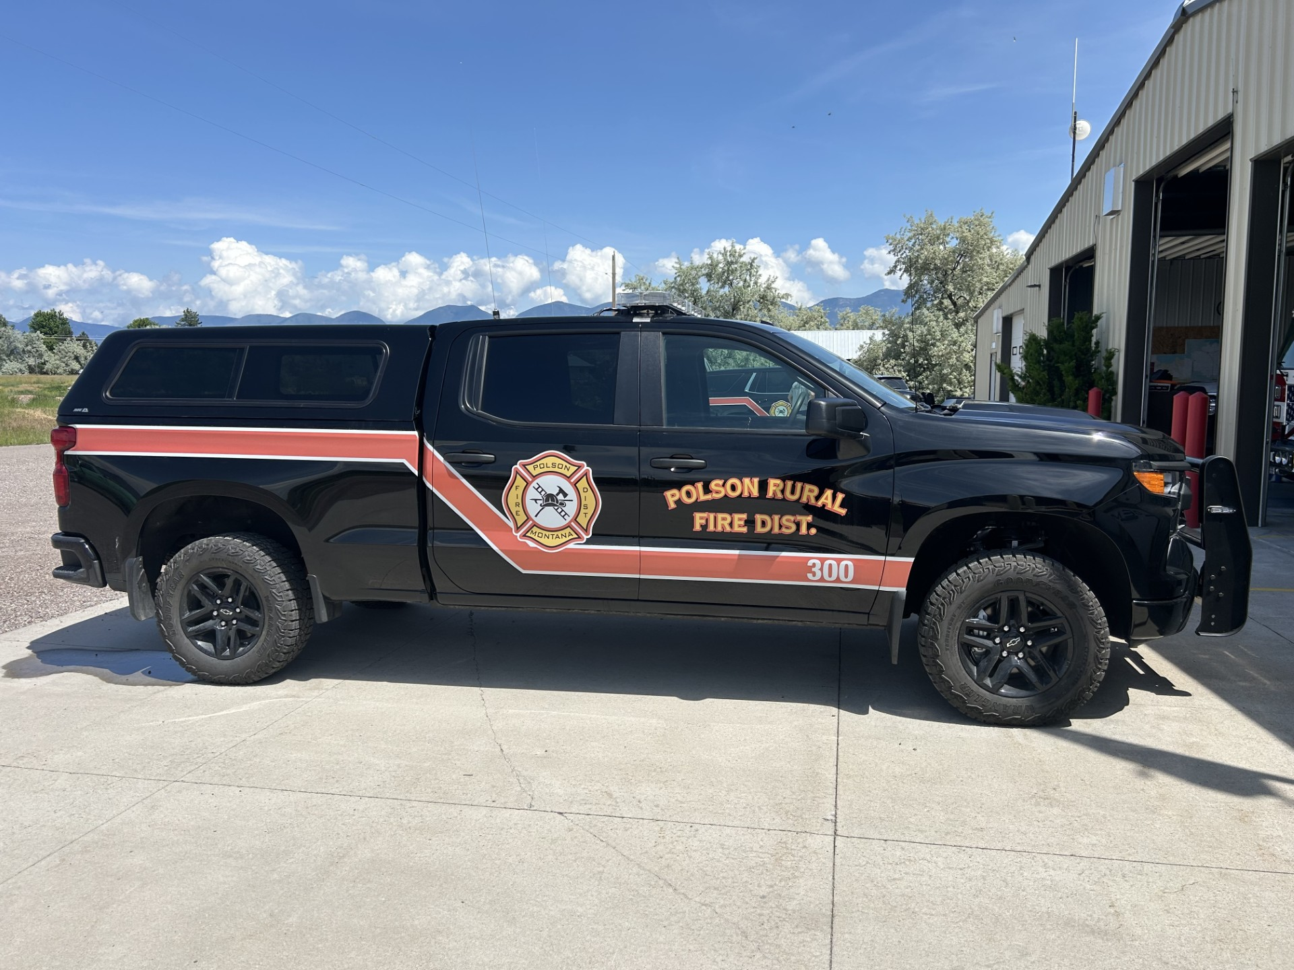
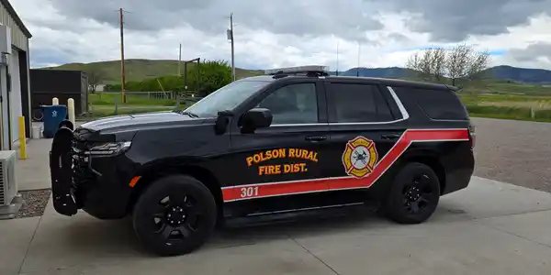
Station 1 Apparatus (Regatta Rd)
Station also houses a Duty Officer Command Vehicle and the Chief’s Command Vehicle.
300 301

Slide 8
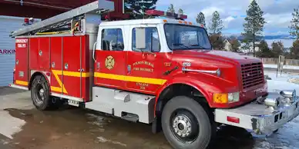
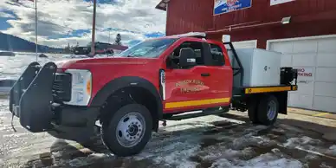
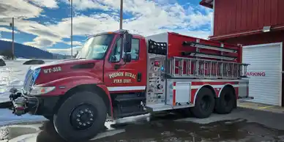
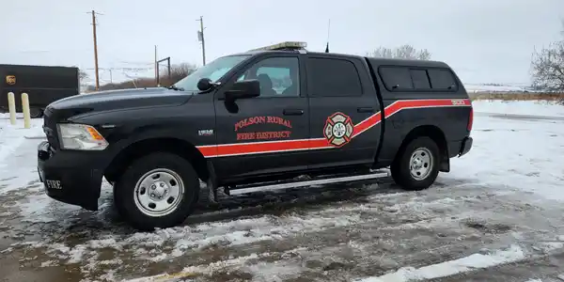
Station 2 Apparatus (Big Arm)
328 (Type 1, Structure,) 325 (Type 5, Wildland,) 312 (Type 2, Tender,) 303 (Command)

Slide 9
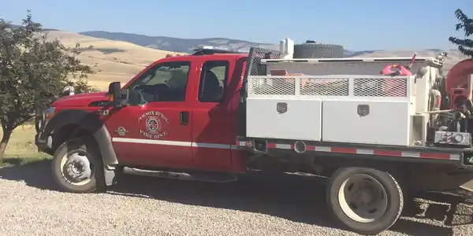
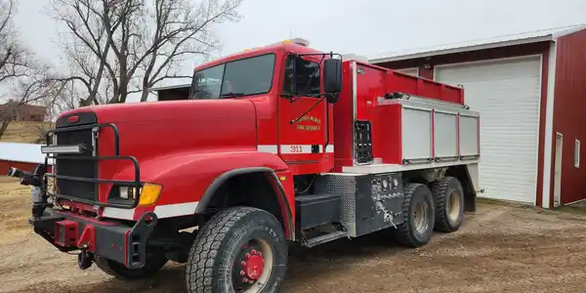
Station 3 Apparatus (Irvine Flats)
333 (Type 5, Wildland,) 311 (Type 2, TAC Tender,) 302 (Command)

Slide 10
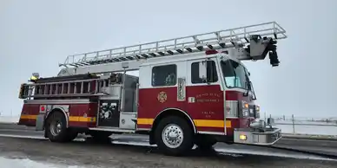
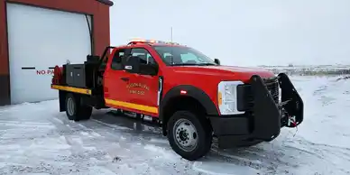
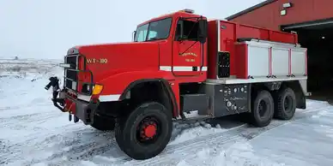
Station 4 Apparatus (Caffrey Rd)
349 (Type 1, Aerial,) 346 (Type 5, Wildland,) 310 (Type 2, TAC Tender)

Slide 11

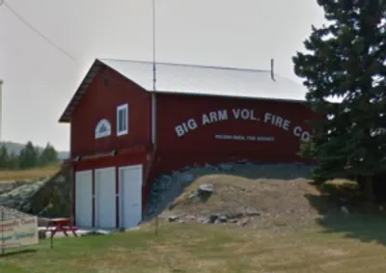
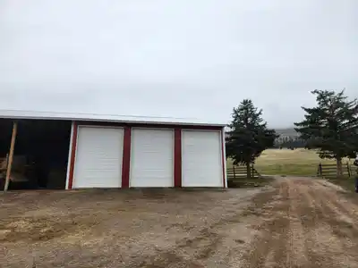
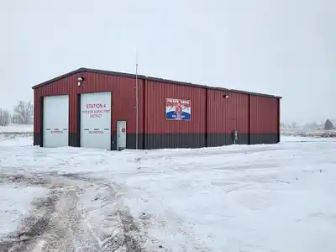
Hey, Here’s What The Stations Look Like!
St 1
St 2
St 3
St 4

Slide 12
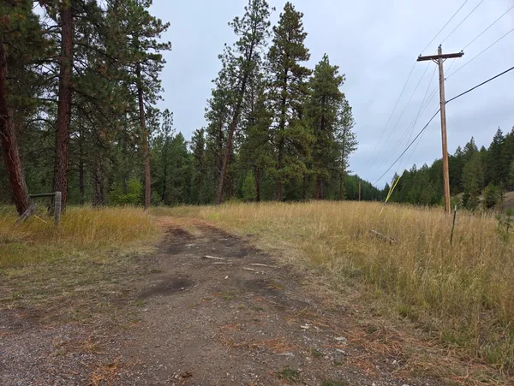
Site For Potential Station 5 (45-Morgan Lane)

Slide 13
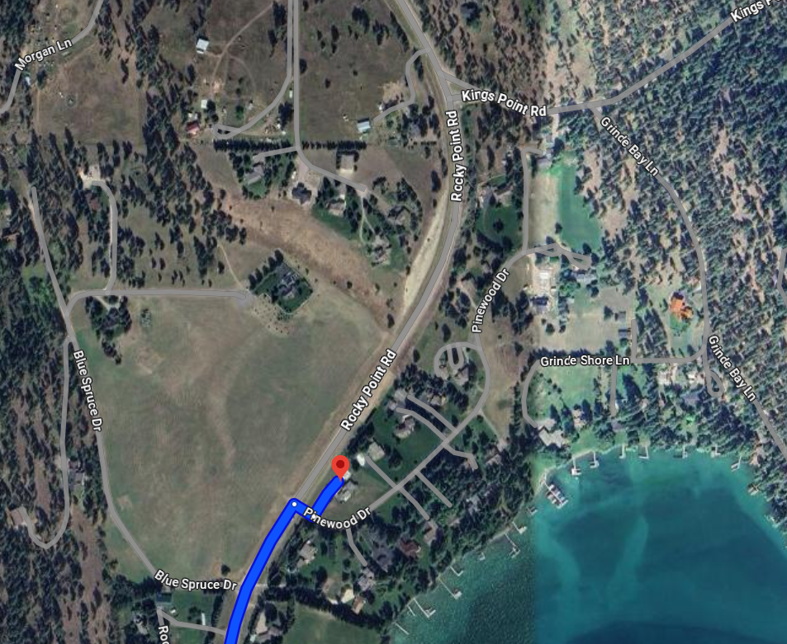
5 road miles from Station One
Ends near Pinewood Drive.
Current PRFD ISO Rating:
Within 5 Road Miles-6
Outside-10

Slide 14
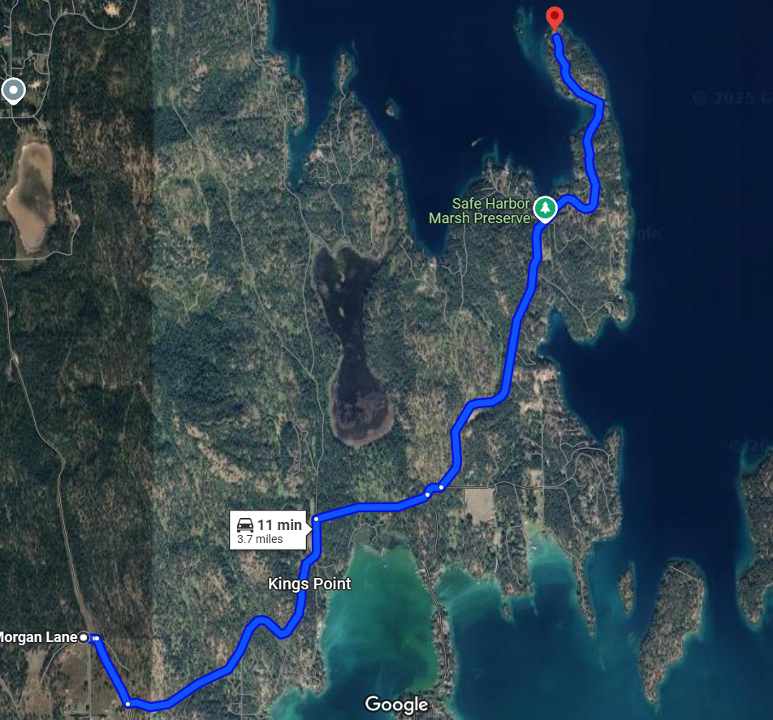
Farthest property on Black Point Road
Is 3.7 Miles from Prospect Station 5.

Slide 15
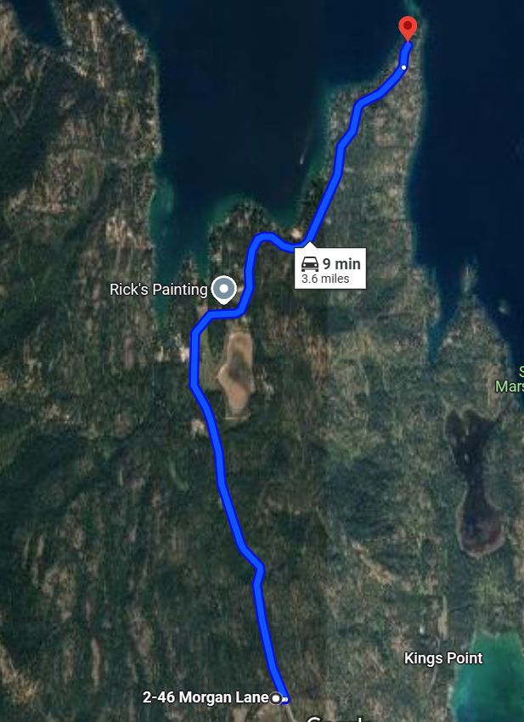
Farthest property on Rocky Point is 3.6 Miles from
Prospect Station 5.

Slide 16
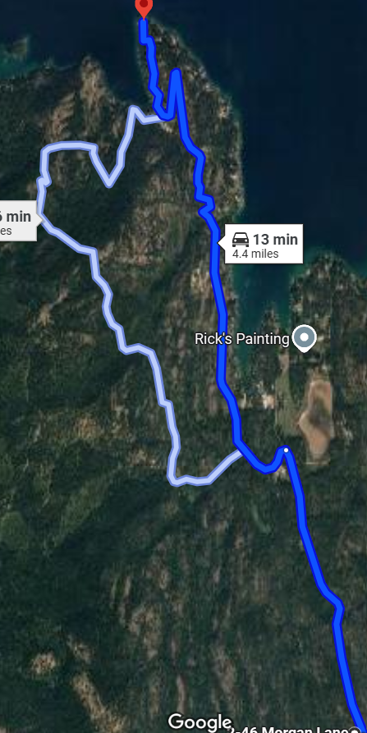
Farthest property on White Swan is 4.4 miles from
Prospect Station 5.
Check your Address and see how far you would be located
Via road miles from Prospect Station 5 use address:
45 Morgan Lane , Polson MT 59860 in google maps.

Slide 17
How Polson Rural Fire District Can Help Save You Money On Insurance
Each Polson Rural Fire District Station is designed to provide homeowners with the proper equipment to maximize their ISO (insurance) ratings.
Learning Point - An ISO score, also known as a Public Protection Classification (PPC) score, is a rating given to municipal fire departments that evaluates their ability to offer adequate fire protection to the communities they serve. The ISO determines these scores by analyzing certain data with its proprietary Fire Suppression Rating Schedule (FSRS.)
Based on several criteria, the ISO issues a classification on a scale of 1 to 10. A Class 1 score indicates excellent service from a fire station. Naturally, then, a Class 10 score suggests that the department doesn’t meet minimum standards
In many cases, ISO scores help underwriters make decisions about insurance rates. They’re also designed to help fire departments improve their services.

Slide 18
ISO Ratings Explained
To reiterate, an ISO score is a measure of how well your department does with fire prevention and response. You may feel that your ISO rating meaning is subjective; however, it is based on several objective factors that affect your department’s ability to protect the community:
Fire Department: 50%
The largest factor of an ISO rating refers to how healthy your department is and how prepared you are to respond to fire incidents. Several aspects can affect this part of your score, such as:
Department size
Staffing levels
Staff training
Equipment maintenance
Departments that aren’t stretched too thin and are maintaining high standards are most likely to score high on this portion of the scale.

Slide 19
ISO Ratings Explained (continued)
Water Supply: 40%
Fire departments with access to a reliable water supply system are often able to put out residential fires quickly. With that in mind, part of your ISO score comes from an evaluation of your water supply levels after daily consumption has been accounted for. Your department will also be scored based on how many fire hydrants you have. Though you may feel these elements are outside your control, the ISO argues that they do play into a fire department’s ability to suppress fires.
Emergency Communication Systems: 10%
The quality of your emergency communication system impacts how quickly residents can contact you when a fire breaks out. It also affects how long it takes you to respond. To rate your department in this category, the ISO considers the following
9-1-1 response system quality
Communications center staffing
Emergency call center agent training
The number and size of computer-aided dispatch (CAD) facilities
How dispatch circuits communicate incident location
When these elements are in place, you have the resources to respond to emergencies promptly. As a result, you’re better able to prevent life and property loss.

Slide 20
ISO Ratings Explained (continued)
Community Risk Reduction: 5.5%
The last chunk of an ISO score is all about what your department does to prevent fires in the community. According to the FSRS, you should at least consider implementing the following:
Community-based fire safety education
Updated fire prevention techniques
Robust fire investigation procedures
Proper education ensures residents know how to reduce the likelihood of a fire. Also, the ability to thoroughly investigate fire incidents helps departments make better decisions about how to respond to future incidents. Better prevention, mitigation techniques, and fire responses can translate to less property damage.
Note that the community risk reduction category, as a whole, represents “extra points” in the eyes of the ISO. The organization doesn’t wish to punish those who have yet to adopt these additional fire prevention measures.

Slide 21
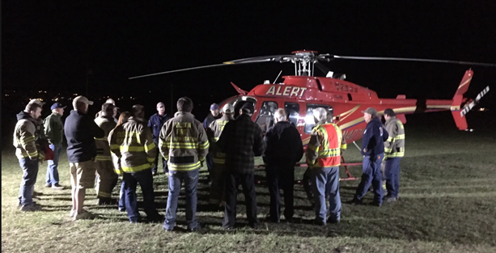
How Else Can Polson Rural Fire District Help You?
We’re always open to suggestions as to how we can improve our services and assist our stakeholders. Please feel free to contact the district at 406-883-4244.
WE’RE ALWAYS LOOKING FOR MORE VOLUNTEERS! WE CAN USE ASSISTANCE IN MANY WAYS SO DON’T BE AFRAID TO JUMP IN!
It’s a great way to contribute to your community, and… it’s fun. The best part of joining the fire district is building a new family. You won’t find a better group of people to spend time with. For real!

Slide 22
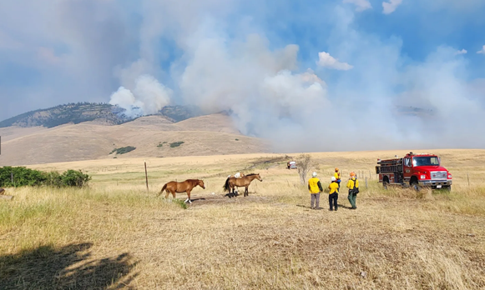
Questions, Comments

Slide 23
Thank You For Your Support

