Slide 1
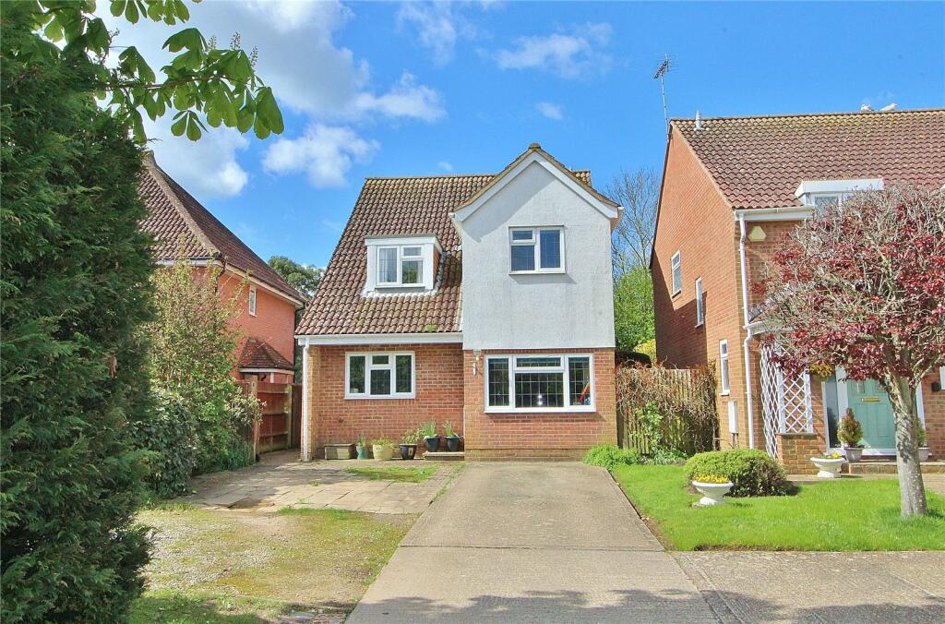

Your Guide to Chestnut Lodge
CONTACT DETAILS
Address: Chestnut Lodge Children’s Home, Durrington, Worthing, BN43 5QU
Phone: 01903
We all hope you will be very happy here. This guide is to help you settle in and to answer some of the questions you may have. If you think of anymore, just ask any member of staff and they will be able to help you.
During your assessment week, you will probably get the hang of some of the house rules and routines. This booklet is your guide to Chestnut Lodge, your home, where we hope you will settle well and enjoy all that is on offer to you, both formal and fun.
We understand that you may be feeling anxious about coming to Chestnut Lodge. It is sometimes quite difficult to meet new people and be in a new environment, but we will try our best to help you settle in as quickly as possible.
Throughout this guide, we will look at some of the things that we are most often asked about. We hope you find this useful.
We look forward to having you join us at Chestnut Lodge!!
Welcome to Willow Family Care
and your home at Chestnut Lodge!

Slide 2
CONTENTS
Welcome ...............................................................................1
Contents ............................................................................... 2
Your Bedroom ........................................................................ 3
Other Rooms / Managers Office / Games Room ...................... 4
Kitchen / Dining Room / Laundry ............................................. 5
Garden .................................................................................. 5
Bedtime / Waking Up Time ...................................................... 6
TV, Music & Computers ........................................................... 6
Money / Phone Calls ............................................................... 6
Advocacy ............................................................................... 6
House Meeting / Travel Arrangements ...................................... 7
Trips & Activities / Contact / Ring Doorbell ................................ 7
Education / Health .................................................................. 8
Keyworkers / Review & Care Plan.............................................. 8
Smoking & Fire Safety …........................................................... 9
Culture & Religion / Bullying / Sanctions.................................... 9
Right to Make a Complaint ....................................................... 10
Getting in touch with the Childrens Commissioner …................. 10
Support Lines .......................................................................... 10

Slide 3
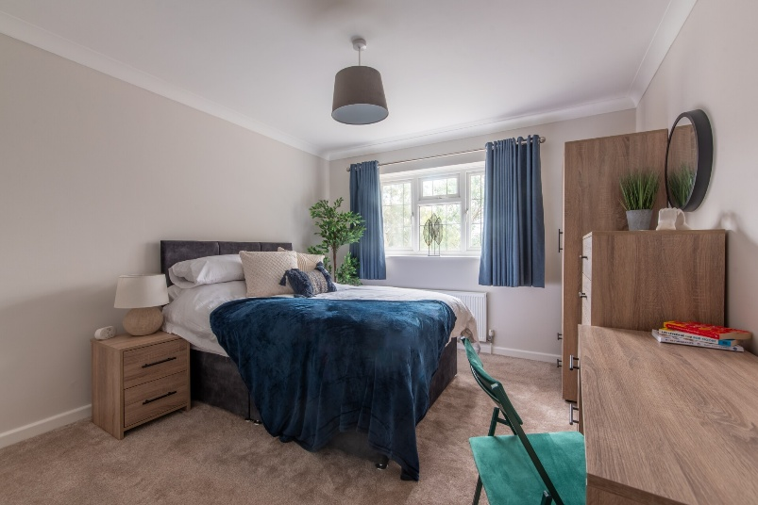
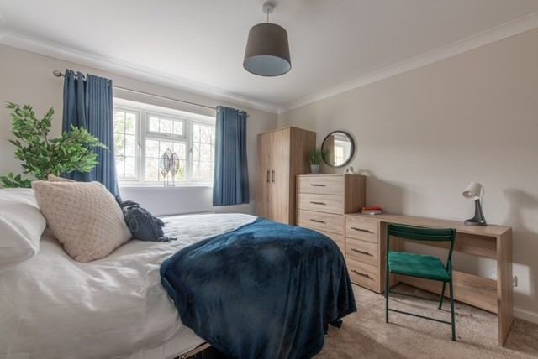
YOUR BEDROOM
You will have your own bedroom with a small double bed and a study area.
We will provide you with a TV in your room (see TV / Bedrooms section for more about this) and bedding and décor of your choosing.
Your room is your responsibility, so please keep it as clean and tidy as possible. Staff will check if you are keeping it tidy, so no hiding stuff under your bed!
We ask that you respect other children’s personal space. We expect you to knock and wait for an answer before entering, and you can expect staff to do the same.
There may be times when staff need to go into your room, but we will try to do this when you are present. If staff need to enter when you are not present, we will let you know.
Visitors are not allowed to go into any of the bedrooms without permission from staff. It is possible for you to have friends around if you arrange this with staff beforehand, but your bedroom door will need to be open at all times.
There may be times when other children are not allowed in your room, but staff will always talk to you about this.
We will give you a key for your bedroom door, which will be your responsibility to look after. If you lose your key, you will need to pay £5 for a replacement, which will be deducted from your pocket money allowance. We encourage you to lock your door when you are not in your room.
Here are some photos of one of the bedrooms. This will be a space that you can make your own and put your own stamp on.
Staff will support you with this and you can add accessories to your own taste.

Slide 4
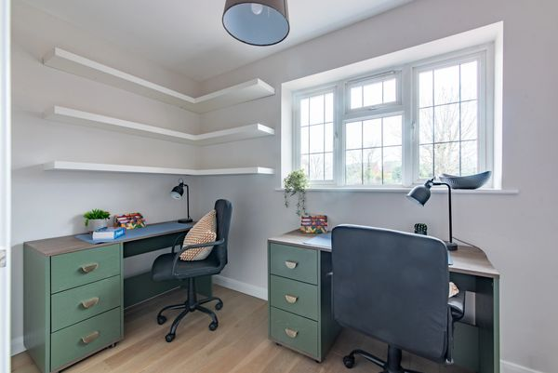
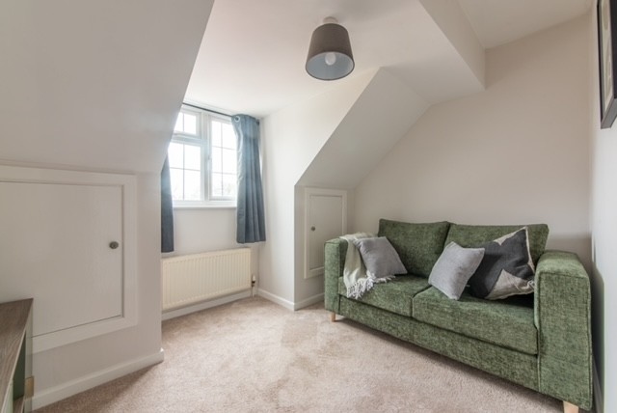
OTHER ROOMS
We recommend you keep your personal belongings in your room, where you can be sure they are safe. This is your home, and we want you to feel comfortable. We don’t mind you bringing your stuff down to use, but please take it back to your room afterwards. We are unable to replace anything that is damaged by being left in communal areas of the home, which are for everyone to use.
THE MANAGERS OFFICE
There is an office on the ground floor, where managers will spend time during the day completing paperwork and making phone calls.
You are very welcome in the office after knocking and being invited in. Please be aware that confidential information is stored in the office. There may be times when managers are in important meetings and are unable to let you in straight away. They will ensure someone is available for you as soon as possible and are grateful for your respecting the office space. Your information is private to you and those who look after you, which is why meetings remain confidential to all children.
THE GAMES ROOM / SECOND STAFF SLEEPING IN ROOM
There is a chill/games room upstairs where you can relax and play the consoles if you would like. In the evening, this will double up as the staff sleep in room, which will allow you to have a member of staff upstairs in case you need any support. We ask you to ensure the room is always kept tidy.

Slide 5
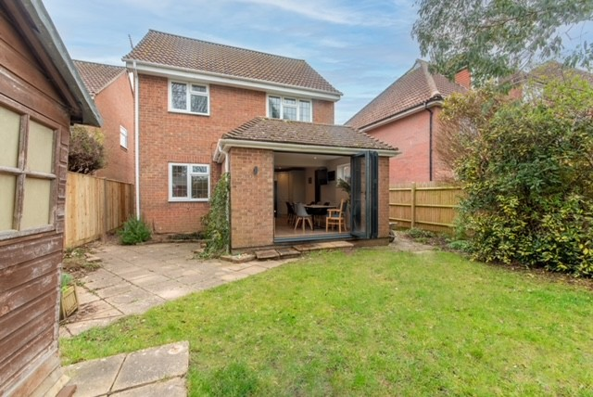
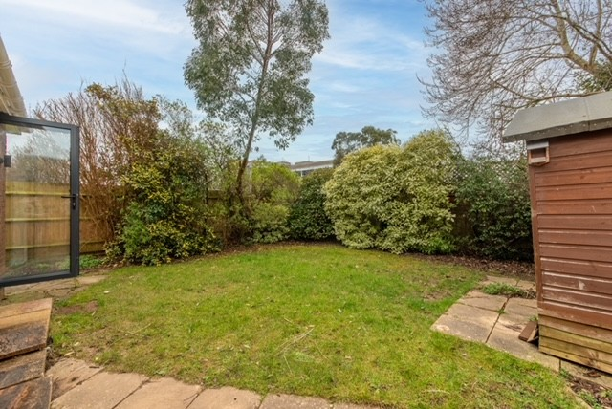
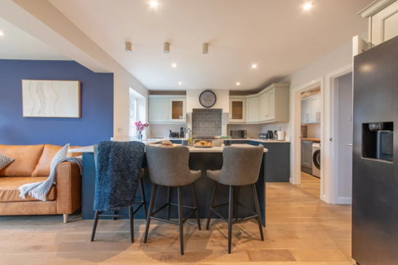
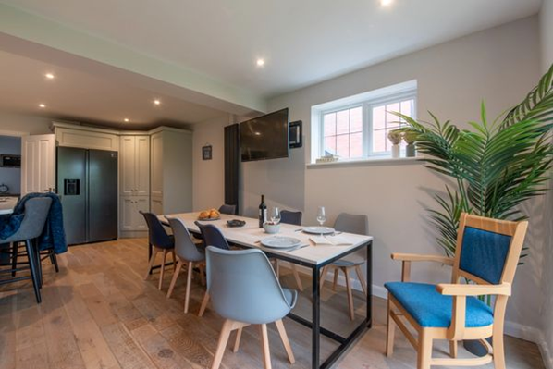
KITCHEN / DINING ROOM
The kitchen is fully equipped with top-of-the-range appliances and cooking accessories. We have a food cupboard where we keep most of the food, which is available at specified times of the day.
Healthy eating is important for everyone, so you will be encouraged to help with planning meals and shopping, as well as preparing and cooking food.
We usually eat together in the dining room, and mealtimes are
During weekends and school holidays, mealtimes are more flexible to fit around other activities.
If you are not going to be in around dinnertime, a meal can be saved for you if agreed with staff in advance.
LAUNDRY ROOM
The Laundry room is located just off the kitchen and has a washing machine and airer available. You will be encouraged to wash your own laundry; however, staff will be available to help if needed.
GARDEN
At Chestnut Lodge, we have an outdoor space that you are welcome to enjoy. In the summer, we will have BBQs and outdoor seating so we can enjoy the nice weather. If you would like anything for the garden, please ask. This is your home.
Breakfast | 7.30 – 9.00 am
Lunch | 12.30 – 2.00 pm
Dinner | Approx 6.00 pm
SNACK-ATTACK
If you are still hungry later in the evening there will be snacks such as fruit and cereal available.

Slide 6
BEDTIME & WAKING UP TIMES
Your bedtime will be discussed with your key worker and may be more flexible on the weekends and school holidays. Any extensions to your usual bedtime would need to be discussed with the staff on shift.
Everyone should aim to be settled in your room by 10pm. Remember that other people may be sleeping when you go up to bed, so please be as quiet as possible.
You will arrange with your keyworker what times you need to be up for school and will be encouraged to get yourself up in the morning with the support of staff.
At weekends and school holidays you can enjoy a longer lie in (not all day 😊)
MONEY
While living at Chestnut Lodge, you will receive pocket money every Saturday. The amount you get depends on your age and your key worker will discuss this with you.
Before you receive your pocket money, you will need to tidy your room and help with a job around the house.
You will also receive £70 a month for your clothes, and you can have a regular haircut/ toiletries allowance. Your keyworker will help you work out your budget to make sure you don’t run out of money too early!
10 yrs | £5.00
11 yrs | £5.50
12 yrs | £6.00
13 yrs | £7.50
14 yrs | £10.00
15 yrs | £12.50
16 yrs | £13.00
TV, MUSIC & COMPUTERS
Please be respectful of others when watching TV, listening to music, and using computers and games consoles.
This means sharing communal televisions and other equipment, and keeping the volume at a reasonable level, both in communal areas and your bedrooms.
At Chestnut Lodge you will be able to watch age-appropriate films and games but nothing that is rated 18.
PHONE CALLS
You will be able to make phone calls to your family or social worker on the office phone, as agreed in your care plan.
There will be no other calls allowed from the office phone, you have your own phones and credit to make calls to friends.
ADVOCACY
You will have an advocate. Their role is to support you to ensure your voice is heard, your rights are respected, and your needs are met.
This can involve helping people understand complex information, express your views, make decisions, and support you to speak up for yourself, especially in situations where you may have difficulty doing so alone.
At Chestnut, you can download an app where you can write, draw, or voice record your feelings, wants, and wishes will also go to the management.

Slide 7
HOUSE MEETING
There will be a meeting every Sunday, which everyone should come along to. This is where everyone will decide what meals will be available for the week ahead and discuss any concerns or feedback you have about the home. We will also be making positive plans for any trips or activities you would like to do. Sometimes, we will talk about a particular topic, and we may have a guest come to speak.
Guidelines for the meeting:
No phones!
We would like you to participate
Be respectful of others.
Take your turn in chairing and writing the notes.
We really want everyone to attend and get involved…
TRIPS & ACTIVITIES
At Chestnut Lodge we actively encourage you to take part in activities you enjoy. Staff can organise day trips such as trips to the cinema, bowling, football, golf, basketball, horse riding or whatever you may be interested in.
Trips tend to be arranged on the weekends and holidays and are discussed in the weekly meetings or with your keyworker. We would also like to arrange a summer holiday abroad so please be involved in the planning.
CONTACT
Whilst you are at Chestnut Lodge we will encourage and support you to keep in contact with your family, depending on your care plan. You can use our phone to make calls to your family, and we will support visits.
Your social worker will have regular contact with you and your keyworker via phone/email and will visit you at home.
You are welcome to have friends to visit you at Chestnut Lodge if this is agreed with the staff on shift. During schooldays, no visitors are allowed before 3pm and must have left by 6pm.
TRAVEL ARRANGEMENTS
We will have a communal care at Chestnut Lodge, and staff will give you lifts for family visits, appointments, and education if this is agreed in your care plan.
We try to support your independence and will encourage age-appropriate independent travel to see your friends and get home again, using public transport. We can support travel fares, if agreed with staff, and may be able to help with a lift sometimes.
No lifts or travel fare will be supported during term time before 3pm, and we will only support it if you have attended education that day.
CCTV/ SURVEILLANCE
It is important to us that you have privacy in your home at Chestnut Lodge, so we have installed a Ring doorbell and CCTV at the front and rear of the property. This is for security and not for observing you or anyone who lives or works at Chestnut Lodge. However, sometimes, you will be on the doorbell camera and CCTV when you are outside the building.

Slide 8
EDUCATION
We want you to achieve your full potential, and we are here to guide and support you with your dreams and aspirations.
Education is a big part of growing up – it helps you to build your future, discover your interests, and learn new things every day, as well as connect with friends.
Whatever type of school or education you attend, the staff at Chestnut Lodge are here to support you with:
Homework and Home Learning
Getting ready for school/college each day
Talking to your school/college to make sure you’re getting the support you need
Attending your parent/carer evenings and meetings to help you do your best
“A good education is a foundation for a better future”
Elizabeth Warren
KEYWORKERS
During your stay here at Chestnut Lodge, you will meet many different staff members; however, you will work closely with a particular member of staff, your keyworker. They will be your person to ask questions, and they will support you in meetings, offer advice and encouragement and support you in all other aspects of your life. Ideally, you will meet weekly for a keywork session, this is where you can discuss any concerns you may have or plans you would like to make.
Your keyworker will be the one to keep a written record of what you talk about in your keywork sessions and write a report at the end of each month with you, and this will be sent to your social worker. This is so we can all keep track of how you are getting on and plan for anything that needs to change.
HEALTH
Staff will support you to register with a local GP (Doctor), Dentist and Optician.
Your health is important! If at any time you feel unwell, please speak to your keyworker or any other member of staff who will make the appointment with you.
Minor bumps, bruises and scrapes are attended to by our trained First Aiders.
Serious health issues are dealt with by a visit to Worthing Hospital, only a short distance away.
Issues of Sexual Health are discussed on a formal basis and are more informally discussed in group meetings with staff in attendance.
A member of the staff team will always help with any questions or worries about healthcare issues, no matter how big or small they may seem.
REVIEW & CARE PLAN
It is important that you, your family, keyworker, and professionals who are involved in your care meet regularly to ensure your needs are being met and to discuss how you are doing.
The meeting is about you and your views, so we encourage you to attend. You will be supported by your keyworker, who will attend the meeting alongside a member of the management team.
At your review, your care plan will be agreed upon and may need to be changed to ensure your needs are met. Your keyworker will talk to you before the meeting to make sure your views are represented and are reflected in changes in your plan.

Slide 9
SMOKING
The whole house is designed as a non-smoking/non-vaping zone. Anyone who decides to smoke or vape in the house is likely to have some restrictions put in place, such as items being confiscated or having to be supervised while spending your money.
It is the staff’s responsibility to discourage you from smoking/aping and tell you about the health and safety risks involved.
We will support you to stop if you wish to.
Staff will not give out lighters or cigarettes to anyone in the home. If you choose to smoke, you will need to do this off the grounds of Chestnut Lodge and dispose of your cigarette ends accordingly.
CULTURE & RELIGION
Here at Chestnut Lodge, we encourage you and support you to follow your own religion and culture. These are important parts of your identity, and we will support you in whatever way we can. For example, providing food or being aware of specific dates or traditions.
Do not be afraid to point out if anyone has been offensive, as people may not always know about other cultures, but we do this in a constructive way.
In the same way, we will ask you to be respectful of other people’s cultures who may be different from your own, both in the home and in the community.
BULLYING
Bullying is not tolerated at Chestnut Lodge. If you feel you are being bullied, it is important you bring this to someone’s attention as soon as possible, and your concerns will always be taken seriously.
Any type of bullying will not be tolerated. This will be taken very seriously. This includes online/cyber bullying. The consequences will include a written warning, followed by more serious action. If things do not improve, this could mean you have to leave the home.
Everyone has to right to feel safe in their home, and Chestnut Lodge will be no exception.
FIRE SAFETY
There are smoke alarms and heat detectors in all rooms and emergency fire points located throughout the home.
The fire alarms will be tested weekly, and you will be advised when this is happening. There will be a monthly fire drill where everyone is expected to evacuate the home and meet at the safety point (outside the front of the home). All safety points will be explained by staff.
You will be provided with a personalised emergency evacuation plan (PEEP), which gives you and staff detailed instructions on what to do in the event of a fire.
SANCTIONS
At times, things may feel difficult, and it can be hard to adjust to living in a new place. We understand that this can sometimes affect your behaviour. However, actions have consequences, and sanctions may be used when needed. These are not meant as punishments but as opportunities to reflect and make positive changes. We always try to ensure that any sanction is linked to the behaviour. For example, if there is an issue involving the TV, the sanction will relate to TV use. Please speak with any member of staff if you would like help understanding this.
*Feedback from Children Inserted Here*

Slide 10
RIGHT TO MAKE A COMPLAINT
If you want to make a complaint, whether it is a problem with another child, a member of staff, or with the way you are being cared for, there are many ways in which you can complain. If you are unclear how to do this, a member of staff can help you. You can also bring your complaints to:
House Meetings
Keywork Sessions
Home / Assistant Managers
Calling your Social Worker
Speaking with Willow Family Directors – David, Jamie or Annie.
RIGHT TO MAKE A COMPLAINT
If you want to make a complaint, whether it is a problem with another child, a member of staff, or with the way you are being cared for, there are many ways in which you can complain. If you are unclear how to do this, a member of staff can help you. You can also bring your complaints to:
House Meetings
Keywork Sessions
Home / Assistant Managers
Calling your Social Worker
Speaking with Willow Family Directors – David, Jamie or Annie.
WHAT HAPPENS AFTER YOU MAKE A COMPLAINT
We take all complaints seriously and will always try to deal with them fairly, respectfully, and as quickly as possible.
Once a complaint has been raised:
Within 24 hours
Your complaint will be shared with the management team so they are aware and can decide the best way to respond.
Within 48 hours
You will be given a response to let you know that your complaint has been received and what will happen next. This may include who is dealing with it and what steps will be taken.
Up to 7 days
SUPPORT LINES
The Youth Emotional Support (YES) service is aimed at children and young people ages 11-18 years and offers support for concerns relating to emotional wellbeing and other concerns.
Mental, physical, or sexual health
Family and peer relationships
Education and employment
Housing and homelessness
Criminal or sexual exploitation
Substance misuse
You can access their services through ‘find it out plus’ centres in West Sussex. The nearest West Sussex Centre is Adur and can be contacted on the number below:
Telephone: 01403 229900 (Mon-Fri
9am to 5pm)
Email: WSChildrenServices@westsussex.gov.uk
“Promise me you’ll always remember – you're braver than you believe, stronger than you seem, and smarter than you think”
Christopher Robin
If you’re in care, leaving care, living away from home or working with social services, they can give you free, impartial help and advice. You can speak to them confidentially about any questions you have or anything that’s troubling you – no issue is too big or too small. Just get in touch with them via email: help.team@childrenscommissioner.gov.uk
If you’d rather speak to them on the phone, you can call free on 0800 528 0731 or visit the website:
Homepage|Children's Commissioner for England

Slide 11
We aim to fully resolve complaints within one week. This may include meetings, speaking to the people involved, and agreeing any actions needed. If it is likely to take longer, we will explain why and keep you updated.
Once a complaint has been raised:
Within 24 hours
Your complaint will be shared with the management team so they are aware and can decide the best way to respond.
Within 48 hours
You will be given a response to let you know that your complaint has been received and what will happen next. This may include who is dealing with it and what steps will be taken.
Up to 7 days
We aim to fully resolve complaints within one week. This may include meetings, speaking to the people involved, and agreeing any actions needed. If it is likely to take longer, we will explain why and keep you updated.
OFSTED – CONTACT INFORMATION
You will always be listened to, kept informed, and supported throughout the process. Making a complaint will not get you into trouble, and you will not be treated unfairly for speaking up.
If you are unhappy with how your complaint is being handled, you can ask for further support or contact Ofsted or the Children’s Commissioner.
You can also complain to Ofsted:
Write to: Ofsted, Piccadilly Gate, Store Street, Manchester, M1 2WD
Email: enquiries@ofsted.gov.uk
Telephone: 0300 123 4666

