Slide 1


Core Curriculum / Careers Information Evening
Wednesday 12 October
Science – Miss O'Neill (Science Lead)
CRE – Miss Shaw (Humanities Lead)
English – Miss Northcott (Ass. English Lead)
Mathematics -Mr Vetcher (Mathematics Lead)
Mr Cousins (Deputy Headteacher)

Slide 2

Science GCSEs 2023
The vast majority of students are studying AQA GCSE Combined Science
This qualification results in two equal or adjacent grades e.g 55, 54, 44, 43.
Higher tier students can achieve up to a grade 99 but not below a grade 43.
Foundation tier students can achieve from a grade 11 up to a grade 55.
A small number of students are studying the Separate Science pathway where they can achieve up to a grade 9 in each of the three Sciences.

Slide 3
16th May 2023 Biology Paper 1 (Cell bio, Organisation, Infection, Bioenergetics) | 9th June 2023 Biology Paper 2 (Homeostasis, Inheritance, Ecology)
23rd May 2023 Chemistry Paper 1 (Atomic structure, Periodic table, Quantitative, Chemical changes, energy changes) | 13th June 2023 Chemistry Paper 2 (Rates, organic, chemical analysis, atmosphere, using resources)
25th May 2023 Physics Paper 1 (Energy, Electricity, Particle model, Atomic structure) | 16th June 2023 Physics Paper 2 (Forces, Waves, Magnetism) + Space physics triple only

Slide 4

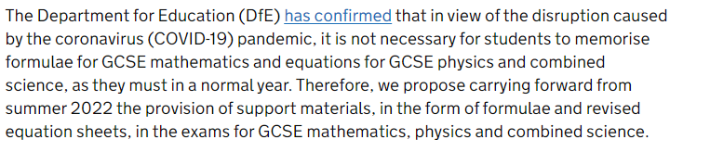

Slide 5
Mocks Autumn 2022
Students in the classes 11xy1, 11xy2 and 11xy3 will be sitting two mock papers- Biology Paper 2 and Chemistry Paper 1.
Students in 11xy4, 11xy5 or 11xy6 will be sitting two papers made of mixed questions from all three sciences.
Check class charts for revision lists and guidance from your class teacher!

Slide 6
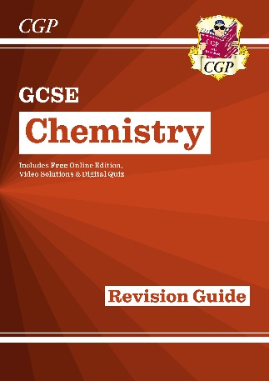

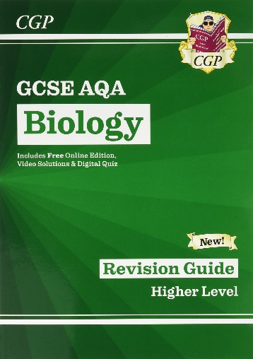
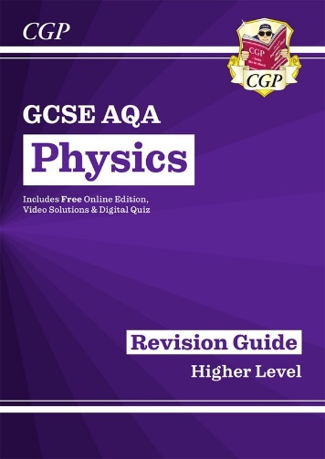
What should students be doing to prepare themselves for the Autumn Mocks and GCSEs?
Purchase revision guides!

Slide 7

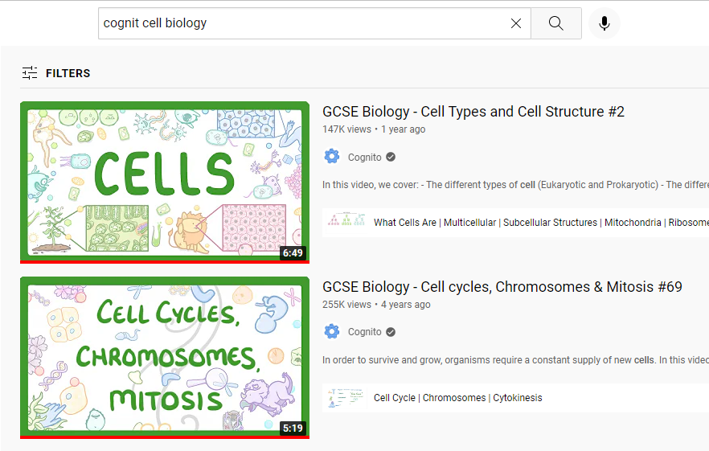

Slide 8
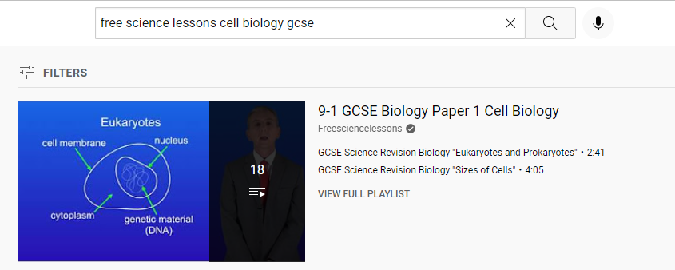

Slide 9
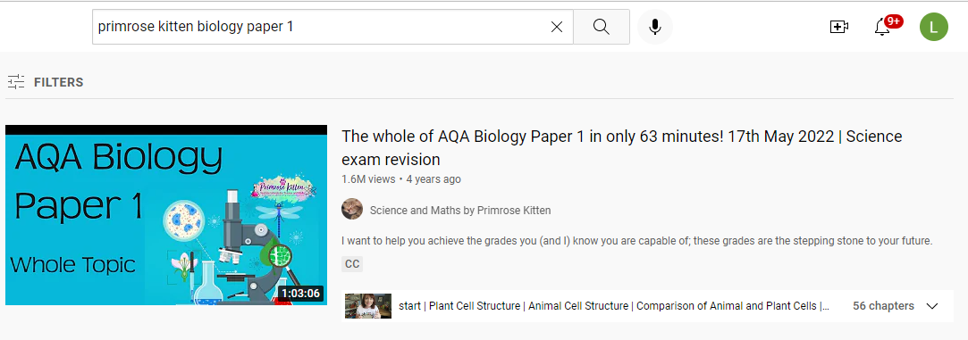

Slide 10



Slide 11



Slide 12


Slide 13
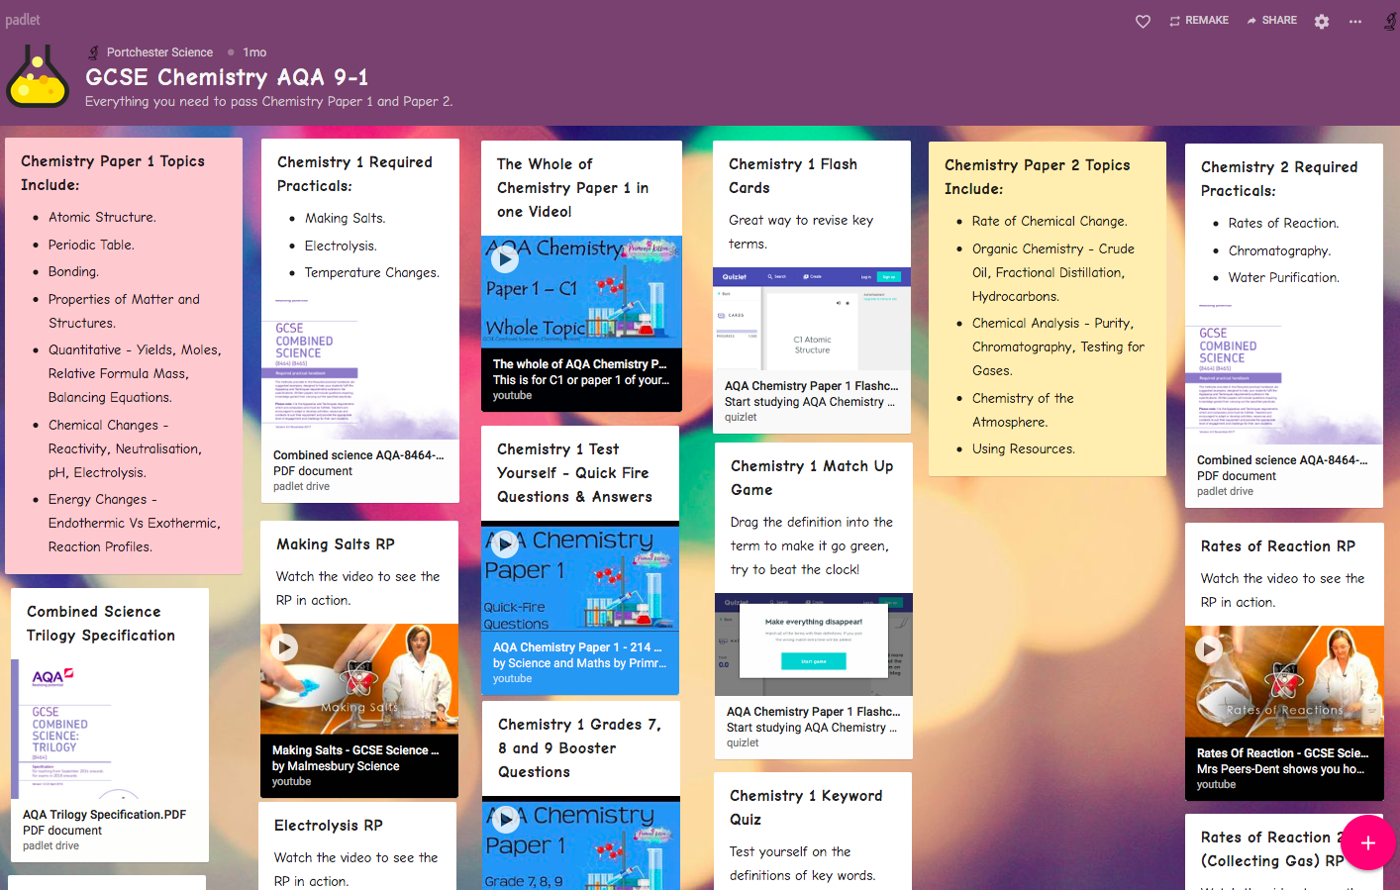

Slide 14
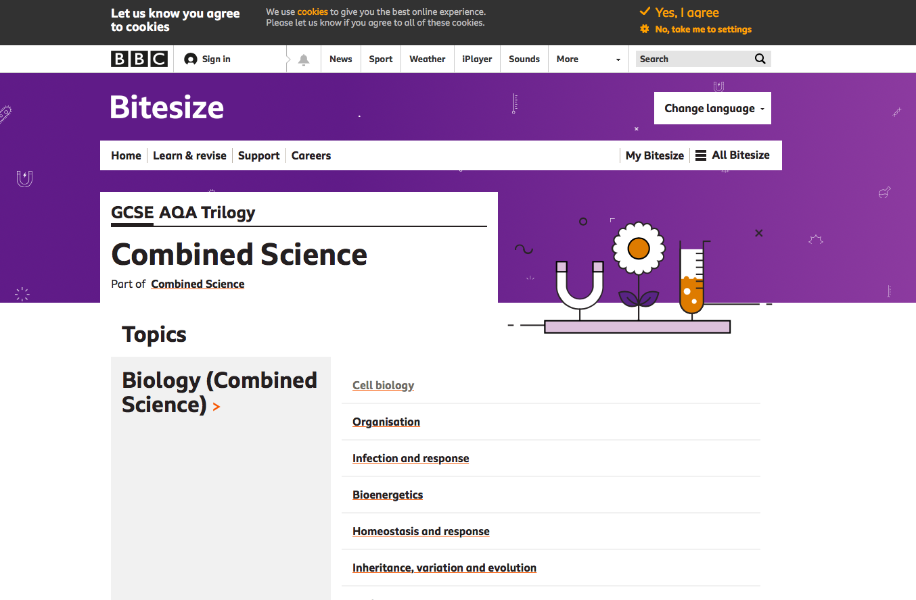
BBC Bitesize
AQA Trilogy.
Combined Science.
OR…
Triple (Separate Sciences).

Slide 15



Any further questions/queries…
l.oneill@portchester.hants.sch.uk
Or contact your Science teacher directly.

Slide 17
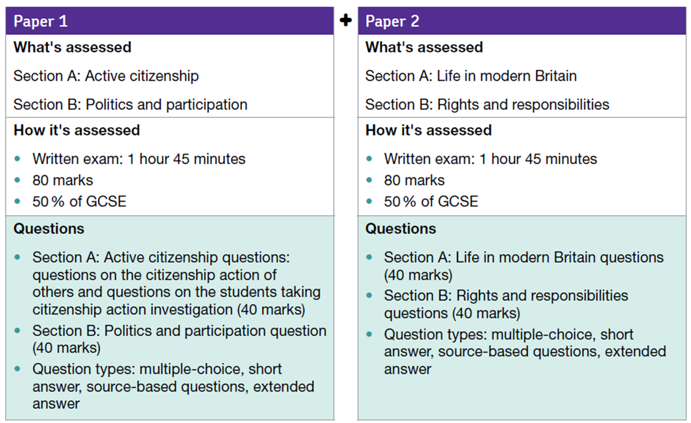
Specification at a glance

Slide 18
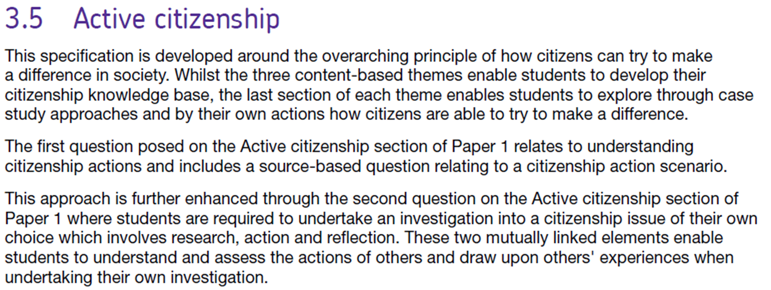
Specification at a glance

Slide 19

Timings
105 minutes
80 marks
50 minutes per section
5 minutes checking time

Slide 20
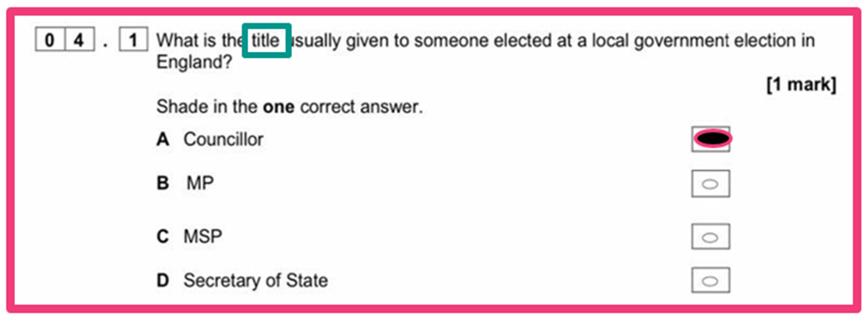
Exam question’s
You may be asked to answer a range of different styles of exam question. This is a multiple choice question for example from an AQA GCSE Citizenship Studies paper.

Slide 21
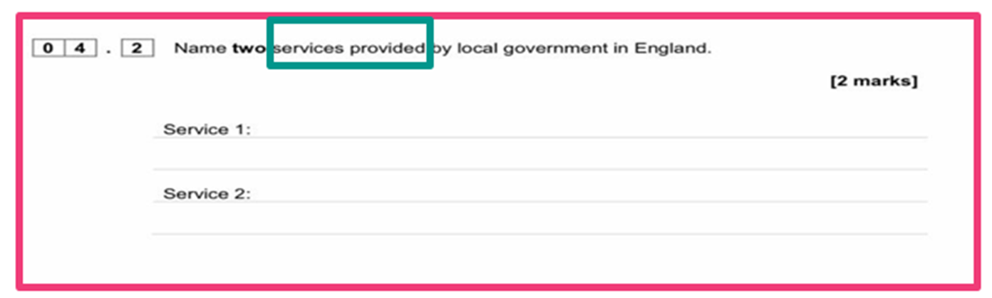
Exam question’s
You may be asked to answer a range of different styles of exam question. This is a short response question similar to those used in AQA GCSE Citizenship Studies papers.

Slide 22
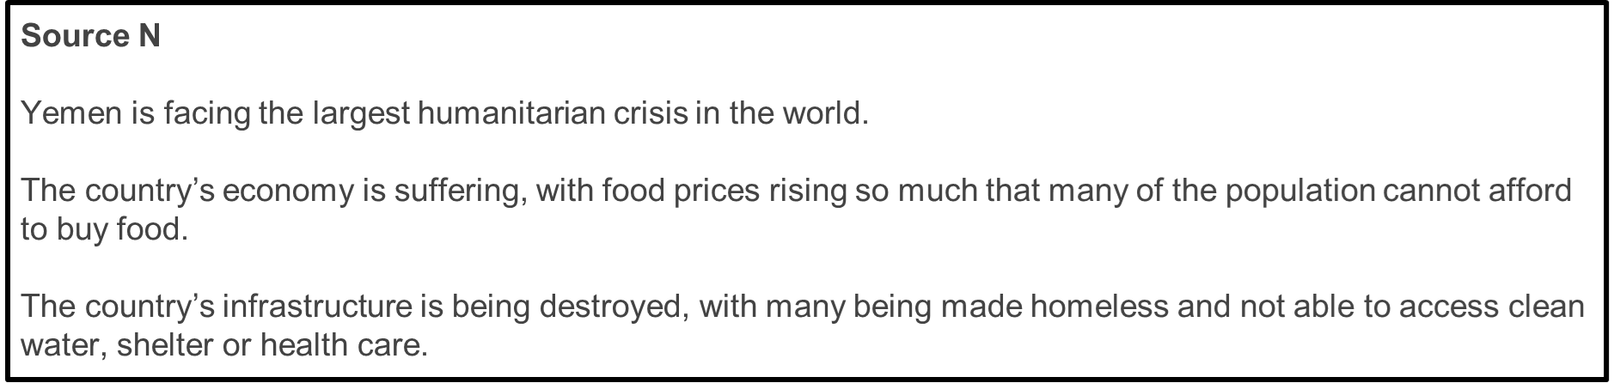
Exam question’s
Using Source N, explain two responses non-governmental organisations are able to make to the stated humanitarian crisis. (4)
Use the source, DO NOT copy the source.
Develop FROM the source.
Answer THE question.
Consider ALL your Citizenship knowledge.
Useful sentence starters:
One response is…
A second response is…

Slide 23

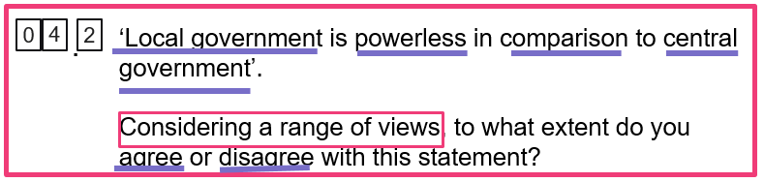
Exam question’s
Box around the command word/s
Underline key words/phrases
Glance back at the question regularly

Slide 24

Structuring an essay
“Local government is powerless in comparison to central government”
Introduction
2 arguments agreeing with statement
2 arguments disagreeing with statement
Conclusion

Slide 25
Top Tips
8 mark questions:
It usually has two bullet points: make sure you answer both of them.
You will usually be asked to “consider a range of views”, so make sure you give different opinions.
Give facts to prove your points: name people/organisations/laws/statistics.
You need to include a sentence at the end giving your own viewpoint.
4 mark questions:
Don’t repeat what is said in the source, you are being asked to show what you have learnt.
Active Citizenship:
You must learn your research, including names of sources/websites/articles and statistics (especially of your primary research and you evaluation surveys at the end).
Multiple choice:
Have a guess if you don’t know, but don’t waste time thinking.

Slide 26
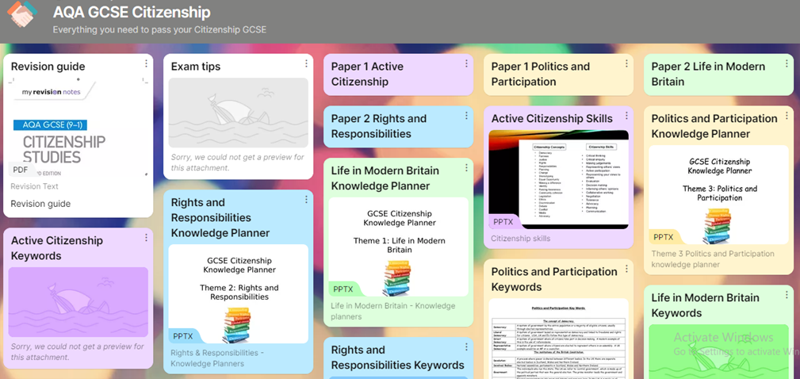


How can I prepare myself?
Learn the key vocabulary to be able to understand the question
Watch the news to keep up to date with things going on in society – especially when it comes to Parliament and the Government
Log onto the school website to find key resources
Follow the link on the school website to go to the revision page on Padlet
Practice exam papers

Slide 27
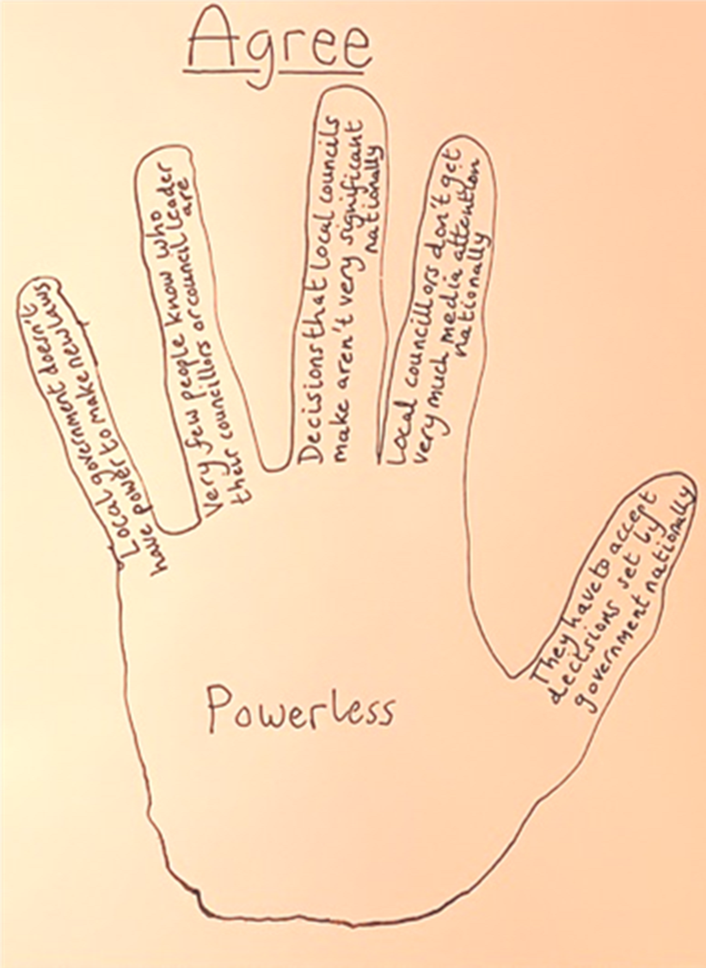

Revision techniques

Slide 29



KS4 Information Evening:
English Language and Literature
October 2022
Literature
Language

Slide 30
Content
Structure of GCSE (9-1)
Language and Literature Courses Overview
Examples of GCSE questions
Any adjustments due to COVID-19?
Recommended resources

Slide 31
GCSE English and English Literature (9 - 1)
(Source: Ofqual, the exam board regulator)
First assessed in June 2017
New GCSE content will be more challenging
The new grades are being brought in to signal that GCSEs have been reformed and to better differentiate between students of different abilities
Grade 9 is the highest award
Fewer Grade 9s will be awarded than A* (Summer 2017 3% of students)

Slide 32
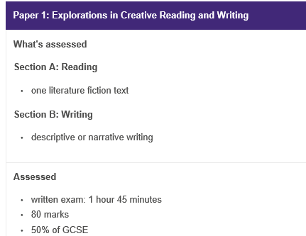
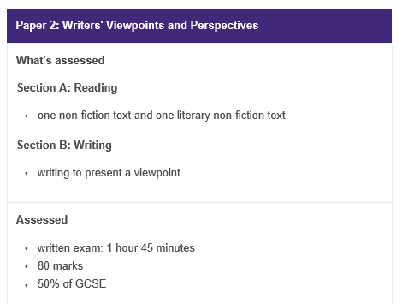
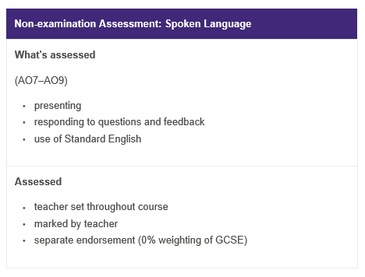
English Language: Consisting of 2 papers and a spoken language endorsement
Language Paper 1
Language Paper 2
Spoken Language Endorsement

Slide 33
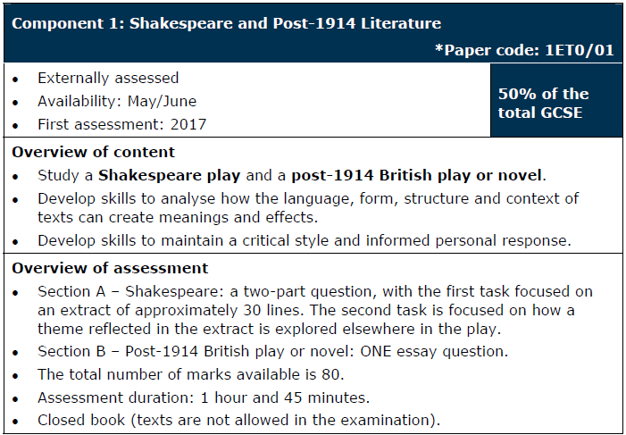
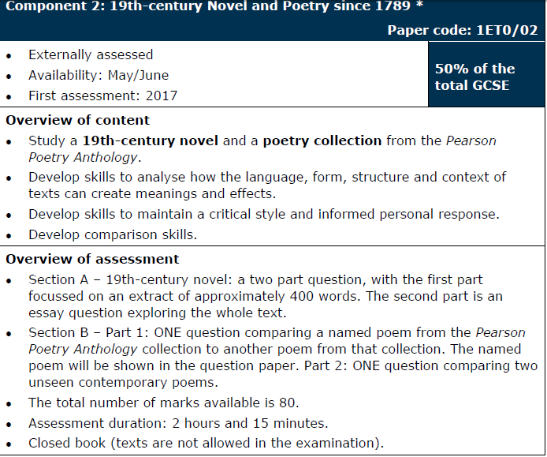






English Literature: Consisting of 2 papers
Novel
Play
Shakespeare
Poetry

Slide 34
At a glance
Language
Literature
Paper 1: 80 marks
  Section A: Shakespeare
    An extract analysis + an essay
  Section B: Modern British text
    A traditional essay + SPaG marks
Paper 2: 80 marks
  Section A: 19th-century fiction
    An extract analysis + an essay
  Section B: Poetry – anthology and unseen
    Two comparative essays – one on poems you will have studied and one on poems you are unlikely to have seen before
Paper 1: 80 marks
  19th-century fiction and imaginative writing
Paper 2: 80 marks
  20th- and 21st-century non-fiction and transactional writing
Spoken language endorsement
  Presentation and discussion – awarded as a separate qualification with a Pass, Merit or Distinction grade

Slide 35
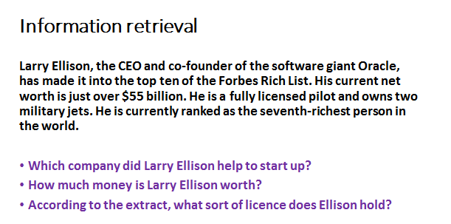
Examples of questions/papers
Basic skill for both courses

Slide 36
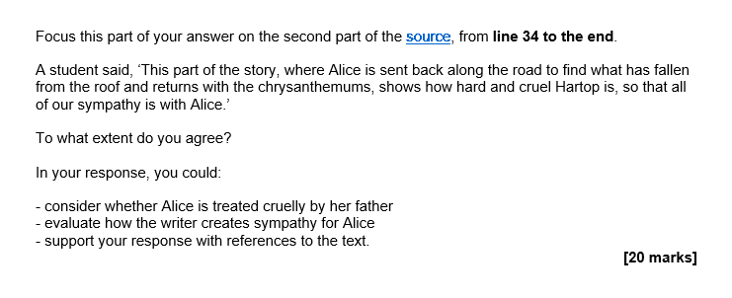
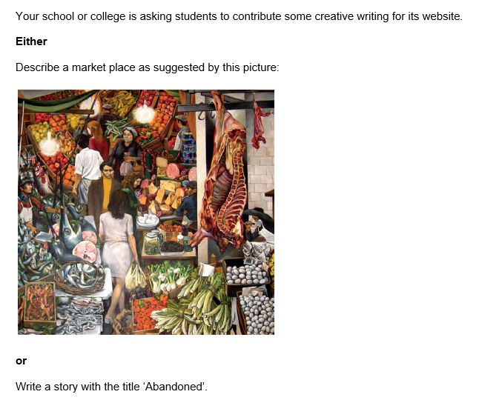
Examples of questions/papers

Slide 37
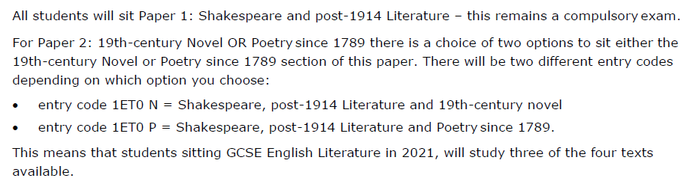
The Changes to 2022 Examinations
English Literature
This year everything is back to normal.
Full Literature Course – Including Poetry
Full Language Course – Including Recorded Spoken Language + No prior warning over the text types for Language Paper 2
English Language
The following changes apply to our GCSE English Language (8700) qualification and only for the 2021 exam series:
there’s no requirement for teachers to submit a sample of audio-visual recordings of Spoken Language assessments the Spoken Language assessment can take place in front of a single teacher who can represent an ‘audience’ the Spoken Language assessment can be conducted by the teacher at any time during the course and by virtual means you’ll still need to submit a Centre Declaration Sheet as normal.

Slide 38
Revision Resources
Revision Sessions
Thursday after school at 3:10pm.
This will take place after half term – targeted at specific students, depending on their English Mock
Language Paper 2 Mock – Wed 19th
Available at the School Bank
Check the English part of the school website.

Slide 39
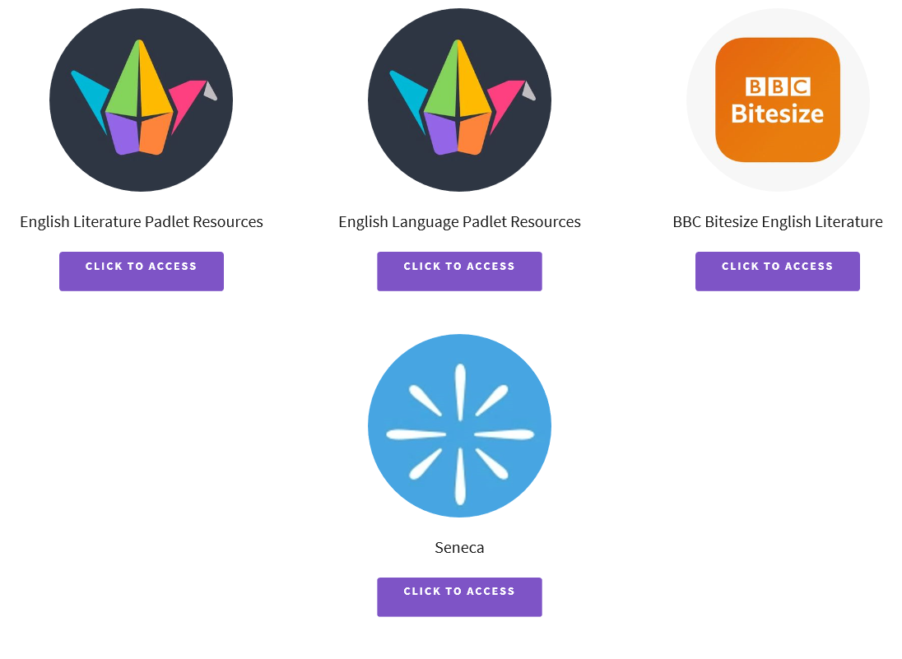
School Website – English and Media

Slide 40

Any concerns or issues
Head of English
Or email your son/daughter’s English teacher

Slide 42

Y11 Information Evening Maths
Content:
Structure of the Mathematics GCSE
Advanced information for SUM 23
Curriculum for this year
Mocks and Feedback
Revision Resources

Slide 43
Y11 Information Evening Maths
Structure of the GCSE
Exam board – Pearson Edexcel
There are three papers in Mathematics:
Paper 1 is Non Calculator
Papers 2 and 3 are Calculator
All Papers are 1 hour 30 minutes and have an equal weighting
Tier of entry:
Higher Paper Grades 9 – 3,
Foundation Paper Grades 5 – 1,

Slide 44
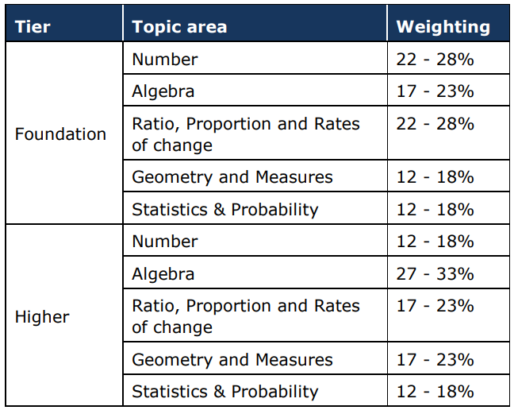
Y11 Information Evening Maths
Structure of the GCSE
The table shows the topic areas covered and their approximate weightings at Higher and Foundation Level.

Slide 45
Y11 Information Evening Maths
Advanced information:
There is no change to the content of the exam this year
Students will be given a formula sheet for this year, the precise nature of the formula sheet is in consultation.

Slide 46
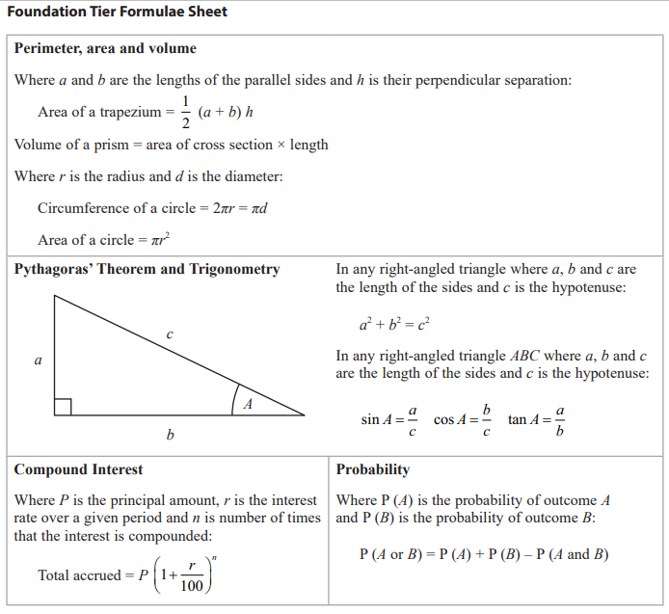
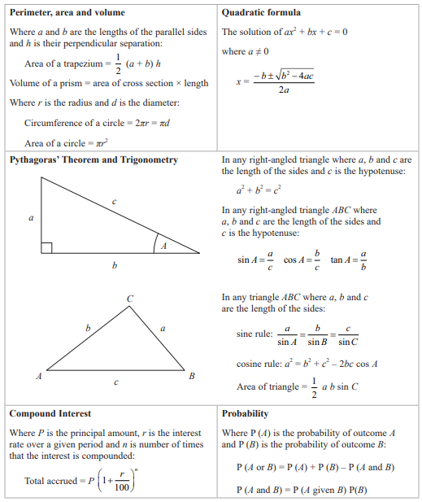
Y11 Information Evening Maths

Slide 47
Y11 Information Evening Maths
Curriculum – Lessons
Up until Christmas, lessons will have a focus on covering the last bits of content students haven’t seen yet.
From Christmas, we will then begin our focus on Exam preparation which will include walking talking mocks.
Both mocks and walking talking mocks with then feed the content of the lessons that students receive.
Every lesson starts with a retrieval practice and this is where content is consolidated from lesson to lesson.

Slide 48
Y11 Information Evening Maths
Mocks:
31st October – 11th November – 2 papers (1 non-calculator, 1 calculator)
5th – 9th December – 1 paper in class (3rd paper from the set above)
6th February – 10th February – 3 papers (one full set of mocks)

Slide 49
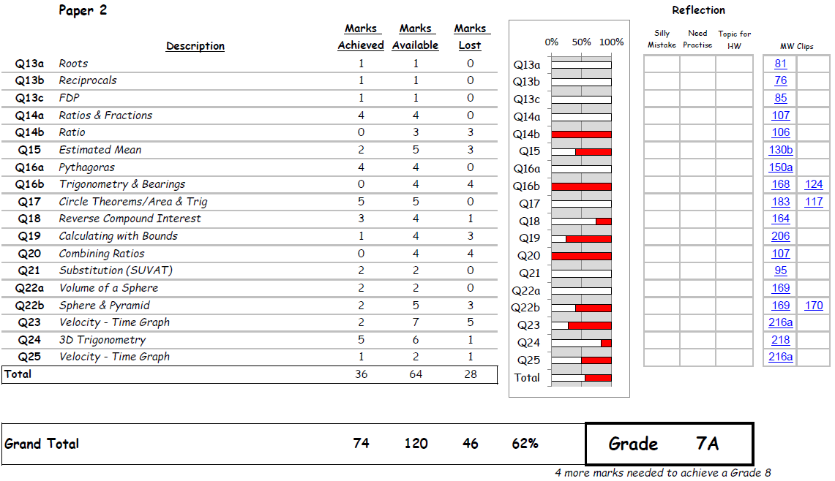
Y11 Information Evening Maths
Assessment Feedback

Slide 50
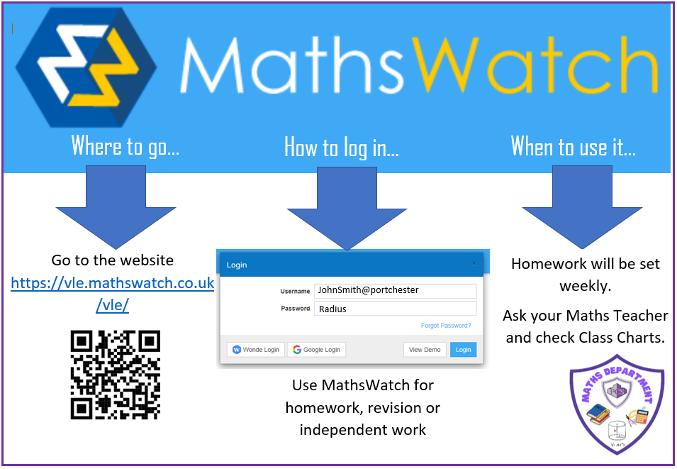
Y11 Information Evening Maths

Slide 51

Y11 Information Evening Maths
Revision resources

Slide 52

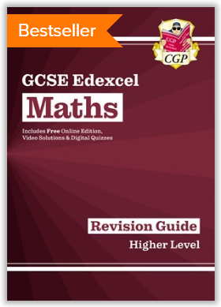

Y11 Information Evening Maths
Revision resources

Slide 53
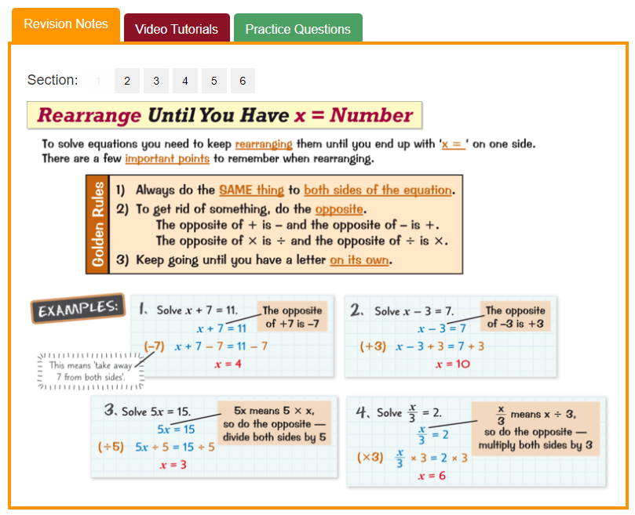
Y11 Information Evening Maths
Revision resources - Mathsbuster

Slide 54
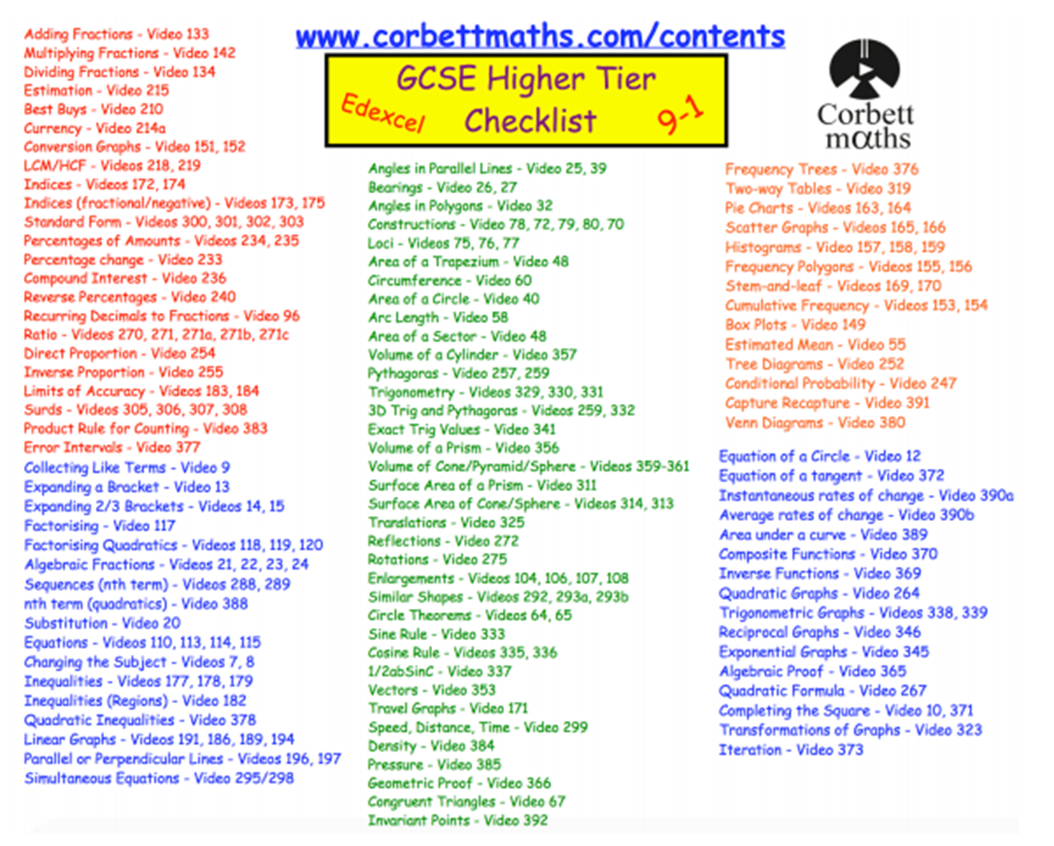
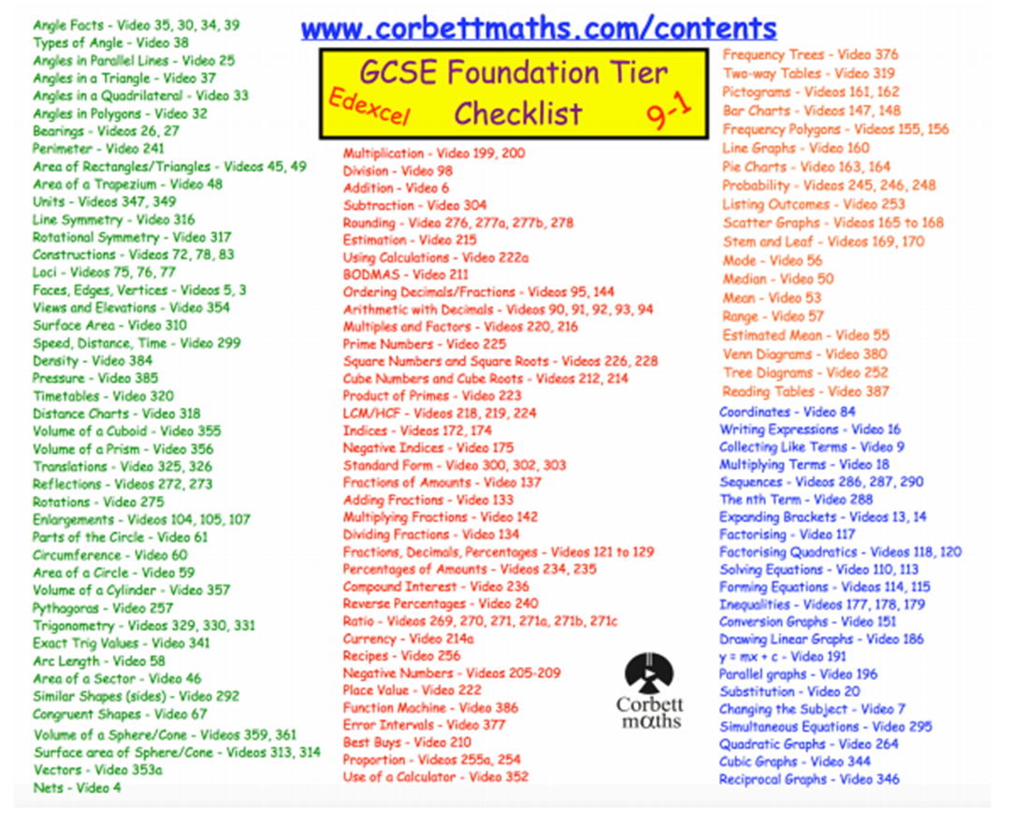
Y11 Information Evening Maths
Revision resources

Slide 55








Y11 Information Evening Maths
Revision resources

Slide 57
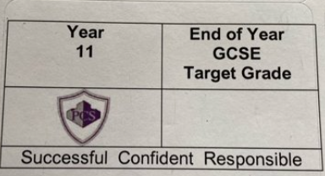
Core Curriculum / Careers Information Evening
FFT 20 Student Expectations

Slide 58

Target Grades
FFT 20
FFT targets are based on how similar pupils performed Nationally in the subject last year (similar pupils are defined as similar prior attainment, gender and month of birth). Also, your teacher has input and can move it.
For each student FFT provides a percentage chance of the likelihood of a child to achieve a specific grade.
They act as a minimum target for you to aspire to achieve.
Many of you will go beyond the target. Your teachers and mentors will talk with you about them and help guide you.
Successful
Confident
Responsible
Notes:
58

Slide 59
Core Curriculum / Careers Information Evening
Mock Window 1
Wednesday 19 October – English Language
Monday 31 October – Tuesday 8 November
Monday 5 December – Art Mock
Mock Window 2 (All Subjects)
Monday 6 February 2023 – Friday 24 February 2023
GCSE Examinations
Monday 15 May – Wednesday 21 June 2023 (Contingency Examination Days are Thursday 8 June and Wednesday 28 June 2023)

Slide 60
Core Curriculum / Careers Information Evening
Parents Evenings
Wednesday 30 November 2022 and Wednesday 15 March 2023
(Reports will also go home before each parents evening)
Mentors – All students have been assigned an academic mentor to support them in school
Revision Guides - £15 School contribution. School bank will have all subjects in stock
Please do communicate directly with your child's teacher.

Slide 61

Planning your next steps
Successful
Confident
Responsible

