Slide 1




KS4 Information Evening:
English Language and Literature
October 2020
Literature
Language

Slide 2
Content
Structure of GCSE (9-1)
Language and Literature Courses Overview
Examples of GCSE questions
Adjustments this year due to COVID-19
Recommended resources

Slide 3
GCSE English and English Literature (9 - 1)
(Source: Ofqual, the exam board regulator)
First assessed in June 2017
New GCSE content will be more challenging
The new grades are being brought in to signal that GCSEs have been reformed and to better differentiate between students of different abilities
Grade 9 is the highest award
Fewer Grade 9s will be awarded than A* (Summer 2017 3% of students)

Slide 4
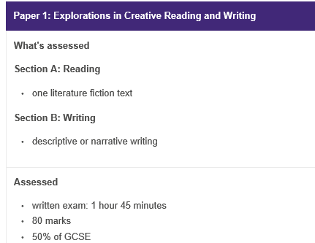
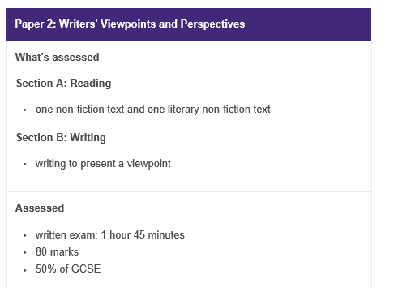
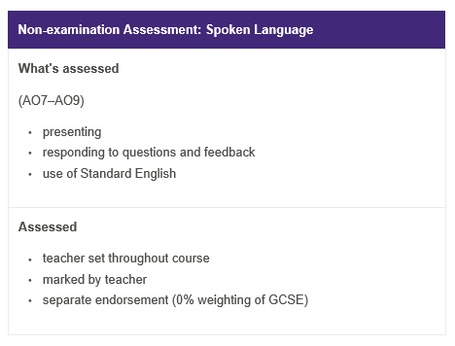
English Language: Consisting of 2 papers and a spoken language endorsement
Language Paper 1
Language Paper 2
Spoken Language Endorsement

Slide 5
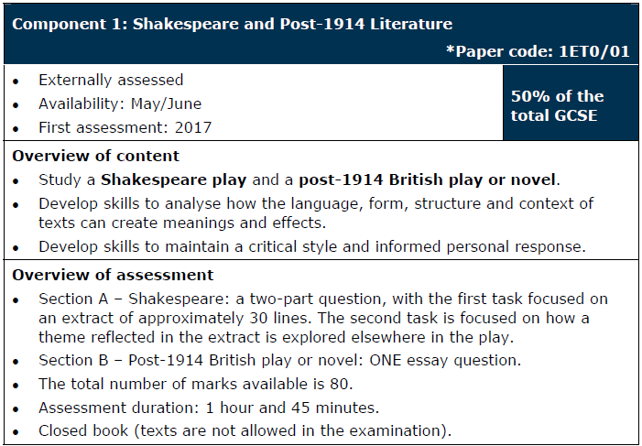
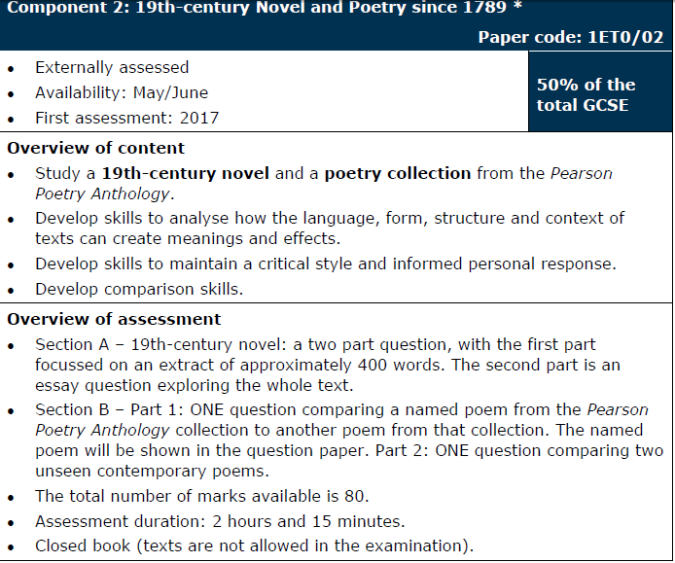







English Literature: Consisting of 2 papers
Novel
Play
Shakespeare
Poetry

Slide 6
At a glance
Language
Literature
Paper 1: 80 marks
  Section A: Shakespeare
    An extract analysis + an essay
  Section B: Modern British text
    A traditional essay + SPaG marks
Paper 2: 80 marks
  Section A: 19th-century fiction
    An extract analysis + an essay
  Section B: Poetry – anthology and unseen
    Two comparative essays – one on poems you will have studied and one on poems you are unlikely to have seen before
Paper 1: 80 marks
  19th-century fiction and imaginative writing
Paper 2: 80 marks
  20th- and 21st-century non-fiction and transactional writing
Spoken language endorsement
  Presentation and discussion – awarded as a separate qualification with a Pass, Merit or Distinction grade

Slide 7
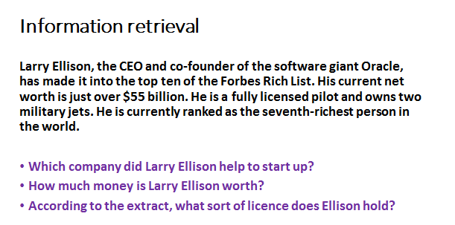
Examples of questions/papers
Basic skill for both courses

Slide 8
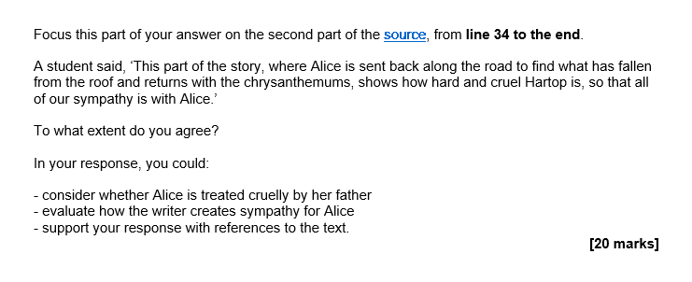
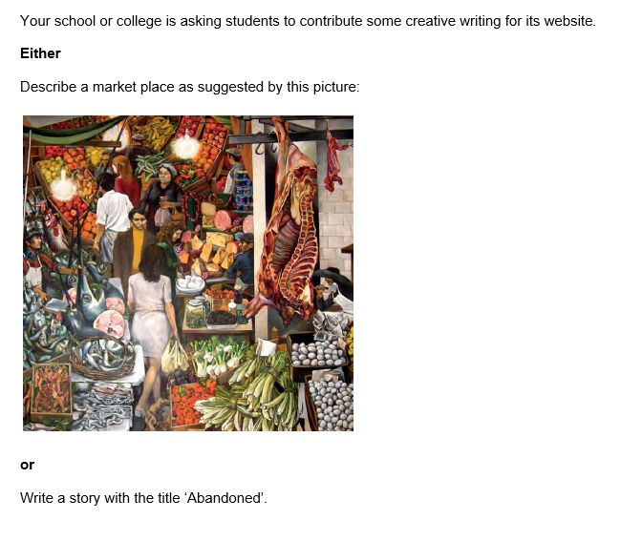
Examples of questions/papers

Slide 9
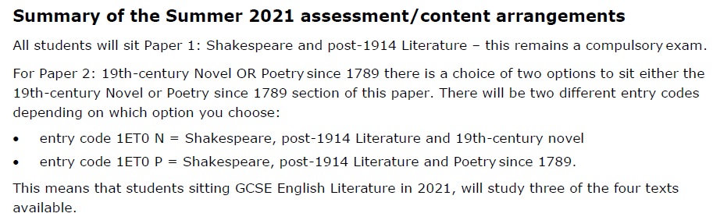
Current Changes to 2021 Examinations
English Literature
English Language
The following changes apply to our GCSE English Language (8700) qualification and only for the 2021 exam series:
there’s no requirement for teachers to submit a sample of audio-visual recordings of Spoken Language assessments the Spoken Language assessment can take place in front of a single teacher who can represent an ‘audience’ the Spoken Language assessment can be conducted by the teacher at any time during the course and by virtual means you’ll still need to submit a Centre Declaration Sheet as normal.

Slide 10
Revision Resources
Teams Revision
Monday after school at 4pm.
This half term is Blood Brothers Revision
Available at the School Bank
Check the English part of the school website.

Slide 11
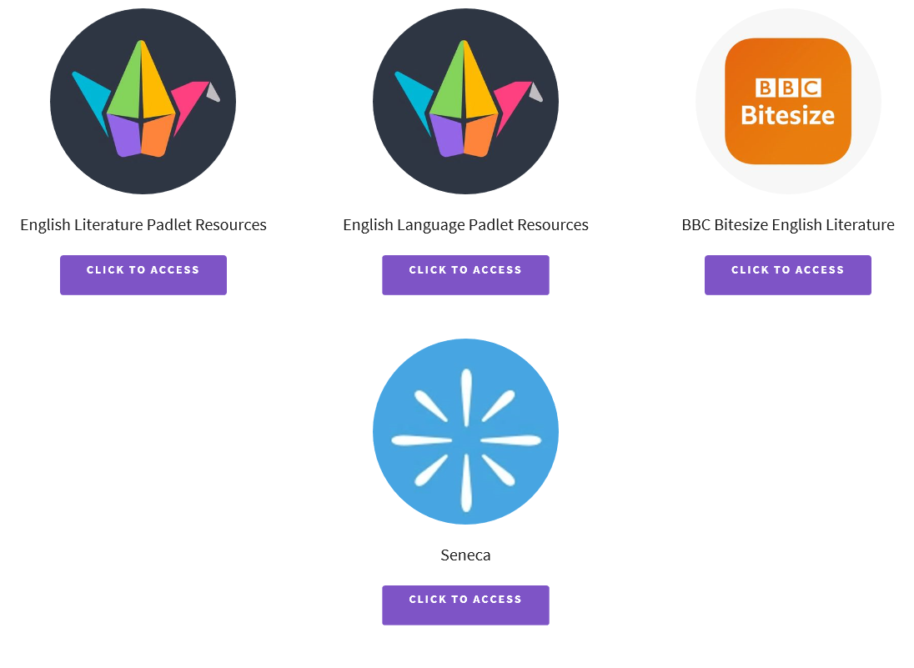
School Website – English and Media

Slide 12

Any concerns or issues
Email myself or your son/daughter’s English teacher

