Slide 1
Core Information Mathematics
October 2020

Slide 2
Content
The Structure of Mathematics GCSE
Covid-19 Update
Revision Resources

Slide 3
Structure of the Mathematics GCSE
The table below shows the topic areas covered and their approximate weightings at Higher and Foundation Level.
Content | Higher | Foundation
Number | 15% | 25%
Algebra | 30% | 20%
Ratio and Proportion | 20% | 25%
Geometry and Measure | 20% | 15%
Statistics | 15% | 15%

Slide 4
Structure of the Mathematics GCSE
There are three papers in Mathematics:
Paper 1 is Non Calculator
Papers 2 and 3 are Calculator
All Papers are 1 hour 30 minutes and have an equal weighting
Higher Paper Grades 9 – 4, students targeting grade 6+
Foundation Paper Grades 5 – 1, students targeting grade 4+

Slide 5
Covid-19 Update
No Change!
The content for the Mathematics GCSE will remain the same.

Slide 6
Revision Resources

Slide 7
Revision Resources

Slide 8
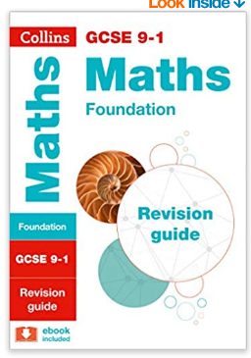
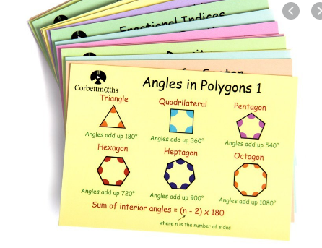
Revision Resources

Slide 9
Revision Resources

Slide 10
Any questions or concerns:
d.eckworth@portchester.hants.sch.uk
Or contact your child’s Maths teacher directly

