Slide 1
Year 8 Options 2020
Successful Learners Confident Individuals Responsible Citizens

Slide 2
In your ‘Options pack’
A letter explaining the process
Guidance on choosing subjects
Information about each option subject
Option choice form to complete

Slide 3
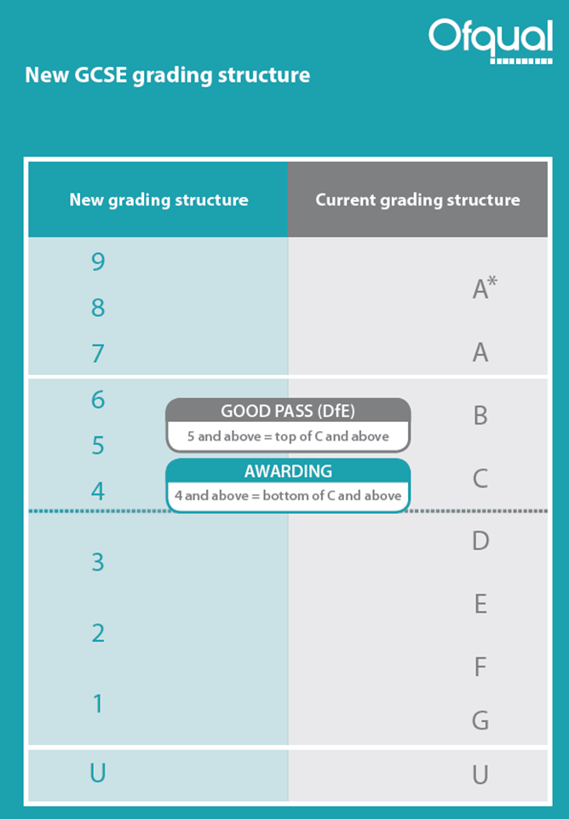
GCSE Grades

Slide 4
What is different?
More challenging content.
Removal of controlled assessment or coursework.
Exams at the end of the course in most qualifications.
More exams for some subjects and more extended writing.
Removal of tiered papers in most subjects.

Slide 5
Compulsory subjects
Subject
English
Maths
Science
Core PE
Citizenship

Slide 6
Compulsory subjects
Subject
English
Maths
Science
Core PE
Citizenship
Option 1
Option 2
Option 3
Option 4

Slide 7
Qualification types
GCSE
Suitable for progression to A level, BTEC, Apprenticeships
Graded 9 – 1
Examination based
Exam is usually 100% (not in every case)
Greater written content
https://www.careerpilot.org.uk/
Vocational
Suitable for progression to A level, BTEC, Apprenticeships
Graded D, M, P
Greater practical content.
Assessed Exam
Less written content but excellent organisation and consistency is essential.

Slide 8
How do I choose?
Good reasons
Already study it and enjoy it
I’m already doing well in it
It helps with my future plans
I’ve not studied it before but I’ve spoken with the teacher and it interests me.
Poor reasons
My friend is choosing it
I don’t like the other subjects
I get on well with the teacher this year

Slide 9
Choose GCSE subjects for:
Specific careers
Specific advanced level course at 16, like A-Levels or BTECs
For a University course
The National Careers Service

Slide 10
The Russell Group
Represents 24 of the country’s leading universities identifies the following subjects as ‘facilitating subjects’ at A level:
English Literature, Geography, History, Modern Foreign Languages, Maths and Science.
The Russell Group

Slide 11
Employers want people with good Maths and English GCSEs (Grade 5 or higher).
It is a requirement that a young person who hasn't yet achieved a Grade 4 (for now) in Maths and English will need to continue to do them until they are 18.
Usually employers are happy to accept a range of GCSEs including English, Maths and Science.
Apprenticeships

Slide 12
Unsure at present?
Select a balance of subjects such as the English Baccalaureate range:
1 x Humanities
1 x MFL
2 x Science
English
Maths

Slide 13
16 subjects to select four from
Art & Design | French | Media Studies
Computer Science | Geography | Music
D&T Graphics | Health & Social Care (Voc) | Physical Education
D&T Resistant Materials | History | Spanish
Drama | Hospitality & Catering (Voc) | Statistics
 |  | Btec in Sport (Voc)

Slide 14
Health & Social Care
Looking at the care industry
Early years development (Nursery)
Individual health and communication
Social care and services
Health care
First aid

Slide 15
Media
Magazines
Advertising and marketing
Newspapers
Social media
Video games.
Radio
Music video
Film Industry

Slide 16
Specific subject guidance
At least one out of MFL, History or Geography.
A chosen MFL must be the same as the one currently studied.
You can only choose one of Design and Technology Graphics or Resistant Materials
Music is only suitable if you already play an instrument or sing.
Statistics is more relevant if you are in a higher ability maths set.
Computing is not about gaming. You need to know about programming (Python, HTML).
GCSE PE or Btec in Sport

