Slide 1
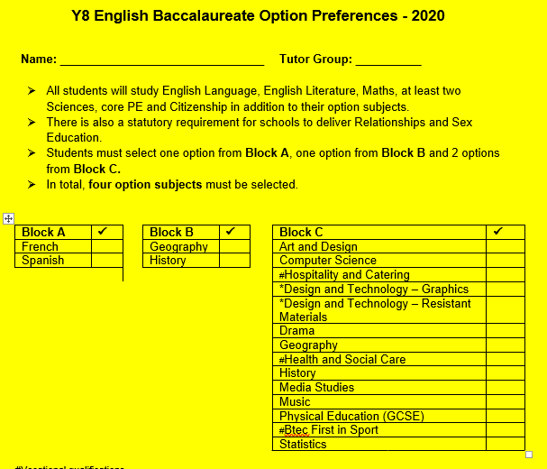
Pathway 1 - English Baccalaureate

Slide 2
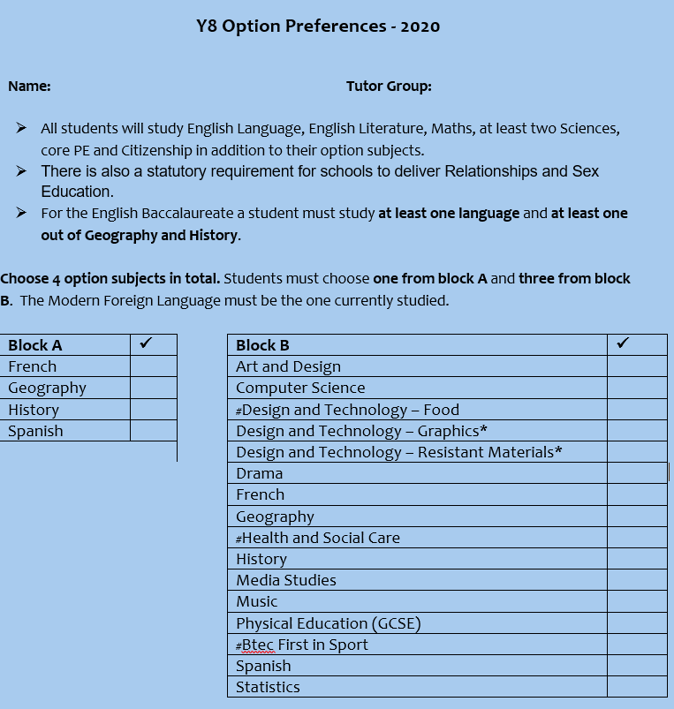
Pathway 2

Slide 3
Why humanities and a language?
There is strong evidence to support many students following this route. Research from 300 schools found that statistically students following the English Baccalaureate subjects were:
more likely to achieve good GCSEs in English and maths
more likely to be taking an A level or other level 3 qualification after the age of 16
less likely to have dropped out of education after the age of 16
Sutton Trust - an educational charity in the UK which aims to improve social mobility and address educational disadvantages
http://educationdatalab.org.uk/wp-content/uploads/2016/07/Changing-the-subject_FINAL.pdf

Slide 4
Frequently asked questions
Who will be the teacher for each option subject?
Are there boys and girls subjects?
Am I guaranteed to get my option preferences?
Will I be able to change my mind in September?
Do I have to put reserve choices on my options form?

Slide 5
Who can help?
Your parents
Your Tutor
Your class teachers
Your Head of Year
Leadership Team
Careers interviews
Any adult in school

Slide 6
Timeline
Action
Wednesday 4 March Year 8 Parents evening
Thursday 11 March – Options Assembly
Wednesday 18 March – Options Evening Presentation 6pm
Option Subjects should be talking to you in lessons
Speak to teachers – find out about the subject
Speak at home with your parents / family
Monday 30 March – Deadline for option returns to students reception. Or if the school is shut then please email to options@portchester.hants.sch.uk

Slide 7
Email option choices
Name
4 first choice preferences
2 reserve preferences
Deadline is Monday 30 March
options@portchester.hants.sch.uk
n.cousins@portchester.hants.sch.uk

