Slide 1
Science Revision Resources

Slide 2
Biology 1 Cells Organisation Infection and response Bioenergetics | Biology 2 Homeostasis and response Inheritance and variation Ecology
Chemistry 1 Atomic structure and the periodic table Bonding and the properties of matter Quantitative chemistry Chemical changes Energy changes | Chemistry 2 Rates of reaction Organic chemistry Chemical analysis Atmosphere Using resources
Physics 1 Energy Electricity Particle model of matter Atomic structure and radiation | Physics 2 Forces Waves Magnetism

Slide 3
Biology Paper 1
Microscopy – https://www.youtube.com/watch?v=SX6mow1AExI
Osmosis – https://www.youtube.com/watch?v=oieXYuQm_xE
Food tests – https://www.youtube.com/watch?v=akMLGbNA0gE
Enzymes – https://www.youtube.com/watch?v=8Yqbu56ImXk
Photosynthesis- https://www.youtube.com/watch?v=id0aO_OdFwA
Chemistry Paper 1
Making salts - https://www.youtube.com/watch?v=qIOMlwBoe_4
Electrolysis - https://www.youtube.com/watch?v=tCHE_7QeRUc
Temperature change – https://www.youtube.com/watch?v=tKxcQYZ2YH8
Physics paper 1
Specific heat capacity - https://www.youtube.com/watch?v=loeRLKNeUsc
Resisitance – https://www.youtube.com/watch?v=m_3JrA-sDEg
I-V characteristics – https://www.youtube.com/watch?v=ksPfzUjMbBk
Density – https://www.youtube.com/watch?v=lvqu6JAbaKc
Biology paper 2
Reaction times – https://www.youtube.com/watch?v=Ws5qVXYHRnQ
Field investigations – https://www.youtube.com/watch?v=yLHz2Ea10Mg
Chemistry paper 2
Rates of reaction – https://www.youtube.com/watch?v=Gl6LVl7oAlU
Chromatography – https://www.youtube.com/watch?v=pnTGNAfu6GE
Water purification – https://www.youtube.com/watch?v=_UGHsbTEBvA
Physics paper 2
Force and extension – https://www.youtube.com/watch?v=QQCJeAqBumE
Acceleration –https://www.youtube.com/watch?v=J9-J0cFQCrE
Waves –https://www.youtube.com/watch?v=OY0lXHPo_nM
Radiation and absorption -https://www.youtube.com/watch?v=LFwio38EK9s
Combined Science and Separate Sciences required practicals

Slide 4
Biology Paper 1
Culturing microorganisms- https://www.youtube.com/watch?v=BkbLI2mAMP8
Chemistry Paper 1
Neutralisation- https://www.youtube.com/watch?v=saRBT5oZfh8
Physics paper 1
Thermal insulation- https://www.youtube.com/watch?v=lLH45loyPUA
Biology paper 2
Decay- https://www.youtube.com/watch?v=LeH5FUKSPzU
Chemistry paper 2
Identifying ions- https://www.youtube.com/watch?v=4iZRs4XlJOE
Physics paper 2
Light- https://www.youtube.com/watch?v=2fN_jvf4fw8
Extra practicals for the Separate Sciences Courses

Slide 5
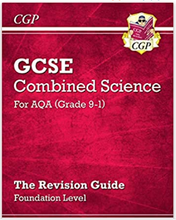
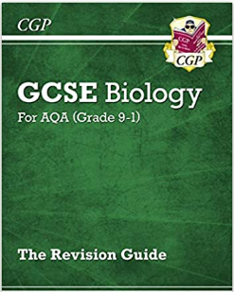
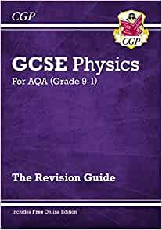
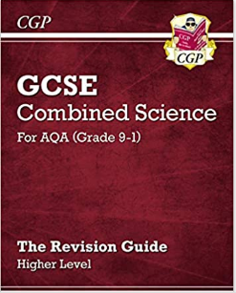
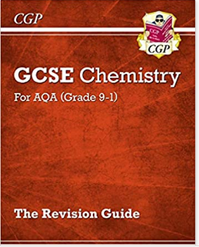

Slide 8
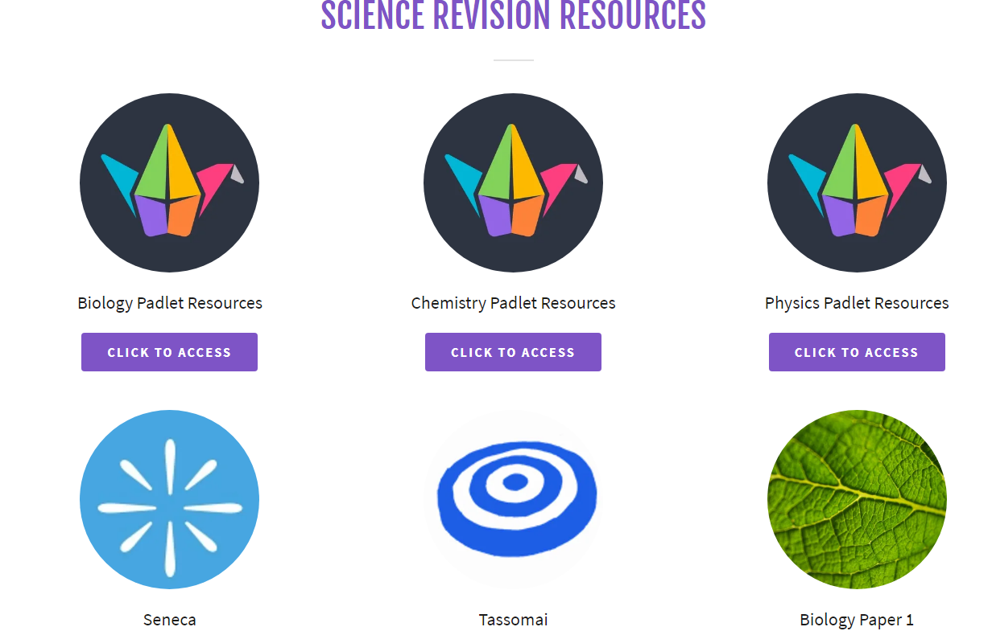

Slide 9
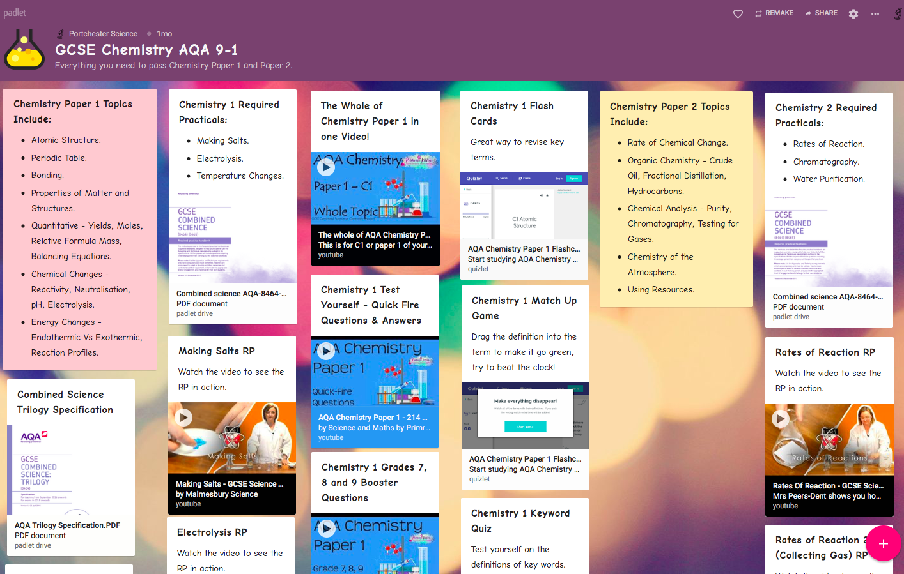

Slide 10
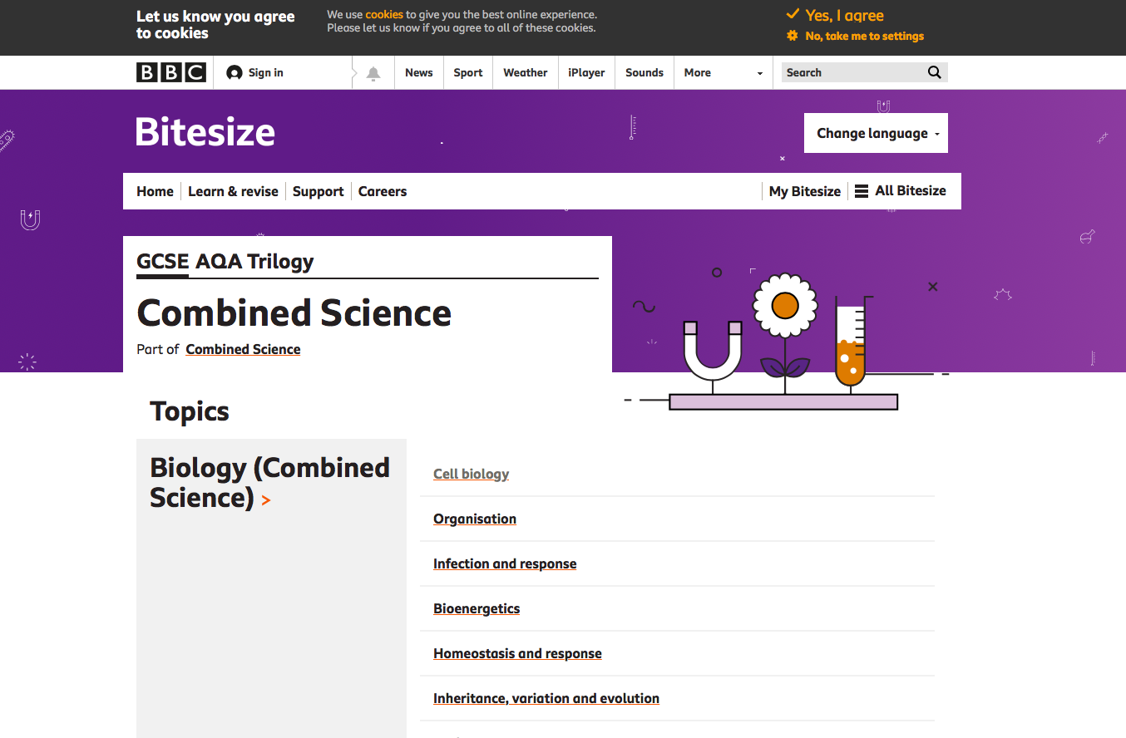
BBC Bitesize
AQA Trilogy.
Combined Science.
https://www.bbc.co.uk/bitesize/examspecs/z8r997h
OR…
Triple (Separate Sciences).
https://www.bbc.co.uk/bitesize/examspecs/zpgcbk7
https://www.bbc.co.uk/bitesize/examspecs/z8xtmnb
https://www.bbc.co.uk/bitesize/examspecs/zsc9rdm

Slide 11
Any further questions/queries…
l.oneill@portchester.hants.sch.uk
Or contact your son/daughter’s Science teacher directly.

