Slide 1
GARI Working Group
June 2022 Meeting during London Climate Action Week
Presented to:
GARI Participants
Zoom Videoconference
27 June 2022

Slide 2
Meeting Agenda
Date/Time: 10:45 to 12:30 pm EST on Monday, 27 June 2022
Time | Agenda Item
10:45 – 11:00 | Participants log on to Zoom videoconference platform*
11:00 – 11:05 | Introductory Remarks (GARI Chair – Jay Koh) and Lori Collins, Strategic Advisor
11:05 – 11:20 | GARI Participant Introductions/Roll Call
11:20 – 11:45 | Discussion Session I: Public/Private Financing for Resilience - Panel and open discussion led by John Chow and Stacy Swann of WSP
11:45 – 12:15 | Discussion Session II: Updates on adaptation and resilience initiatives
12:15 – 12:30 | Wrap up and Next Steps
* Note: Upon logging on to the platform, you will initially be placed in a Zoom “waiting room” where
a GARI team member will then grant you entry into the videoconference.

Slide 3
GARI Participants/Roll Call
If you would prefer not to be named during roll-call, please feel free to remain silent as we move through the list of organizations. Please say your name, role, organization, and where you are dialing in from.
Acumen
AfriBot
Aspen Institute
CGAP (2)
City of Alexandria (2)
Climate Adaptation Works
Climate Bonds Initiative
Climate Policy Initiative (2)
Climate Resilience Consulting
CUNY
GIZ
EA - UK
Earth Labs Group
EHAB
Emerald Peak Private Equity
Environmental Defense Fund
Global Futures Group
ICF
IFAD
IIGCC
Impax AM
Lightsmith Group
MARBE SA
Miami-Dade County
Nixon Peabody LLP
NYSERDA
One Planet Ventures
OSSEDI Malawi
PGIM
Planalytics
Private Finance Advisory Network
RMA
RMSI
S&P Global Ratings
San Francisco Public Utilities Commission
ScoreData
Tata Consulting/TCS
Thrive Consulting
UC Berkeley Goldman School
UDYAMA
UNDP (2)
Waterfront Alliance
World Bank Group/GEF
WSP (multiple)
WTW
YAPU (2)

Slide 4

Discussion Session I: Public/Private Financing
Moderators:
John Chow, Stacy Swann of WSP
London Climate Action Week (LCAW) 2022
Home | London Climate Action Week
https://www.londonclimateactionweek.org/
Globally/ collectively deliver the outcomes of COP26 in during global recovery and shape adaptation action towards COP27.
Focused on delivering on our shared Glasgow promises in a time of crisis.
Overarching themes of LCAW 2022
  1) Green, Fair and Resilient Transitions,
  2) The Road to COP27 for Ambition & Adaptation,
  3) Creating a Sustainable, Net Zero London and
  4) Whole of Society Climate Mobilisation
Notes:
These are per our funders – not as much for discussion as next slides

Slide 5
Discussion Session I: Public/Private Financing
Moderator: John Chow and Stacy Swann of WSP
Opening questions:
From city, regional, state, national, international perspectives
(all are welcome to participate)
  What kinds of needs does your organization have for investments in resilience - particularly infrastructure?
  Have you considered leveraging public balance sheets - either through PPPs or other ways to finance resilience investments?
  What are some challenges/roadblocks to be able to unlock financing for public resilience investments? What changes could be made?
Notes:
These are per our funders – not as much for discussion as next slides

Slide 6
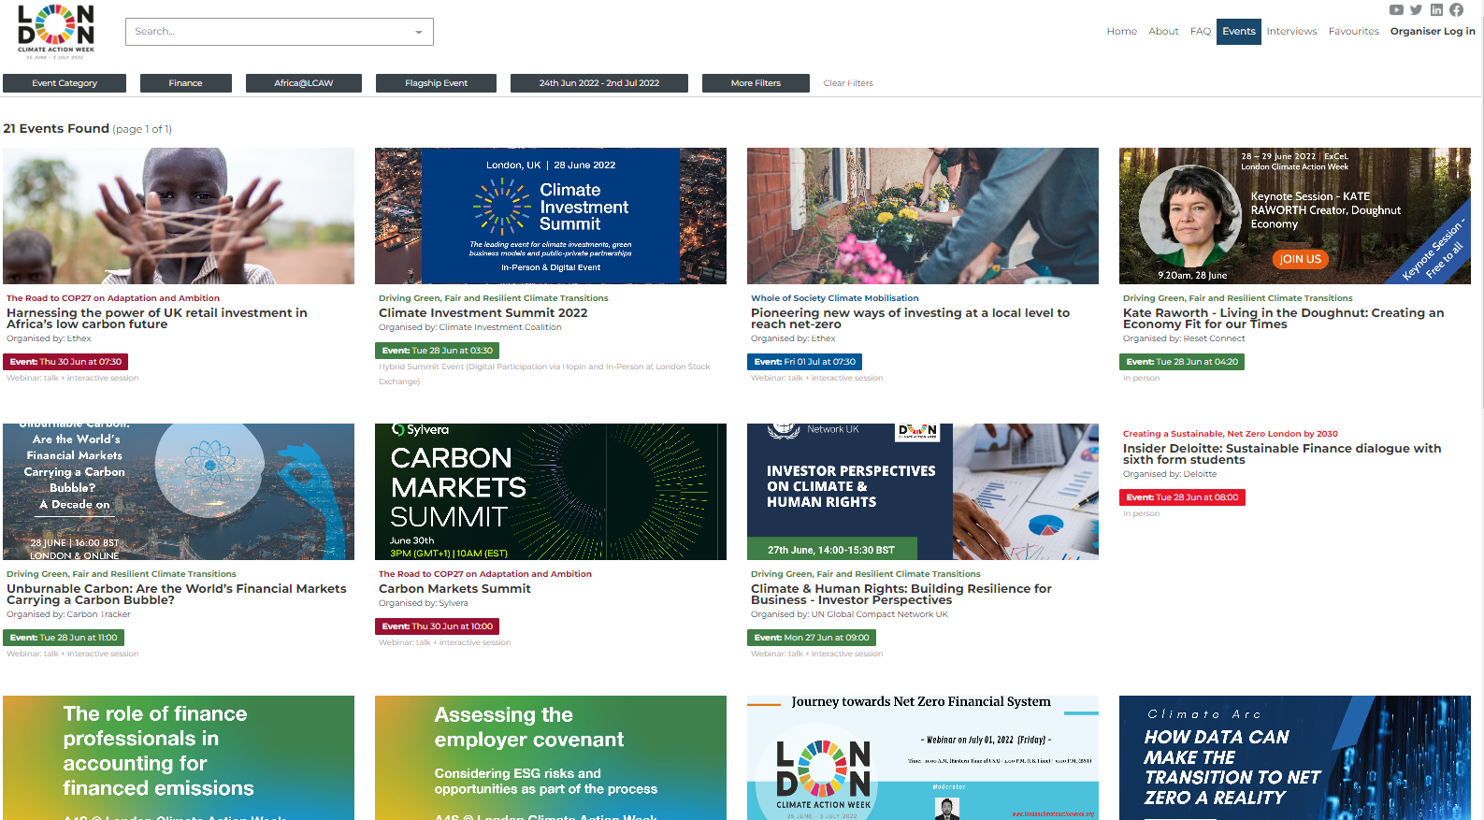
Discussion Session I: Public/Private Financing
London Climate Action Week
At least 21 events filtering for “Finance”
Notes:
These are per our funders – not as much for discussion as next slides

Slide 7
Discussion Session I: Public/Private Financing
London Climate Action Week
Examples of events that are relevant to our topic
6/28: Climate Investment Summit 2022
6/29: Catalysing bank climate action – lessons from the inside
6/29: How MDBs support countries to deliver long-term strategies?
6/30: Harnessing power of UK retail investment in low-carbon Africa
6/30: Carbon Markets Summit
6/30: Building/financing climate-resilient agriculture/food in Africa
7/1: New ways of investing at local level to reach net-zero
GARI participation in COP events
GARI invited every year to participate in the High Level Roundtable on Resilience as part of the Marrakech Partnership for Climate Action
Hold the Climate Resilience and Adaptation Investment side events with IDB and GEF for every COP since COP22
Notes:
These are per our funders – not as much for discussion as next slides

Slide 8
Discussion Session II: Participant Initiative Updates
Brief updates from GARI participants on current initiatives
  Andrew Eil, Tata Consulting – collaboration on GARI virtual speaker series
  Mallory St. Claire, Aspen Institute – ANDE program/climate resilience metrics
  Arun Kashyap, Global Futures Group – Debt-for-Climate Swaps, Insurance & Blended Finance
  Eugene Montoya, Waterfront Alliance – WEDG waterfront design guidelines
  Danielle Boyd, IIGCC – partnership update
Feedback & Next Steps

Slide 9
Wrap Up and Next Steps
  GARI 2022 Survey – please respond!
    Survey results will contribute to making the GARI 2022 discussion paper most effective in meeting the interests of the private sector
    In your inbox - will send again directly to today’s participants
    Collaboration on distribution with IIGCC and CCRI – thank you!
  GARI 2022 Discussion Paper
    Survey response analysis, content development this summer
    GARI participants/member input welcomed – working team involved
    Target publishing in Fall, 2022
  Next GARI Convening
    September 28 – at New York offices of Nixon Peabody
      investor panel planned
      New York Climate Week updates
    Possible side events TBD

