Slide 1
CARING FOR THREE GENERATIONS AT A TIME: clinical perinatal care of individuals with obesity
Cecilia Jevitt, PhD, RM, CNM, FACNM, APRN
January 2021

Slide 2
This presentation is an overview of assisting women with obesity and:
- uses people-first language as outlined by Obesity Canada
- uses obesity photos from the Rudd
Center for Food Policy and Obesity photo gallery with permission
- focuses on obesity, not excessive gestational weight gain (which is linked with the same co- morbidities)
I have no conflict of interests to declare for this presentation.

Slide 3
OBJECTIVES
At the completion of this presentation, the learner will:
Define obesity
Use person-centered, de-stigmatizing language in discussions about weight gain and obesity
Describe at least two characteristics of white adipose tissue that produce maternal and fetal complications during pregnancy and birth
Identify at least three major hormonal pathways altered by obesity
Describe the contributions of at least 6 environmental factors on obesity
Select healthy weight prenatal weight gain ranges based on body mass index (BMI)
Apply at least 6 care measures to ameliorate the effects of obesity during the perinatal period

Slide 4
CORE BELIEFS ABOUT OBESITY
Healthy nutrition and physical activity are essential to optimizing health during pregnancy and the postpartum period.
Nutrition, activity and weight gain affects two to three generations during each pregnancy.
Evidence-based counseling assists clients to manage their own nutrition, activity and weight gain during pregnancy.
Health care counseling is relational and most effective when client-centered and trauma-informed.
Obesity is an intergenerational adaptation to multiple socio-economic disparities, social and physical environments that alter the hypothalamic–pituitary–adrenal axis (HPA) through exposure to chronic stress and endocrine-disrupting chemicals, and broken, nonnutritive food systems.
Body weight regulation is not entirely under voluntary control and that individuals with overweight and obesity face unfounded social stigma.
Managing nutrition, activity and weight gain reduces obesity-related complications of pregnancy.

Slide 5
Body Mass Index (BMI)
A weight to height ratio, not a perfect measure but increasing BMI is associated with increasing amounts of adipose tissue
BMI = kg/m² where kg is a person's weight in kilograms and m² is their height in meters squared
Divided into categories based on associated health
  Underweight <18.5
  Normal 18.5-24.9
  Overweight 25-29.9
  Obese > 30
    Class I: 30-34.9
    Class II: 35-39.9
    Class III: > 40
    Perinatal research uses prepregnancy BMI or BMI measured at first prenatal visit

Slide 6
Obesity Trends* Among U.S. Adults
BRFSS, 1990, 1998, 2006
(*BMI ≥30, or about 30 lbs. overweight for 5’4” person)
1990
1998
2006
No Data <10% 10%–14% 15%–19% 20%–24% 25%–29% ≥30%

Slide 7
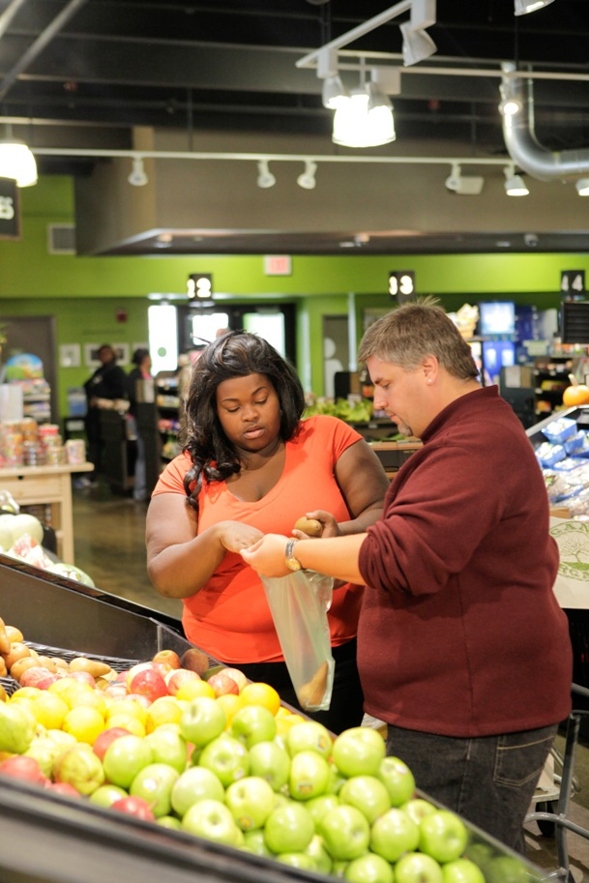
CURRENT
Overall US:31%
Overall Canada: 21%
Overall England: 28.7%
Overall Australia:31%
Rates from 2017, 2018 or 2019.
All perinatal care providers will work
with women with obesity.

Slide 8
IMMUNITY
APPETITE REGULATION, WEIGHT HOMEOSTASIS
GLUCOSE & LIPID METABOLISM
ANGIOGENESIS
VASCULAR TONE CONTROL, COAGULATION,
FIBRINOLYSIS
WHITE ADIPOSE TISSUE FUNCTIONS
LARGEST GLANDULAR TISSUE
IN BODY

Slide 9
What causes obesity-related perinatal complications?
MOLECULE | MAIN SITE OF PRODUCTION | FUNCTION
Leptin | Subcutaneous adipose tissue, Also produced by the placenta as a growth hormone | Increases appetite based on signals from adipose stores, decreases energy expenditure
Adiponectin | Secreted only from adipose tissue, mainly subcutaneous | Improves insulin sensitivity, stimulates fatty acid oxidation and glucose uptake in skeletal muscle, stimulates appetite and reduces energy expenditure
Angiotensin |  | Precursor of angiotensin II (blood pressure and electrolyte regulation, possible role in hemostasis)
Acylation stimulating protein (ASP) | Subcutaneous adipose tissue | Increases lipogenesis, may contribute to dyslipidemia in diabetes and cardiovascular disease
Tumor necrosis factor (TNF-α) | Macrophages within adipose tissue, mainly visceral adipose tissue | Pro-inflammatory cytokine, insulin resistance, potential contributor to type 2 diabetes
Interleukin-6 (IL-6) | More produced in visceral adipose tissue, adipose produces 30% of circulating IL-6 | Pro-inflammatory cytokine, insulin resistance, potential contributor to type 2 diabetes
Visfatin | Visceral adipose tissue | Pro-inflammatory cytokine, activates leukocytes and stimulates production of TNF-α and IL-6
Hormonal changes:
  Insulin sensitivity
  Leptin resistance
Inflammatory cytokines

Slide 10
Quickly, write down all the things you think contribute to obesity.

Slide 11
FACTORS CONTRIBUTING
TO OBESITY
Exposure to endocrine disrupting chemicals
  Canned foods, plastic food containers
  Pesticides
  Environmental pollutants
Neighborhood unsafe for physical activity
Starvation
  In utero growth restriction
  Food deprivation
    Poverty
    History of slavery
    Economic slavery
    War, relocation
    Long term dieting to maintain low weight: ballet, athletics, clothing models
Grandmother obese during mother’s gestation
Mother obese during pregnancy
Grandmother or mother smoked during pregnancy
Formula fed instead of breastmilk
High glycemic index, calorie dense, highly processed foods
Lack of control over foods
  Public food programs, food pantry use
  Family groups sharing foods
Chronic stress, racism
Night shift work, inadequate sleep

Slide 12
ENDOCRINE DISRUPTING CHEMICALS highly persistent, bioacculumative synthetic compounds
EDCs
Environmental sources:
Organochlorines (DDT, DDE)
Bisphenol A (BPA)
Phthalates
Polychlorinated biphenyls (PCBs)
Polybrominated diphenylethers
Parabens
phytoestrogens
Pesticides
Household plastics (food storage containers, baby bottles)
Carpeting, curtain and furniture fabric treatments
Flame retardants
Electric insulation
Plasticizers, adhesives, lubricants, hydraulic fluids
Coolants
Soaps, lotions, cosmetics

Slide 13
Look around. How many items in your room might contain endocrine disrupting chemicals?

Slide 14
Obesity
has less to do with personal choice
than with socioeconomic limits on choices & epigenetics
PERINATAL MORBIDITY & MORTALITY
EPIGENETIC CHANGES:
*fetal
*ova in female fetus
ECONOMIC & EDUCATIONAL DISPARITIES:
˅ access to quality education
˅ access to living wage
˅ access to health care
˅ access to health information
NUTRITIONAL DISPARITIES:
˅ incidence & duration of breastfeeding
˅ income for quality nutrition
˅ availability of nutritious foods
˄ exposure to calorie dense,
high glycemic index foods
ENVIRONMENTAL DISPARITIES:
˄ exposure to endocrine disrupting chemicals
˄ increased tobacco product exposure
˅ safety of physical activity
OBESITY:
˄ white adipose tissue cytokines & hormones
˅ satiety signaling from gut microbiome

Slide 15
maternal circulation
hyperglycemia, hyperinsulinemia, endocrine disrupting chemicals, inflammatory cytokines
fetal/placental circulation
fetal circulation to ovaries

Slide 16
Obesity is more than
-a BMI > 30
-over-eating
-lack of physical activity
Obesity is an intergenerational adaptation to multiple socio-economic disparities, and social and physical environments that alter the hypothalamic–pituitary–adrenal axis (HPA) through exposure to chronic stress and endocrine-disrupting chemicals, and broken, nonnutritive food systems.
Jevitt 2020

Slide 17
Perinatal care providers can help women to interrupt obesity-causing pathways during the perinatal period and improve health at least three generations forward.

