Slide 1
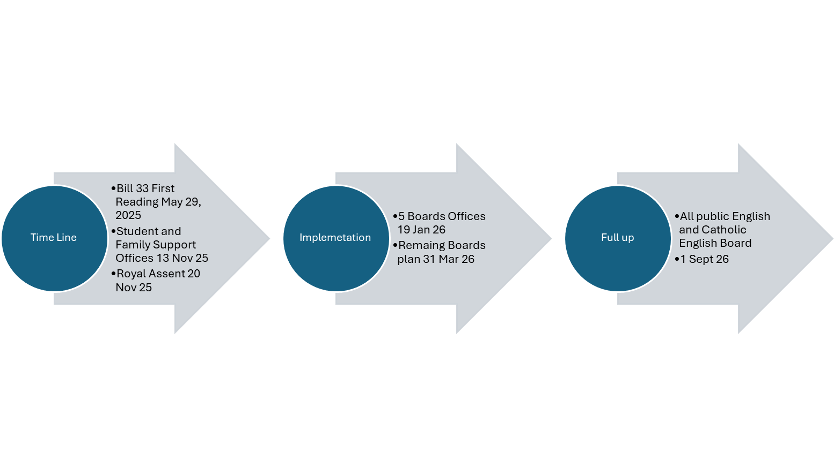

Bill 33
There are 76 public school boards in Ontario,
34 English Public
29 English Catholic
Total 63 Boards will be affected by Bill 33
Remaining Boards: 8 French Catholic boards
1 English Protestant board (Dominational matters only)

Slide 2
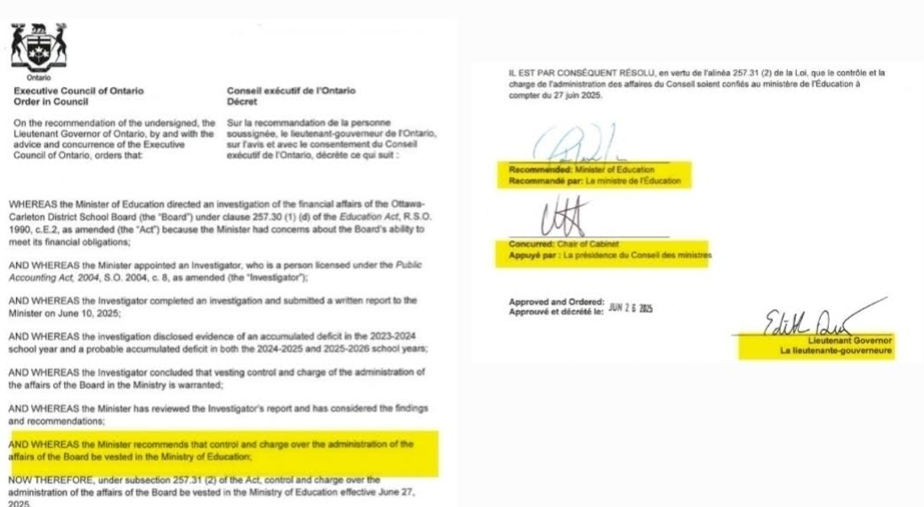
3 Signatures
to take control
Ed Act 257.31(2)
There are 76 public school boards in Ontario
34 English Public
29 English Catholic
Total 63 Boards will be affected by Bill 33
Remaining Boards: 8 French Catholic boards
1 English Protestant board (Dominational matters only)

Slide 3
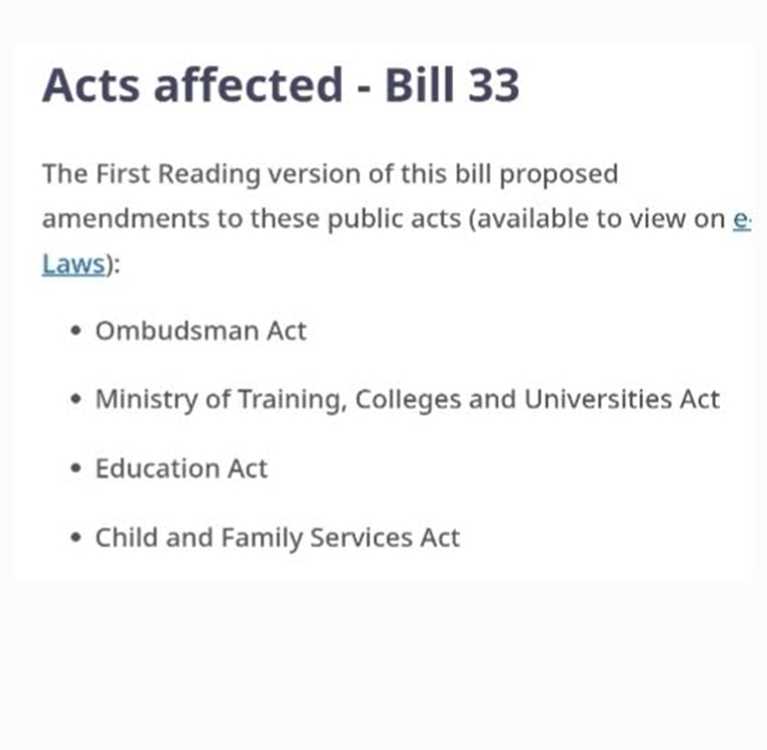
Bill 33
There are 76 public school boards in Ontario,
34 English Public
29 English Catholic
Total 63 Boards after by Bill 33
Remaining Boards: 8 French Catholic boards
1 English Protestant board
Notes:
1. **Child Services**:
- The amendments to the **Child, Youth and Family Services Act, 2017** expand the obligations of children’s aid societies and residential licensees. They are now required to inform children, young persons, and individuals entitled to continued care and support about the Ombudsman’s role. This communication must be done using age-appropriate language and in specific circumstances, such as when entering a section 124 agreement.
2. **Ombudsman Education Act**:
- Amendments under the Ombudsman Act enhance the oversight and accountability measures in educational settings. This includes improved mechanisms for addressing complaints related to educational institutions, ensuring that students and their families have clearer access to the Ombudsman’s services.
3. **Overall Impact**:
- The legislation aims to bolster transparency and support for children and students within the education system and child services. By enhancing the awareness and accessibility of the Ombudsman’s services, the Act seeks to ensure that the rights and welfare of children are better protected.

Slide 4

Bill 33
There are 76 public school boards in Ontario,
34 English Public
29 English Catholic
Total 63 Boards after by Bill 33
Remaining Boards: 8 French Catholic boards
1 English Protestant board
Notes:
Bill 33, also known as the Supporting Children and Students Act, 2025, introduces several significant amendments to the Education Act in Ontario. Here are the key changes:
1. **Ministerial Policies**: The Minister of Education is empowered to establish policies and guidelines that school boards must follow regarding their expense policies. This aims to increase accountability in how school boards manage funds.
2. **School Resource Officer Programs**: School boards are now required to collaborate with local police services to implement school resource officer programs. This change is intended to enhance safety and security in schools.
3. **Naming and Renaming Schools**: A new approval process has been established for naming or renaming schools, which will involve community input and oversight.
4. **Investigations**: The Minister may direct investigations if there are concerns regarding matters of public interest related to school boards. This gives the Minister more authority to ensure compliance and address issues proactively.
5. **Control and Compliance**: If a school board fails to comply with directives from the Minister, the Minister can assume control over certain functions of the board. This change is aimed at ensuring that boards adhere to the regulations and policies set forth.
These amendments are part of a broader effort to enhance the educational framework, improve accountability, and ensure that the interests of students are prioritized. For a comprehensive overview, you can refer to the full text of the bill on the Ontario Legislative Assembly website.

Slide 5
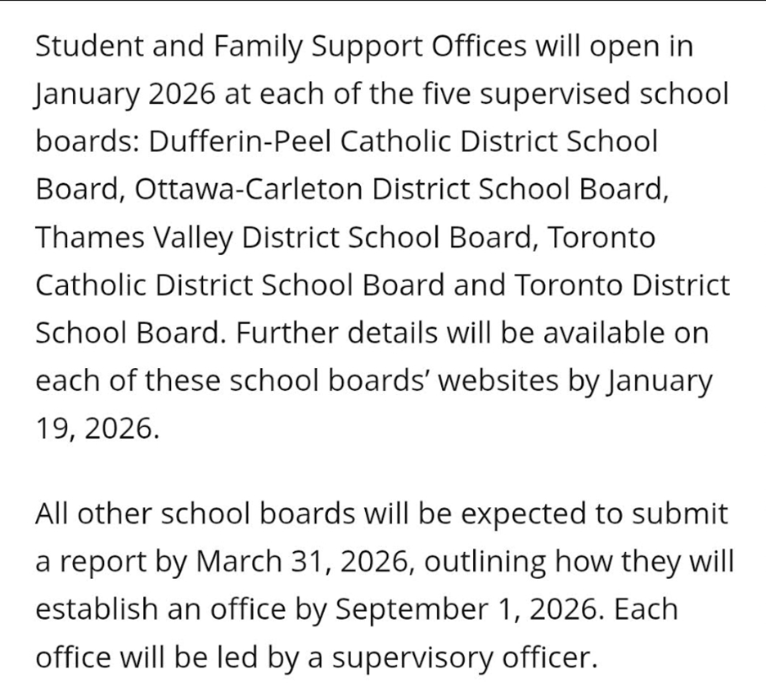

Bill 33
There are 76 public school boards in Ontario,
34 English Public
29 English Catholic
Total 63 Boards after by Bill 33
Remaining Boards: 8 French Catholic boards
1 English Protestant board
Notes:
The roll out

Slide 6
Bill 33
Outcomes
Bill 33, Key Changes to empower the MOE with
Investigation Powers: The Minister may direct investigations if there are concerns regarding matters of public interest related to school boards.
Control and Compliance: If a school board fails to comply with directives from the Minister, the Minister can assume control over certain functions of the board.
There are 76 public school boards in Ontario,
34 English Public
29 English Catholic
Total 63 Boards after by Bill 33
Remaining Boards: 8 French Catholic boards
1 English Protestant board
Notes:
Investigations**: The Minister may direct investigations if there are concerns regarding matters of public interest related to school boards. This gives the Minister more authority to ensure compliance and address issues proactively.
5. **Control and Compliance**: If a school board fails to comply with directives from the Minister, the Minister can assume control over certain functions of the board. This change is aimed at ensuring that boards adhere to the regulations and policies set forth.
These amendments are part of a broader effort to enhance the educational framework, improve accountability, and ensure that the interests of students are prioritized. For a comprehensive overview, you can refer to the full text of the bill on the Ontario Legislative Assembly website.

