Slide 1

Parents’ Rights in Education: Importance, Legislation, and Action
“As your New Leaf Trustee, I will champion advance notice and opt-out rights, advocate for parental consent on key decisions, and ensure transparency in all classroom materials. I am committed to balanced, age-appropriate education and to building schools where every family’s voice is heard. Together, we will lead the way in establishing a Parents’ Bill of Rights that reflects our community’s values and priorities.”
Notes:
1. Why Parents’ Rights Matter
Parents’ rights are a core principle, not just a policy detail.
In a changing educational landscape, families must have a meaningful voice in shaping their children’s school experiences and values.
Upholding these rights ensures transparency, builds trust, and reflects our community’s priorities.
2. Overwhelming Support for Parental Involvement
Statistics show most parents want to be involved in their children’s education.
Parental involvement leads to better academic outcomes and fewer behavioral issues.

Slide 2
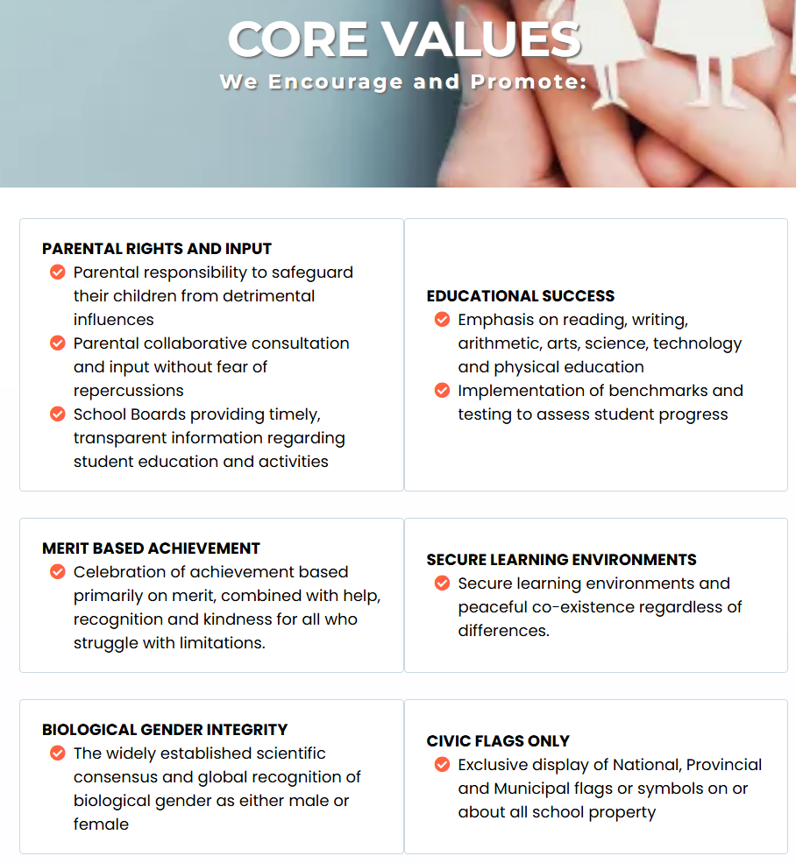
Core values
Notes:
Let them read

Slide 3
iNTRODUCTION
As your New Leaf Trustee, I will champion these foundational principles, ensuring that parents are partners in education, not bystanders. Together, we can build an education system that honors every family’s voice and prepares our children for a bright future.
Parent Rights
Canadian and International Laws
3 Bills 3 Provinces
Legislative Process-Ontario
Challenges
Benefits
Notes:
1. Why Parents’ Rights Matter
Parents’ rights are a core principle, not just a policy detail.
In a changing educational landscape, families must have a meaningful voice in shaping their children’s school experiences and values.
Upholding these rights ensures transparency, builds trust, and reflects our community’s priorities.
2. Overwhelming Support for Parental Involvement
Statistics show most parents want to be involved in their children’s education.
Parental involvement leads to better academic outcomes and fewer behavioral issues.
3. What You’ll Learn Today
The process for establishing a Parents’ Bill of Rights.
The powerful benefits of supporting parents in our schools.
How we can build an education system that honors every family’s voice.
4. Legal Foundations
Canadian and international laws recognize parents’ rights in education.
Examples include the Canadian Charter of Rights, the Constitution Act, and international treaties like the Universal Declaration of Human Rights and the Convention on the Rights of the Child.
5. How a Parents’ Bill of Rights Is Established
The legislative process involves drafting, stakeholder input (especially from parents), and multiple stages before becoming law.
Families and communities directly shape the law through this process.
Challenges
6. Powerful Benefits of Supporting Parents
Advance notice and opt-out rights for sensitive topics.
Parental consent for key decisions (e.g., name/pronoun changes).
Choice of educational approach and pre-approval of third-party materials.
Ban on child gender transitions (where applicable).
Age-appropriate content and balanced perspectives.
Legal recourse for parents to address concerns.
7. Together for Our Children’s Future
By supporting parents’ rights, we create schools where every family’s voice is heard.
Let’s take the next steps together for our children, our families, and our future.

Slide 4
Canadian law international
As Your New Leaf Trustee, I Will:
✅ Champion advance notice & opt-out rights
✅ Support parental consent for key decisions
✅ Promote transparency in classroom materials
✅ Defend your right to educational choice
✅ Provide clear channels for your concernsLet’s
Canadian Charter of Rights .Section 2(a) specifically recognizes the constitutional right of parents to determine all aspects of their children’s education, including choosing religious education.
Constitution Act, 1867 (Section 93) Parents can participate in decisions about curriculum and school policies
Universal Declaration of Human Rights (UDHR):
Article 26 states, “Parents have a prior right to choose the kind of education that shall be given to their children.” This is a foundational principle in international law. [ohchr.org]
UNESCO Convention against Discrimination in Education (1960):
This binding treaty prohibits discrimination and affirms the right of parents to choose schools and ensure education aligns with their convictions. [unesco.org]
International Covenant on Economic, Social and Cultural Rights (ICESCR):
Article 13 and 14 guarantee the liberty of parents to choose schools and ensure the religious and moral education of their children in conformity with their own convictions. [ohchr.org]
Convention on the Rights of the Child (CRC):
Recognizes the right of children to education and the role of parents as primary caretakers and decision-makers in their children’s upbringing and education. [cba.org]
European Convention on Human Rights (Protocol 1, Article 2):
States must respect parents’ rights to ensure education and teaching in conformity with their own religious and philosophical convictions. [ohchr.org]
Notes:
Canadian Laws
Canadian Charter of Rights and Freedoms
Canada’s foundational legal document protecting individual rights
Includes parents’ rights to participate in their children’s education and advocate for their interests
Section 2(a): Parents have the constitutional right to determine all aspects of their children’s education, including religious education
These rights may be restricted if parental decisions go against the best interests of the child
[legalline.ca]citeturn5search23
Constitution Act, 1867 (Section 93)
Gives provinces exclusive jurisdiction over education
Federal law sets the framework for rights and responsibilities
Parents have the constitutional right to ensure their children are enrolled in and attend school
Parents can participate in decisions about curriculum and school policies
[lawshun.com], [thecanadianencyclopedia.ca]citeturn5search20turn5search21
International Laws
Universal Declaration of Human Rights (UDHR)
Article 26: Parents have a prior right to choose the kind of education for their children
[ohchr.org]
UNESCO Convention against Discrimination in Education (1960)
Prohibits discrimination
Affirms parents’ right to choose schools and ensure education aligns with their convictions
[unesco.org]
International Covenant on Economic, Social and Cultural Rights (ICESCR)
Articles 13 and 14: Guarantee parents’ liberty to choose schools and ensure religious/moral education in line with their convictions
[ohchr.org]
Convention on the Rights of the Child (CRC)
Recognizes children’s right to education
Affirms parents as primary caretakers and decision-makers in upbringing and education
[cba.org]
European Convention on Human Rights (Protocol 1, Article 2)
States must respect parents’ rights to ensure education aligns with their religious and philosophical convictions
[ohchr.org]
Summary
Canadian law (Charter and Constitution) and international law (UDHR, UNESCO, UN treaties)
Strongly defend parents’ rights to be involved in their children’s education
Support parents’ right to choose the type of education
Ensure education aligns with family values and convictions

Slide 5
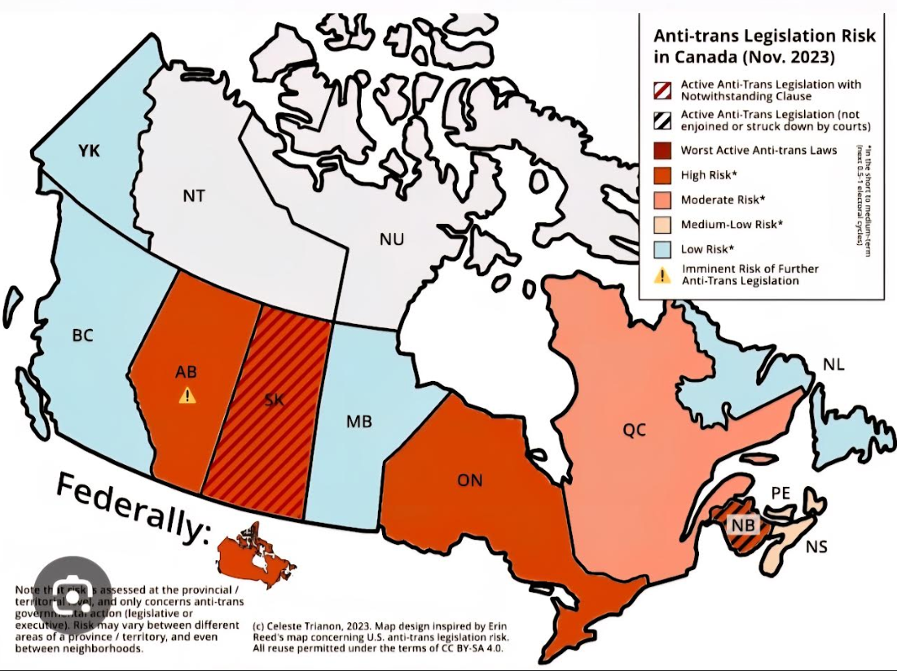
snap shot
Ontario is currently in a period of transition —but not sure which they will go on parents rights bill outcome based on this graph celeste trianon
Notes:
Celeste Trianon is a transfeminine jurist and activist, living on unceded land traditionally in the custody of the Kanien’kehá:ka — Tio’tiá:ke, aka Montréal, Québec.
The founder of her own legal clinic, she offers pro-bono services to her community, having helped over a thousand trans people in multiple jurisdictions access legal name and gender changes. A public speaker and prominent figure in trans activism and trans law in Canada, her specialties are the intersections between trans people and the law, anti-trans hate in Canada, as well as trans social movements as a whole.
A front-line activist that you won’t miss at local trans rights protests (or in the media), she dreams of a world in which “justice” isn’t a mere theoretical ideal, but instead something that can be felt and lived by everyone.
Provincial Leadership:
Provinces like Saskatchewan, Alberta, and New Brunswick have enacted robust Parents’ Bill of Rights and parental involvement policies. These include:
Advance notice and opt-out rights for sensitive topics
Parental consent for changes to student identity
Pre-approval of third-party classroom materials
Strong public support for parental involvement (with approval rates above 80%).
Ontario’s Status:
Ontario is currently in a period of transition —BILL 33 No mention of parents rights only school councils directed on 12 Nov 25 to ask questions on any matter related to education

Slide 6
Provincial Examples
Parents are recognized as primary decision-makers
✅ Advance notice & opt-out rights for sensitive topics
✅ Parental consent for name/pronoun changes
✅ Curriculum focused on facts, not interpretations
✅ Support for inclusive environments
Why does it work?
✔️ Over 80% of parents want a say in what their kids learn
✔️ Parental involvement boosts grades & reduces behavioral issues
✔️ Laws protect your right to be informed and involved
Comparison Table: Parents’ Bill of Rights and Parental Involvement in Canada
Saskatchewan Parents’ Bill of Rights (2023) Notice & opt-out for sexual health content Consent for name/pronoun changes under 16 81% want advance notice of controversial topics 70% support opt-out rights | Alberta Parental Consent & Notification Policies (2024–2025) Consent for name/gender/pronoun changes under 15 Notification for 16–17 year olds Opt-out of gender/sexuality lessons Pre-approval of third-party materials Ban on child gender transitions 86% want facts, not interpretations 76% want both sides of issues | New Brunswick Policy 713 (2020, revised 2023–2025) Consent for name/pronoun changes under 16 Notice & opt-out for sensitive content 91% want age-appropriate material 81% want advance notice
Notes:
**Saskatchewan**
* Education (Parents’ Bill of Rights) Amendment Act, 2023
* Parents are primary decision-makers
* Right to be informed about attendance, behaviour, achievement
* Access to school file
* Notice and opt-out for sexual health content
* Parental consent for name/pronoun changes under 16
* 81% of parents want advance notice of controversial topics
* 70% support the right to opt out of specific lessons
* Invokes notwithstanding clause for 5 years to shield law from Charter challenges
**Alberta**
* Parental Consent & Notification Policies (2024–2025)
* Parental consent for name/gender/pronoun changes under 15
* Notification for 16–17 year olds
* Opt-out of gender/sexuality lessons
* Pre-approval of third-party materials
* Ban on child gender transitions
* 86% of parents want facts, not interpretations, in curriculum
* 76% want both sides of controversial issues presented
* Alberta Bill of Rights affirms informed parental decision-making
**New Brunswick**
* Policy 713 (2020, revised 2023–2025)
* Parental consent for name/pronoun changes under 16
* Gender-neutral bathrooms
* Support for GSA clubs
* Notice and opt-out for sensitive content
* 91% of parents want age-appropriate material
* 81% want advance notice of controversial topics
* Policy revised in 2023; subject to legal challenges and ongoing debate
**Ontario & Others**
* Education Acts & General Legal Frameworks
* Right to choose schooling type
* Duty to ensure school attendance
* Right to be informed and make decisions about education and upbringing
* Parental involvement boosts academic success: students with involved parents are 30% more likely to earn higher grades; schools with high parental involvement see a 15% reduction in behavioural issues
* No formal “Parents’ Bill of Rights” statute; rights protected by general laws

Slide 7

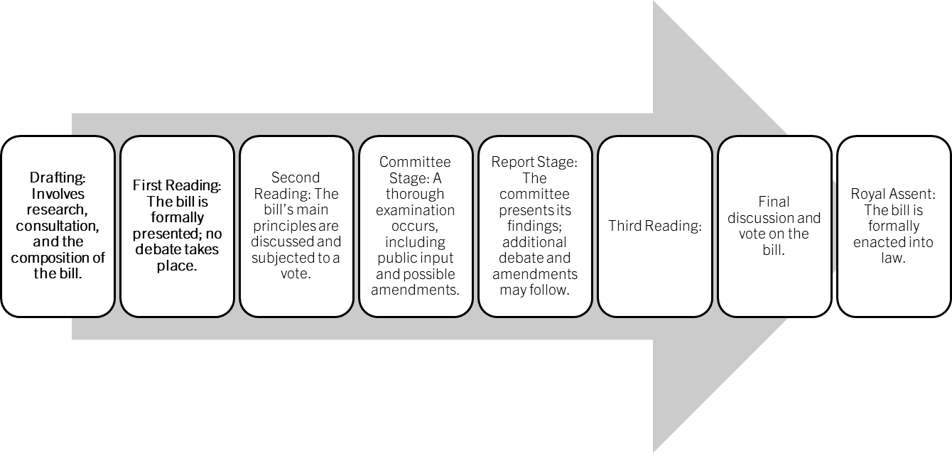


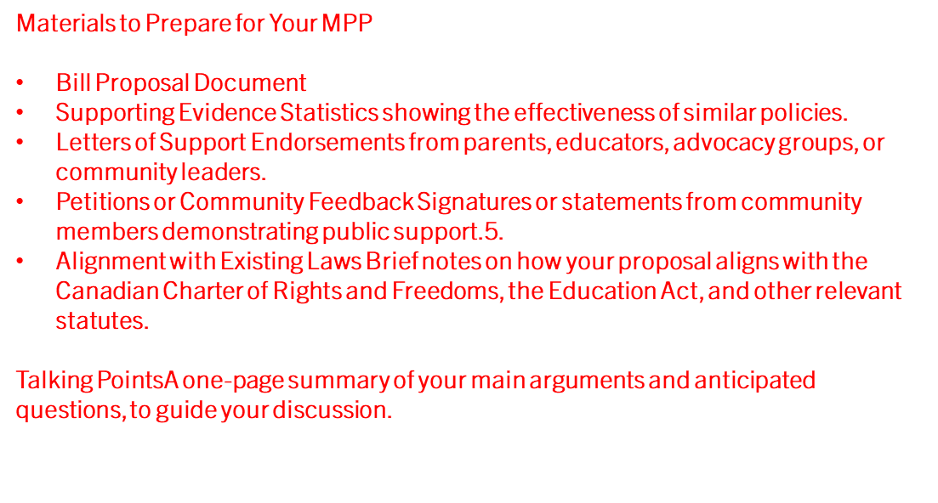
How Parents’ Rights Are Legislated
The step-by-step process—from drafting to royal assent—guarantees that laws are not made in isolation. Stakeholder input is sought at every stage, especially from parents, educators, and legal experts. This means the voices of families and communities directly shape the law.
Notes:
In Ontario, passing a bill—like a Parents’ Bill of Rights—isn’t just a formality. It’s a journey that begins with research and consultation, often initiated by a Member of Provincial Parliament, the government, or advocacy groups working together.
At this earliest stage, parents, educators, and legal experts are invited to share their insights, ensuring the bill reflects the real needs of our communities.
When the bill is introduced in the Legislative Assembly, it goes through several readings and debates.
At the committee stage, the public—including parents and advocacy groups—can present their views, suggest changes, and help shape the final law.
This is where your participation truly makes a difference. Public hearings and committee reviews guarantee transparency and open debate, so your concerns are not just heard—they are acted upon.
Bills are improved through feedback and amendments, making sure new laws are practical, balanced, and responsive to the needs of students and families.
Every new policy must also align with the Canadian Charter of Rights and Freedoms and the Education Act, protecting your rights and ensuring legal soundness.
Materials to Prepare for Your MPP
Bill Proposal Document A clear, concise draft of your proposed bill or a summary outlining its purpose, key provisions, and intended outcomes.
Supporting Evidence Statistics, research, and examples from other provinces or countries (e.g., Saskatchewan, Alberta, New Brunswick) showing the effectiveness of similar policies.
Letters of Support Endorsements from parents, educators, advocacy groups, or community leaders.
4. Petitions or Community Feedback Signatures or statements from community members demonstrating public support.
Talking Points A one-page summary of your main arguments and anticipated questions, to guide your discussion.

Slide 8
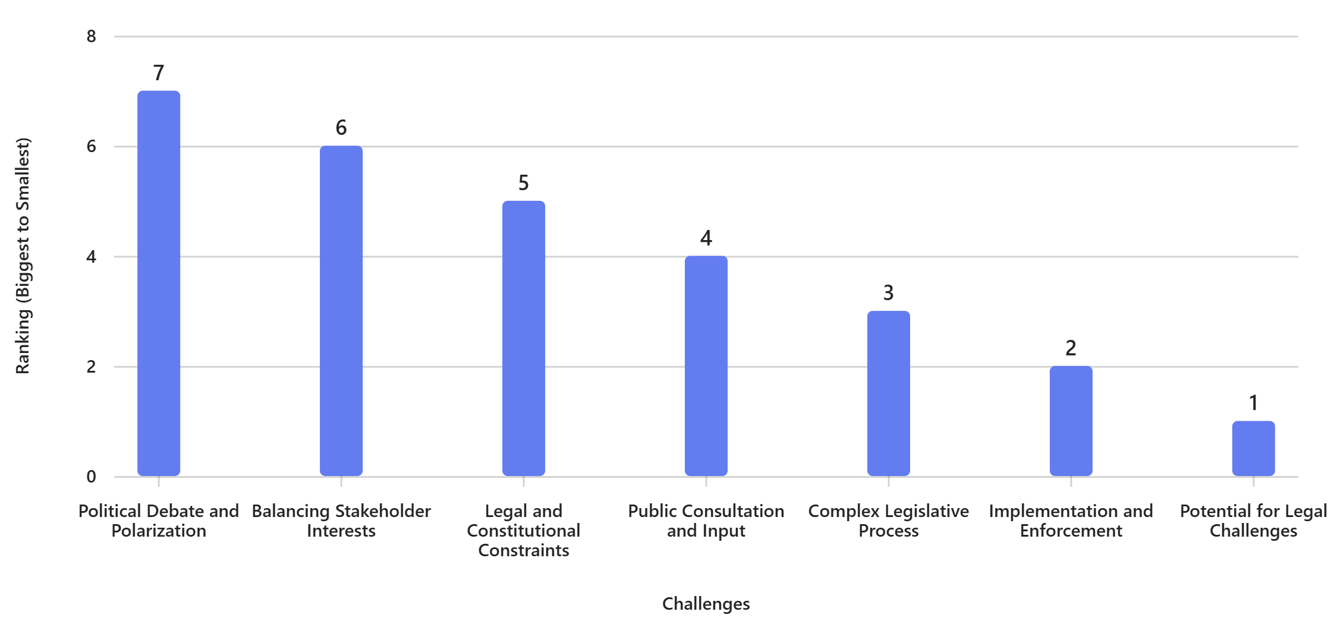

Challenges
POLITICAL DEBATES
SHAREHOLDER INTEREST
Notes:
Challenges in Passing a Parents’ Bill of Rights
Political Debate and Polarization:
Intense debates among lawmakers, advocacy groups, and the public make consensus difficult, especially on sensitive topics like curriculum and gender identity.
Balancing Stakeholder Interests:
Conflicting priorities between parents, educators, students, and advocacy organizations complicate drafting and amending the bill.
Legal and Constitutional Constraints:
Bills must comply with the Canadian Charter of Rights and Freedoms, provincial education acts, and international treaties, which can limit scope or wording.
Public Consultation and Input:
Gathering broad feedback and addressing concerns from diverse communities is time-consuming and may reveal deep divisions.
Complex Legislative Process:
Multiple readings, committee reviews, amendments, and votes present opportunities for delay, opposition, or significant changes.
Implementation and Enforcement:
Ensuring consistent application in schools and boards requires resources and oversight, and can be challenging after the bill is passed.
Potential for Legal Challenges:
New laws may face court challenges if perceived to conflict with existing rights, delaying implementation and creating uncertainty.

Slide 9
Benefits op IN/out choice
3rd party ban GT
AGE APPROPRIATE
FREE SPEECH
LEGAL
✅ Benefit | Description | How This Could Apply in Ontario Schools
Advance Notice & Opt-Out Rights | Parents receive advance notice of sensitive/controversial topics and can opt out for their child | Advance notification for health, sexuality, or controversial topics; opt-out forms available
Parental Consent for Name/Pronoun/Gender Changes | Parental consent required for changes to a child’s name, pronouns, or gender identity (for minors) | Parental approval process for student name/pronoun changes under age 16
Choice of Educational Approach | Parents can choose programs and approaches that match their values | Options for French Immersion, religious education, or alternative programs
Pre-Approval of Third-Party Materials | Parents involved in approving third-party classroom materials | Parental review/approval of external presentations or resources
Ban on Child Gender Transitions | Legal prohibition on child gender transitions (where applicable) | Policy clarity on medical or social transitions for minors
Age-Appropriate Content | Parents can advocate for age-appropriate material | Review of reading lists; alternative assignments for sensitive material
Balanced Perspectives | Factual information and both sides of controversial issues presented | Curriculum includes multiple viewpoints on debated topics
Legal Recourse | Formal process for parents to address concerns or challenge policies | School board complaint procedures; escalation pathways for unresolved issues
Notes:
Combined Benefits of a Parents’ Bill of Rights (Across Provinces)
Advance Notice & Opt-Out Rights: Parents receive advance notice of sensitive or controversial topics (such as sexual health or gender/sexuality lessons) and can opt out of these lessons for their children.
Parental Consent for Name/Pronoun/Gender Changes: Parental consent is required for changes to a child’s name, pronouns, or gender identity, especially for minors (typically under 15 or 16). Notification policies apply for older teens.
Choice of Educational Approach: Parents have the right to choose educational programs and approaches that align with their values, including religious or alternative education.
Pre-Approval of Third-Party Materials: Parents are involved in approving third-party materials used in classrooms.
Ban on Child Gender Transitions: Some provinces prohibit child gender transitions.
Age-Appropriate Content: Parents can advocate for age-appropriate material and have a say in what is taught.
Balanced Perspectives: Parents support receiving factual information and both sides of controversial issues.
Legal Recourse: Formal processes exist for parents to address concerns or challenge school policies.

