Slide 1

Sexual Harassment & Discrimination
Gonna B’ERs

Slide 2
Introduction
Federal and state laws prohibit workplace discrimination and harassment. This training reviews the Grand Lodge’s Discrimination and Harassment Guidelines Manual

Slide 3
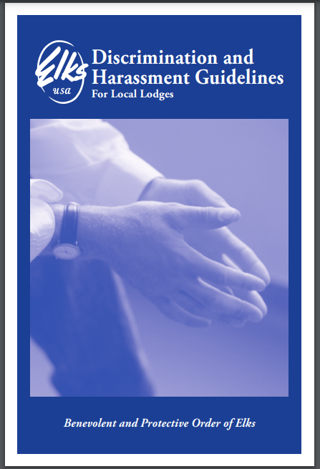
Download the Discrimination and Harassment Guidelines For Local Lodges manual to establish your lodge’s guidelines.

Slide 4
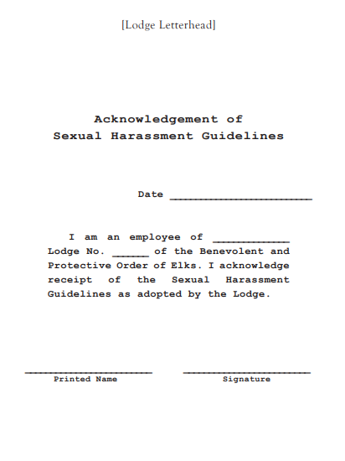
Review and acknowledge the Sexual Harassment Guidelines annually and during new employee orientations. Signed acknowledgments should be placed in personnel files.

Slide 5
DISCRIMINATION AND HARRASMENT TRAINING FOR LOCAL LODGES
Training Purpose
Maintain a respectful, accountable, and harassment-free working environment.

Slide 6
Employee Conduct
Employees must behave professionally and ethically. Unacceptable behaviors include posing danger, harassment, abuse, inappropriate sexual conduct, and providing false information.

Slide 7
QUESTIONS ???

Slide 8
Harassment-Free Workplace
The Lodge is committed to a respectful and harassment-free work environment.

Slide 9
Examples of unlawful harassment include but are not limited to unwelcome sexual advances, derogatory comments, and offensive materials.

Slide 10
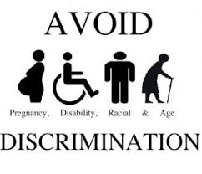
Avoid discrimination against pregnant women, individuals with disabilities, racial minorities, and the elderly.

Slide 11
Report Harassment to your immediate supervisor, the Exalted Ruler, or one of the Lodge Officers.

Slide 12
Harassment Complaints
All harassment complaints will be investigated confidentially, with no retaliation against complainants.

Slide 13
Corrective Action
Disciplinary actions for unacceptable conduct may include termination. Supervisors condoning harassment could face disciplinary action as well.
Similarly, Lodge Officer(s) who is aware of unlawful harassment and condone such conduct by allowing it to continue will be subject to disciplinary action as determined by the governing body of the lodge.
Non-employees in violation of this policy are subject to appropriate remedial action, as determined by the governing body of the lodge, including but not limited to removal from the Lodge property and/or termination of the Lodge relationship.

Slide 14

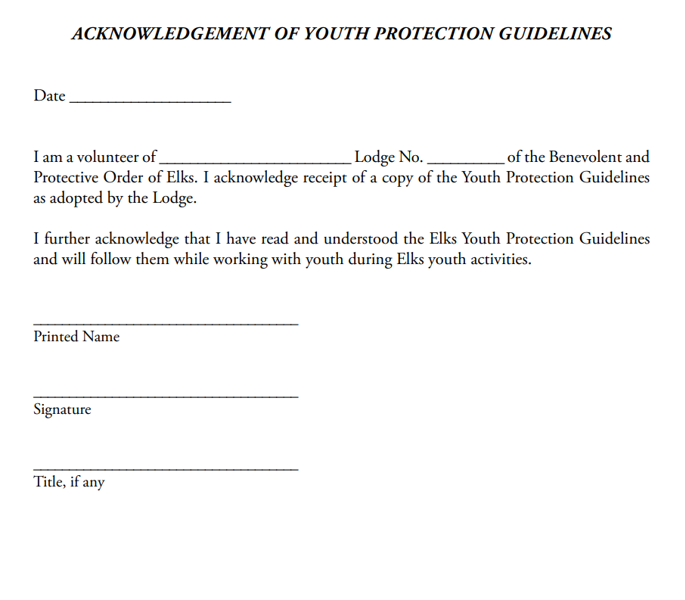
Youth Protection Guidelines

Slide 15
