Slide 1
Exalted Ruler

Slide 2
-CEO-
Chief
Executive
Officer

Slide 3


Slide 4


Slide 5


Slide 6


Slide 7
Study the Laws of the Order and the By-Laws of your Lodge
2. Familiarize yourself with Rituals
3. Study the Exalted Rulers, Lodge Officers and Committee Members manual
4. Robert’s Rules of Order
5. Voting requirement guide (page 192- Statutes Annotated)
6. Protocol Manual
7. Other Grand Lodge Committee Manuals

Slide 8


Slide 9


Slide 10
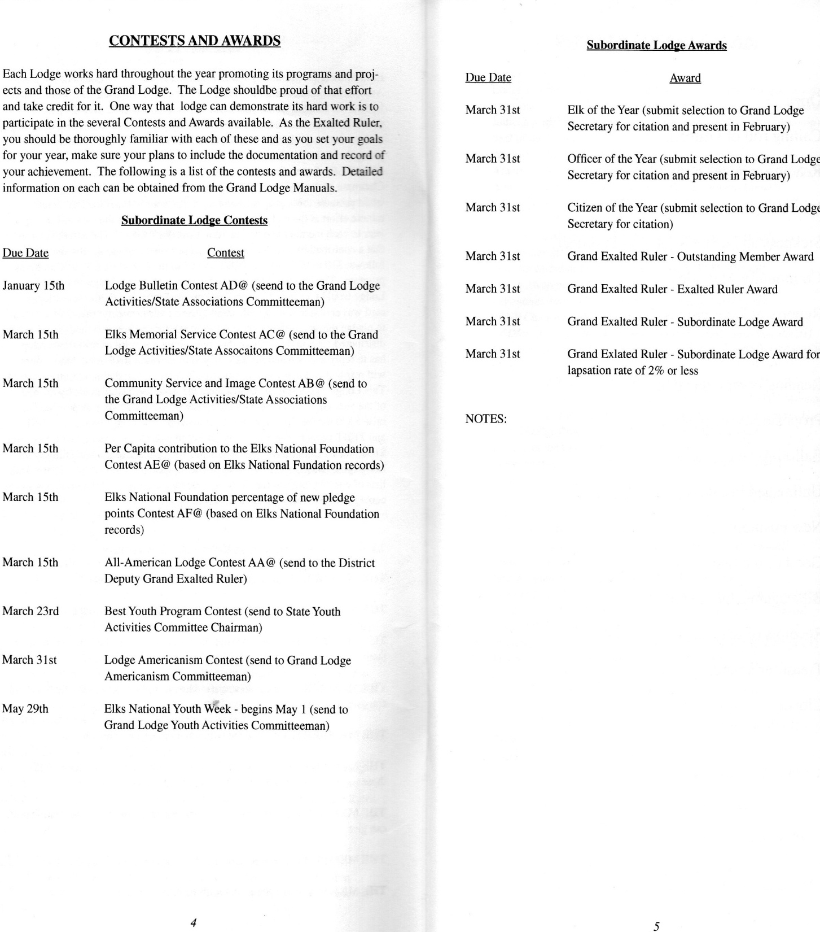

Slide 11
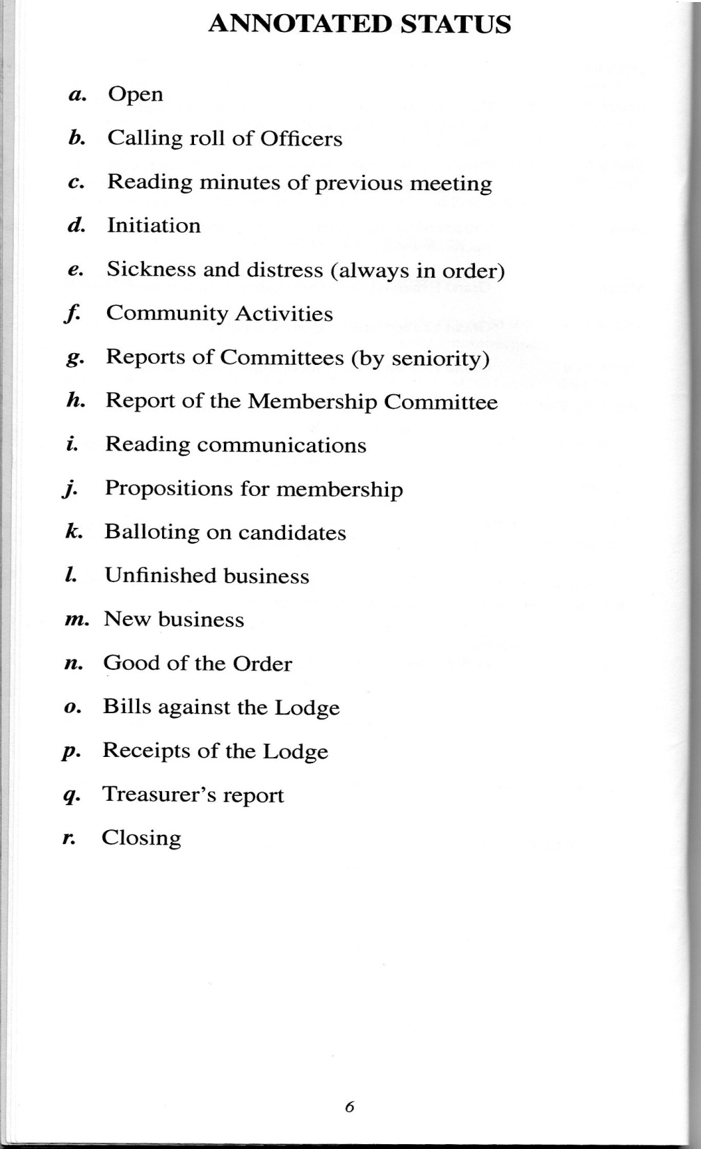

Slide 12
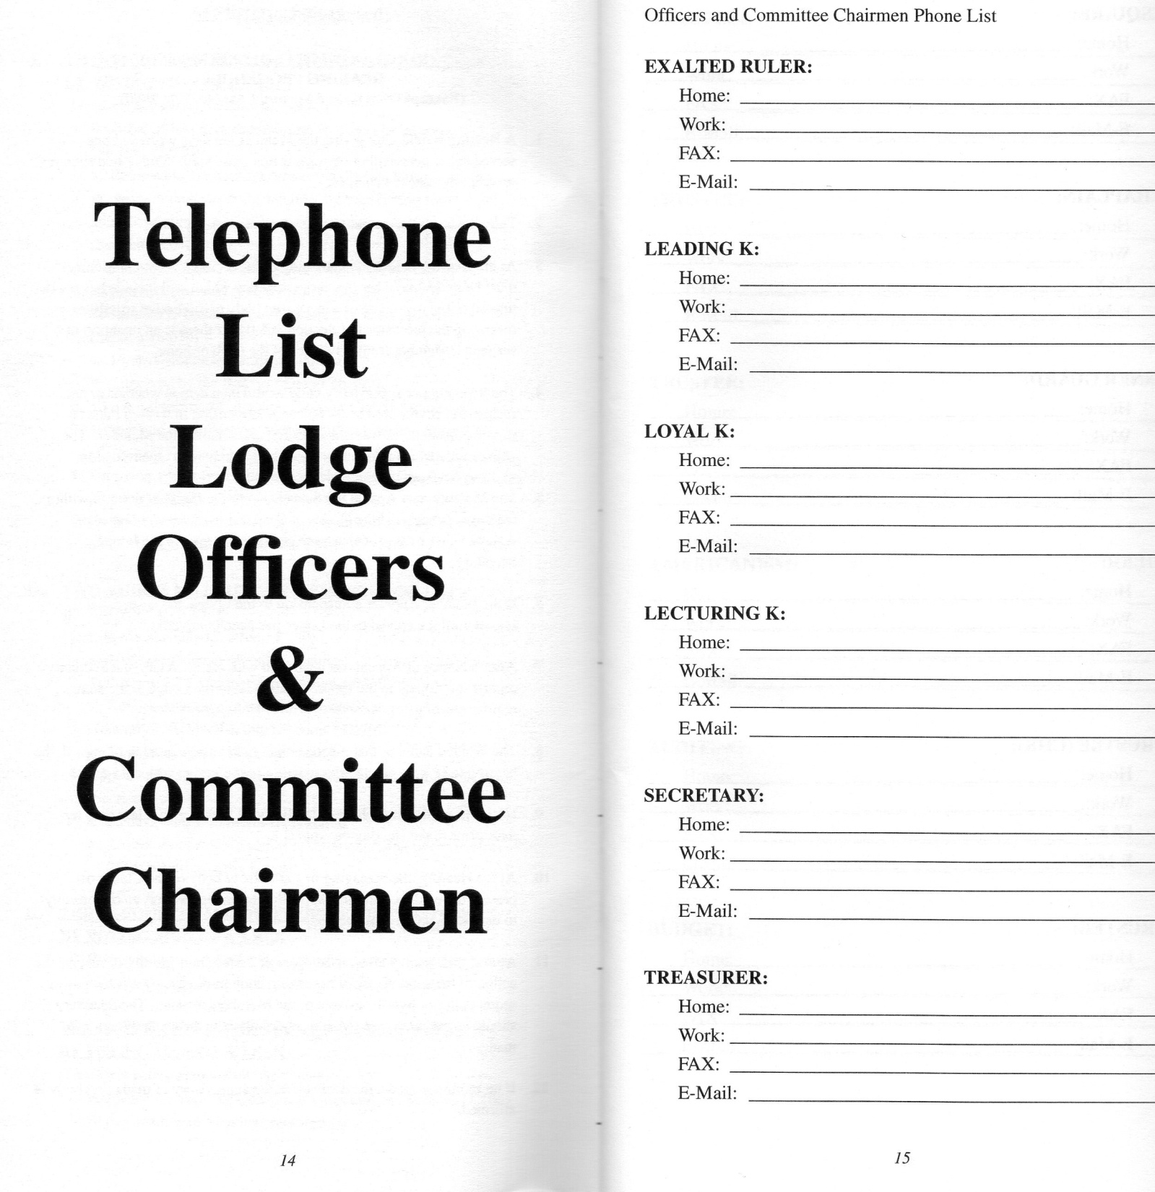

Slide 13
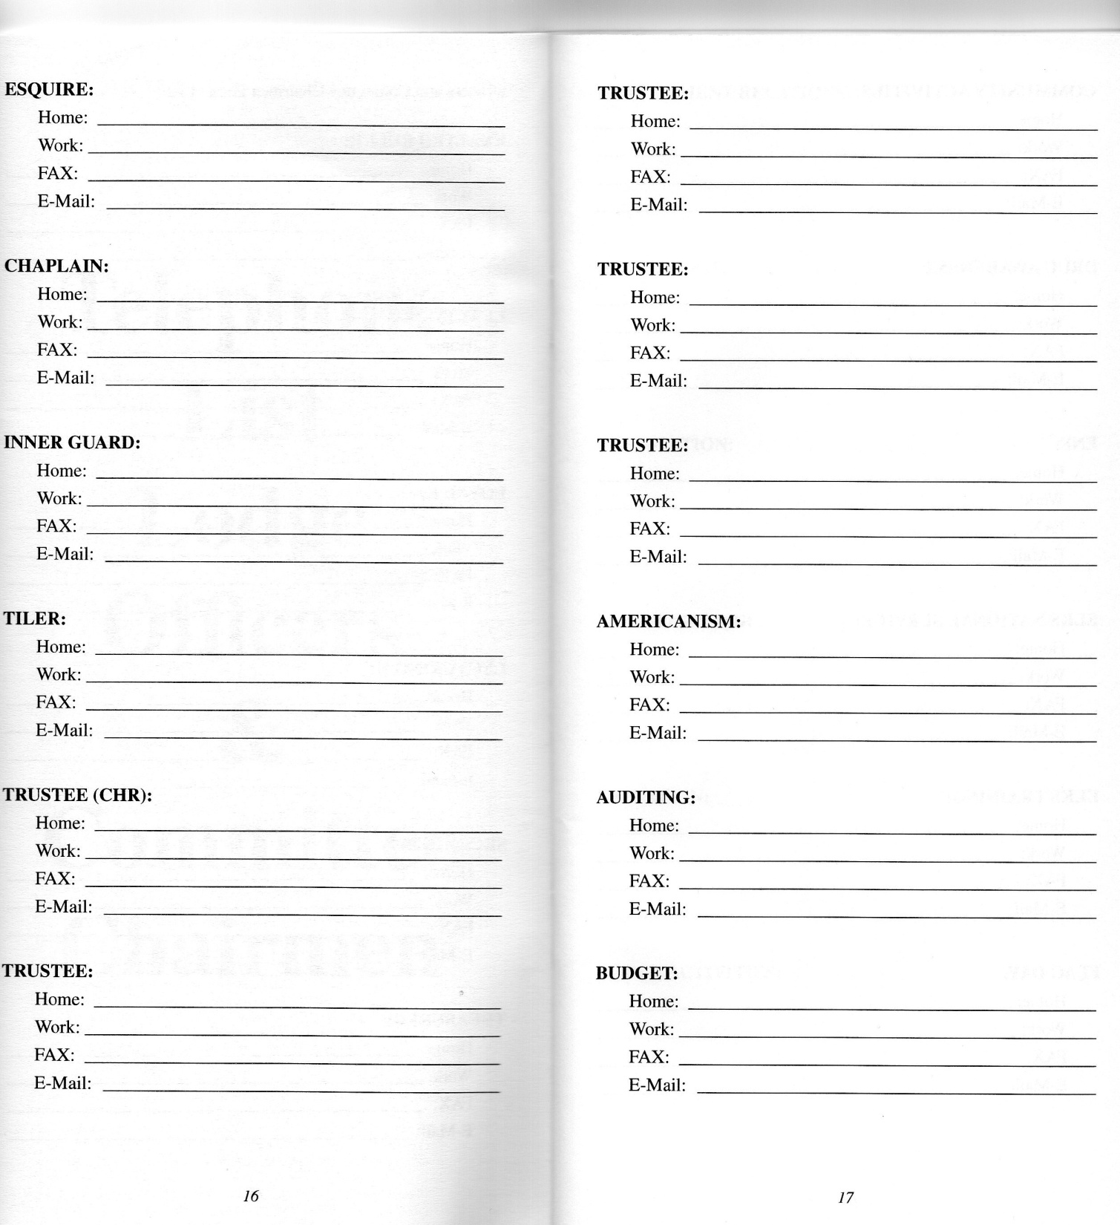

Slide 14
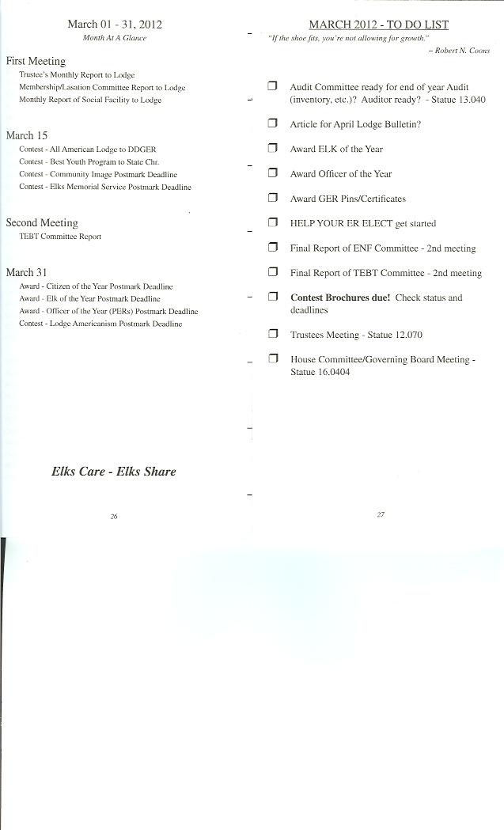
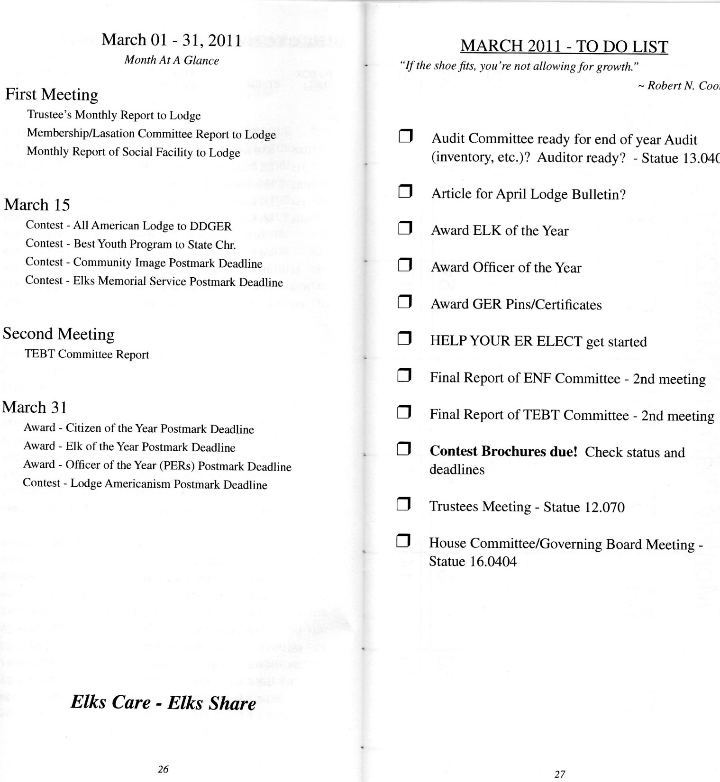

Slide 15
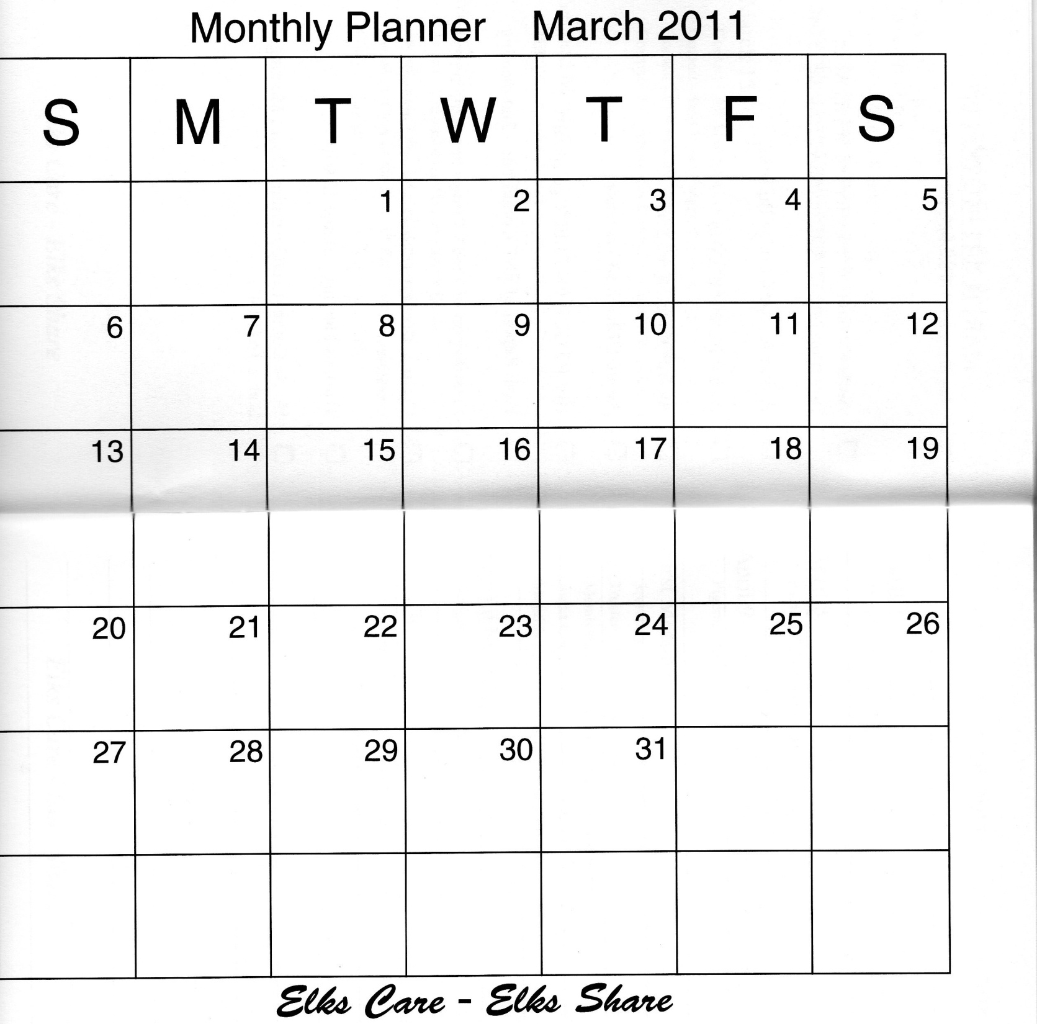
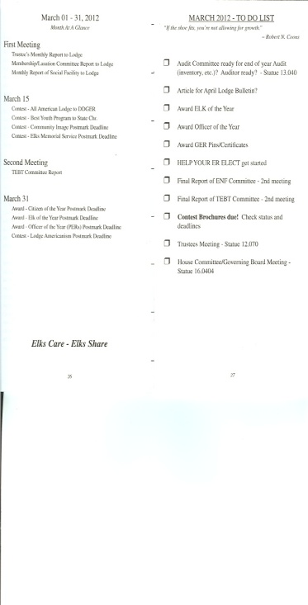


Slide 16
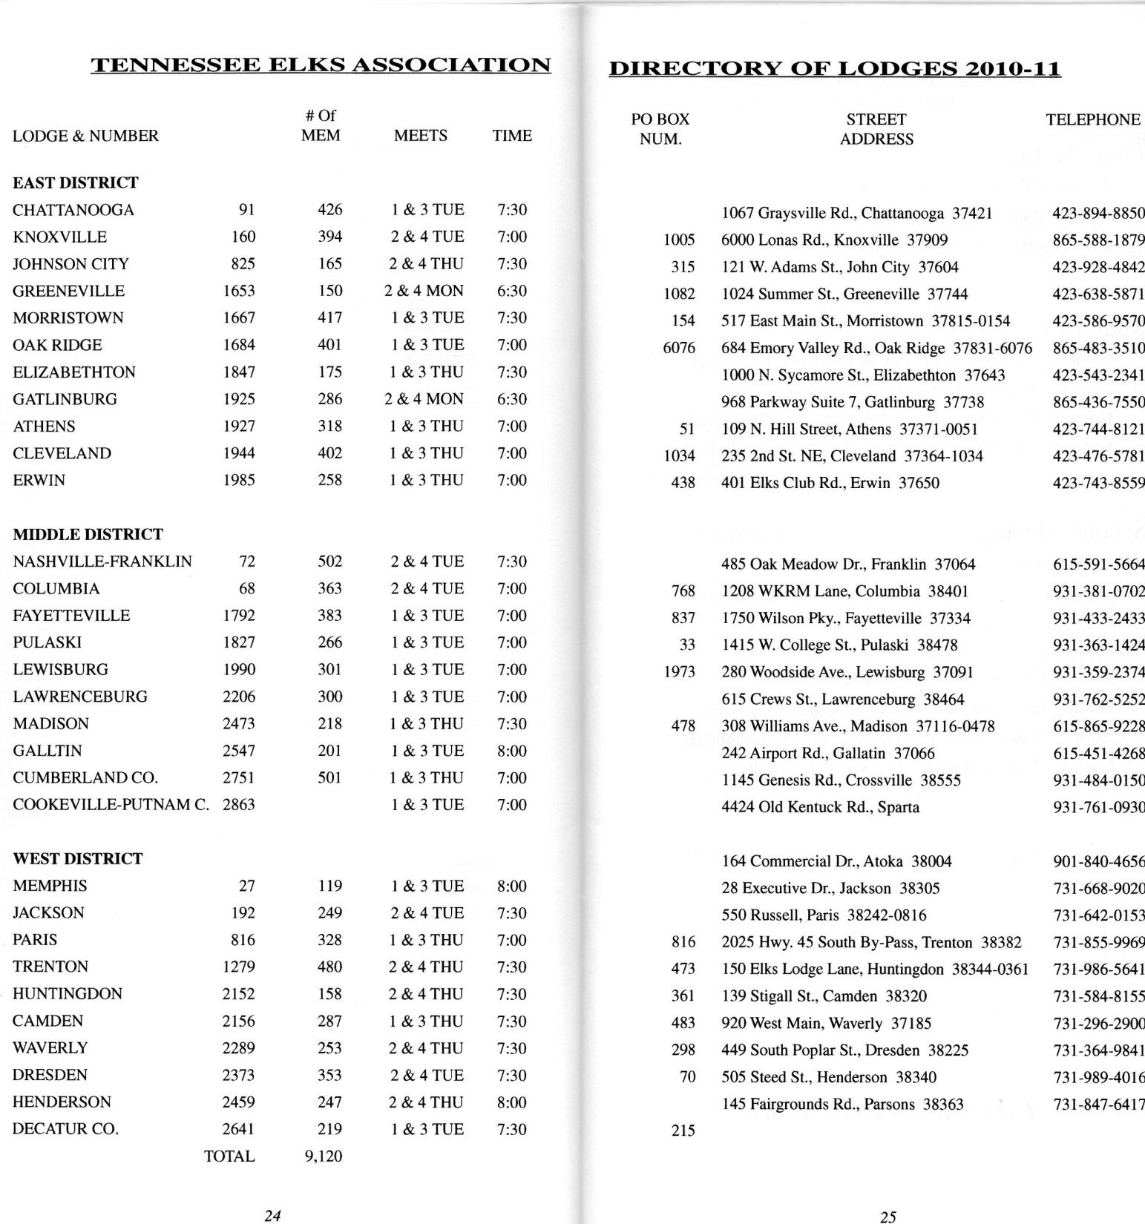

Slide 17


Slide 18


Slide 19


Slide 20
Grand Exalted Ruler
MICHAEL T. LUHR.
Petersburg, Alaska
Lodge No. 1615

Slide 21
State Sponsor
Arthur H. (Jack) Frost, III, PGER
P.O. Box 5886
Oak Ridge TN 37831-5886
865-482-7586 Office
ahfger@bellsouth.net

Slide 22
District Deputy-East
Tennessee East District #8320
Reeda Hall
120 Brently Woods Dr.
Chattanooga, TN 37421
Res.: (423)240-3506
ReedaHElksTN@comcast.net

Slide 23
District Deputy-Middle
Tennessee Middle District #8360
Ann Gable
6618 Holt Road
Nashville, TN 37211
(615)517-0778
afgable@comcast.net

Slide 24
District Deputy-West
Tennessee West District #8440
Joe Allen
130 Mixpah Street
Springville, TN 38256
Res. (731)441-2097
J.Allen@camdenhc.com

Slide 25
State Sponsor
Arthur H. (Jack) Frost, III, PGER
P.O. Box 5886
Oak Ridge TN 37831-5886
865-482-7586 Office
ahfger@bellsouth.net

Slide 26
Grand Secretary
Bryan R. Klatt
2750 N. Lakeview Avenue
Chicago IL 60614
Office: (773)755-4708

Slide 28










Slide 29


Slide 30


Slide 31
Tennessee Elks Association
Leadership Training Committee
March 2, 2019
Chairman: Hershel B.Wilkes, PSP

