Slide 1

Who’s in Charge?
Benevolent and Protective
Order of the Elks
United States of America
TENNESSEE ELKS ASSOCIATION

Slide 2
Duties of Officers
Exalted Ruler
Duties On Assuming Office
The Knights
Board of Trustees
Secretary (DELETE
Secretary (continued)(DELETE
Treasurer
Club Management Organization
Club Management Duties
Subordinate Lodge Committees
Subordinate Lodge Committees
(continued)
Subordinate Lodge Committees
(continued)
Parliamentary Procedure
Parliamentary Procedure
(continued)
Parliamentary Procedure
(continued)

Slide 3
Duties of Officers
Exalted Ruler
Esteemed Leading Knight
Esteemed Loyal Knight
Esteemed Lecturing Knight
Board of Trustees
Secretary
Treasurer

Slide 4
Exalted Ruler
Initial Duties
Chief Executive Officer
Administrative Duties
Officer and Committee Disciplines
Schedules and Deadlines
Communication
Protocol
By-laws
Balloting
Voting Requirements
Contests and Awards
Promotional Duties

Slide 5
Exalted Ruler
Duties On Assuming Office
Appoint Presiding Justice and Mediator
Appoint Committees and inform G.L.
Memorize part for ritual
Preside at all meetings and use agenda

Slide 6
The Knights
Officiate for Exalted Ruler in his absence
Duties as designated by Exalted Ruler
Esteemed Leading Knight attend DD Clinics

Slide 7
Board of Trustees
( or board of Directors)
Control all Properties, Funds and Investments
Execute all Contracts
Maintain Records and Present Reports
Prepare Budget
Establish Controls for Spending
Accident Prevention
Chairperson attend DD Clinics
Meet Regularly

Slide 8
Treasurer
Receive all Monies from Secretary
Pay Bills
Keep Record of Receipts and Disbursements
Establish Bond $5,000.00 or more
Treasurer of all Committees
Sign all Checks unless otherwise required
Get Paid?

Slide 9
Club Management Organization
Four Alternative Methods of Organization:
Exalted Ruler, Knights and Trustees or
House Committee, not less than Three
or more than Thirteen Members appointed by ER or
3. Trustees
4. A separate corporation formed by GLS 16.030

Slide 10
Club Management Duties
Manage Operations subject to Lodge control
(exception: employment relations and prices)
Hold Meetings with Minutes
Prepare Club Budget annually and monitor expenses
Authority/duty to suspend club privileges iaw
Statutory Procedure, not more than one year

Slide 11
Subordinate Lodge Committees
Subordinate Forum (presiding Justice)
Mediator

Slide 12
Subordinate Lodge Committees
(continued)
Statutory Committees
(not less than 3 members)
  Americanism
  Auditing & Accounting
  Drug Awareness
  Flag Day
  Government Relations
  Membership

Slide 13
Subordinate Lodge Committees
(continued)
Lodge Activities
Memorial Day
Elks National Foundation
National Veterans Service
Public Relations
Community Activities
Visiting
Youth Activities
Hoop Shoot
Soccer Shoot?

Slide 14
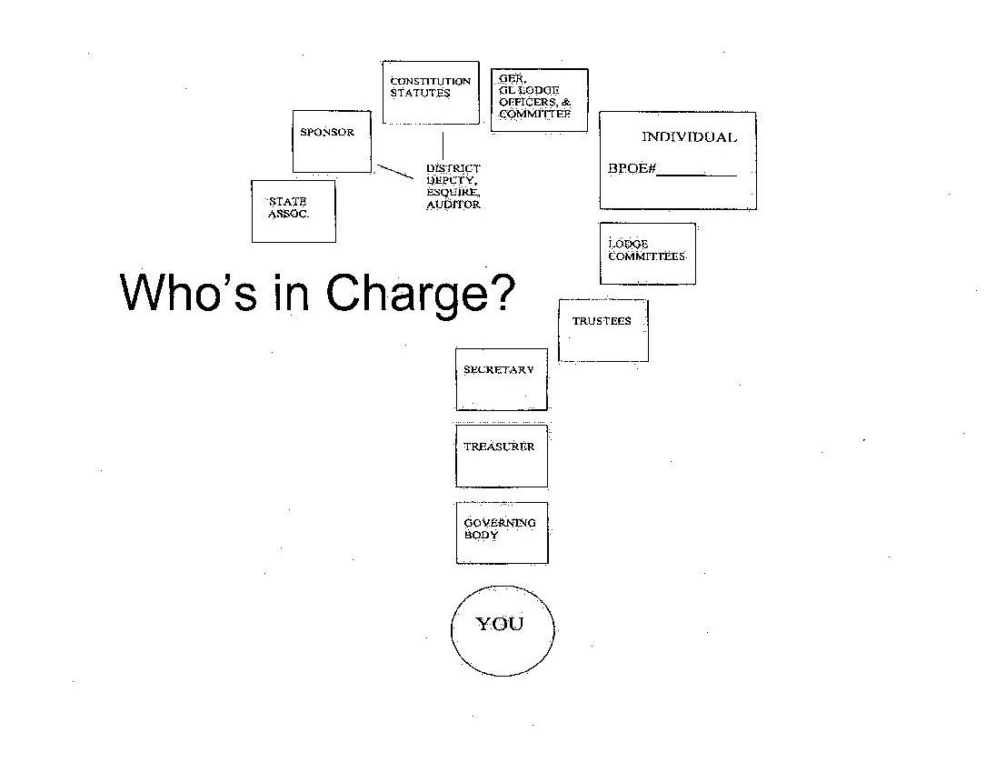
Who’s in Charge?

Slide 15
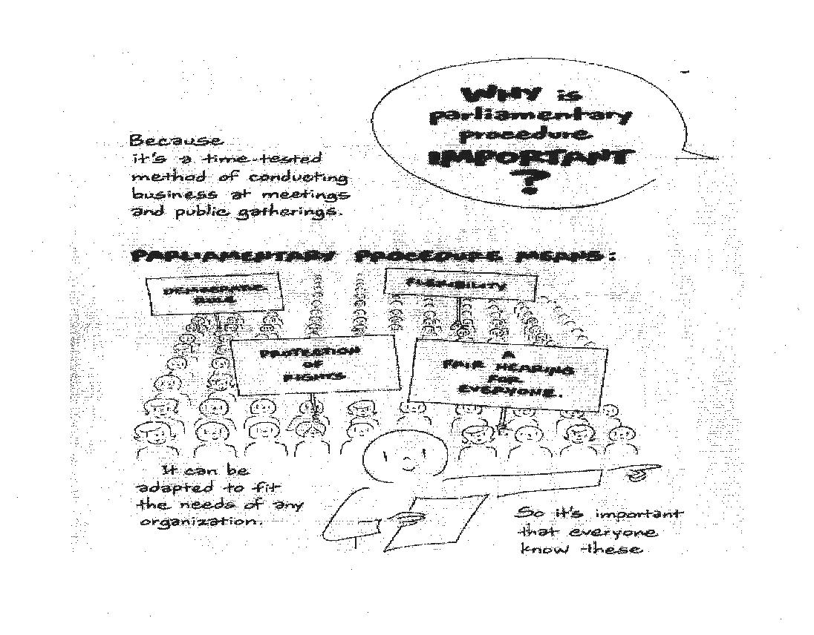

Slide 16
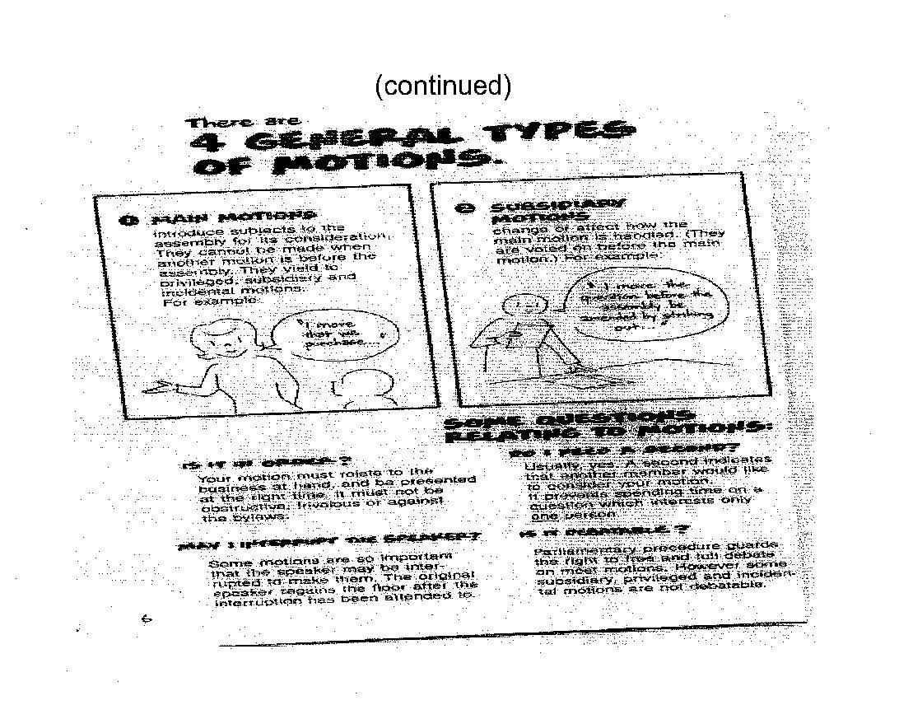
(continued)

Slide 17
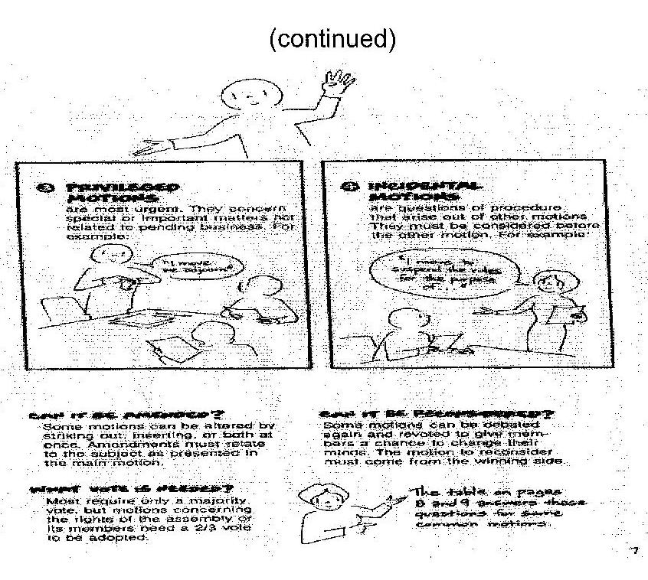
(continued)

Slide 18

Benevolent and Protective
Order of the Elks
United States of America
TENNESSEE ELKS ASSOCIATION
Who’s in Charge?

Slide 19
Who’s in Charge?

Slide 20
Secretary
Keep Minutes
Maintain Accounts
Membership Mailing List
Receive Monies and pay Treasurer
Track Applications and Applicants
Notify Committee
Prepare Membership Reports
Report Expulsions and Suspensions
Read/answer all Correspondence with ER approval
Establish Bond $5,000.00 or more

Slide 21
Secretary (continued)
Written Report to Lodge in April and October
Get Paid?
Duties as required by Subordinate Forum
Attend DD Clinic

