Slide 1

Navigating the Liminal Shift in Sixth Form Pedagogy and Provision
Transitioning from Pedagogy to Andragogy in Post-16 Education
Maria Budzynska, St John Bosco College, London

Slide 2
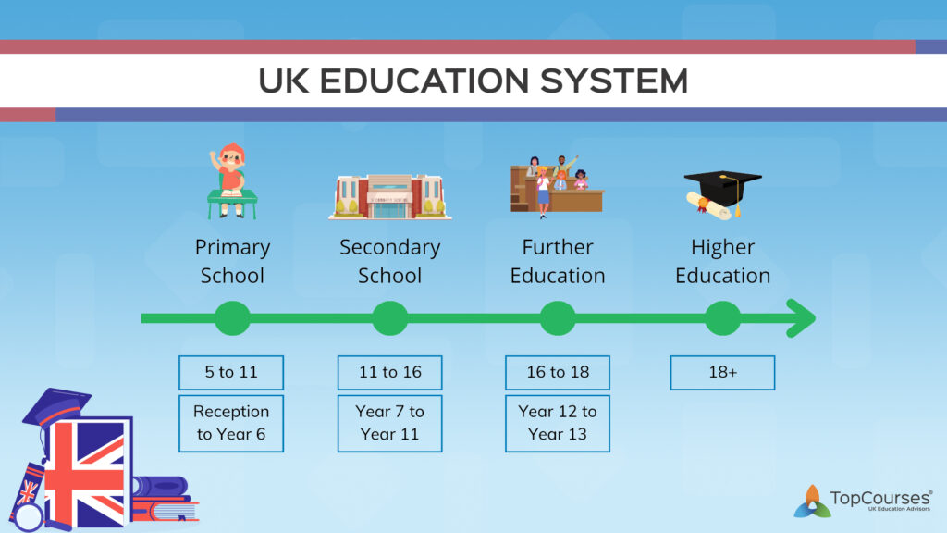

Key Stage 1/2
Key Stage 3/4
Key Stage 5

Slide 3
The "liminal space" a threshold between adolescence and young adulthood
structured learning
(KS3/4)
self-directed enquiry
(KS5)

Slide 4

How do we define learning and
why does this matter?
What do YOU think?
How do YOU define learning?
3 mins
Notes:
Outline questions you will explore

Slide 5
An observable change in behaviour
Something that is actively constructed through the learner’s experience
A change to long term memory
A shift in perspective
The transmission of knowledge
The detection and correction of error
Notes:
Give participants a few minutes to read these definitions and then ask them to discuss briefly with person sitting next to them which one comes closest to their own definition of learning.
Read out each definition and ask for a show of hands to indicate which definition they came closest to. Comment on any interesting patterns in the room.
Explain that either consciously or unconsciously each of their definitions will have been informed by learning theory-highlight the link between each of the definitions and the learning theories behind them.
For example, if your definition was that learning is an observable change in behaviour or the transmission of knowledge then it is informed by behaviourism.
If you view learning as a change to long term memory, then you are taking cognitivist approach.
However, if you view learning as something that is actively constructed by the learner then you are taking a social constructivist approach. These are all definitions of learning associated with pedagogy
However, if you view learning as a shift In perspective your definition is more in line with a transformational approach to learning deriving from adult learning theory, likewise learning being a reflective act of detecting and correcting error

Slide 6
An observable change in behaviour
Something that is actively constructed through the learner’s experience
A change to long term memory
Would you answer differently if I asked:
How do we define learning for children and
why does this matter?
3 mins
A shift in perspective
The transmission of knowledge
The detection and correction of error
Notes:
Outline questions you will explore

Slide 7
An observable change in behaviour
Something that is actively constructed through the learner’s experience
A change to long term memory
A shift in perspective
The transmission of knowledge
The detection and correction of error

Slide 8

Why does how we define learning matter?
Notes:
…why does how we define learning matter?
Highlight the fact that each of these definitions have instructional implications..eg, if you believe that learning is a change to long term memory then the instructional implications of that include focusing on cognitive load theory, practice retrieval etc. Whereas, if you define learning as a social act and something that is actively constructed, then instruction implications may include, group work/ inquiry-based learning.
Any curriculum or pedagogical approach necessarily has theories of learning built into it whether consciously or unconsciously-and all learning activities in schools are underpinned by a belief about how both students and adults learn (we will come to the difference between this a bit later on in the session)
Therefore, as current or future leaders of students, I would argue that you must be clear about what those beliefs are and why, because they will underpin the leadership actions you take
However, it is complicated ….explain that the fact that there is no single definition of learning highlights how complex learning theory is –it emanates from so many different fields of research psychology, neuroscience, behavioral ecology, evolutionary theory, and computer science, each with it’s own way of researching and conceiving learning..cognitive act, social act, emotional act etc…

Slide 9
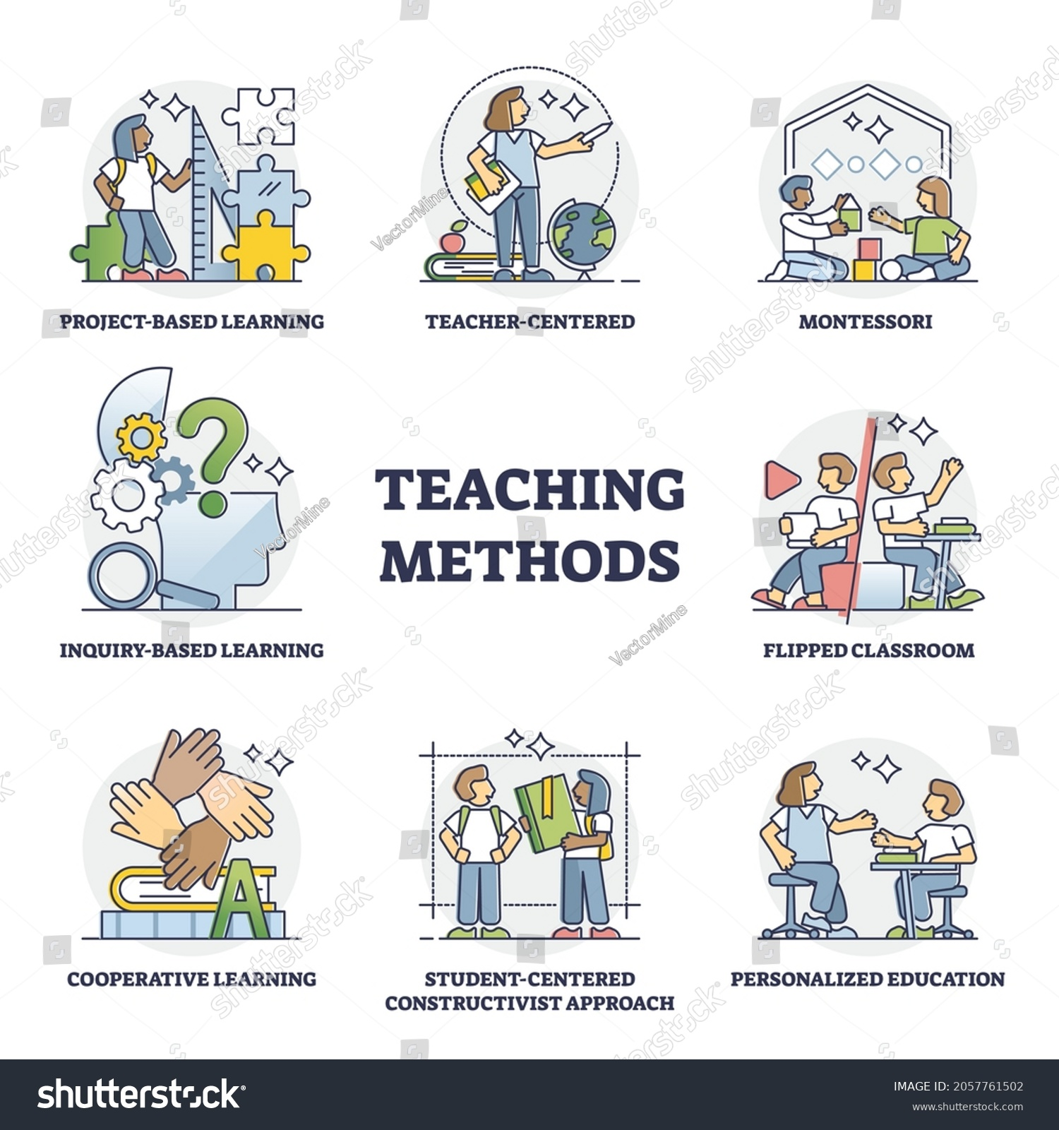
All learning activities in schools are underpinned by a belief about how both students and adults learn

Slide 10
Do children and adult learners learn in the same way?
Explain – give examples!
Notes:
3 minutes – discuss and then look at next slide
Do you agree about these differences?

Slide 11
Regarding | Pedagogy | Andragogy ‘anēr’ and ‘agogos’, meaning "man" and "guide"
Concept of the learner | Learner is a dependent. Teachers takes full responsibility for determining what is to be learned, how it is to be learned and if it has been learned | Adults have a deep psychological need to be self-directing ( however, this may occur at different rates for different people)
Role of Experience | The experience learners bring is of little worth. It may be used as a starting point only. Accordingly, primary techniques are transmittal techniques | As people grow, they accumulate a rich reservoir of experience through which their learning is filtered. People attach more meaning to learning from experience than learning passively
Readiness to Learn | People are ready to learn whenever society says they are (so long as pressure is great enough). Learning is organised into a standard curriculum with the same progression steps | People are ready to learn when they experience a need to learn it in order to cope with real- life tasks and problems. Therefore, the educator must help adult learners discover their ‘need to know’
Orientation to Learning | Learning is a process of acquiring subject matter that will be useful later in life | A process of developing increased competence to achieve their full potential in life. They want to be able to directly apply knowledge and skills straight away.
Knowles, M.S., 1970. From pedagogy to andragogy. Cambridge Adult Education.
Do you agree?
Notes:
This concept aligns with ‘andragogy’ a term derived from the Greek words ‘anēr’ and ‘agogos’, meaning "man" or "adult" and "leader" or "guide." Popularized by Malcolm Knowles in the 20th century, andragogy emphasizes a self-directed, experience-based approach to adult learning, distinct from child-centred pedagogy.
Reflections? Talk in pairs Ask students to critique this…is there such a thing as a distinction between student and adult learning?
What are the instructional implications of this when leading adult learning?

Slide 12
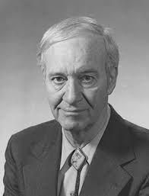
Malcolm Knowles' andragogy and its principles:
Self-Direction: Knowles emphasized that adults, unlike children, have a strong need to direct their own learning, taking initiative and responsibility for their educational journey.
Role of Experience: He recognized that adult learners bring valuable life experiences that enrich their learning, allowing them to draw connections between new knowledge and their personal backgrounds.
Relevance and Practicality: Knowles argued that adults are more motivated to learn when they see clear relevance to real-life tasks, work situations, or personal goals, making practical application key.
Problem-Centered Learning: Rather than abstract theory, adult learners prefer solving real-world problems and gaining skills that can be applied immediately, promoting engagement.
Internal Motivation: He noted that adults are driven more by internal motivators—like self-improvement and achievement—than by external pressures, fostering a deeper commitment to learning.

Slide 13
Adult learners
need
most motivated by
bring experience
need to be
Problem centred learning
Subjects relevant to them
Basis for learning
…including mistakes
Involved
in
in
employment
life
planning instruction
evaluation

Slide 14
So whilst pedagogy and andragogy may contrast and overlap – the role of a teacher at this transitional liminal point between pre and post 16 education it to understand the importance of both approaches in bridging the teaching and learning experience

Slide 15
Bridging the liminal learning gap between pre and post 16 study:
so what does this look like in the classroom?

Slide 16
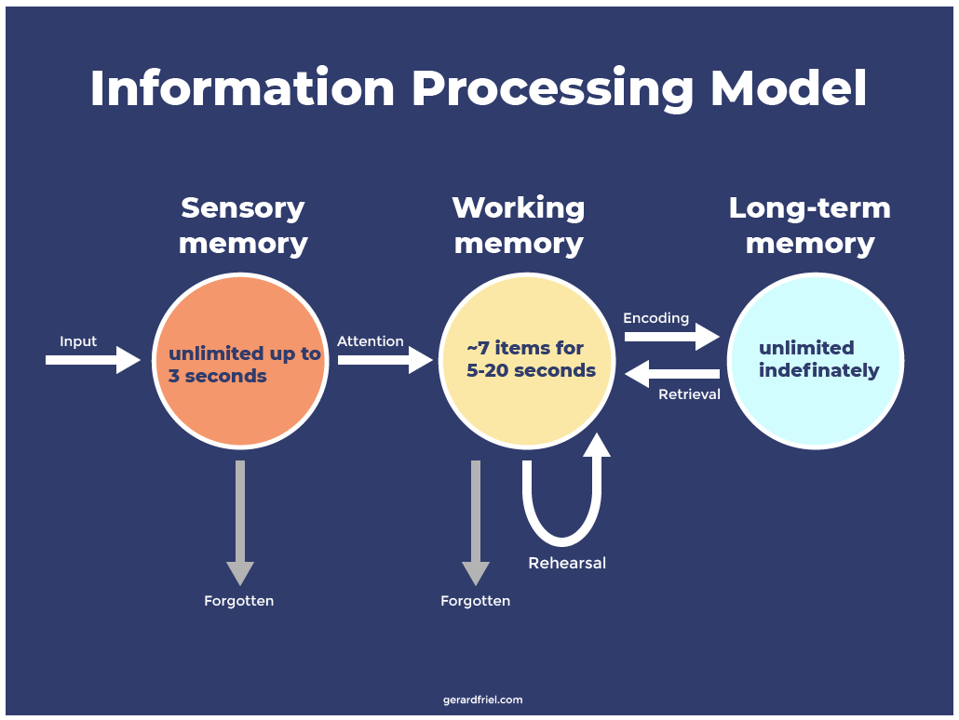
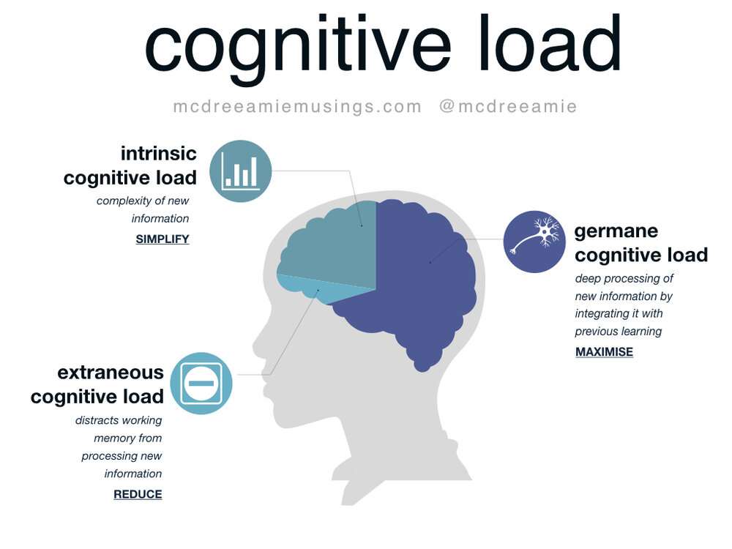
There is some tension between teaching younger learners (pedagogy)
students versus problem-solving and inquiry-based learning for older students.

Slide 17
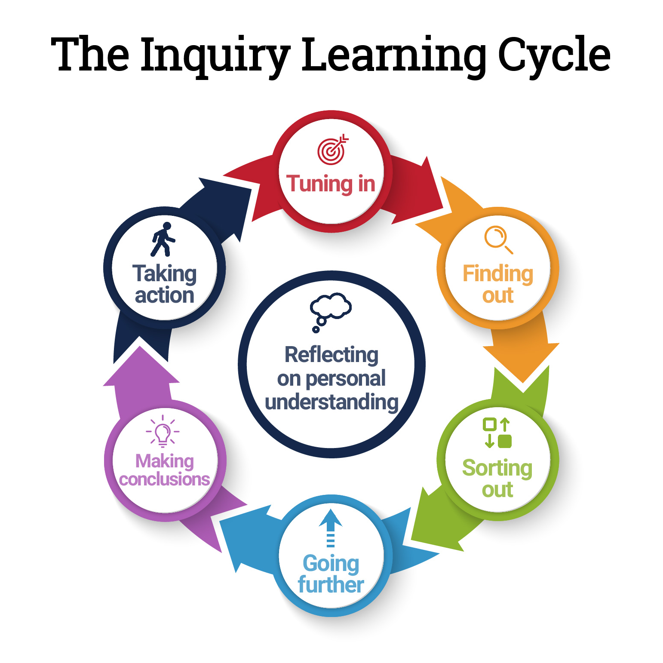
versus problem-solving and inquiry-based learning (andragogy) for older students

Slide 18





And if that’s not enough of a challenge!
Post 16 learning is a transitional phase with diverse maturity levels and readiness for self-directed learning…

Slide 19
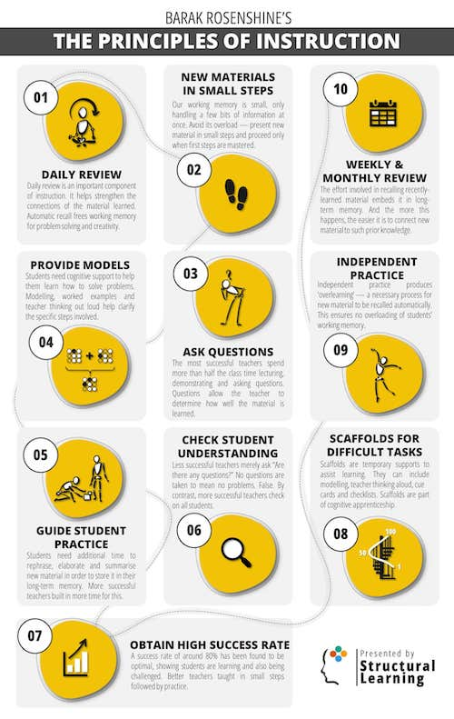

Hybrid and Dynamic Approach to Teaching
A balanced approached

Slide 20
Dewey’s progressive education principles
Teacher as Facilitator: Dewey advocated for teachers to guide and support learning rather than direct it, allowing students more freedom to explore and discover.
Experience-Based Learning: He emphasized that students learn best through direct experiences and active participation, which makes learning more meaningful.
Focus on Critical Thinking: Dewey encouraged fostering critical thinking and problem-solving skills over rote memorization, preparing students to tackle real-world challenges.
Collaborative Learning: He supported group work and social interaction as essential parts of learning, helping students learn from each other and develop social skills.
Preparation for Life: Dewey believed education should equip students to participate actively in society, prioritizing skills and values that prepare them for adulthood.

Slide 21
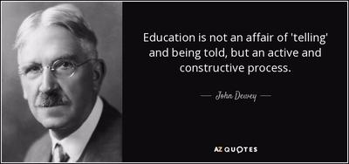

Slide 22
Some ideas to get you started to help students develop independence, critical thinking, and practical skills
Incorporate Self-Directed Projects
Allow students to choose topics or projects that interest them, encouraging ownership and self-motivation in their learning.
Integrate Real-World Problem-Solving
Design assignments that address practical, real-life issues, making the learning process relevant and immediately applicable.
Use Reflective Practices
Include regular reflection exercises, such as journals or group discussions, to help students connect their experiences to the material, reinforcing self-awareness and critical thinking.
Facilitate Peer Learning
Encourage group work and peer teaching activities, giving students opportunities to learn collaboratively and develop interpersonal skills.
Balance Structure with Flexibility
Provide structured support and clear expectations but allow flexibility for students to approach tasks in ways that suit their individual learning styles and preferences.

Slide 23
Most importantly don’t forget you are working in a liminal space… both sides of the transitional bridge need to be balanced

Slide 24
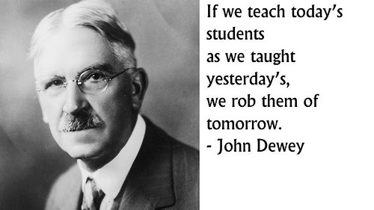

Slide 25
Navigating the Liminal Shift for post 16 learners
Questions?

