Slide 1

Education and Social Justice
Equality Versus Equity
Sue Matthews
Assistant Headteacher
Blessed Hugh Faringdon Catholic School

Slide 2
Definitions
Equality: the right of different groups of people to receive the same treatment:
Equity: the situation in which everyone is treated fairly according to their needs and no group of people is given special treatment.
There are times when, to treat people equally, we have to treat them differently according to their needs

Slide 3
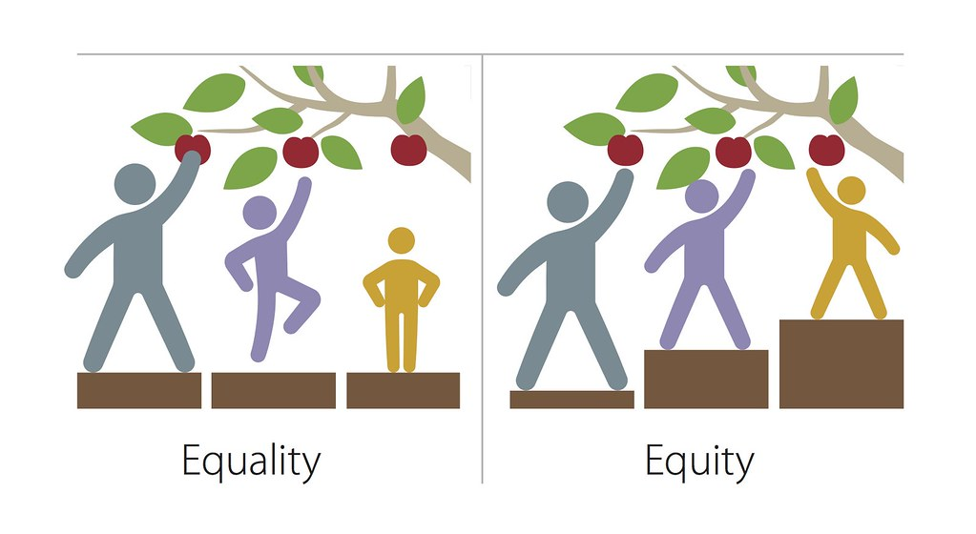
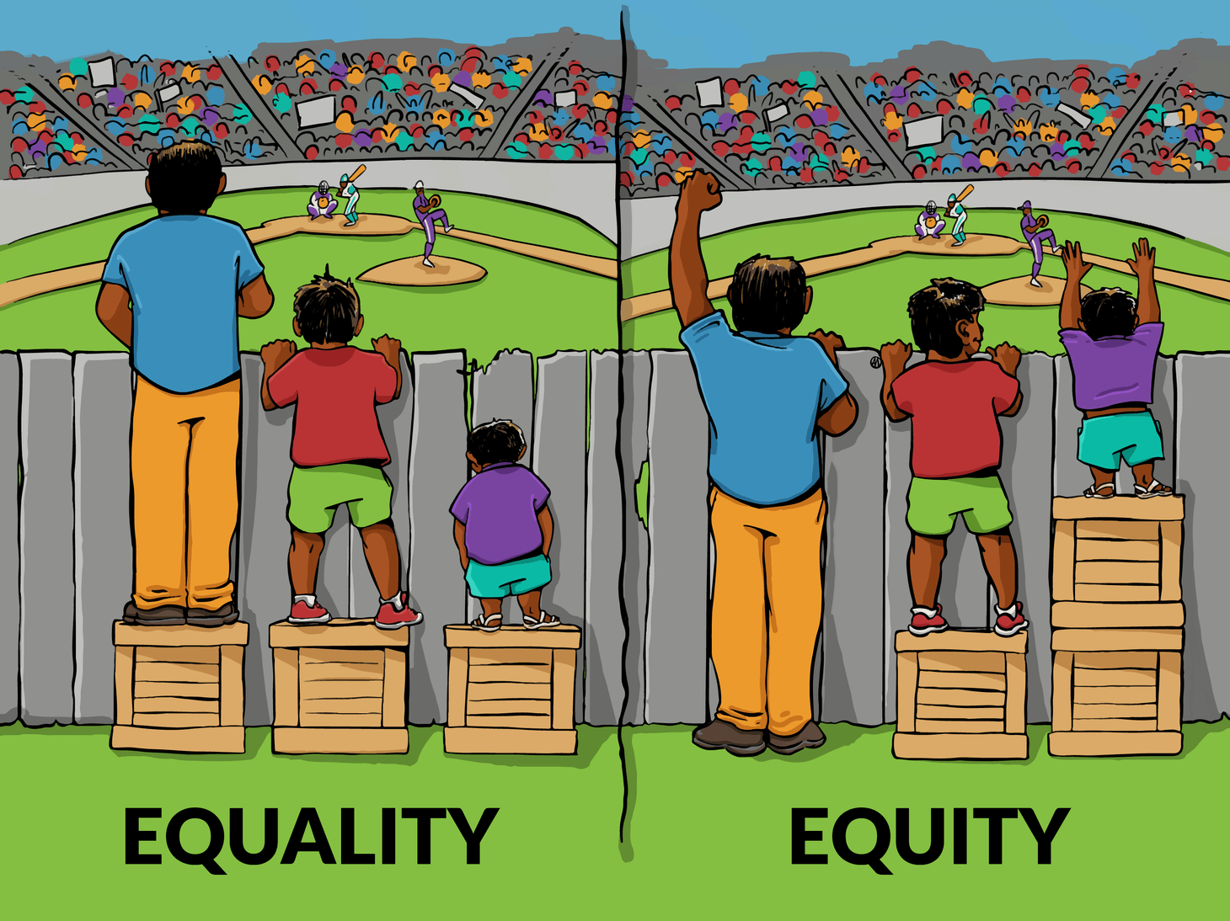
Another way of looking at it…………
This Photo by Unknown Author is licensed under CC BY

Slide 4
Reflection Point:
Should we always treat people the same? When and why might it be appropriate to do so?
In order to treat people equally, and with dignity, are there times when we need to treat some people differently?
Hold onto that thinking/responses…………

Slide 5

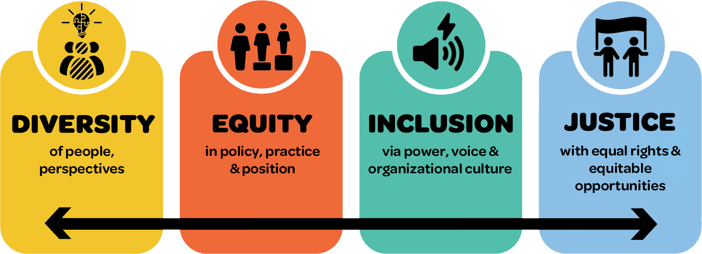
Now let’s apply that to Education………
This Photo by Unknown Author is licensed under CC BY-NC

Slide 6

If only every school/classroom was like this…
If yours is like this with everyone motivated, on task and learning then well done.
What are you doing right?
Is it getting the results you expect?
If it’s not, what next?
This Photo by Unknown Author is licensed under CC BY-NC-ND

Slide 7
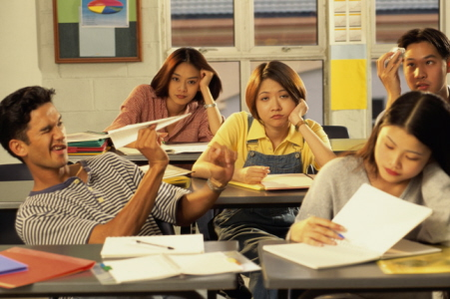
Or, is this more the picture?.......
Ask yourself :
‘Why might this be? ‘
‘What’s the potential outcome if not addressed?’
Who is responsible for putting it right?
We are……….

Slide 8

If all students aren’t engaged, why might that be?
Teaching style/lesson content are not matched to the child’s ability, learning style and/or interests.
A literacy difficulty. (e.g. dyslexia: Language processing, short term memory, reading, writing)
A condition (e.g. Autism, Attention Deficit Hyperactivity Disorder (ADHD), a hearing, sight problem or other learning/medical concern.
Mental Health and Wellbeing (anxiety, stress, difficulties at home/friendship difficulties).
Etc……. A whole range of reasons……..
Stop to think: If your classroom/school lead you to believe that all’s well, for all students, where’s your proof?

Slide 9
Let’s consider the following…..
Does a school/classroom with well-behaved children mean they’re all learning? How do you know?
If your measures show that some aren’t achieving, have you considered that there might be a reason (or more than one reason)?
What are you doing to find out and address the root cause?
What more is it in your power to do?
What help do you need (internally and externally)?
Is that help available? Where? How?
What are your next steps?

Slide 10

Useful resources……….
Behaviour Difficulties (but there’s always a cause): Dealing with the difficult – tips and tricks for effective behaviour for learning | Tes
Learning Difficulties: Supporting Adults and Adolescents with Dyslexia - Online Course – FutureLearn
Autism: Autism in the classroom: Strategies for success | Autism Speaks
ADHD: ADHD in the Classroom: How to Support Students with Attention-Deficit/Hyperactivity Disorder - Waterford.org
Mental Health and Wellbeing: https://emogym.weebly.com,
Mental Health | DASH | CDC
These are examples. You may know of others…… please share them…..

Slide 11
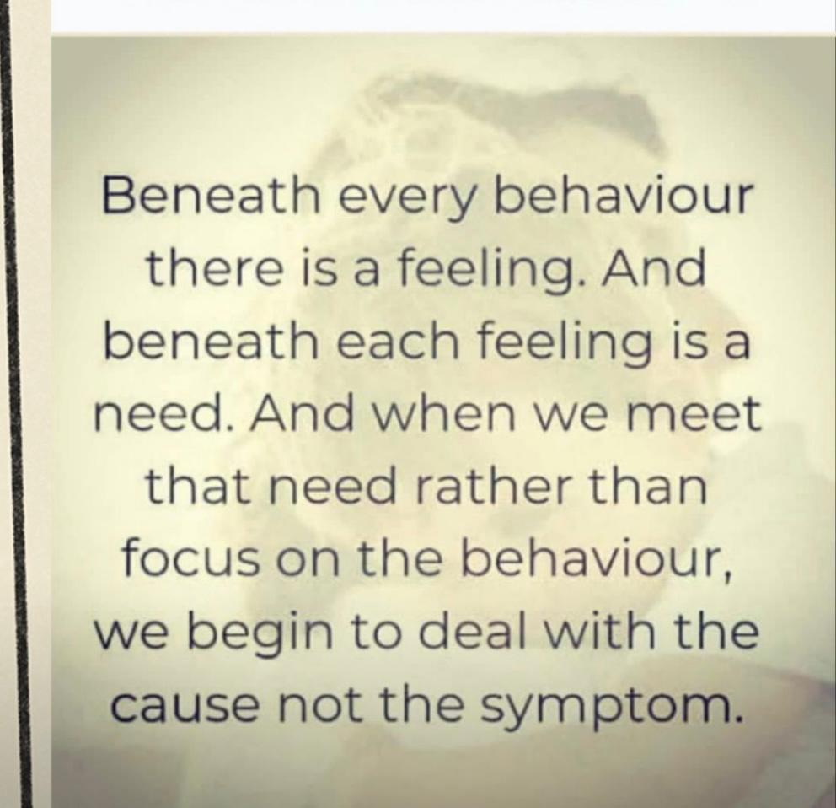
Now back to our Conference theme ‘Education and Social Justice’ ………….

