Slide 1
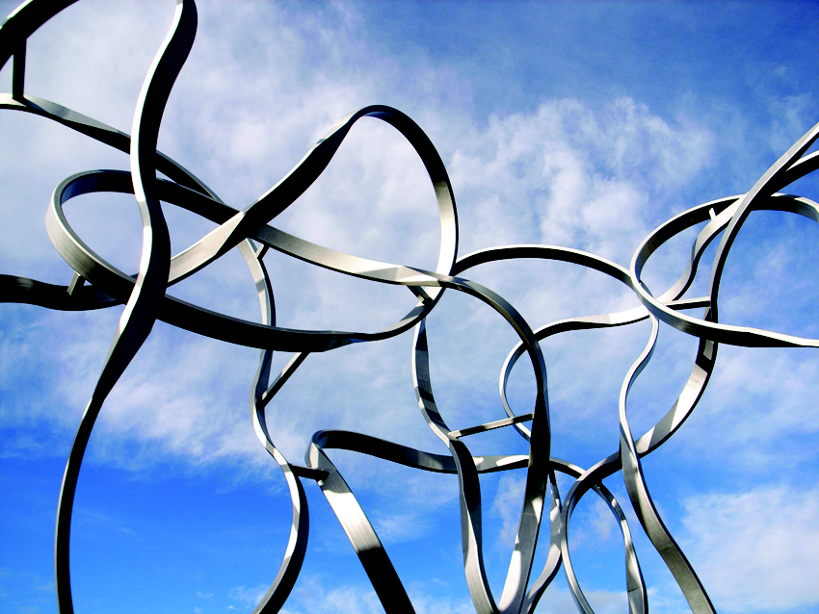


Slide 2
Social Justice and (Higher) Educational Leadership
Professor David Oswell,
Deputy Warden, Goldsmiths, University of London

Slide 3
Social Justice for Universities and for Students
  How do students express their concerns as stakeholders in the institution?
  How do we support social justice in and of the university?

Slide 4
1. How do students express their concerns as stakeholders in the institution?
Three guiding principles:
    Voice
    Equity
    Participation and Co-Creation

Slide 5
Issues, Campaigns and Gestures
Demonstration
Social media
Demands for accountability

Slide 6
Social Justice within a Symbolic Order
The media (but not as a public sphere) constitute a court of social justice
A form of populism
Speech that is not deliberative or dialogical
Inhibitive speech
Non-evidentiary speech
A form of punitive justice

Slide 7
2. How do we support social justice in and of the university?
Two models:
    The Chicago Principles
    The university as a moral actor

Slide 8
Committee on Freedom of Expression, University of Chicago, 2014
In a word, the University’s fundamental commitment is to the principle that debate or deliberation may not be suppressed because the ideas put forth are thought by some or even by most members of the University community to be offensive, unwise, immoral, or wrong-headed. It is for the individual members of the University community, not for the University as an institution, to make those judgments for themselves, and to act on those judgments not by seeking to suppress speech, but by openly and vigorously contesting the ideas that they oppose. Indeed, fostering the ability of members of the University community to engage in such debate and deliberation in an effective and responsible manner is an essential part of the University’s educational mission.

Slide 9
The university as a moral actor
In recent years, it builds on models of corporate social responsibility
But it also draws on Cardinal Newman’s concept of the university and liberal education
Social justice in and of the university

Slide 10
Newman, 1852
… an assemblage of learned men, zealous in their own sciences, and rivals of each other, are brought by familiar intercourse and for the sake of intellectual peace to adjust together the claims and relations of their respective subjects of investigation. They learn to respect, to consult, to aid each other. Thus is created the pure and clear atmosphere of thought…

Slide 11
Newman
‘a habit of mind’ with the attributes of ‘freedom, equitableness, calmness, moderation, and wisdom’

Slide 12
Universities as moral actors in the public realm
Universities take positions on social and political issues and concerns

Slide 13
3. Concluding Thoughts – How to reconcile student and university positions?
It is not for universities to settle different social justice claims nor simply to provide a framework so that such claims might be settled (although this is important), but to recognise that the social ground for such claims has shifted whilst at the same time to maintain the values of reasonable discourse and the pursuit of disciplined inquiry and truth.
The register of social justice, or rather perhaps its tonality, is affective and therapeutic.

Slide 14
The challenge that is laid at the feet of higher educational leaders today is not, then, to manage our students nor simply to ensure that they learn how to engage in social justice deliberations, rather the challenge is threefold:
    accepting a change in the domain and register of discourse;
    whilst also drawing on the rich history of how a university should and can operate as space of free thought and thinking, supported by civility and good manners;
    and presenting that tradition in the public sphere as a counter to the misbehaviours and untruths that are circulated on social media.

