Slide 1
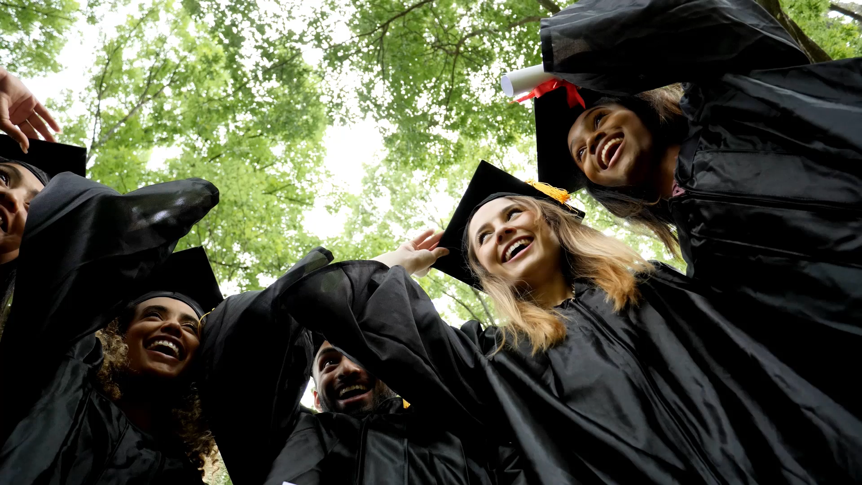
Social Justice in Education
Marcin Hryniewicz
BHFCS

Slide 2
What is Social Justice in education ?
"Social justice is aimed at promoting a society which is just and equitable, valuing diversity, providing equal opportunities to all its members, irrespective of their disability, ethnicity, gender, age, sexual orientation or religion, and ensuring fair allocation of resources and support for their human rights”

Slide 3
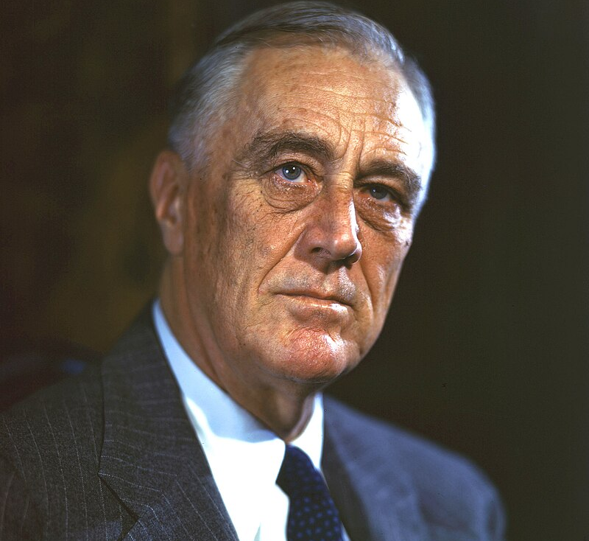
Franklin D. Roosevelt's concept of social justice.
During the Great Depression, Roosevelt's New Deal aimed to reduce poverty and unemployment through the newly established alphabet companies, focusing on economic relief and recovery.

Slide 4


What is the modern relevance of social justice?
Encompasses broader issues including economic inequality, racial and gender equity, human rights, healthcare, and access to education.

Slide 5
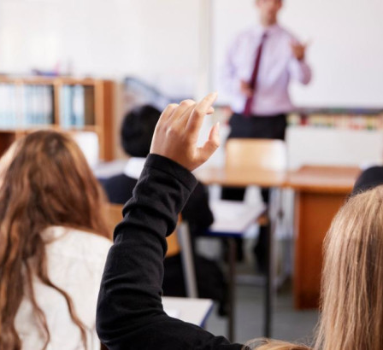
Social justice in history lessons
I would like to share with you some of the examples of how social justice can be applied in history lessons:

Slide 6
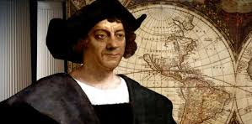
Decolonising the Curriculum - re-examining and revising educational content to include non-Western perspectives, challenge colonial narratives and ensure that the voices of marginalised groups are represented in the study of history.

Slide 7
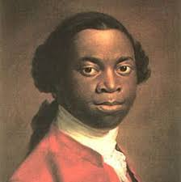
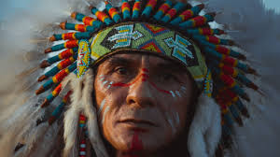
Activity examples:
Compare primary sources from both colonisers and Indigenous peoples.
○ Use writings like The Interesting Narrative by Olaudah Equiano.

Slide 8
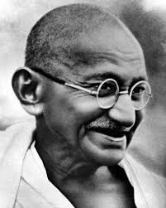
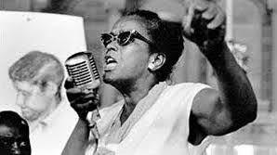
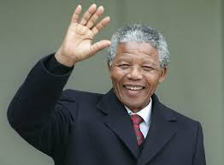
Highlighting Resistance Movements - involves focusing on the struggles of oppressed groups who fought against social, racial, or political injustices, and emphasizing the contributions of lesser-known activists and movements in history.
Do you recognise the following people?

Slide 9

Example: Include lesser-known activists and movements within the Civil Rights Movement and global contexts.

Slide 10
Activity
Students could research a resistance movement from history and present on how oppressed groups challenged injustice.

Slide 11
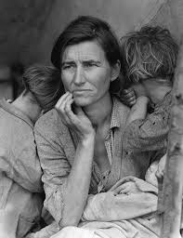
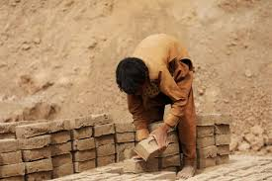
Examining Economic Inequality- in history means exploring the disparities between social classes, especially in terms of wealth distribution, labour conditions, and access to resources. It includes analysing the causes and consequences of these inequalities over time.

Slide 12
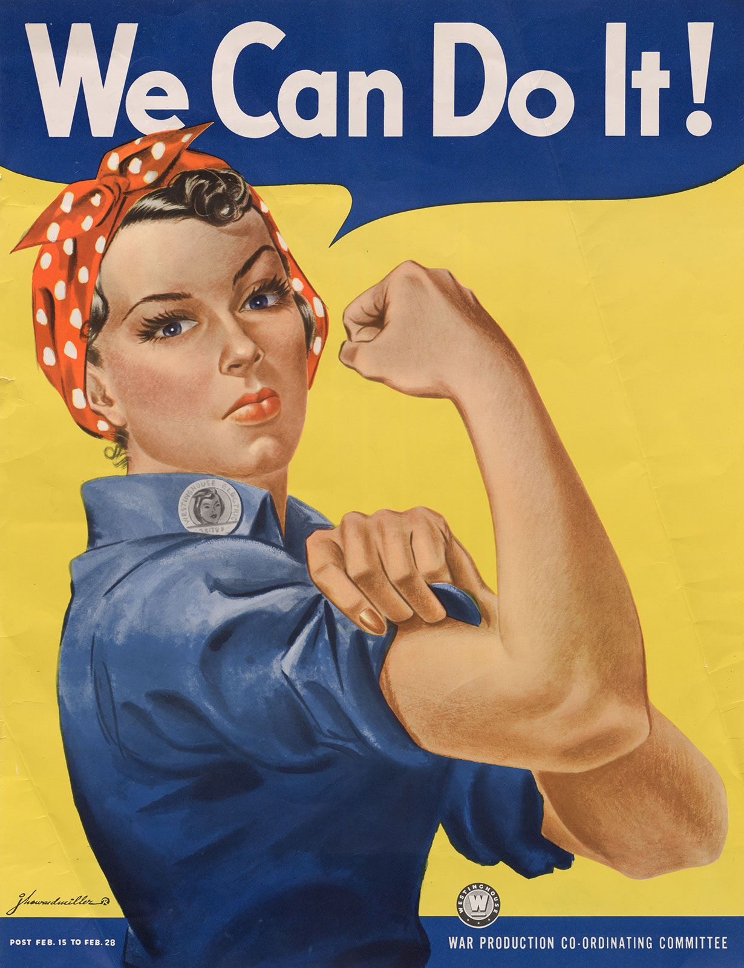
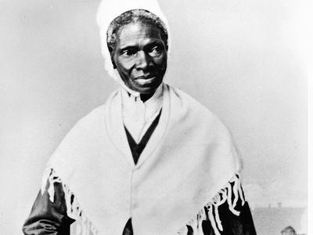
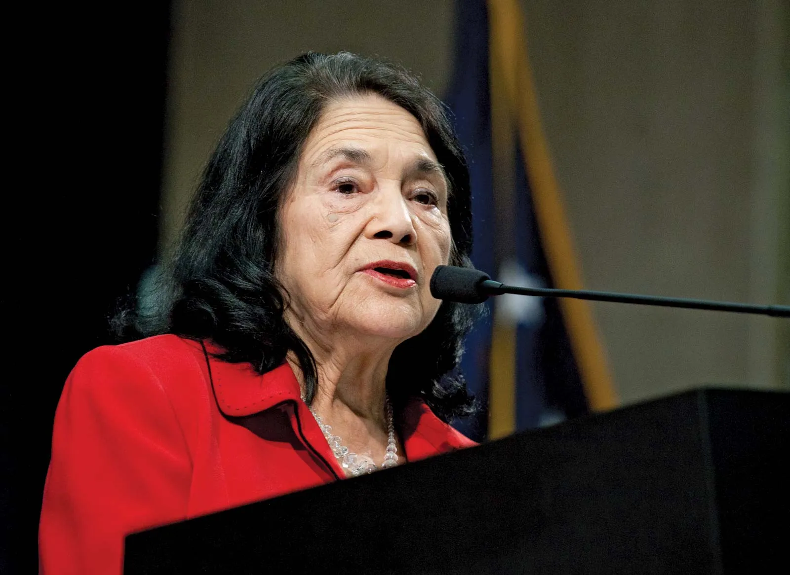
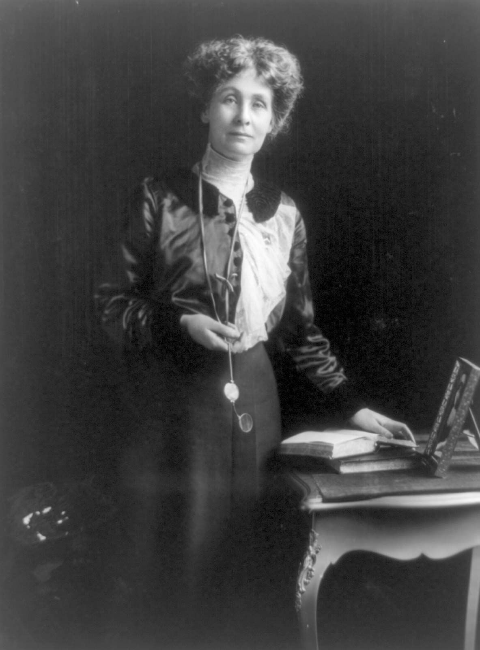
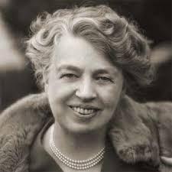
Addressing Gender History - involves studying the historical experiences, contributions, and struggles of women and gender minorities. It seeks to bring to light the roles these groups played in historical events, which are often marginalised or ignored in traditional narratives.
How many of the following women are you familiar with?

Slide 13
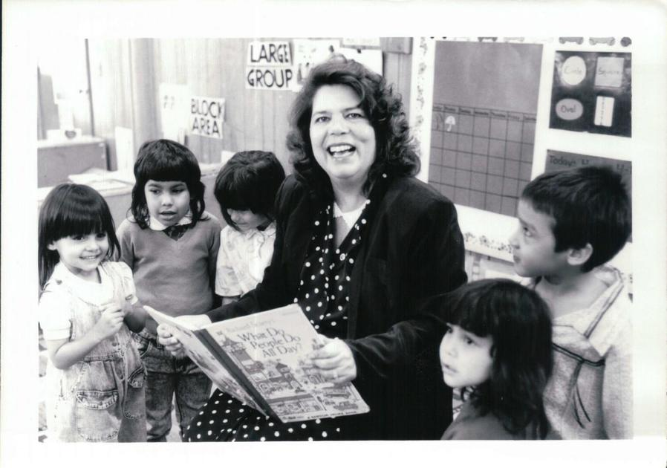
Examples and activities:

Slide 14
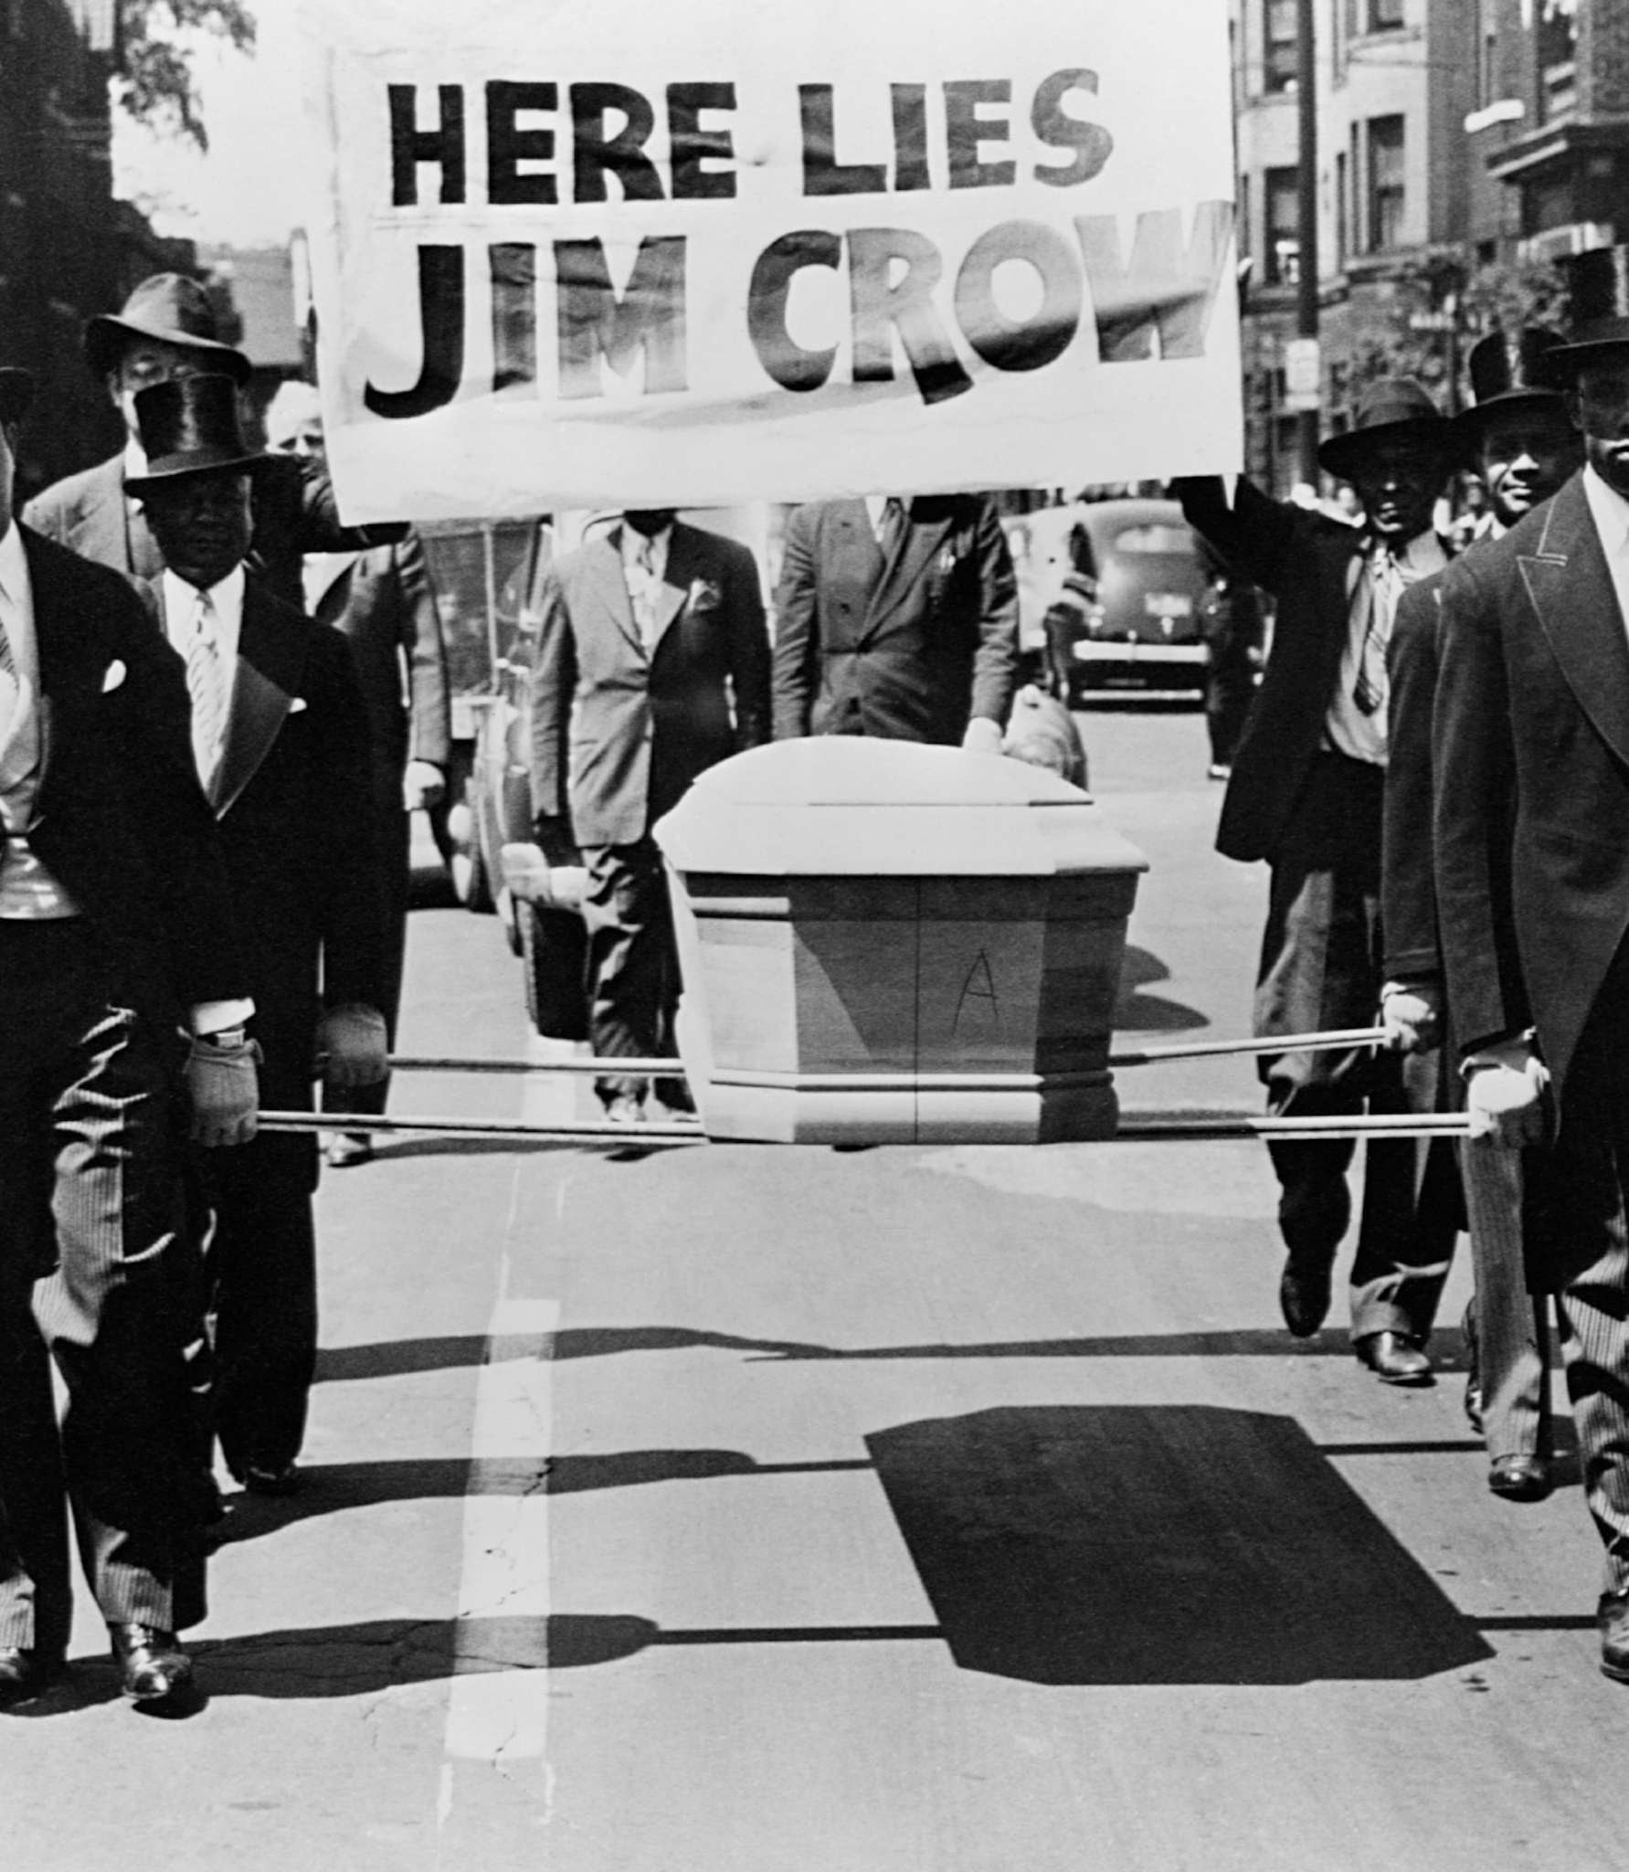
Interrogating Power and Privilege - refers to analysing how certain groups have historically gained and maintained power through systemic advantages, while others were marginalised or oppressed. This approach helps students understand the historical roots of current social inequities.

Slide 15
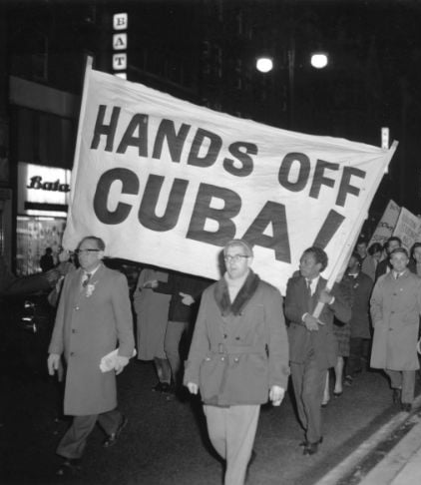
Incorporating Global Histories - teaching historical events from a global perspective, rather than focusing solely on Western or Eurocentric viewpoints. This approach highlights how events shaped and were shaped by non-Western countries and cultures.

Slide 16
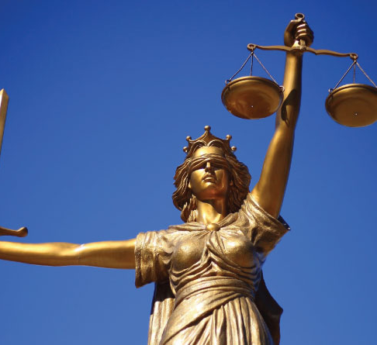
Connecting Past and Present - is the practice of linking historical events and movements to contemporary issues, helping students see the relevance of history in today’s world and understand how past struggles for justice resonate with ongoing social movements.

Slide 17
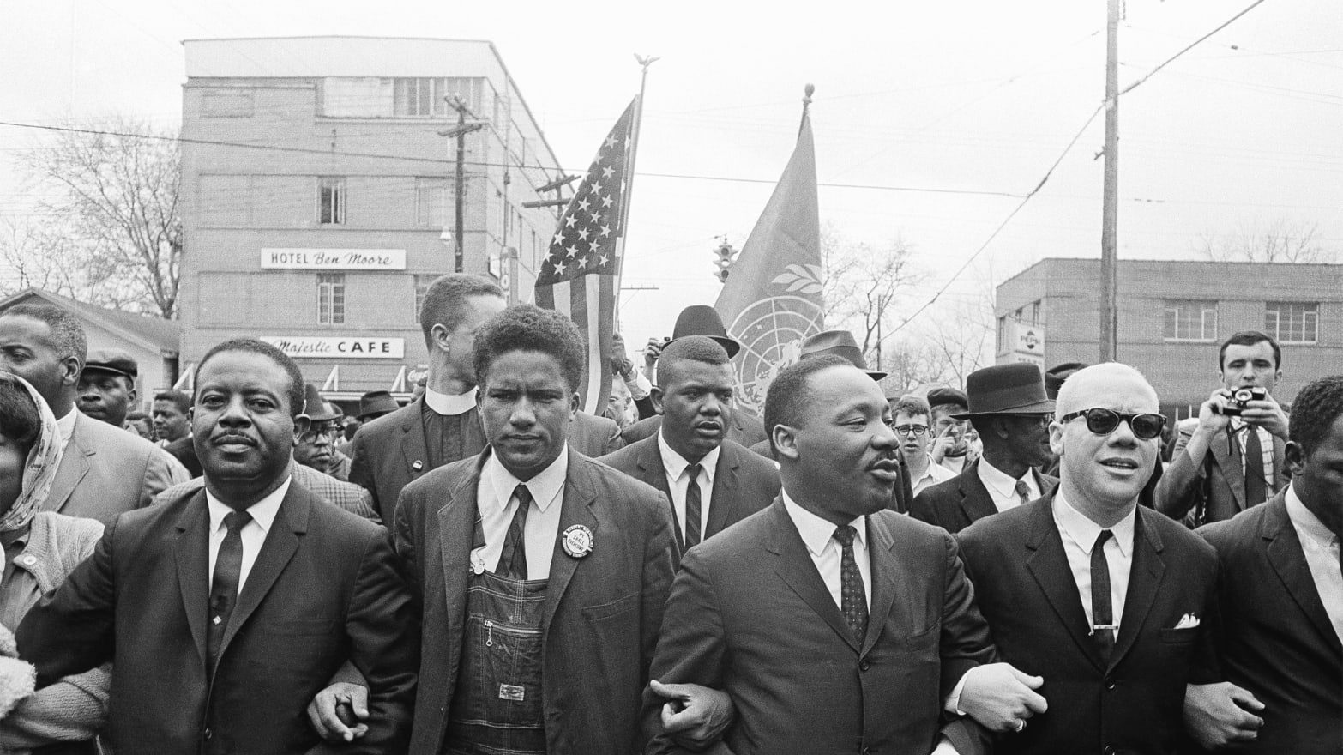
Impact of social justice in History education

Slide 18
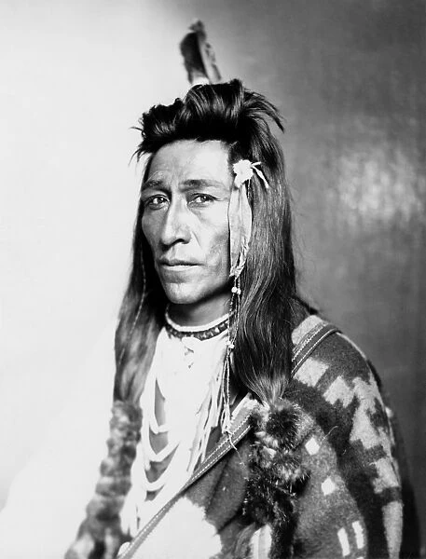
Promote fairness, empathy, and understanding.

Slide 19
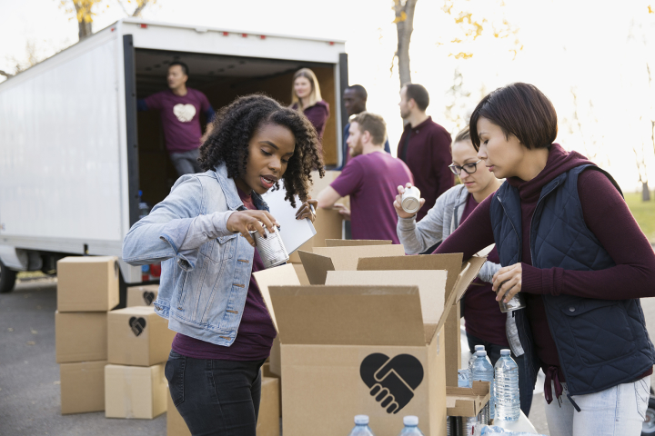
Encourage students to advocate for a more just society.

