Slide 1
Under the bonnet: maintenance and performance of the school engine.
Maria Budzynska

Slide 2
Imagine you have just been given 30,000€ to buy a car – what are your requirements?
Safety?
Speed?
Reliability?
Eco-Friendly?
Economic/Good value
for money?
Sex Appeal 😀 ?
Notes:
So we now know what we want to ACHIVE … What makes this happen ?

Slide 3
What makes these wishes a reality…?
Unseen
Often overlooked
Keeps everything working …
and safe… and effective…

Slide 4
The School Engine…
Maintained by Middle Leaders

Slide 5
The challenge is great … and in 2022 perhaps even greater than ever before …
A crisis of mental health – an epidemic within a pandemic
A lack of trust in institutions
The rise of individualism and the evaporation of social contracts

Slide 6
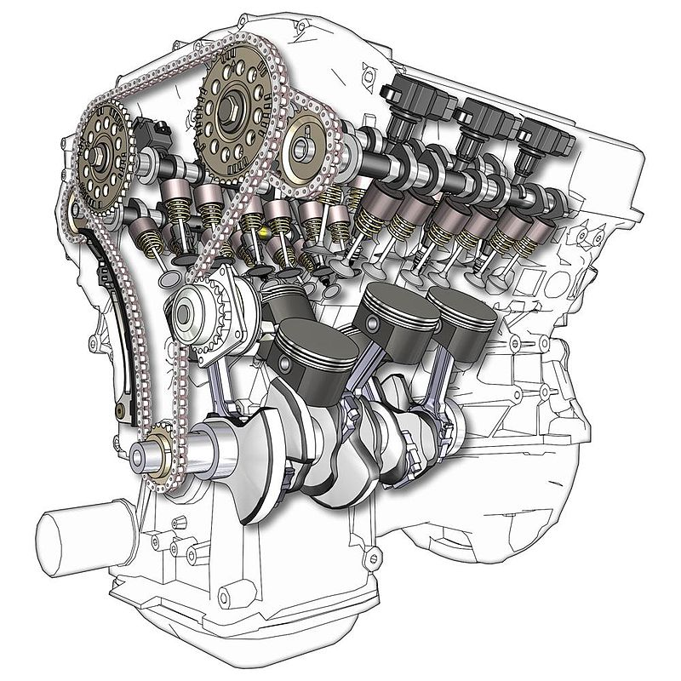
More than ever, schools need well running engines
A crisis of mental health – an epidemic within a pandemic
The mental health of young people was already changing pre – Covid
2000– 37 countries; 20,000 students 18% reporting high levels of loneliness Twenge and Haidt
By 2012 -2018 double that in Europe, Latin America & English speaking countries
Correlated with rates of insufficient sleep, rates of depression, anxiety and suicide

Slide 7
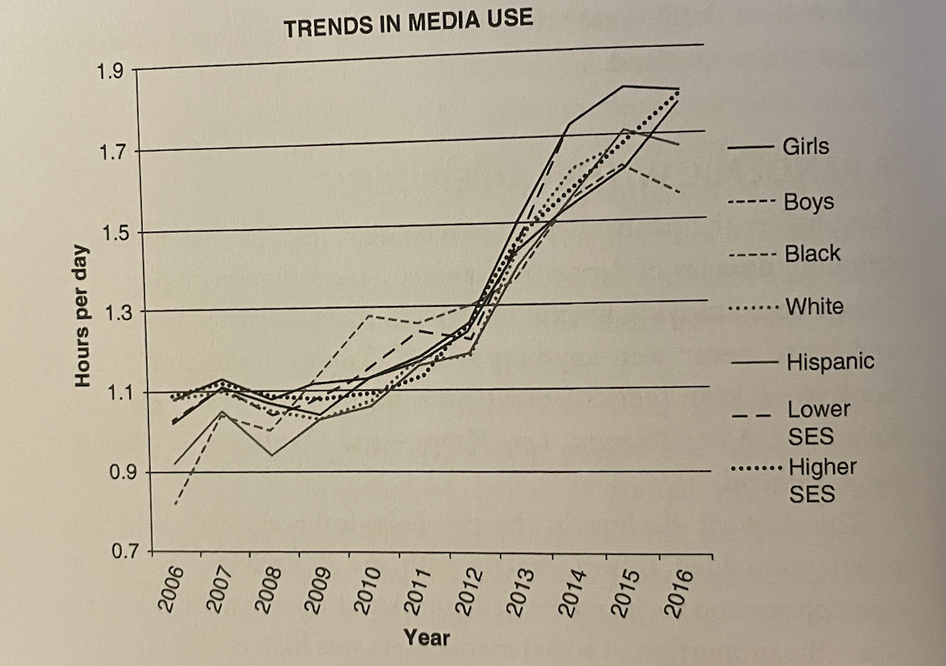
More than ever, schools need well running engines
A crisis of mental health – an epidemic within a pandemic
Impact on:
Social interaction
Concentration and focus

Slide 8
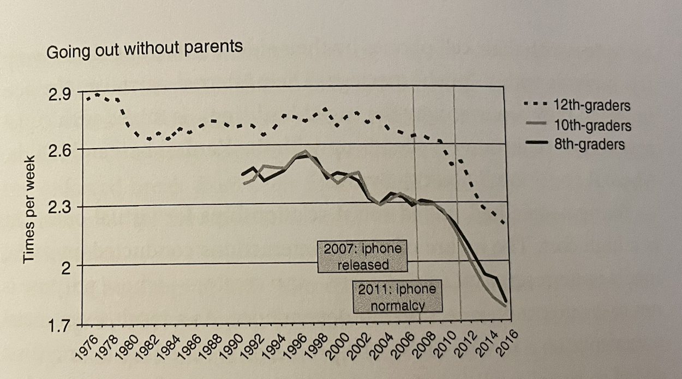
A more dynamic engine than ever is needed in every school
A crisis of mental health – an epidemic within a pandemic
Impact on:
Social interaction
Concentration and focus

Slide 9
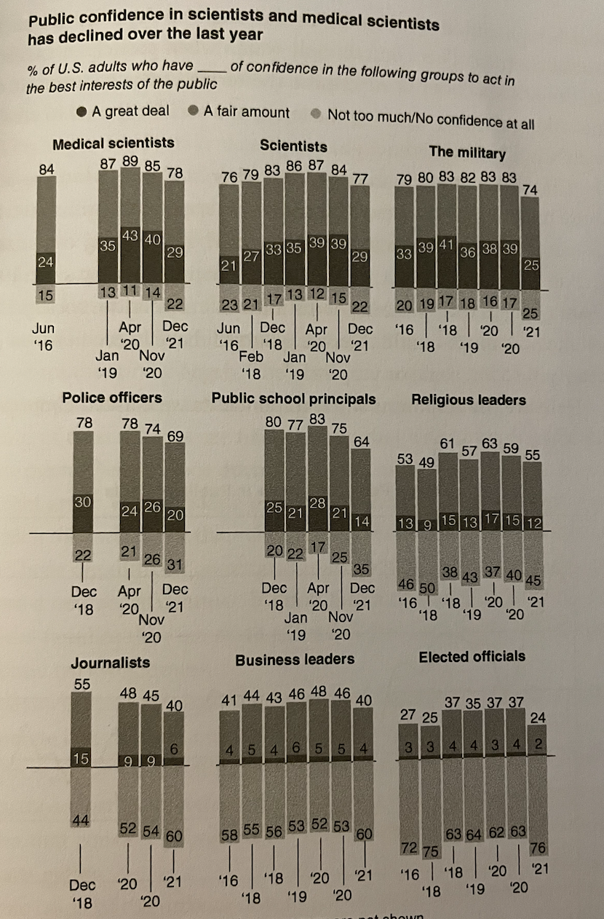
More than ever, schools need well running engines
A lack of trust in institutions
The rise of individualism and the evaporation of social contracts

Slide 10
Three parts to this engine maintenance time today:
Ethos of the school – a culture where middle leaders are valued
Systems that help middle leaders be impactful –the toolkit
Equipping the mechanic: supporting leaders to be effective

Slide 11
Ethos of the school – a culture where middle leaders are valued
What do you need to do your job well ?
What tools/resources do you need?
2. What do you need to feel?

Slide 12
Ethos of the school – a culture where middle leaders are valued
What do you need to do your job well ?
What tools/resources do you need?
Well designed “engine” –ethos / systems. skills/knowledge/training/ resources – books/ photocopier/time/ staff/ rest space/ clarity of job role / chance for promotion and development
2. What do you need to feel?
work is important /autonomy/ safety + support / purpose / energy & motivation/
/ self development learning / interest

Slide 13
What is your job role?
What do you notice ?
Notes:
People at all levels need the same

Slide 14
Notes:
African Proverb – that need to be part of that village and belong and have purpose / but it’s the same as being part of an engine – every piece is vital to the whole …

Slide 15
Three parts to this engine maintenance time today:
Ethos of the school – a culture where middle leaders are valued
Systems that help middle leaders be impactful –the toolkit
Equipping the mechanic: supporting leaders to be effective
Notes:
Systems –every part needs to work well – this is how you do it-

Slide 16
Middle leaders need to know, support and develop
their department
How is that done?
Presence
Visibility
Gather Data
Top Tool:
Lesson Drop-Ins
Notes:
This needs to be set from the top: Role of school culture – SLT walking around present etc – walk with the people – tone setting – embody values
How do you get under the bonnet and do this effectively and supportively? You as the mechanic ..?

Slide 17
Teaching observations and
lesson “dop ins” in the UK
There are two separate parts of the state British Educational System:
Performance Management formal observations – 3 times a year – can affect pay decisions – summative
Supportive and developmental lesson “drop ins” all year round. Formative.

Slide 18
Notes:
https://teacherhead.com/

Slide 19
Normal practice – not about judging but about knowing your team and how they are delivering curriculum.
Think of it as how you help students to learn: AFL (Assessment for Learning) – an opportunity for you to learn from the teacher and also for you to develop the teacher’s practice
Set the culture: no surprises. Senior Leaders need to model from the top
Subtle. Make yourself part of class.
Frequent and talked about – each is a learning opportunity

Slide 20
Make notes – for YOURSELF
Precise Praise: specific elements of the lesson that I think were effective including precise phrases in questions, explanations or student responses.
Probe: Questions I have about what I see – to raise later with the teacher – or notes on elements of the techniques where I feel the teacher could strengthen their practice.

Slide 21
Identify what is going on: top three parts of a lesson:
Teacher explaining and modelling, largely in instructional mode at the front of the room.
Teacher questioning.
Students engaged in a form of practice task with the teacher monitoring and supporting.

Slide 22
Identify what is going on: top three parts of a lesson:
Teacher explaining and modelling, largely in instructional mode at the front of the room.
Does the task or explanation make sense to the students around me? Can they do the task; do they understand the concepts?
Teacher questioning.
Is the teacher conspicuously trying to involve every student, checking for understanding and responding accordingly?
Students engaged in a form of practice task with the teacher monitoring and supporting.
Is it possible for any student to be largely passive, not needing to think or participate, because the lesson dynamics don’t create a culture where all students engage and expect to have to answer questions or contribute ideas?
Are there opportunities for practice and consolidation, with scaffolds or less confident students?

Slide 23
Remember the individual and the department…
Curriculum Issues
Individual Issues.
Collective Issues
Notes:
How to get the best out of your engine
Curriculum Issues: Very commonly, any given lesson throws up a range of curriculum questions. Teachers are typically using resources and a scheme of learning that is produced by their wider team, so it might be better to explore them at the team level, via the team leader. The likelihood is that issues relating to one lesson will be cropping up elsewhere so it’s important to separate them from the specific teacher. I’m often interested in when and how teachers are able to explore the rationale for the materials they use a part of a wider ongoing team process.
Individual Issues: The specific actions and areas for development for the specific teacher in the way they run the room and use the resources. These are the things within the teacher’s control that typically form the core an instructional coaching sequence.
Collective Issues: Very commonly, a team is focusing on a shared set of actions – eg developing retrieval practice routines or supporting students to be more confident with class discussion or working on modelling writing. Here, I might pick up on this when observing a whole series of lessons in a school or a department. I often suggest that it might be more effective to address collective issues within the team CPD cycle rather than with each individual.

Slide 24
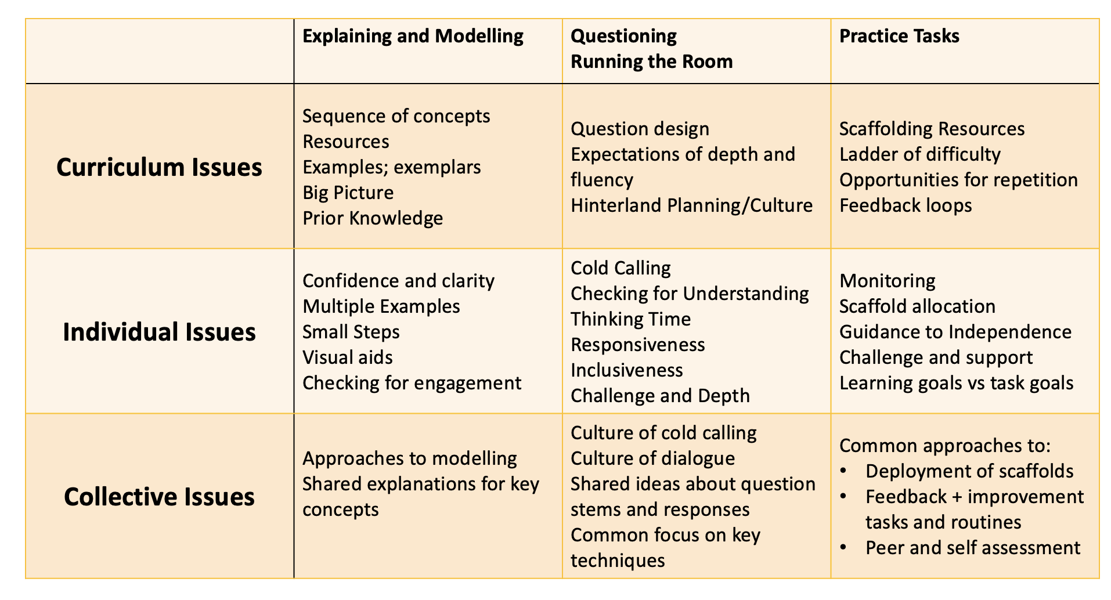

Slide 25
Notes:
eg I noticed that although Jessica really got it, James was still struggling’. What do you think might help him?

Slide 26
Three parts to this engine maintenance time today:
Ethos of the school – a culture where middle leaders are valued
Systems that help middle leaders be impactful –the nuts and bolts
Equipping the mechanic: supporting leaders to be effective

Slide 27
Equipping the mechanic: how to be a good leader?
Be good at what you do
Clarity of purpose
Focus on process
Notes:
Speak to other mechanics; develop your knowledge; look at other engines
Always go back to principles – about the design of the school – lift your head up – bigger picture
Focus on process – the value of the lesson drop in – continually improving people and systems
Challenges are temporary
Some days, just getting through is fine
Everyday is a school day- each day is a learning opportunity
Stay true to what you believe – lean on this when dealing with people
Mistakes are ok
Lean on others – sideways and upwards!
It does get easier 😌
Look after yourself

Slide 28
Are you ready for the journey?
Thank you

