Slide 1
Cor, ad cor, loquitor –
Heart speaking to Heart
Models of partnership working for educational institutions
Notes:
John Henry Newman made cardinal by Leo XIII in 1877 – phrase of St Francis de Sales

Slide 2
Partnerships – with whom?
University
Industry
Local Government
Central Government (Education Ministry)
Local Primary/High School
Other Schools
International
Who else???

Slide 3
Partnerships – for what reason>
Work Experience for your students
Offer courses your institution cannot offer
Secure economies of scale
Professional development of your staff
Develop status and profile in the region
Other High Schools
Improve teaching and outcomes
What else???

Slide 4
In your institution, what external partnerships do you have?
How are all members of your institution made aware of this, if at all?

Slide 5
What value do those external partnerships bring your institutions?
How are all members of your institution made aware of this, if at all?

Slide 6
Why collaborate?
The potential for school-to-school partnership and support to act as a vehicle for educational improvement is well discussed in UK educational literature (Chapman & Fullan, 2007; Muijs et al., 2010; Muijs et al., 2011). Though it remains controversial (Male, 2022), Greany, T. & Higham, R. (2018) Here are some examples

Slide 7
CORE ADVANTAGES EXTERNAL ADVANTAGES
Teaching
Survival
Professional Development
Student Outcomes
Staff recruitment and retention
Economies of Scale
Status
Growth
Economies of scale
Branding
Cenre of Innovation
International Partnerships

Slide 8
Contexts for collaboration
No choice (coercive?)
No choice – policy
Choice – for improvement
Choice – variety of advantages
Choice – develop as a leading school
Required by education department to secure rapid improvement
Required by ‘sponsor group’ e.g. Catholic diocese
Seen as desirable by a school seeking improvement wishing to join stronger schools
Seen as desirable for the reasons given on the previous slide
Seen as desirable as the school wishes to be the ‘lead school’ in the MAT

Slide 9
A constructivist approach
Constructivist theory suggests that organisations are sense-making systems with their own distinct perceptions of reality and as a result are at risk of becoming myopic. This can be helped through inter-organisational networking or collaboration with external partners to facilitate a broader world view.
According to Muijs et al. (2010), organisations such as schools that exist in complex and uncertain environments, particularly those in challenging circumstances, are more susceptible to myopia and, therefore, from a constructivist perspective have the most to gain from collaboration.

Slide 10
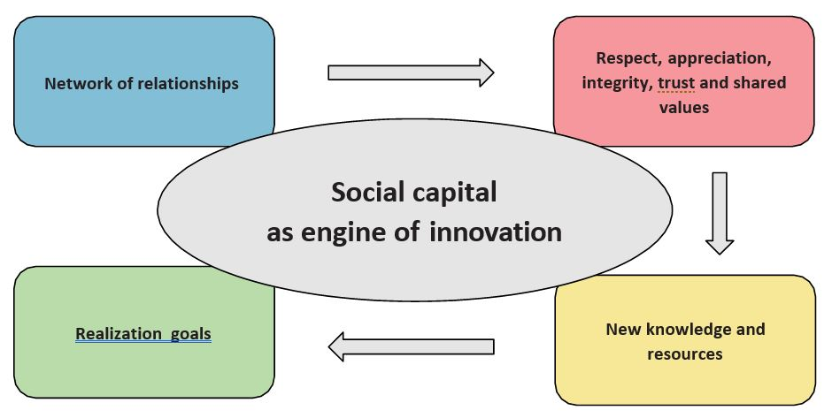
Social capital theory offers a more functional perspective in emphasising how organisational collaboration can provide a vehicle to utilise and share the resources held by actors within and across a network and thus increase information flows. Collaboration is a potentially constructive endeavour for all stakeholders as each brings their own contributions to plugging these gaps in knowledge. As a consequence, the network becomes greater than the sum of its parts.
In his thinking around school-led systems, Hargreaves (2011) underscores the importance of social capital; key pillars of which he suggests are reciprocity and trust. He argues that deep partnerships between schools are those in which expertise and intelligence are shared freely, thus enhancing reciprocity and trust between members of the network.

Slide 11
Levels of ‘working together’ – the ‘escalator of collaborative endeavour’ (Chapman, 2019).
Collegiality
Collaboration
Cooperation
Association
Notes:
The first level is association, which represents traditional hierarchical working interspersed with incidental meetings and with little sharing of knowledge. The second level is cooperation, characterised by short-term activity around specific issues with some knowledge exchange albeit fairly superficial and task-focused. The third level is collaboration, in which the joint activity becomes more sustainable with the emergence of common goals, shared values and the potential to develop new ways of working. The fourth level is collegiality in which longer-term commitments to the partnership emerge underpinned by strategic goals and objectives, common values and a focus on shared knowledge, resource and practice development for the betterment of all partners. Chapman also emphasises the importance of social capital, suggesting that partnership activity is susceptible to failure when this is low. He terms this the dark side of collaboration, in which cooperation is fabricated and contrived as stakeholders tussle for power, influence and status and traditional hierarchies remain. research into networked school leadership and governance identifies trust between headteachers as the bedrock of successful partnership activity (Chapman et al., 2010). Varga-Atkins et al. (2010) talk about the creation of trusting environments where individual views are respected, ideas can be tested and risks taken as crucial conditions for partnership activity between schools.

Slide 12
What can concern school leaders and stop them working together?
Fear of loss of autonomy
‘sharing our secrets’
Losing staff
Strong (inflexible?) school cultures
One school feeling ‘inferior’
Lack of co-ordination / support by dedicated ‘Partnership Team’
Funding
Does the ‘successful’ school end up being ‘responsible’ for the weaker school? (Ehren and Godfrey, 2017).
It has not been done before…

Slide 13
Three approaches
Multi-Academy Trust
Teaching School
School Networking

Slide 14
Model 1: Multi- Academy Trusts
Academy schools are state-funded schools in England which are directly funded by the Department for Education and independent of local control.
A multi-academy trust (MAT) is established to provide strategic collaboration across a number of schools
The MAT is accountable for the performance of each school, although each school has its own Governing Body with whatever powers the MAT gives them
Academies are established as companies limited by guarantee with a Board of Directors that acts as a Trust;
The Academy Trust has exempt charity status, regulated by the Department for Education;
The Board of Directors, or Trustees, will sit at the top with ultimate responsibility for the governance of the trust;
One academy will be the MAT sponsor;
Directors normally include the CEO;
MATs will operate a central trust function, employing the CEO, Finance Director and incur other central costs which are shared across the trust.

Slide 15
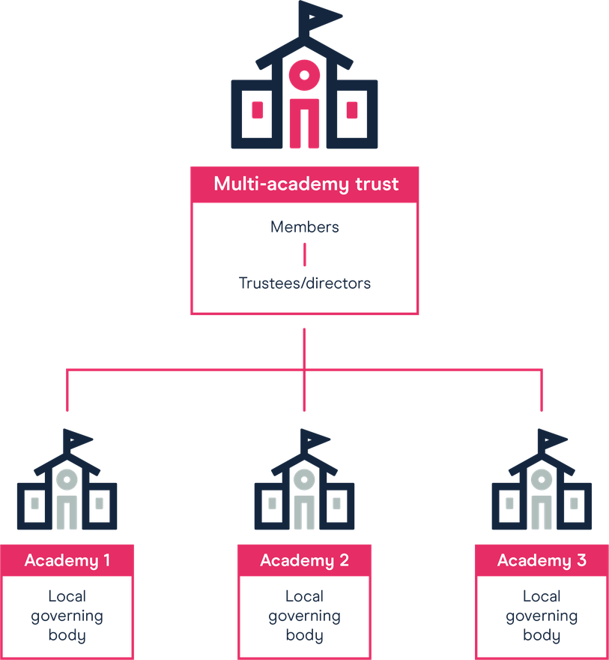
Click here for details
A real example of a Catholic MAT

Slide 16
So what kinds of things does the MAT do?
Provides strategic leadership – planning, monitoring, delivery
Is ultimately accountable
The Chief Executive Officer oversees the schools, is accountable to the Board
An Education Director focusses exclusively on improving teaching
The Chief Operating Officer (or CFO) ensures financial oversight of the schools
The Chair and Board members of the Trust are appointed by the Sponsor e.g. Catholic Diocese
Admin, legal, Human Resources, estate management, school improvement support, IT management….

Slide 17
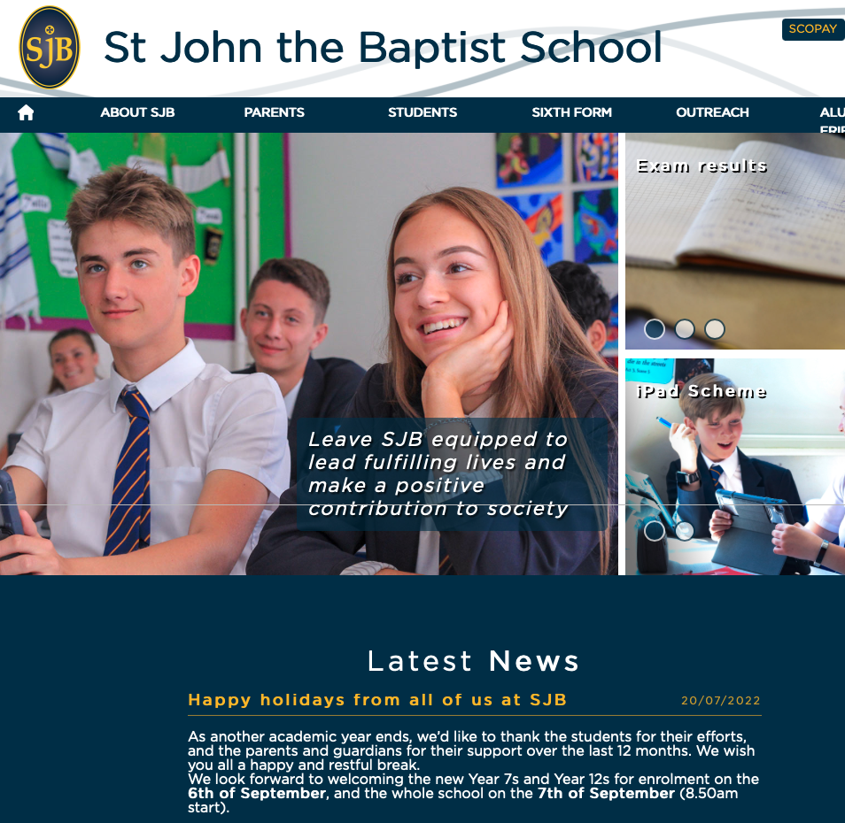
My own children’s school…

Slide 18
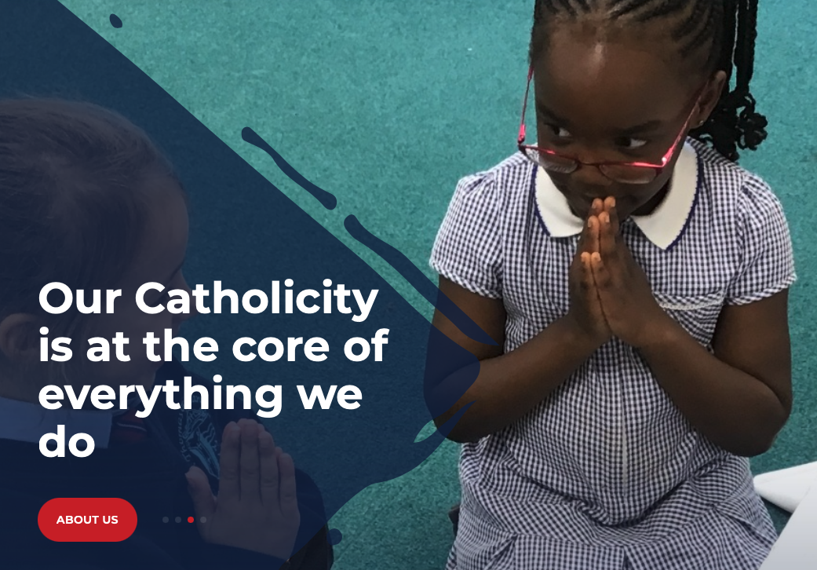
The Multi-Academy Trust to which it belongs

Slide 19
Model 2: Teaching School Hub Model
Support school-based initial teacher training
Support teachers in their first two years in particular
Provide specialist courses
Funded by Central Government on a 3-yearly basis – could be locally funded too
Annual grant based on performance
Management Board which reflects the interest of all schools in the Hub
Teaching School
Hub School
Hub School
The Xavier Teaching Hub

Slide 20
Audience | Session | Link
ECT | An introduction to year two of the ECF programme | https://youtu.be/9LVusQZO5Mg
ECT | Sustainable workload | https://youtu.be/w_kn0C_oX-Y
ECT | Maximising development cycles | https://youtu.be/AXFxKBWhh8c
ECT | Developing pupils’ intrinsic motivation | Topic of first development cycle seminar in the autumn term
Mentor | Introduction to year two of the ECF programme | https://youtu.be/NmaY8djZ6K0
Mentor | Supporting development cycles | https://youtu.be/Kz46V30L9hw
Mentor | Networking for professional development | https://youtu.be/1XqbDdNsy5I
ECT | An introduction to instructional coaching | https://youtu.be/ZN0SMdqzBQw
Mentor | The Teach First Early Career Framework Programme | https://youtu.be/EZJ8d_Q65T4
Mentor | Moving from novice to expert | https://youtu.be/mVTZjjo5tLg
Mentor | Instructional coaching and deliberate practice | https://youtu.be/uEFCcf63hjM
Mentor | Improving instruction | https://youtu.be/6jfZe0YEYvo

Slide 21
Credits/support towards formal qualifications | The national Professional Qualification Suite
Masters Diplomas Professional Doctorates/PhD | Senior leadership – develop your leadership knowledge and expertise to improve outcomes for teachers and pupils in your school Headship – develop the knowledge that underpins expert school leadership and apply it to become an outstanding headteacher Executive leadership – develop the expertise you need to become an outstanding executive leader, leading change and improvement across your group of schools or multi-academy trust Early years leadership – develop expertise in leading high-quality early years education and care, as well as effective staff and organisational management Leading teacher development – learn how to become a teacher educator and successfully support teachers in your school to expand their skills Leading teaching – learn how to lead the teaching and learning of a subject, year group or phase Leading behaviour and culture – learn how to create a culture of good behaviour and high expectations in which staff and pupils can thrive Leading literacy – learn how to effectively teach and promote literacy across the whole school, year group, key stage or phase
Notes:
NPQH ForSchool leaders and head teachers
Course duration18 months
Average weekly study time1 to 2 hours
Study typeMix of self-study and group sessions
Assessment typeReflection based on case study (up to 2,500 words)

Slide 22
Model 3: Deep Informal/Fluid Collaboration
www.koinoniaschools.org

Slide 23
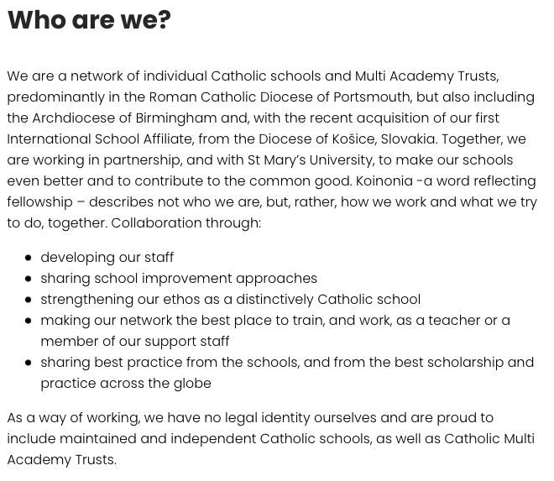

Slide 25
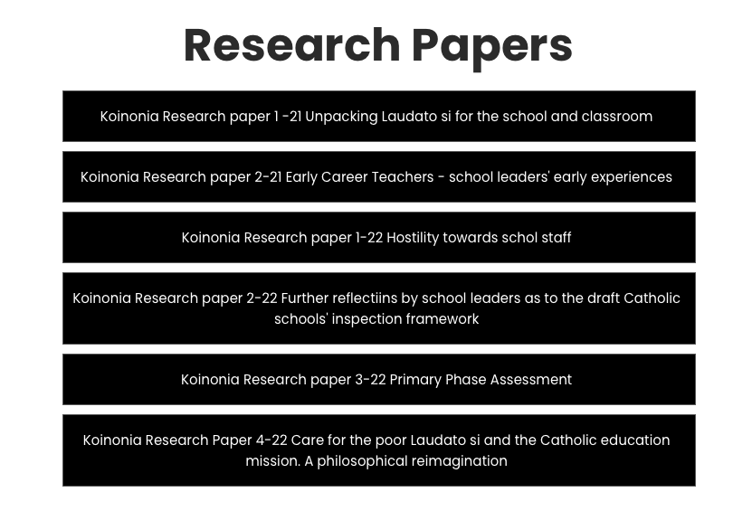

Slide 26
Strong link with university and industry

Slide 27
2.
A group of Portsmouth Diocese Heads invited to look at models of deeper collaboration, 2019
3.
Research project, undertaken by Headteacher, Simon Uttley, identified demand for deep collaboration, irrespective of the form of organisation [Academy, VA, Independent…]
4.
It was recognised there was a high degree of trust between Catholic schools, and their leaders, with opportunity for further leverage
5.
Small schools in particular, were seeking supportive structures
6.
Our Programme Director began to seek an alignment with St Mary’s University, leveraging his role there as Visiting Professor in Catholic education
7.
Sstaff identified to facilitate and broker training and development
8.
Pre-launch in 2021 with formal launch event, September 2022
1.
Koinonia – the Greek word for fellowship, often applied to Christian fellowship
The Koinonia Story

Slide 29
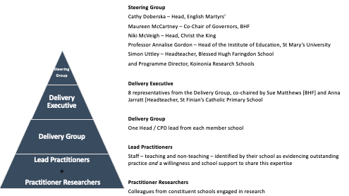

Slide 33
To conclude…
Partnership working can keep us honest about the state of our institutions
Partnership working can improve outcomes for our students, the quality of our teaching, the curriculum we offer and how we organise ourselves
Partnership working can develop a strong brand and improve status
Partnership working can keep us up to date with best practice
Done properly, it is not a sign of weakness, but of strength and confidence

Slide 34
What opportunities for collaboration do you see in your organisation?
What value would you see this having?
Who would be your allies?
What obstacles might you face?

Slide 35
It requires…
A high level of trust
Professional integrity
Leadership – both strategic and operational
A medium-term plan as well as a short-term operational plan
Ongoing monitoring and quality assurance
Excellent communication so the benefits can be known by all
Thank you!

